Slide 1
DS 256 – Seminar Presentation Giraph Unchained: Barrierless Asynchronous Parallel Execution in Pregellike Graph Processing Systems Minyang Han and Khuzaima Daudjee David R. Cheriton School of Computer Science University of Waterloo Proceedings of the VLDB Endowment, Vol. 8, No. 9, 2015
Presenter: Shriram R
04-Apr-19

Slide 2
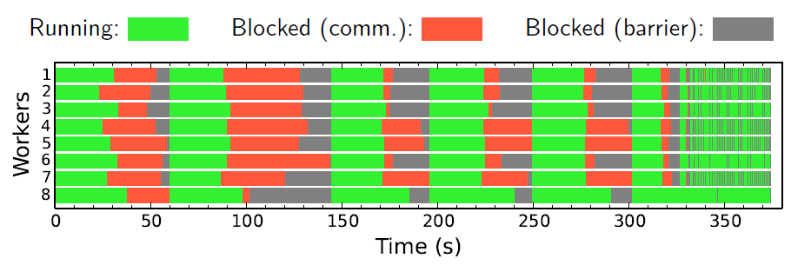
Motivation
Bulk Synchronous Parallel (BSP) Model
Stale Messages
Slower Convergence & longer computation time
Frequent Global Sync. Barriers
Costly Communication overheads
Straggler problem

Slide 3
Motivation
Existing Asynchronous Models
GraphLab (Pull Based)
Gather, Apply, Scatter (GAS) model
Distributed Locking
Giraph++ and GRACE (Push Based)
Asynchronous parallel (AP) model
Global barriers
Shortcomings
Does not Scale
Non-transparent
Leaks info. about asynchrony to the developer API
Does not support graph mutations
Incompatible with algorithms with multiple computation phases

Slide 4
Key Contributions
Barrierless asynchronous parallel (BAP) model
Reduces frequency of global barriers
No distributed locks
Implemented in Giraph and preserves Giraph’s BSP interface
Support for graph mutations
Compatible with multiple computation phases
Up to 5x over synchronous and 86x over asynchronous systems

Slide 5
Asynchronous Parallel (AP) model
Vertices can immediately see their received messages
True for both local and remote messages
Reduces staleness of messages
Retains global barriers
To separate supersteps
Messages that do not arrive in time will become visible in next superstep
Disadvantages
Still suffers from synchronization overhead
Limited algorithmic support

Slide 6
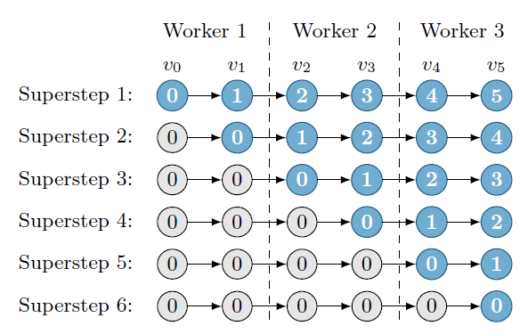
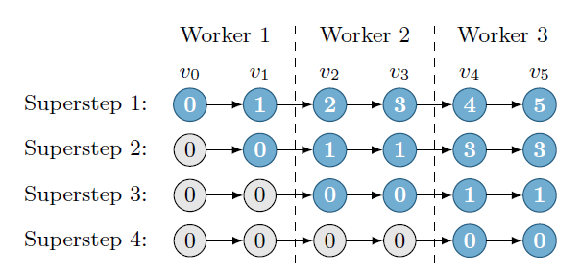
Asynchronous Parallel (AP) model
AP Example
BSP Example
Assumption: Single Threaded Worker

Slide 7
Barrierless asynchronous parallel (BAP) model
Local Barriers
Separates logical supersteps.
Inexpensive and Local to each worker
Pausing point to perform tasks like graph mutations
To decide if a global barrier is necessary
Internal and transparent to developers
Global supersteps is a collection of logical supersteps separated by global barriers

Slide 8
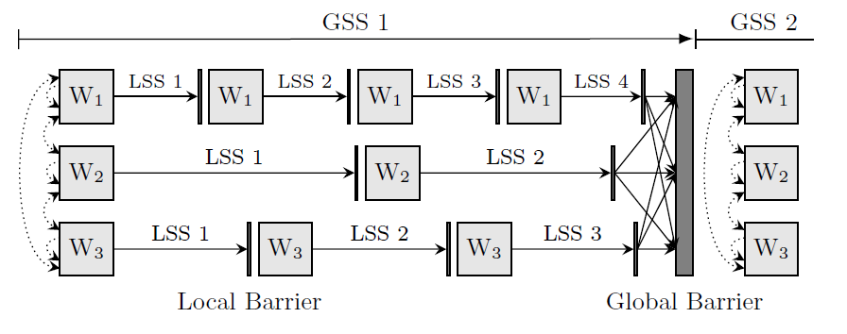
Barrierless asynchronous parallel (BAP) model
BAP Illustration

Slide 9
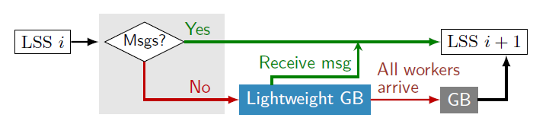
Termination Check
Worker Control Flow
Two steps – First at a local barrier and second occurs globally at the master
Step 1 – Worker independently blocks if there are no messages to process
Step 2 – Regular BSP check once all the workers arrive at the global barrier

Slide 10
Multiple Computation Phases
Example: Distributed Minimum Spanning Tree (DMST)
Phase I – Vertices find a minimum weight out-edge
Phase II – Vertices add and remove edges
BAP separates different phases by global barrier
Uses local barriers within each phase
Three type of messages
Message sent in k-1 phase for k phase
Message sent in k phase for the same phase k
Message sent in k for next phase k+1

Slide 11
Multiple Computation Phases
BAP uses two message stores
SC – messages stored for current phase
SN – messages stored for next phase
In a new phase, SN of previous phase becomes SC of current phase
Messages tagged with a Boolean to indicate the store
BAP detects phase transitions without modification to the API
Start – Start of a global superstep
End – No messages for current phase

Slide 12
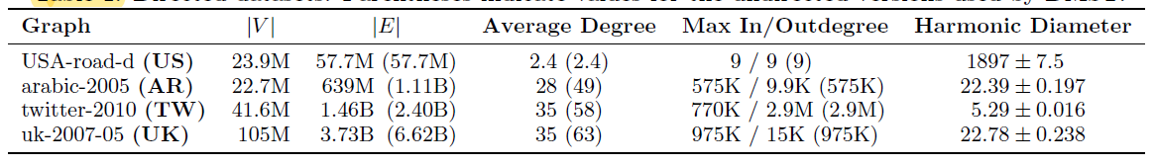
Experimental Evaluation
Giraph UC compared with Giraph, Giraph async, GraphLab sync and GraphLab async
Experimental Setup
64 EC2 instances with 4 vCPUs, 30.5GB memory, Ubuntu 12.04, Hadoop 1.0.4, jdk1.7.0_65 and Giraph 1.1.0-RC0
Graph Datasets

Slide 13
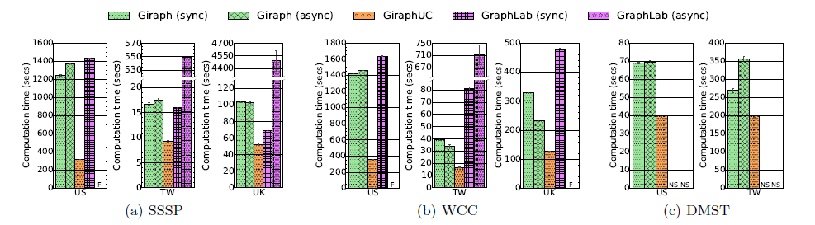
Experimental Evaluation
Computation times for SSSP, WCC and DMST

Slide 14
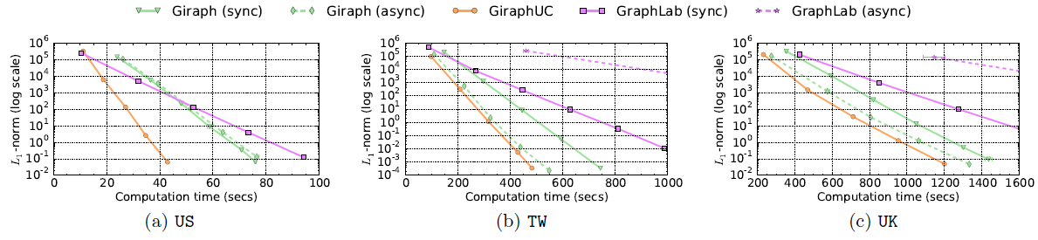
Experimental Evaluation
Computation Time for PageRank

Slide 15
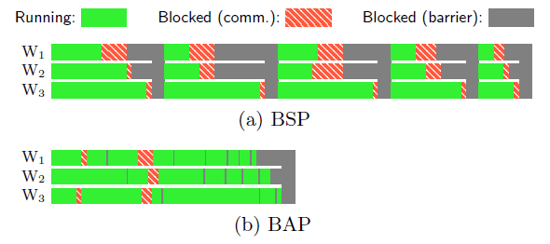
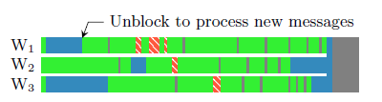
Experimental Evaluation
WCC on 16 workers with TW dataset
SSSP on 16 workers with TW dataset

Slide 16
Takeaways
Strengths
Proposed general system covering the entire graph algorithm space
Demonstrated Order of magnitude performance improvement in general
Well motivated, coherent and precise writing
Weakness
Gains are lower when the algorithm is compute bound
Not truly async – Local barriers require every local vertex to synchronize
No support for online graph processing

Slide 17
Implementation Notes
Outgoing local messages skip the buffer
Workers assigned multiple graph partitions
Checkpointing performed at global barriers
Lightweight Global Barrier
Coordinated by Master via ZooKeeper
Does not require workers to record any statistics with ZooKeeper
Vertex and edge mutations are local operations
Resolved during a local barrier

Slide 18
Theorems
The AP and BAP models correctly execute single-phase BSP algorithms in which vertices do not need all messages from all neighbors.
Given a message store that is initially filled with valid messages, retains old messages, and overwrites old messages with new messages, the BAP model correctly executes single-phase BSP algorithms in which vertices need all messages from all neighbors.
If every message is tagged with a Boolean at the API level and two message stores are maintained at the system level, then the BAP model supports BSP algorithms with multiple computation phases.

Slide 19
References
Minyang Han and Khuzaima Daudjee. 2015. Giraph unchained: barrierless asynchronous parallel execution in pregel-like graph processing systems. Proc. VLDB Endow. 8, 9 (May 2015), 950-961. DOI: https://doi.org/10.14778/2777598.2777604
M. Han and K. Daudjee. Giraph Unchained: Barrierless Asynchronous Parallel Execution in Pregel-like Graph Processing Systems. Technical Report CS-2015-04, University of Waterloo, 2015

