Slide 1
DS 294 – Project Presentation Analytics & Visualization of Knowledge Graphs
Shriram R
04-Apr-19

Slide 2
Project Aim
Perform Analytics and Visualization of Knowledge Graphs
Implement the following features
Complete Searching of Vertices (Entities)
Visualize neighbors along with relationships
Traversal from one Vertex to another interactively
Analytics
Find related vertices & visualize them
View documents in the form of Knowledge Graph

Slide 3





Dataset & Tools
Primary Dataset – YAGO [2]
Huge Semantic Knowledge Base
Approx. 3.8 million entities & 12.5 million facts
Secondary Datasets
WordNet (For document cleaning)
PostgreSQL – Data Hosting
PostgREST – Backend API Server
Angular 6 – Web framework
D3.js - Graph Visualization
Node.js – Web server

Slide 4
Graph Visualization
Force graph technique
Simulates physical forces on particles (vertices)
Many-Many body force using Barnes-Hut approximation
Allows ambient spacing between the vertices
Spacing depends on the force strength
Vertices joined by edges experience more force

Slide 5
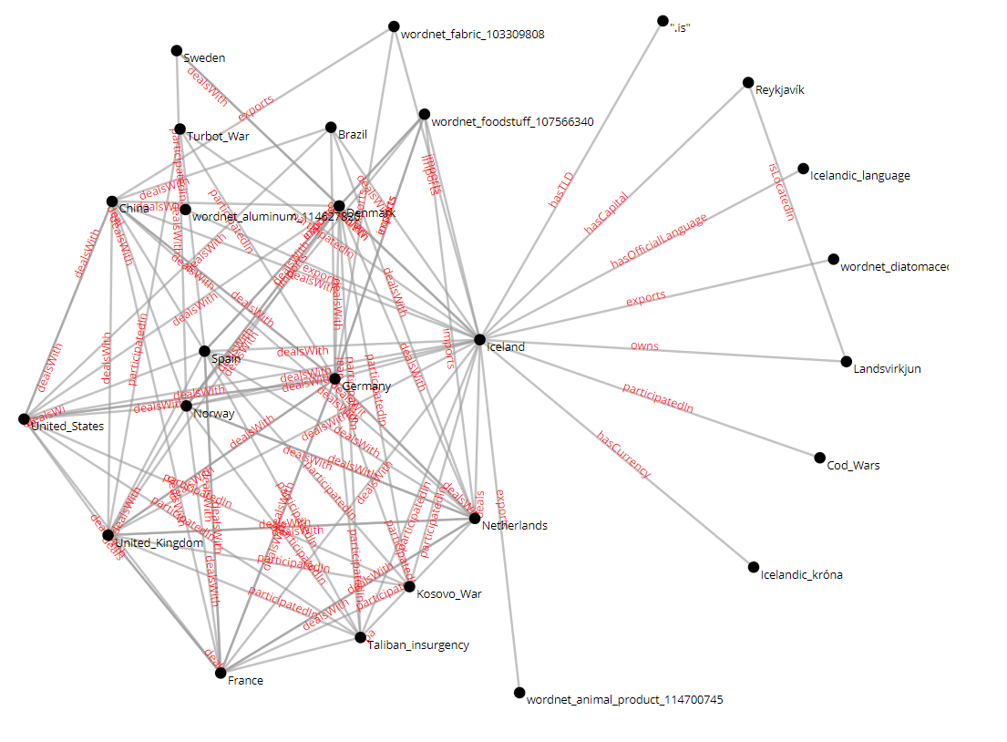
Graph Visualization

Slide 6
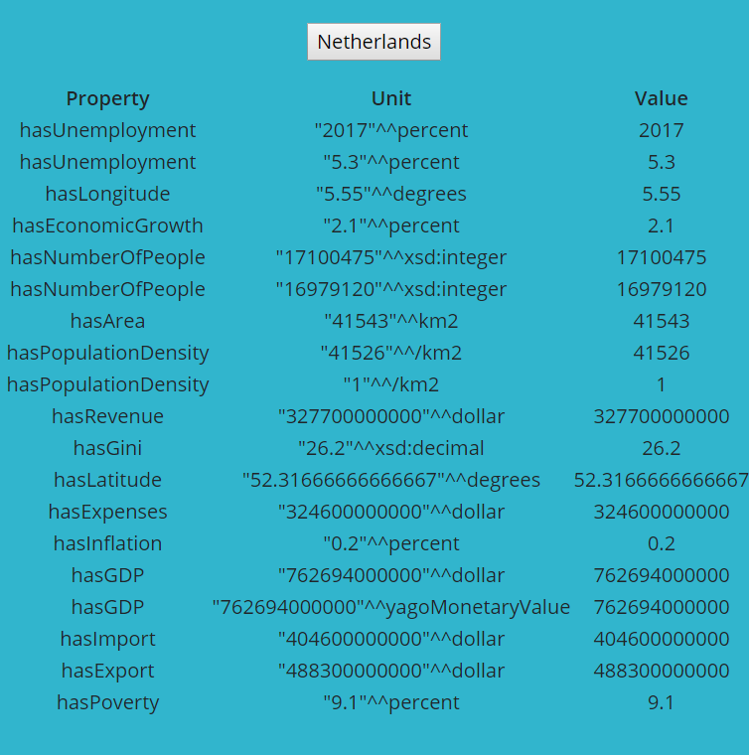
Graph Visualization

Slide 7
Related Vertices
Uses Local Similarity index – Common Neighbours
Vertices can have IN and OUT links
For a given vertex,
Other vertices are sorted in descending order by the number of common IN and OUT links
E.g. If V = <Bangalore> then <Mysore> and <Bangalore> can have a common OUT link: <Belongs_To> with <Karnataka>
The top 50 related vertices are plotted in a bubble chart with size indicating the common link count

Slide 8
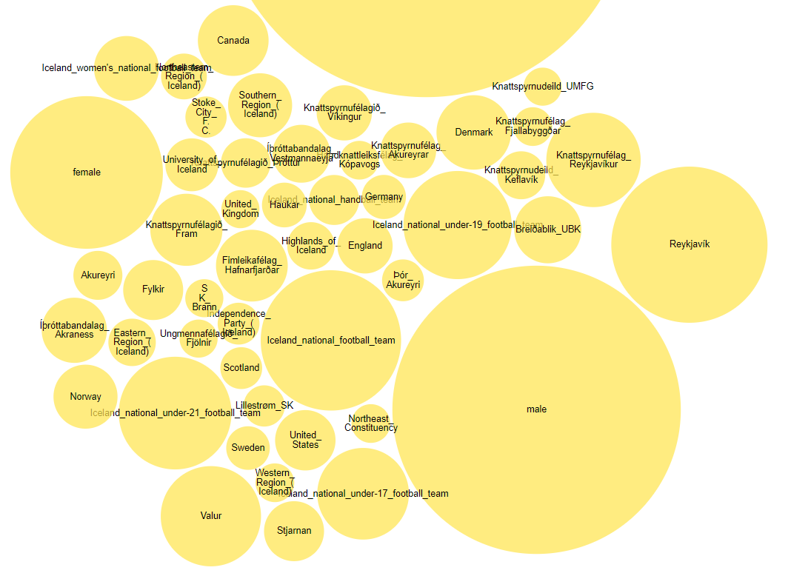
Related Vertices

Slide 9
Document Visualization
Document is tokenized into individual words without punctuation
Common filler words, verbs, adjectives and adverbs are filtered using the WordNet database
For each remaining word,
A closest vertex in the knowledge graph is found using trigrams
Trigrams – E.g. “foobar” has “f”, “fo”, “foo”, “oob”, “oba”, “bar”, “ar” and “r” as the list of possible trigrams
Similar entities will share more number of trigrams
The matches vertices are then visualizes in the form of force graph with edges between them

Slide 10
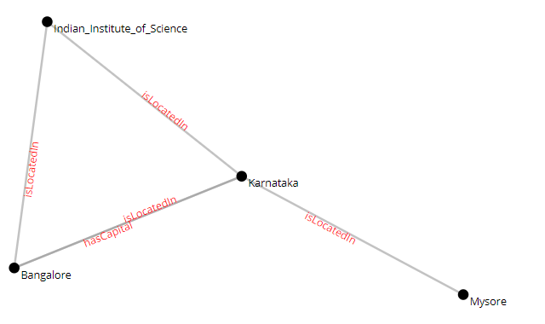
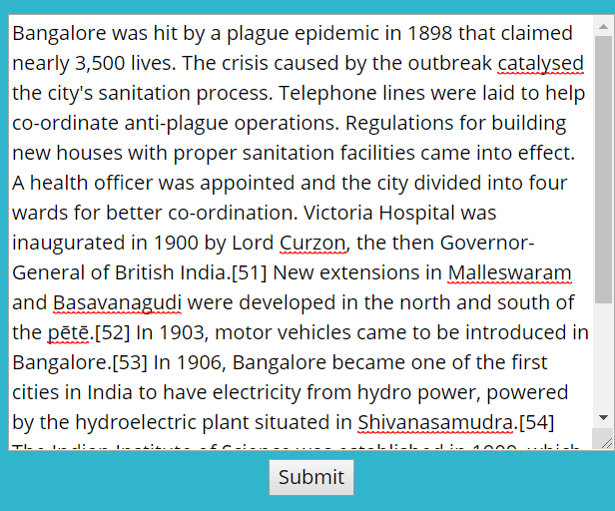
Document Visualization

Slide 11
Conclusion
The web tool provides easy to navigate functionality for large knowledge graphs
Can be attached to any knowledge graph dataset by implementing the interface
Can perform different kinds of analysis and visualize them in real time

Slide 12
References
https://ieeexplore.ieee.org/stamp/stamp.jsp?arnumber=7358050
http://postgrest.org/en/v5.2/index.html
https://github.com/d3/d3-force#many-body
https://www.mpi-inf.mpg.de/departments/databases-and-information-systems/research/yago-naga/yago/
https://www.postgresql.org/docs/9.6/pgtrgm.html
https://bl.ocks.org/heybignick/3faf257bbbbc7743bb72310d03b86ee8
https://wordnet.princeton.edu

