Slide 1
DS 294 – Data Analysis & Visualization Seminar Presentation Tree visualization: Indented lists and Node-link trees
Shriram R
30-Mar-19

Slide 2
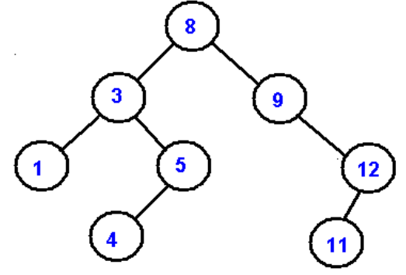
Tree - Definition
General
Connected & Acyclic
N vertices & N-1 edges
May contain labels
Rooted Tree
One vertex defined as root
Vertices can have 0+ children

Slide 3
Indented Lists
Vertices displayed as indented rows
Level of indentation -> Level in the tree
Works well for hierarchical relations
Suitable for parent -> child traversal
Mainly used as UI element
Difficult to display the full tree
Node 8
Node 3
Node1
Node 5
Node 4
Node 9
Node 12
Node 11

Slide 4
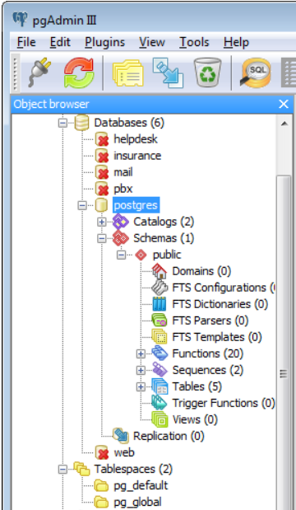
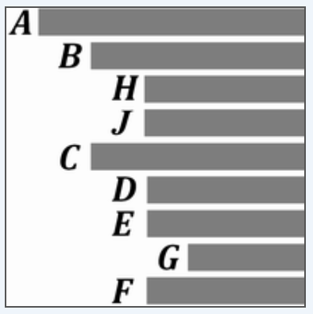
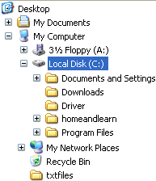
Indented Lists - Examples
[1]
[2]
[3]

Slide 5
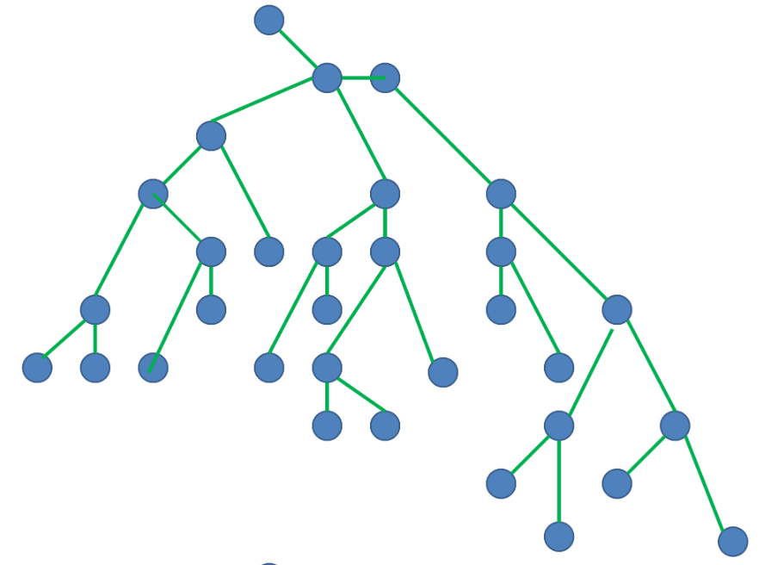
Node-link trees
2-D layout of vertices (nodes)
Vertices connected by links (edges)
Distance b/w vertices denote level
Versatile & used for all kinds of trees
Can be extended to generic graphs
Different algorithms & types
[1]

Slide 6
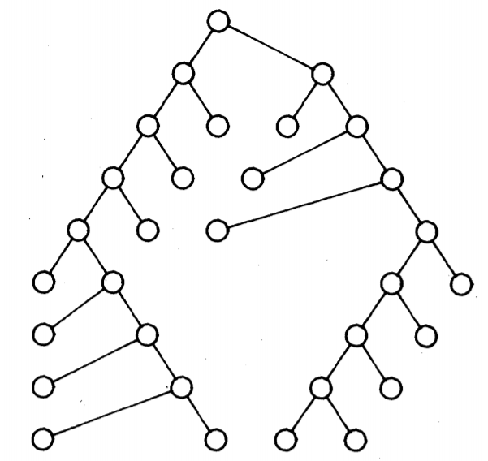
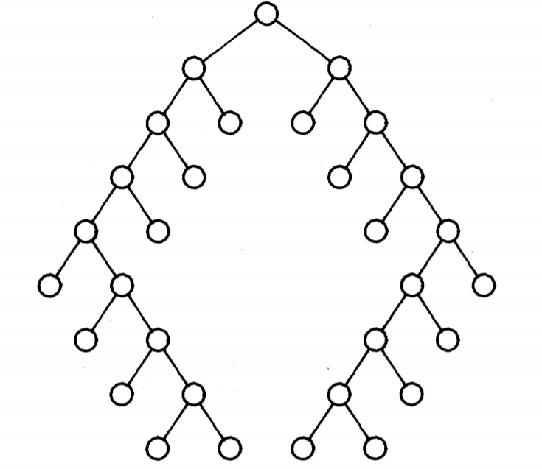
Node-link Trees – Basic Layout

Slide 7
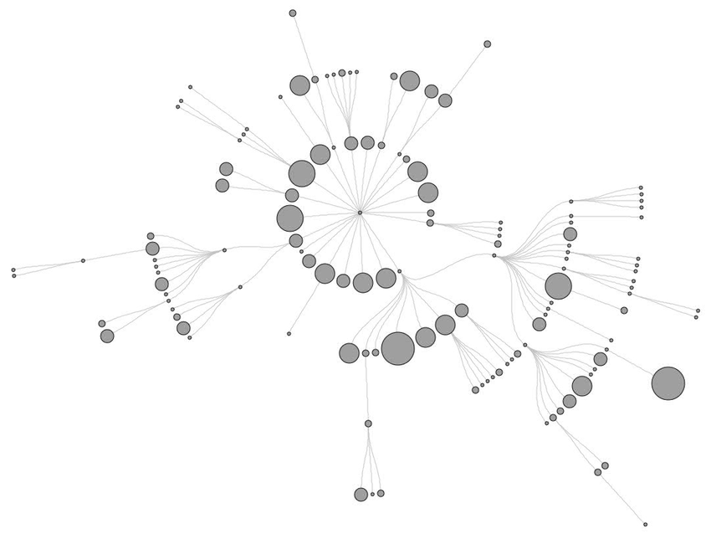
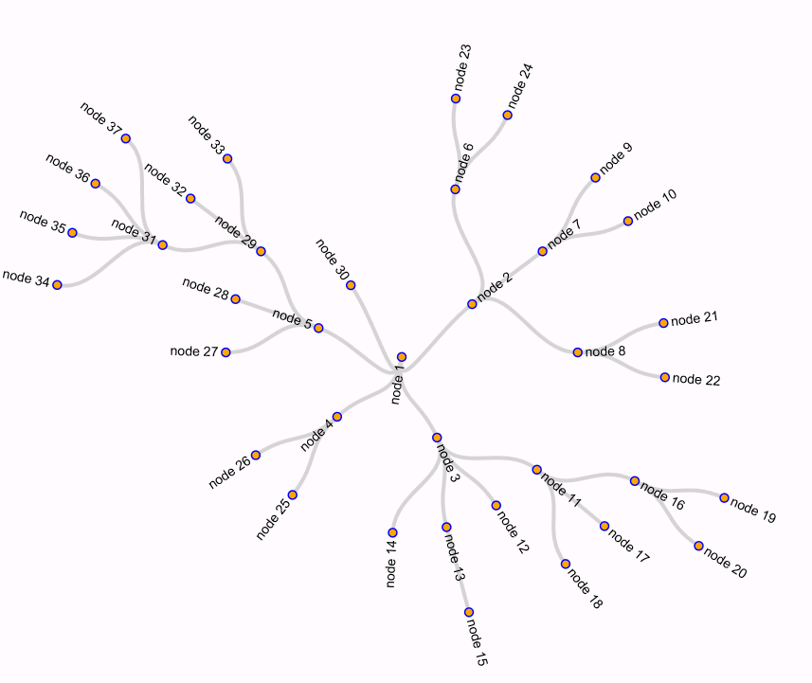
Node-link trees – Radial Layout
[1]
[2]

Slide 8

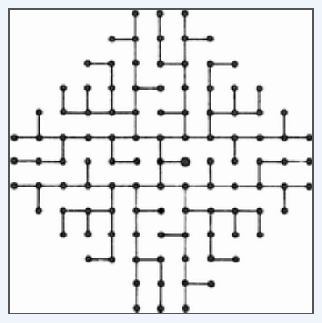

Node-link trees – More Complex Layouts
[2] Thread Arcs
[1] Orthogonal Grid Embedding

