Slide 1
Granite: A Distributed Engine for Scalable Path Queries over Temporal Property Graphs
Shriram R.
Advisor : Prof. Yogesh Simmhan
10th September 2020

Slide 2
Introduction

Slide 3
Temporal Property Graph
Vertices & Edges have key-value properties.
Time is a first class entity. Structure & Properties in the graph are time varying.
Found in different domains
Social Networks
Financial Transactions
Transportation
Queries looking for patterns across space and time can be performed.

Slide 4
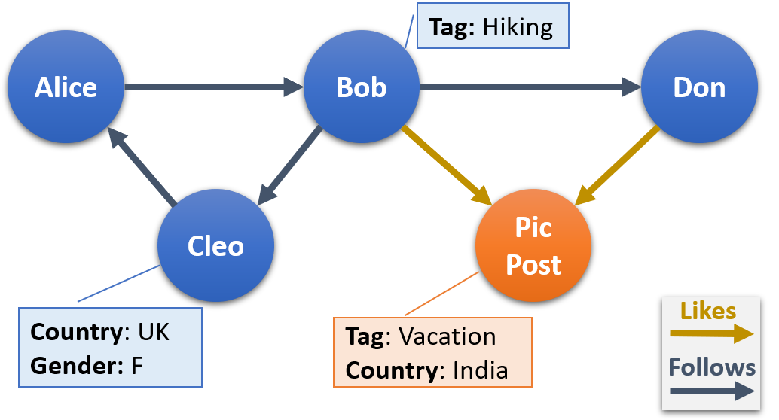
Static Property Graph

Slide 5
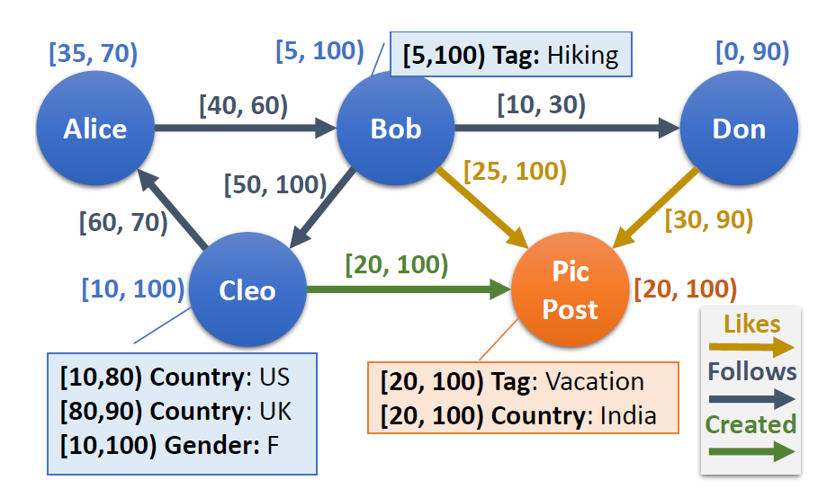
Temporal Property Graph

Slide 6
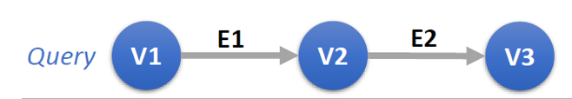
Query Example
Find people tagged with ‘Hiking’ who liked a post tagged as ‘Vacation’, before the post was liked by a person named ‘Don’.
Path (edges)
liked
Properties
tagged with ‘Hiking’
named ‘Don’
Temporal relations
before
(Bob->Pic Post<-Don)

Slide 7
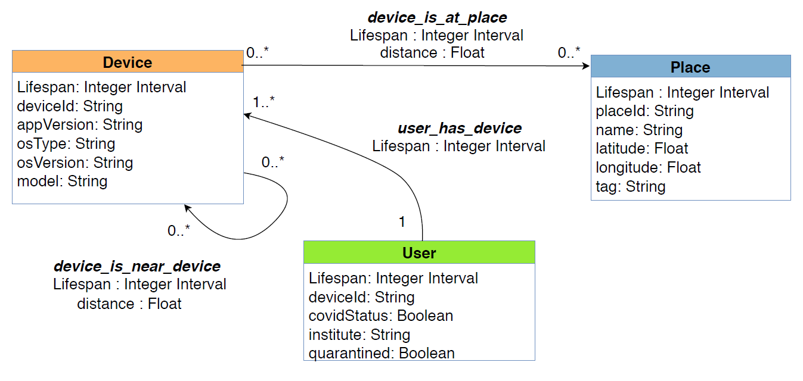
Use Case: Querying the COVID-19 Contact Tracing Graph*

Slide 8
Use Case: Querying the COVID-19 Contact Tracing Graph
For each person who is COVID positive, get the list of people who were near to them using place contacts.
Mess
[0, 50)
Bob
ATM
[60, 200)
[120, 180)
[10, 30)
Alice
Kim
Normal
[50, 100)
[70, 90)
Positive
Sam
Beth
is_at_place

Slide 9
Our Contributions
Temporal property graph query model
Distributed execution engine for our query model with optimizations
Cost model to select the best execution plan using statistics
Detailed evaluation of performance and scalability using LDBC workload
Publications based on our work:
S. Ramesh, A. Baranawal, Y. Simmhan, A distributed path query engine for temporal property graphs, IEEE/ACM International Symposium on Cluster, Cloud and Internet Computing (CCGrid), 2020.
S. Ramesh, A. Baranawal, Y. Simmhan, Granite: A distributed engine for scalable path queries over temporal property graphs, under review at The Journal of Parallel and Distributed Computing (JPDC).

Slide 10
Query Model

Slide 11







Temporal Property Graph Model
- Temporal Property Graph
- Lifespan of existence
and
Type-Property Function -
Constraints
Uniqueness - and should be unique
Referential Integrity -
Constant Edge Association

Slide 12
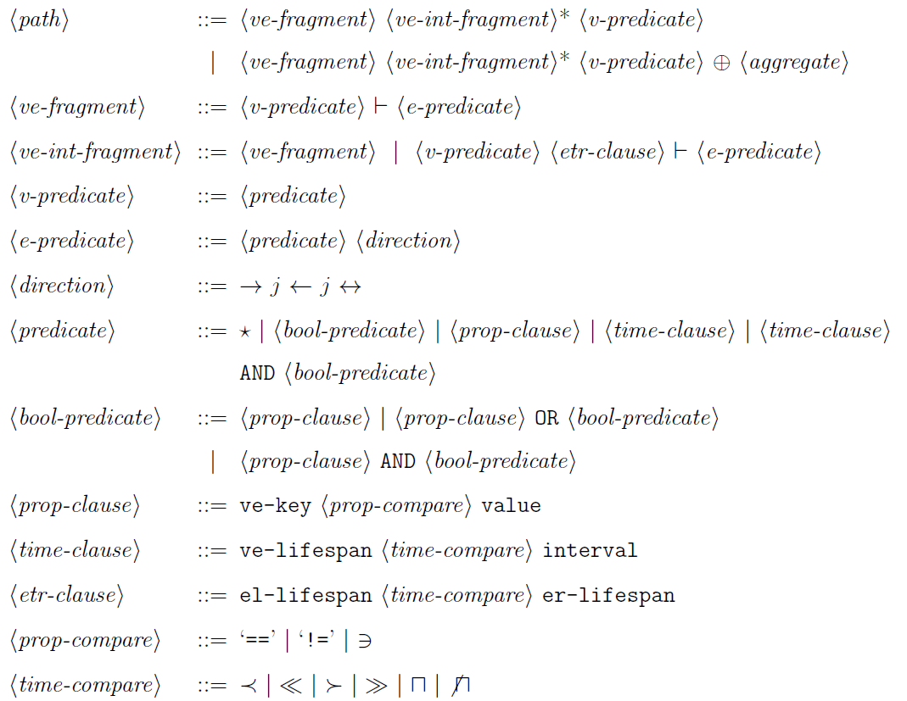
Path Query Model
N-hop linear chain pattern
N vertex and N-1 edge predicates
Find people tagged with ‘Hiking’ who liked a post tagged as ‘Vacation’, before the post was liked by a person named ‘Don’.

Slide 13
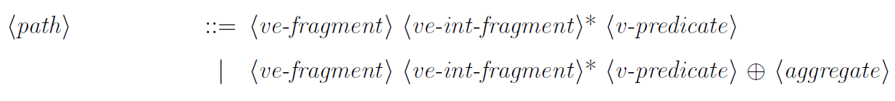
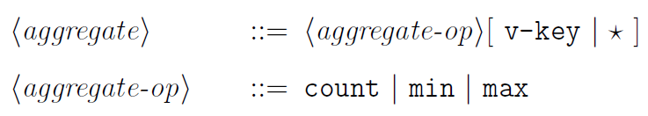
Temporal Aggregate Queries
Count the number of persons followed by a person `Bob' during his existence in the network.
{ [5,10):0, [10,30):1, [30,50):0, [0,100):1 }

Slide 14
Query Engine

Slide 15
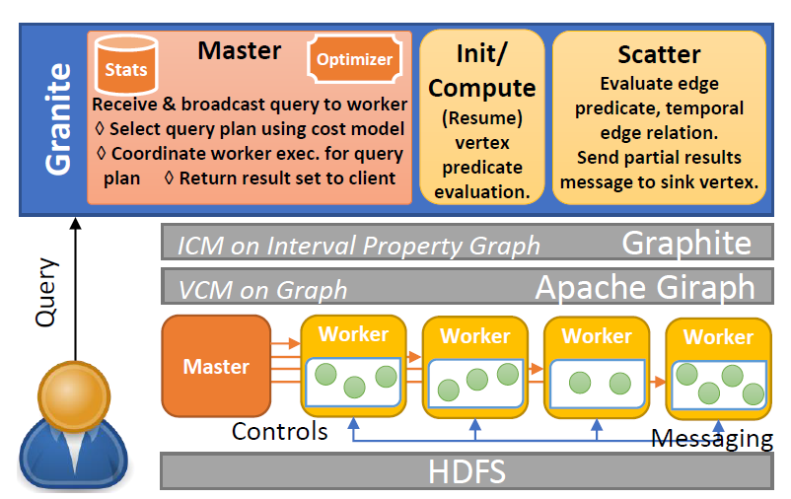
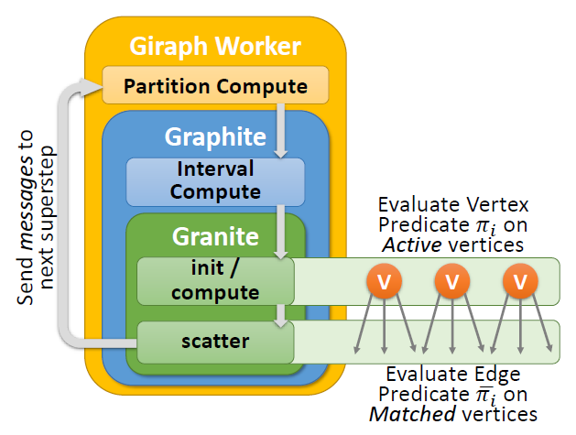
Distributed Execution Model
Relaxed Interval Centric Model (ICM)*
One ICM superstep per query hop.
Vertex Predicates – compute
Edge Predicates – scatter

Slide 16
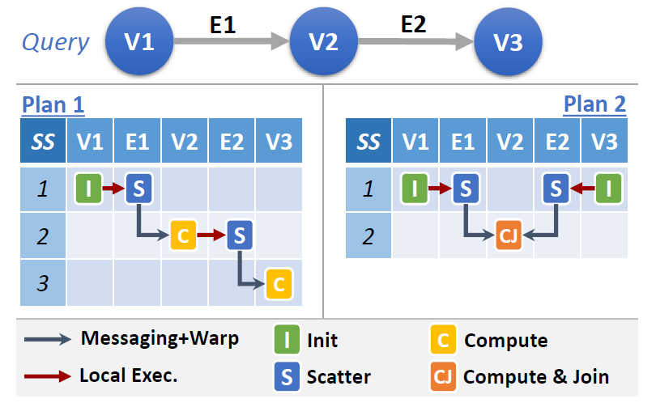
Query Execution Plans
Superstep wise execution of different stages

Slide 17
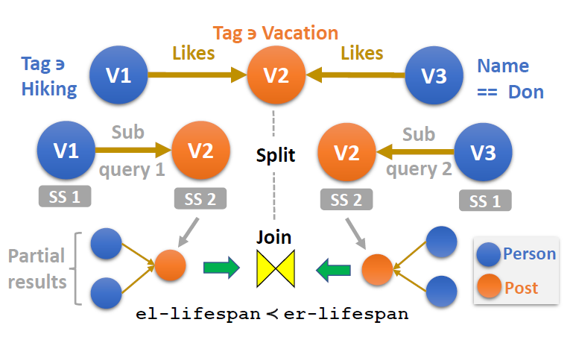
Query Execution Plans
Illustration of split and join operation

Slide 18
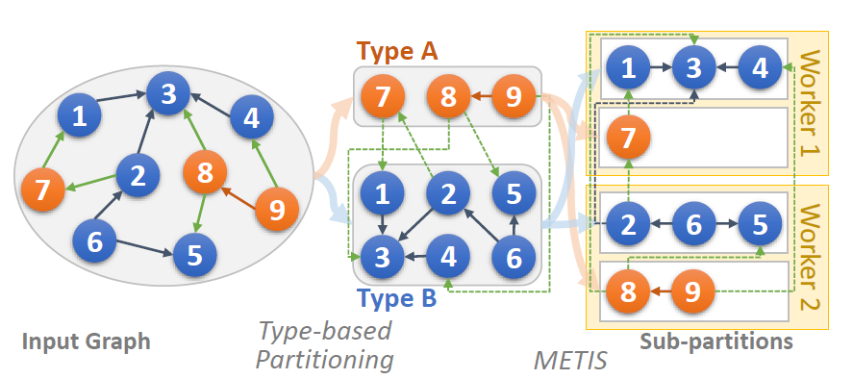
System Optimizations
Type-based Graph Partitioning
5.8x speedup due to type-based over hash based partitioning
32% improvement from METIS

Slide 19
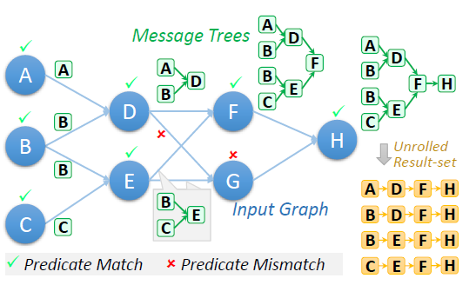
System Optimizations
Message Trees
O(hxn) to O(2n-1) for a full binary tree

Slide 20
Query Optimization

Slide 21
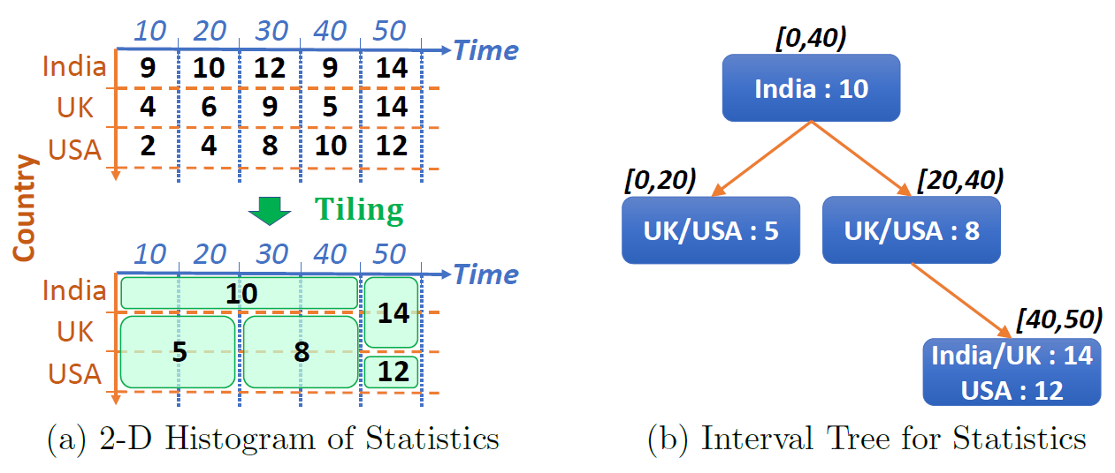
Statistics - 2D Histograms

Slide 22








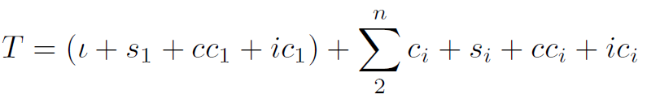
Cost Model
Sfsf - sequence of predicates
- Vertex(Edge) Type enforced
- Set of Vertices and Edges
Init -
Compute -
Scatter -
Partition Compute -
Interval Compute -

Slide 23
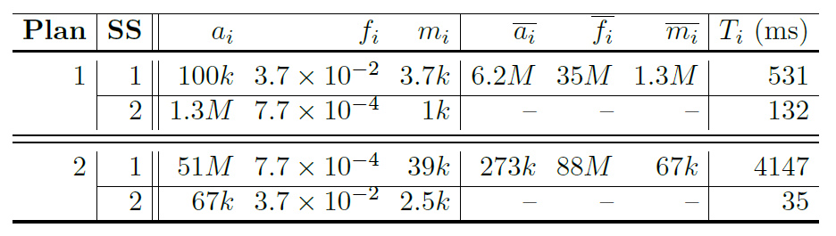
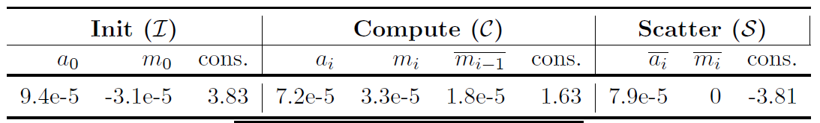
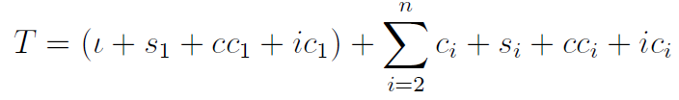
Cost Model - Illustration

Slide 24
Evaluation

Slide 25
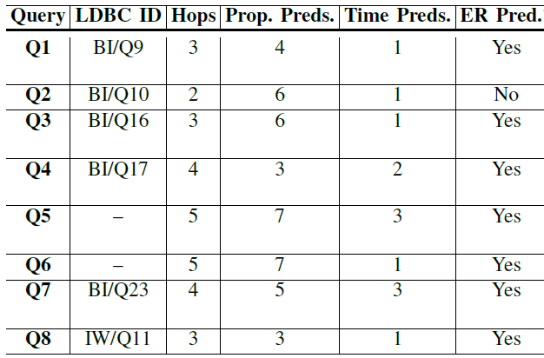
Workload Generation
LDBC Business Intelligence (BI) and Interactive Workload (IW)
100 query instances per query template

Slide 26
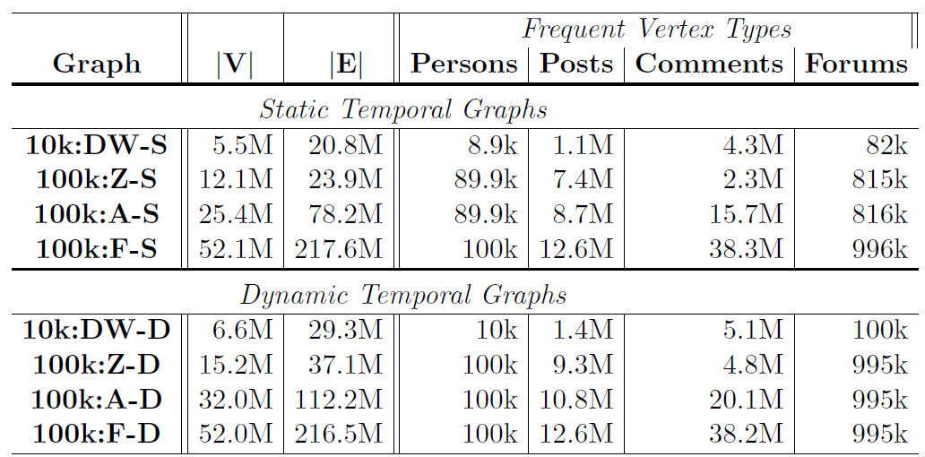
Graph/Workload Generation
LDBC Benchmark Graph*
3-year Time Period

Slide 27
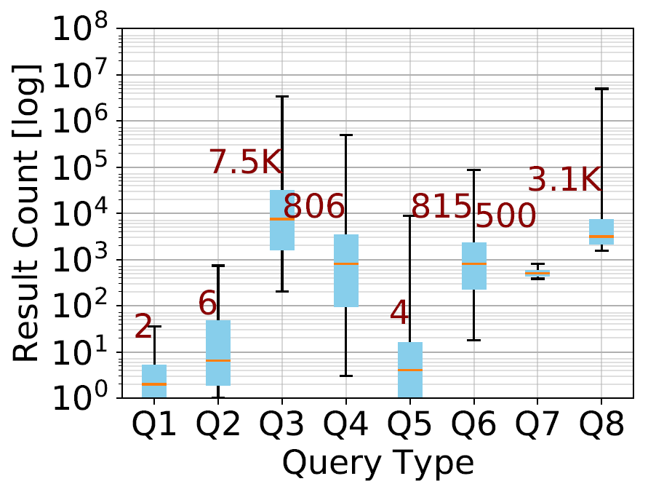
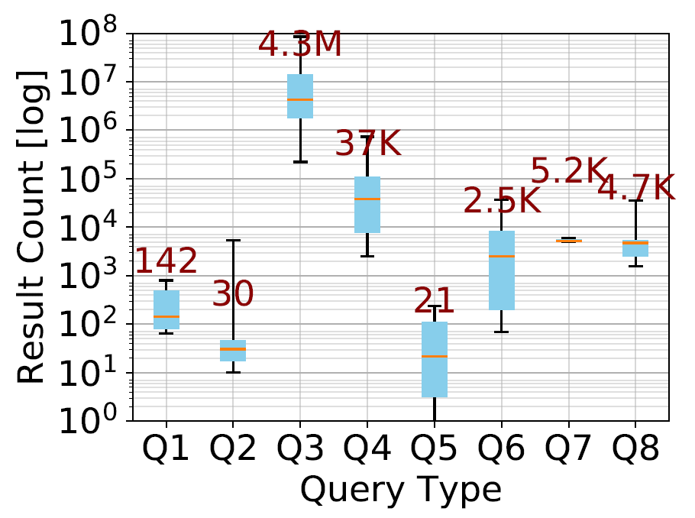


Result Distribution
Box and whiskers distribution plot of the result set count for the 100 instances of each non-aggregate query type. The median result set count is labeled.

Slide 28
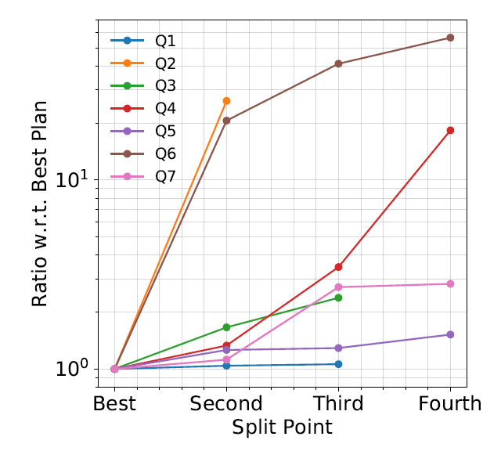
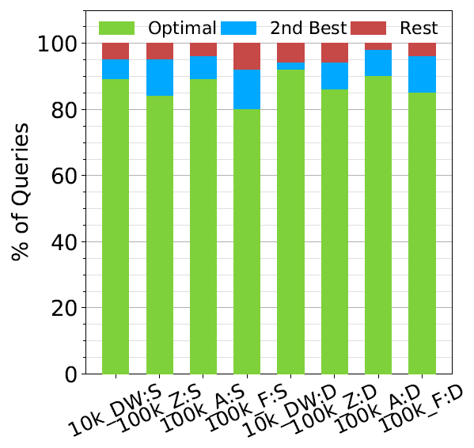
Cost Model Effectiveness
Ratio of estimated average execution cost of the other plans relative to the optimal plan, for all query types of 100k:A-S graph
Cost Model Accuracy. % of times
the optimal plan, 2nd best plan and
other plans were selected by our model for all graphs

Slide 29
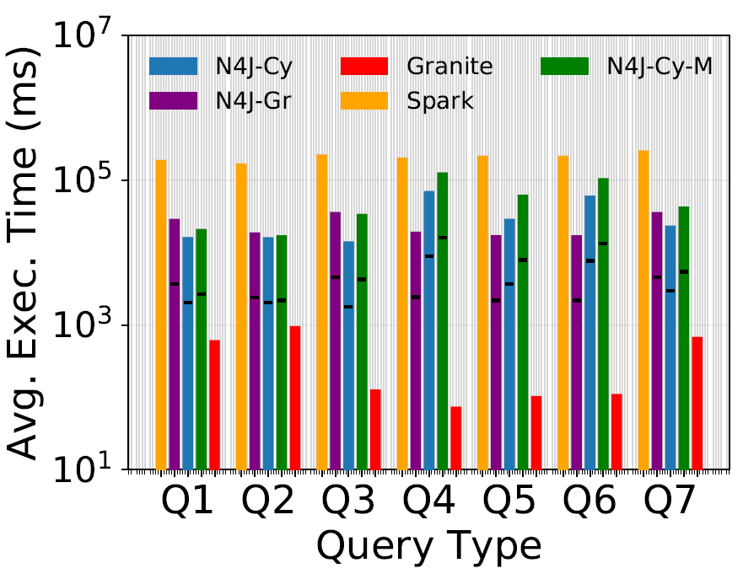
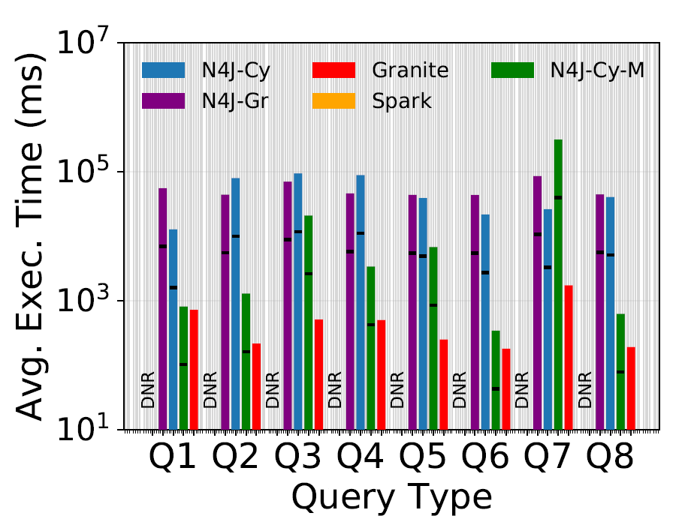
Comparison With Baselines
100k:Z-S
100k:Z-D
Spark – Distributed and N4J-Cy, N4J-Gr and N4J-Cy-M – Single Machine

Slide 30
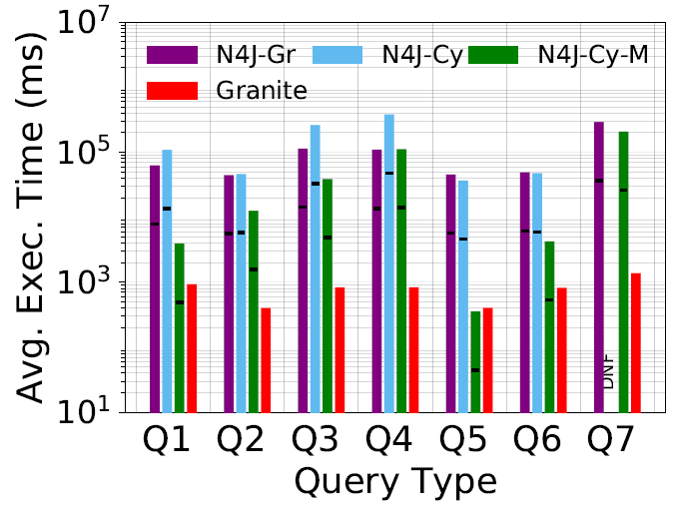
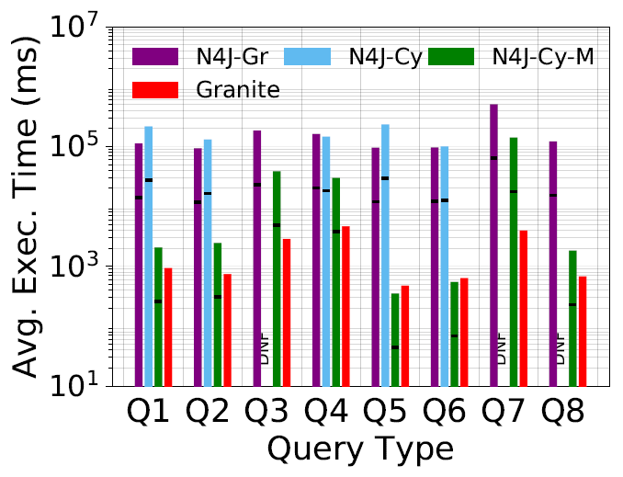


Comparison with Baselines – Temporal Aggregate Queries
Comparison of average execution time of Granite with baseline systems for
Temporal Aggregate query types.

Slide 31
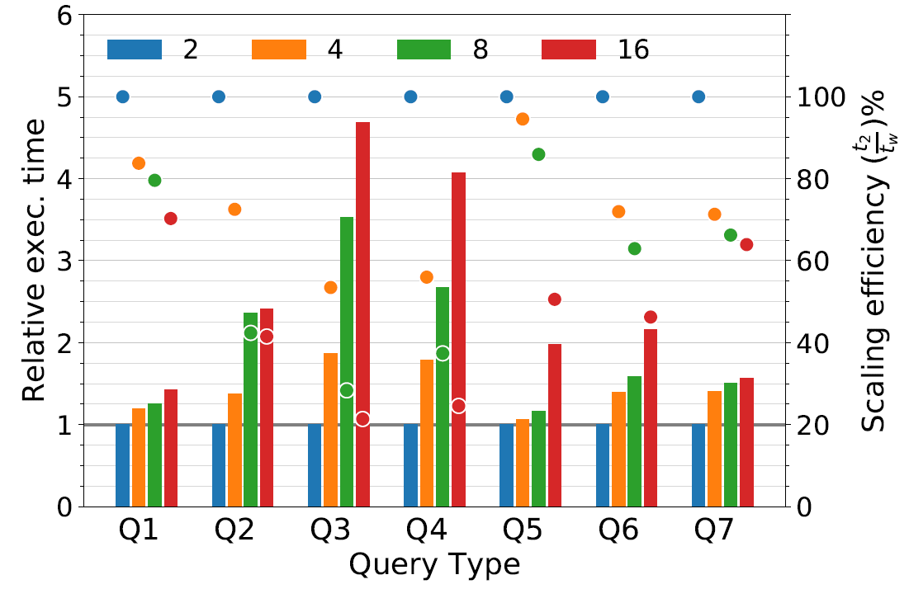
Weak Scaling
Relative execution time (left axis, bar) and Scaling efficiency% (right axis, circle) for Worker counts w = 4; 8; 16, relative to w = 2 for Weak Scaling runs with (w x 6:25k):F-S graphs

Slide 32
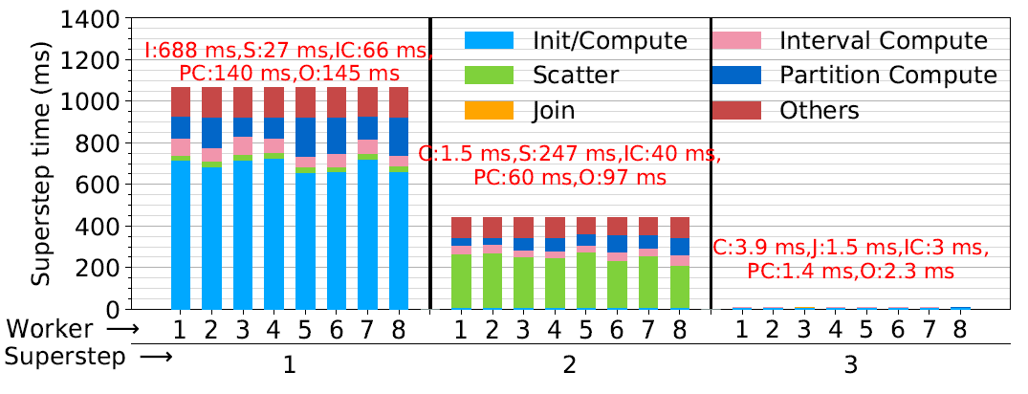
Components of Execution
Stacked bar plot of component execution times in each superstep, averaged over all queries of query type Q7 on 100k:A-S graph. Header labels indicate average component time across Workers in a superstep.

Slide 33
Future Work

Slide 34
Future Work
Concurrent Query Processing
Extensions to query optimizer
Partial result sharing among queries
Bounded/Approximate Querying
Statistics based selection of paths
Indexing Techniques
Neighbourhood indexing
Partition level indexing for properties
Support for Reachability queries
Shortest time, Shortest distance, Earliest arrival time

Slide 35
The End

