Slide 1

Introduction to CSS Flexbox
CSS Flexbox, or the Flexible Box Layout Module, is a CSS layout model designed to help create more efficient and predictable layouts by distributing space within a container and aligning items in a flexible manner.
by Shrirang Nikam
SN

Slide 2

Features of Flexbox :
1. High flexibility.
2. Arrangement & alignment of items.
3. Proper spacing.
4. Order & sequencing of items.
5. Bootstrap 4 is built on top of the flex layout.

Slide 3
Before the Flexbox Model :
1. Block: Sections in web pages
2. Inline: Text
3. Table: Two-dimensional table data
4. Positioned: Explicit position of an element

Slide 4
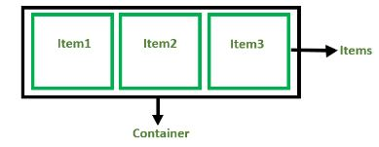
Flexbox Components:
Flex Container: The parent div containing various divisions.
Flex Items: The items inside the container div.

Slide 5
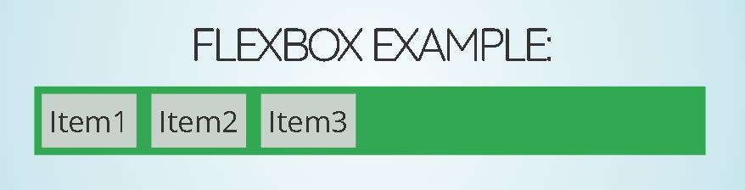
FLEXBOX EXAMPLE:
<!DOCTYPE html>
<html>
<head>
<title>Flexbox Tutorial</title>
<style>
.flex-container {
display: flex;
background-color: #32a852;
}
.flex-container div {
background-color: #c9d1cb;
margin: 10px;
padding: 10px;
}
</style>
</head>
<body>
<div class="flex-container">
<div>Item1</div>
<div>Item2</div>
<div>Item3</div>
</div>
</body> </html>
OUTPUT:

Slide 6
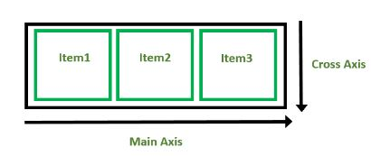
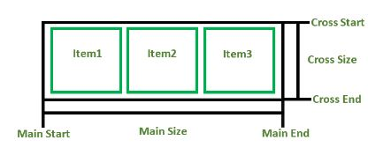
Flexbox Axes: Flexbox operates on two axes 1. Main Axis: Runs from left to right by default.
2. Cross Axis: Perpendicular to the main axis, runs from top to bottom.
1. Main Axis:
Main Start: The start of the main axis
Size: The length between Main Start and Main End.
Main End: The endpoint of the main axis.

Slide 7
2. Cross Axis: The cross axis will be perpendicular to the main axis.
Cross Start: The start of the cross axis.
Cross Size: The length between Cross Start and Cross End.
Cross End: The endpoint of the cross axis.

Slide 8

Flex Direction Properties:
1. Left to Right: flex-direction: row;
2. Right to Left: flex-direction: row-reverse;
3. Top to Bottom: flex-direction: column;
4. Bottom to Top: flex-direction: column-reverse;

Slide 9
Flexbox Properties:
1.display: Defines a flex container.
2.flex-direction: Defines the main axis direction.
3.flex-wrap: Allows items to wrap onto multiple lines.
4.flex-flow: Shorthand for flex-direction and flex-wrap.
5.justify-content: Aligns items along the main axis.
6.align-content: Aligns items along the cross axis.

Slide 10
Flex Property:
1.flex-grow: Specifies how much a flex item will grow relative to the rest of the flex items.
2.flex-shrink: Specifies how much a flex item will shrink relative to the rest of the flex items.
3.flex-basis: Specifies the initial size of a flex item.
4.flex-wrap: Controls whether flex items stay on a single line or can wrap onto multiple lines within the container.

Slide 11
THANK YOU

