Slide 1
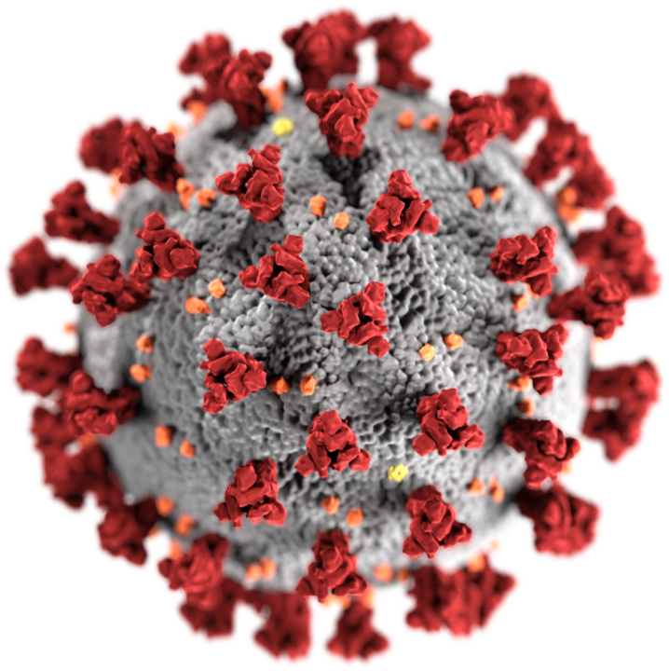

Corona Virus Analysis Using MySQL
Presented by: Shiwani Akshay Kapile
For Mentorness Internship Program

Slide 2

Corona Virus Dataset
The Coronavirus pandemic has significantly impacted public health, creating an urgent need for data-driven insights to understand its spread. As a data analyst, You will analyze a Coronavirus dataset to uncover key patterns and trends, such as infection rates, mortality rates, and recovery statistics across different regions and demographics.

Slide 3

About The Dataset
Query for Dataset:
SELECT * FROM `CoronaVirusDataset` LIMIT 10;
Our dataset contains 8 Columns named as :
Province: Geographic subdivision within a country/region.
Country/Region: Geographic entity where data is recorded.
Latitude: North-south position on Earth's surface.
Longitude: East-west position on Earth's surface.
Date: Recorded date of CORONA VIRUS data.
Confirmed: Number of diagnosed CORONA VIRUS cases.
Deaths: Number of CORONA VIRUS related deaths.
Recovered: Number of recovered CORONA VIRUS cases.

Slide 4

Questions For Analysis:
Checking NULL values and Updating.
Checking total number of rows.
Checking Start_date and End_date.
Counting the number of months present.
Monthly average for confirmed, deaths, recovered cases
Finding the most frequent value for cases.
Finding the minimum values for cases.
Finding the maximum values of cases.
Finding the total number of cases.
Check how corona virus spread out with respect to confirmed, Death and Recovered cases (Eg.: Total cases, Average, Variance & Standard Deviation )
Finding the Country with highest number of the Confirmed case
Finding the Country with lowest number of the death case
Find top 5 countries having highest recovered case

Slide 5
Que 1: Write a code to check NULL values
Query :
SELECT Province,Country,Latitude,Longitude,Date,Confirmed,Deaths, Recovered
FROM ` CoronaVirusDataset`
WHERE Province||Country||Latitude||Longitude||Date||Confirmed||Deaths|| Recovered IS NULL;
Que 2: If NULL values are present, update them with zeros.
Query :
SELECT IFNULL(Province, 0 )
FROM `CoronaVirusDataset`;

Slide 6
Q3. check total number of rows
Query :
select count(*) as Total_raows
from ` CoronaVirusDataset`;
Q4. Check what is start_date and end_date
Query :
Select MIN(Date) as start_date, MAX(Date) as end_date,
from `CoronaVirusDataset`;
Q5. Number of month present in dataset
Query :
SELECT COUNT(DISTINCT EXTRACT(MONTH FROM Date)) AS num_months
FROM `CoronaVirusDataset`;
Result: There are 12 distinct months present in the dataset.

Slide 7
Q6. Find average for confirmed, deaths, recovered rate
Query :
select Round(avg(Confirmed),2) as avg_confirmed_rate, Round(avg(Deaths),2) as avg_death_rate , round(avg(Recovered),2) as avg_recovery_rate
from `CoronaVirusDataset` ;
Q7. Find minimum values for confirmed, deaths, recovered.
Query :
select min(Confirmed) as min_confirmed, min(Deaths) as min_death , min(Recovered) as min_recovery
from `CoronaVirusDataset`;

Slide 8
Q8. Find most frequent value for confirmed, deaths, recovered
Query :
Confirmed Cases
SELECT Confirmed, COUNT(Confirmed) AS `most_confirmed`
FROM `CoronaVirusDataset`
GROUP BY 1
ORDER BY 1 LIMIT 5;
Death cases
SELECT Deaths, COUNT(Deaths) AS `most_Deaths`
FROM `CoronaVirusDataset`
GROUP BY 1
ORDER BY 1 LIMIT 5;
Recovered cases
SELECT Recovered, COUNT(Recovered) AS `most_Recovered`
FROM `CoronaVirusDataset`
GROUP BY 1
ORDER BY 1 LIMIT 5;
our dataset for Confirmed, Death and recovered cases, most frequent value is 0 followed by 1.

Slide 9
Q9. Find maximum values of confirmed, deaths, recovered.
Query :
select max(Confirmed) as max_confirmed, max(Deaths) as max_death , max(Recovered) as max_recovery
from `CoronaVirusDataset`;
Q10. The total number of case of confirmed, deaths, recovered.
Query :
select sum(Confirmed) as total_confirmed, sum(Deaths) as total_death , sum(Recovered) as total_recovery
from `CoronaVirusDataset`;

Slide 10
Q11. Check how corona virus spread out with respect to confirmed case (Eg.: total confirmed cases, their average, variance & STDEV).
Query :
select sum(Confirmed) as total_confirmed, round(avg(Confirmed),2) as avg_confirmed,round(stddev(distinct Confirmed),2) as standard_deviation,
round(variance(distinct Confirmed),2) as confirm_variance
from `CoronaVirusDataset`;
Q12. Check how corona virus spread out with respect to death case (Eg.: total death cases, their average, variance & STDEV )
Query :
select sum(Deaths) as total_Deaths, round(avg(Deaths),2) as avg_Deaths,round(stddev(distinct Deaths),2) as standard_deviation,
round(variance(distinct Deaths),2) as Deaths_variance
from `CoronaVirusDataset`;

Slide 11
Q13. Check how corona virus spread out with respect to recovered case (Eg.: total recovered cases, their average, variance & STDEV ).
Query :
select sum(Recovered) as total_Recovered, round(avg(Recovered),2) as avg_Recovered,round(stddev(distinct Recovered),2) as standard_deviation,
round(variance(distinct Recovered),2) as Recovered_variance
from `CoronaVirusDataset`;
Q14. Find Country having highest number of the Confirmed case
Query :
select Country,sum(Confirmed) as Confirmed,
from `CoronaVirusDataset`
group by 1
order by 2 desc;

Slide 12
Q15. Find Country having lowest number of the death case
Query :
select Country,sum(Deaths) as Deaths,
from `CoronaVirusDataset`
group by 1
order by 2;
Q16. Find top 5 countries having highest recovered case
Query :
select Country,sum(Recovered) as Recovered,
from `CoronaVirusDataset`
group by 1
order by 2 desc,

Slide 13
Insights:
Query: | Result
Null Values | There are no Null values
Total number of Rows | 78386
Start – End Date | 09/09/2020 – 01/01/2021
No. Of Months | 12
Average rate of Confirmed Cases | 2156.83
Average rate of Death Cases | 46.54
Average rate of Recovered Cases | 1442.73
Most Frequent Value | 0
Minimum value for Cases | 0
Maximum value for Confirmed Cases. | 8,23,225
Query: | Result:
Maximum value for Death Cases. | 7,374
Maximum value for Recovered Cases. | 11,23,456
Total Number of Confirmed Cases. | 16,90,65,144
Total Number of Death Cases. | 36,47,894
Total Number of Recovered Cases. | 11,30,89,548
Top 5 Countries with Confirmed Cases. | US, India, Brazil, France, Turkey
Top 5 Countries with lowest Death Cases. | Dominica, Kiribati, Marshall Islands, Samoa
Top 5 Countries with Recovered Rate. | India, Brazil, US, Turkey, Russia

Slide 14
Thank You If you have any query Email: shriraoshiwani11@gmail.Com Contact no.: 7385944580 Linkedin: https://www.Linkedin.Com/in/shiwani-shrirao-8046471b5/

