Slide 1

MTH 442: Time Series Analysis
Forex Exchange Analysis
Instructor : Prof. Amit Mitra
Submitted by:
Lakshika (210554)
Om Shivam Verma (210684)
Pankajh Jhamtani (210695)
Sanat Goel (210918)
Shrish Shete (211013)

Slide 2
Overview
Introduction
Motivation
Methodology
Visualisations & Tests
Results & Interpretation
Conclusion

Slide 3
Introduction
Forex (FX) refers to the global electronic marketplace for trading international currencies and currency derivatives.
It has no central physical location, yet the forex market is the largest, most liquid market in the world by trading volume, with trillions of dollars changing hands every day.
IMF exchange rates, often referred to as "International Monetary Fund exchange rates," are foreign exchange rates used by the International Monetary Fund (IMF) for its financial and economic activities.
SDR "Special Drawing Rights," is an international reserve asset created and maintained by the International Monetary Fund (IMF). The prices used here are relative to SDR.

Slide 4
Motivation
The purpose of this study is to make foreign exchange predictions using time series analysis called Auto Regressive Integrated Moving Average (ARIMA) and Long Short term memory methods.
Time series has great significance in the field of finance, economics and trade.
Weather forecasting is one of the major applications of time series.

Slide 5
Methodology & Working Strategy
Step 1: Import Data
Step 2: Data preprocessing, cleaning and separating data into train and test data.
Step 3: Plots of time series to visualise the data
Step 4: Rough plots of the trend, seasonal and random component
Step 5: Applying ADF test for testing stationarity in time series
Step 6: If stationary, then finding the ACF and PACF plot and estimating the parameters of model

Slide 6
Methodology & Working Strategy
Step 7: If not stationary, apply differencing till the time series becomes stationary, then estimate the parameters using ACF and PACF(in case of USD)
Step 8: After estimating the model parameters, we do cross validation. For cross validation, we use
i) AIC to predict p, d and q from training data
ii) Using the forecast function to test the parameters on
testing data

Slide 7
Methodology & Working Strategy
Step 9: Finally, we do the residual analysis to check if the residuals are stationary and white noise
Step 10: If our residuals are white noise processes , we have correctly estimated the parameters of the model

Slide 8
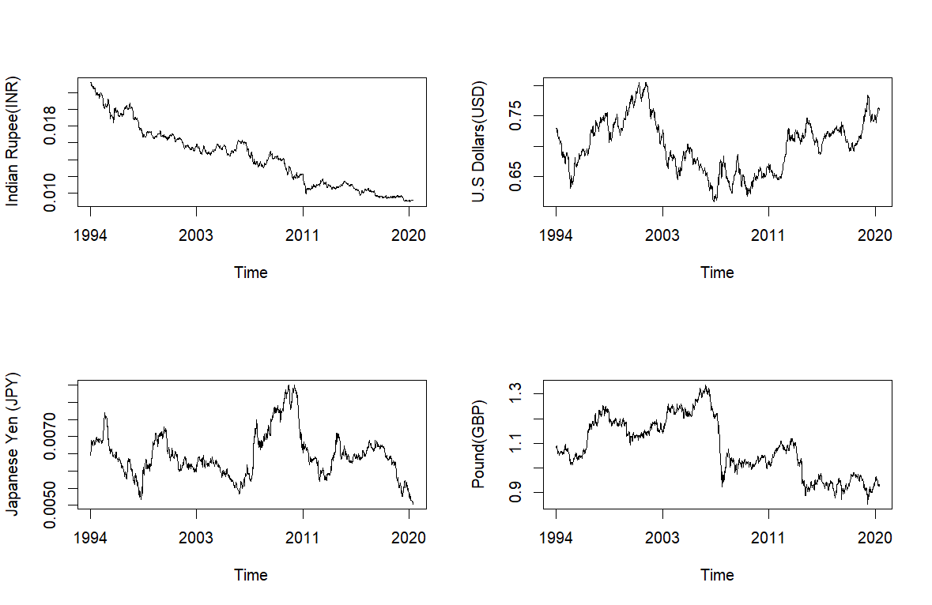
The Foreign Exchange Data as time series

Slide 9
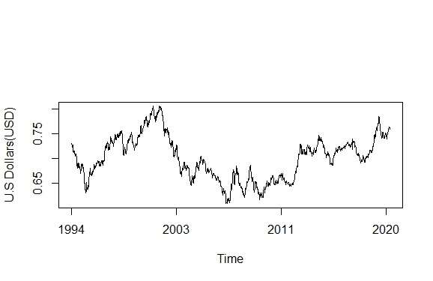
Visualisations & Tests
We are working on USD time series:
US Dollar Time Series

Slide 10
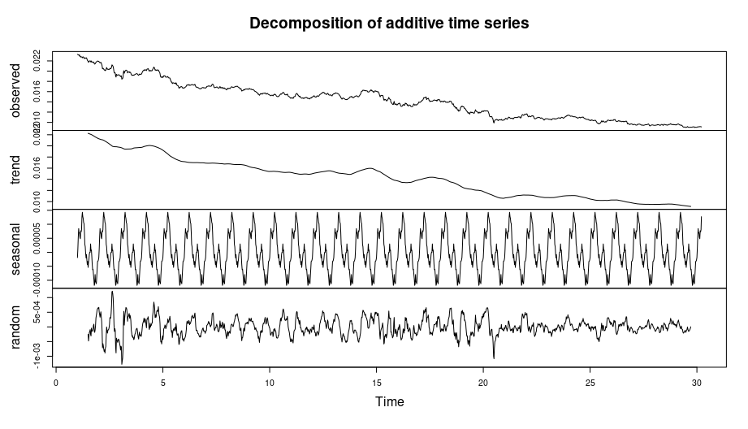
Visualisations & Tests
Decompose the time series using additive model

Slide 11
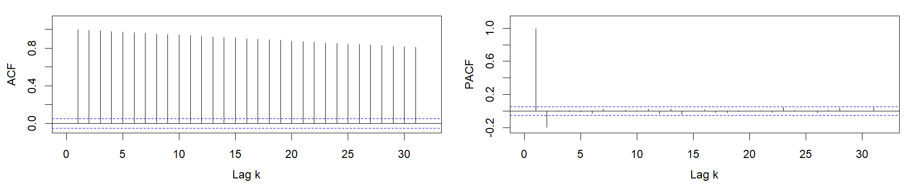
Visualisations & Tests
2. Relative Ordering Test: To test for existence of trend
3. Augmented Dickey Fuller (ADF) Test: Used to test for Stationarity.
p-value greater than 0.05 to reject alternative hypothesis i.e Stationarity.
4. Autocovariance function (ACF) and Partial autocovariance function (PACF):
To get a rough estimate of parameters of ARIMA Model.

Slide 12
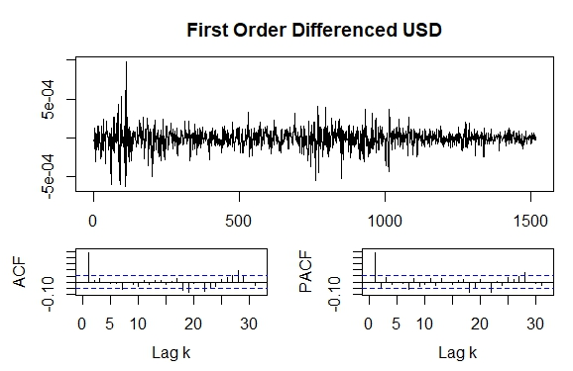
Visualisations & Tests
5. Differencing the time series:

Slide 13
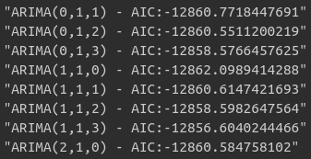
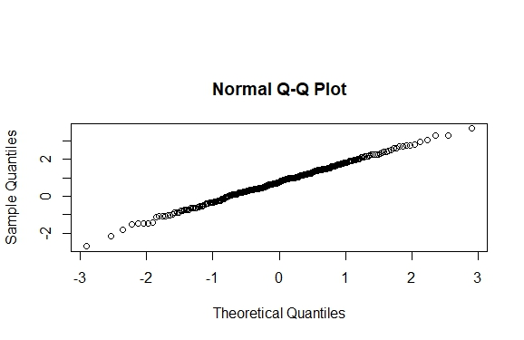
Visualisations & Tests
6. Akaike information criterion (AIC) values:
Evaluates the goodness-of-fit of a model
Lower AIC indicates better fit
7. Residuals Q-Q plot:

Slide 14
Results and Interpretation
The USD (United States Dollar) time series was non stationary by ADF test. The p-value for the same is 0.6219. Hence, we accept the null hypothesis .
We apply first order differencing and then visualise that the time series now becomes stationary. The p-value for the same is 0.01. Hence, we reject the null hypothesis
Price of USD clearly follows ARIMA(1,1,0) i.e non stationary ARMA(2,0) as the ACF tails off and PACF has 2 spikes.
The differenced time series follows stationary ARMA(2,0) or AR(2) process as the PACF has only 1 spike.
Goodness of fit was evaluated by using AIC: Best Parameters - (1,1,0) , min AIC : -10509.2178833479
Residuals calculated using predicted values and test data followed somewhat normal distribution as observed from quantile-quantile plot.
Forecasted the USD exchange of November 2024: 0.7583252

Slide 15
Conclusion
Extracted and preprocessed the USD foreign exchange time series data
Used various steps for model building and tests to determine the best fit time series model for the data.
Evaluated our fitted model using residual Q-Q plot.
Forecasted the USD foreign exchange rate

