Slide 1

MINI PROJECT PRESENTATION ( WE-CAMP)
SUBMITTED TO:-
DR. S.GOSH
(MINI PROJECT COORDINATOR)
TEAM MEMBERS:-
AMAN SINGH- 2101430100024
AYUSH MALIK- 2101430100047
AYUSH RAWAT- 2101430100048
DEV DHAMA- 2101430100062
HARSH RAJVANSHI- 2101430100077

Slide 2
CONTENTS
INTRODUCTION
AIM OF THE PROJECT
METHODLOGY
IMPLEMENTATION
RESULTS
CONCLUSION
FUTURE WORKS

Slide 3

INTRODUCTION
THE PROJECT TITLED AS “WE-CAMP" is an organized social media platform which is completely based on the web development i.e. HTML AND CSS
This is the web page which will be provided user for interaction and sharing information.
In this member of the respective department are interacting with each other and sharing information by the guidance or supervision.
Information sharing like (event , activities , announcements , and holiday).

Slide 4

AIM OF THE PROJECT
The main aim of this project is to get the deep knowledge about the languages that are being used while developing the WE-CAMP
In todays daily life we need to connect with our corporation our organization or with our colleges with the help of we-camp.
We need to find people , pages on social media
Being active with events , activities or other kinds of announcements……..
But now after this concept we just need a user ID and password to connect with every single person of our organisation

Slide 5

METHDOLOGY
Here in this project we are using the two very well known and used at majority level languages.
So the two languages that are being used are HTML and CSS .
HTML stands for Hypertext Markup Language and CSS stands for Cascading Style Sheet . These languages are the core techniques for building a web page
HTML is used for displaying the content or your views over internet and structuring the web page and it's contents.
CSS tells us how to display the html elements on the screen and on other media. CSS is the language which can handle or can control many various web pages.

Slide 6
IMPLEMENTATION
LOGIN PAGE
FEED
PROFILE
INBOX LOG
SETTINGS

Slide 7
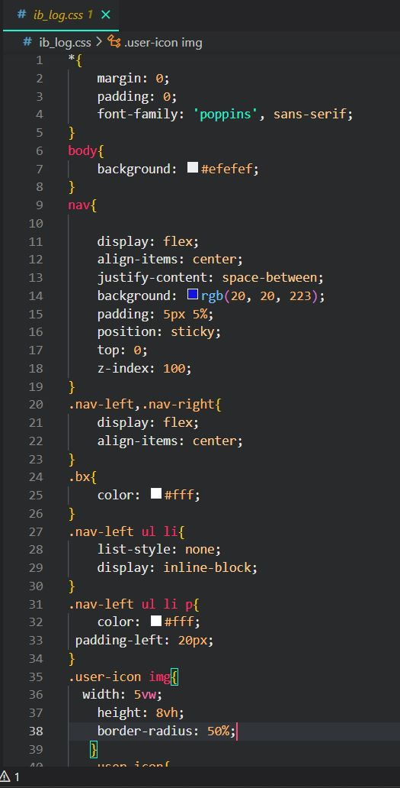
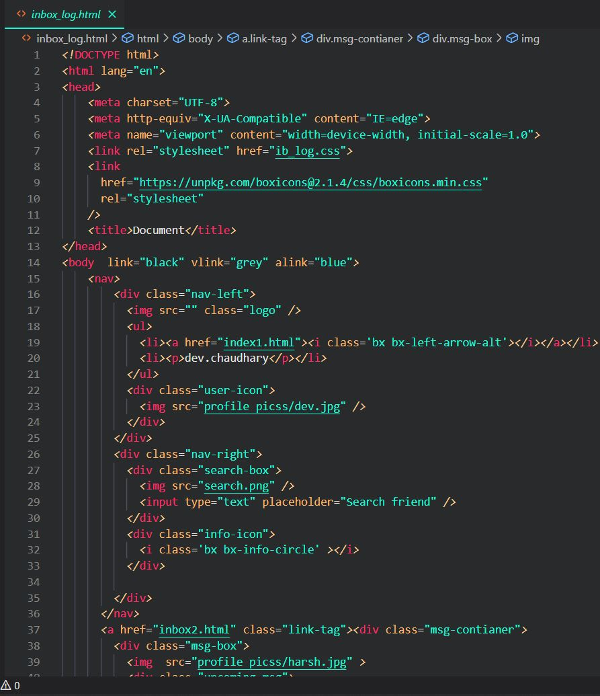
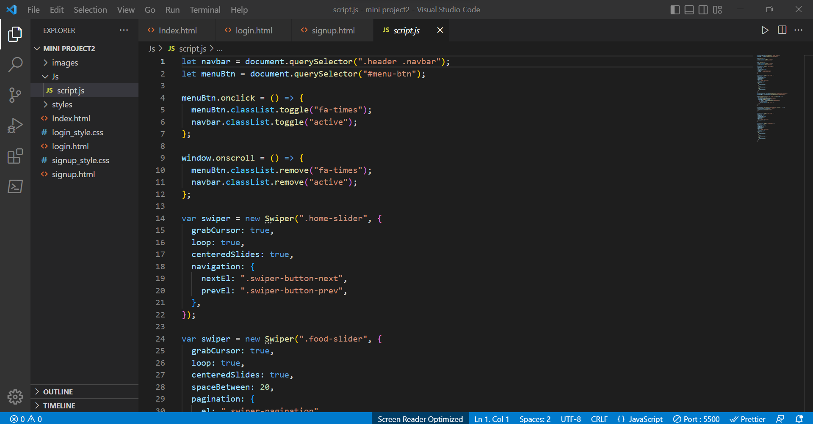

Slide 8
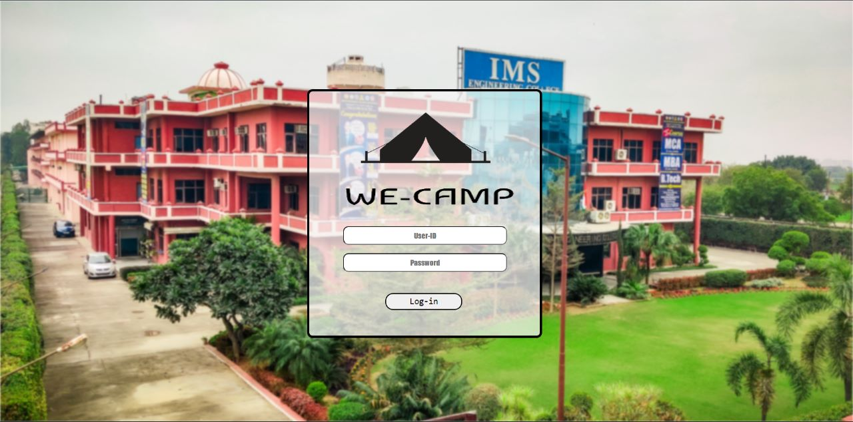
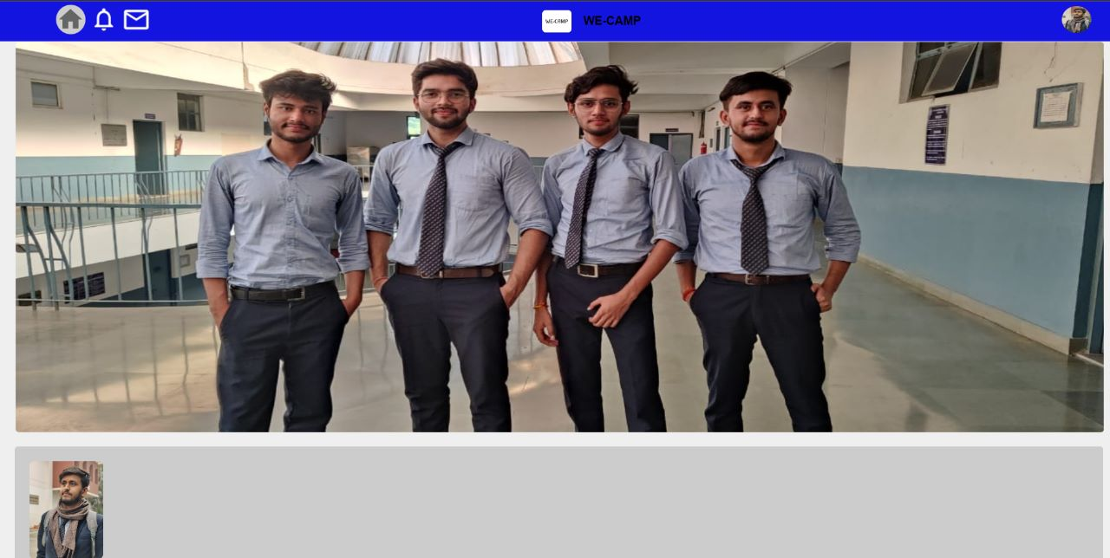
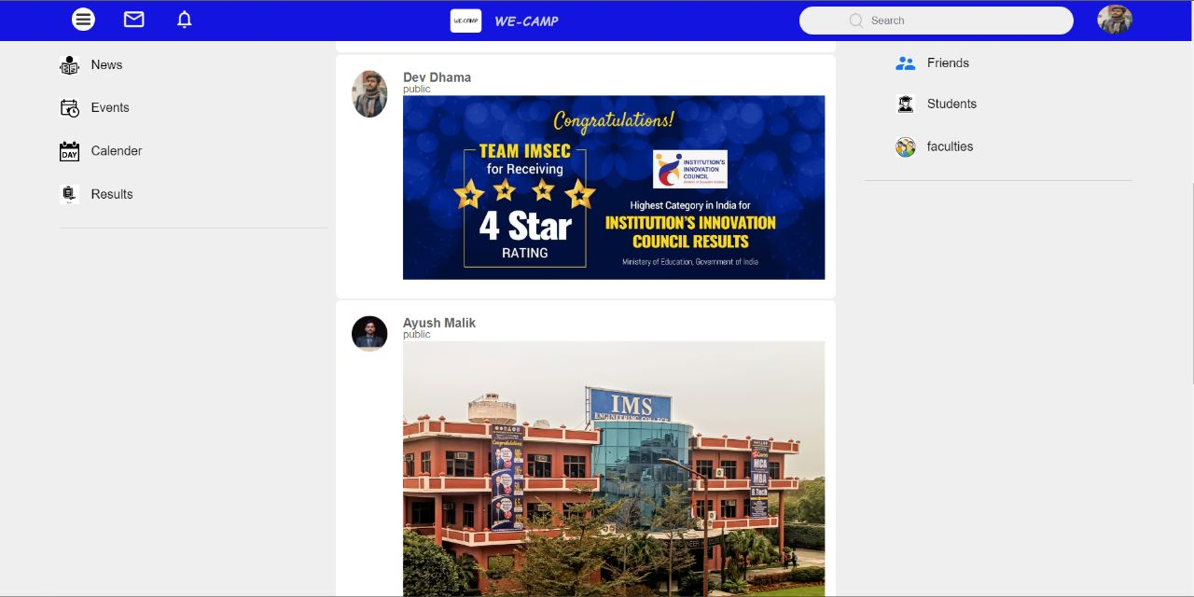
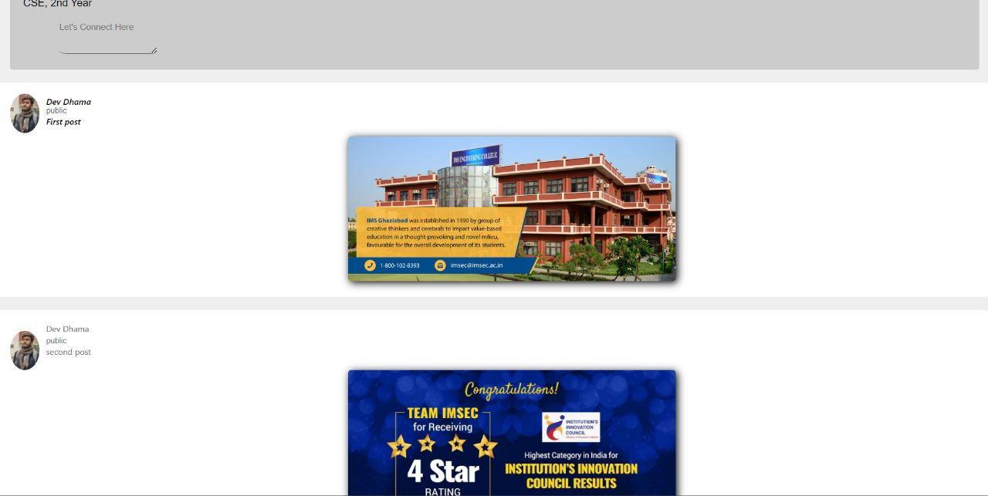
RESULTS

Slide 9
CONCLUSION
It has been a great pleasure to all of our team member to work on this exciting and challenging project.
This project has proved good for all of us as it has provided the practical knowledge not only in programming also about the handling procedure related with the Information sharing i.e how we-camp works.
Hence the importance and use of HTML and CSS is been reflected through this project which will be helpful in exploring and making many more useful websites.

Slide 10
FUTURE WORKS
This has provided the better guidance and the opportunities in future in developing projects independently .
This project work was created in a limited amount of time and there is a large scope of improvement in the project work . More features can be added into the code to improve the functionality of the code.

Slide 11
THANK YOU!!

