Slide 1

EduBot
Problem statement title: Smart education ecosystem for specially abled students.
Problem statement number: SIH-1500
Team Name: Viktorioius.ly
Team Leader Name: Vasu Kumar Nagar Institute Code (AISHE):
Institute Name: IMSEC
Theme Name: Smart education

Slide 2
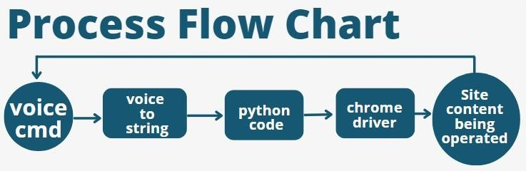
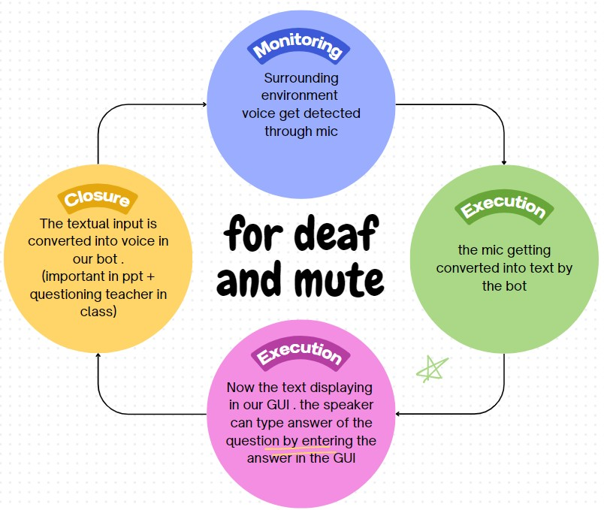
Idea/Approach Details
Blind /Handicap person
Basic idea:- Our website/app will be controlled with smart voice bot. From which a student can access to their specific topics without help of any guardian or without touching the system by just giving voice commands.(each and every buttons and functions can be controlled by the bot.)
Structured voice bot/modifications:-
Biggest flaw of an education website for physically disabled student is that there are various type of disabilities. So, Each type of disability needs a special treatment so they can easily access to their studies.
For this problem our smart bot modifies automatically according to the disability entered by the user so they can get special treatment according to their disability hence it makes their learning easier.
Such as if a person is blind then bot will read out all the buttons, texts, options, location of website so they can know about the enviornment of the website, if a user is deaf then mostly content will be in text and their would be sign language content. Their would a feature in which the bot can convert surroundings speech into text, and so on.
And many more modifications according to the type of disability of the student so they can get access to education in more easier and faster way according to their disability, which was never possible before.
Interactive Learning Activities: The AI assistant can facilitate interactive learning activities. For instance, a student with limited mobility can participate in quizzes, flashcards, or math problems by providing verbal responses, making learning engaging and accessible
Communication and Collaboration: The platform can facilitate communication
and collaboration among students. For instance, a student with a speech
impairment can engage in group discussions and collaborative projects by using voice-to-text and text-to-voice features.
Parent Engagement: Parents of specially-abled students can use the platform to monitor their child's progress, communicate with teachers, and receive updates on their child's educational journey, all through voice commands for accessibility.
Continuous Learning and Skill Development: The AI assistant can recommend additional resources, courses, and skill development opportunities based on a student's interests and career goals, fostering lifelong learning.
Describe your Technology stack here:
Technologies used in front-end :-
HTML, CSS, JS, REACT(for website)
Tkinter (for Bot GUI)
Technology used in back-end: Django, python
Database used: MySQL
Chrome driver

Slide 3
Idea/Approach Details
Describe your Use Cases here
Describe your Dependencies / Show stopper here
Accessibility Standards: Compliance with accessibility standards (e.g., WCAG) is essential.
Regulatory Compliance: Depending on the region or institution, compliance with education and privacy regulations is crucial.
Data Availability: The availability of high- quality educational content and resources is crucial for the success of Platform
4G network access for better experience
Mic quality : but now it is solve by noise cancelation in speaker
Mic and camera permission: which may come under privacy issue
Latest chromedriver according to chrome version so everytime you update chrome you have to redownload the bot for blind / handicap bot but not for the mute / deaf .
For Area where there are not school for physically disable students.
For blind student/Handicap so that can learn and operate website just like a normal people using voice.
For deaf and mute to represent themselve without any boundation look (for flowchart of deaf and mute)
For higher studies as one go on path of learning they are time when they are alone which can be obstacle for the physically disabled but not with our voice bot.
No need for external help or guardian to be at their side to operate the site for blind/handicap they can operate using voice command so our bot can operate the work.
24/7 availability so that they can learn anytime just like a normal person browse a site.
Upto some level we are able to automate Youtube, whatsapp and gmail for handicap .

Slide 4
Team Member Details
Team Leader Name: Vasu Kumar Nagar
Branch : Btech Team Member 1 Name: Ankit Maurya | Stream : CSE | Year: III
Branch : Btech | Stream : CSE | Year: III
Team Member 2 Name: Shrish Gupta Branch : Btech | Stream : CSE | Year: III
Team Member 3 Name: Ayush Rawat Branch : Btech | Stream : CSE | Year: III
Team Member 4 Name: Shaurya Seth
Branch : Btech Team Member 5 Name: Sonali Maddheshiya | Stream : CSE | Year:III
Branch : Btech Team Mentor 1 Name: Manoj Singh | Stream : CSE | Year: III
Category: Academic | Expertise : Machine Learning and Data Science | Domain Experience: 4 Years

