Slide 1

CRYPTO TRACKER
Team : Velle College : IMSEC Members : Shrish Gupta Ankit Maurya Parth Sarthi

Slide 2
What is Crypto ?
Cryptocurrency is decentralized digital money that’s based on blockchain technology
Anonymity
No intermediary or supervisory bodies
Security ( due to blockchain )
No centralization
Sending cryptocurrencies
Irreversible transactions
Fast development
Why Crypto ?

Slide 3
Our Aim
To make a Website which has a user-friendly interface
User can find Detailed Info and previous performance about any currency on the go
User can also buy and sell from our website

Slide 4
Features of our Website
Realtime Data
Support 200+ Crypto-currencies info
Shows ups and downs of crypto prices
Graphical representation for better understanding
Dedicated page for public interactions
Experts comment on specific crypto-currencies

Slide 5
What makes us unique ? ( USP )
Dedicated page for public interactions
Here different people can discuss about emerging crypto-currencies and also ups and downs of trending currencies
Experts comment on specific crypto-currencies
Here our experts will evaluate the crypto-currency on their criteria like :
Popularity
Performance
Past ups and downs

Slide 6
METHODOLOGY
HTML is added to give a skeleton to the web structure
CSS is used to design a pleasant looking layout for the web structure
JavaScript is added to keep things in motion and to keep the design dynamic
CoinGecko API is used to get required real-time data of cryptocurrencies

Slide 7
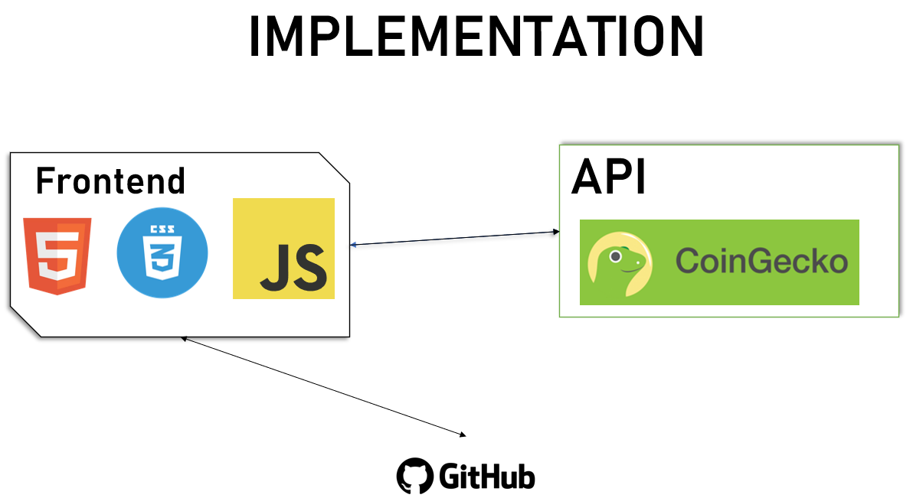

Slide 8
THANK YOU
While ( Alive ) {
// Eat
// Sleep
// Code
// Repeat
}

