Slide 1


Slide 2
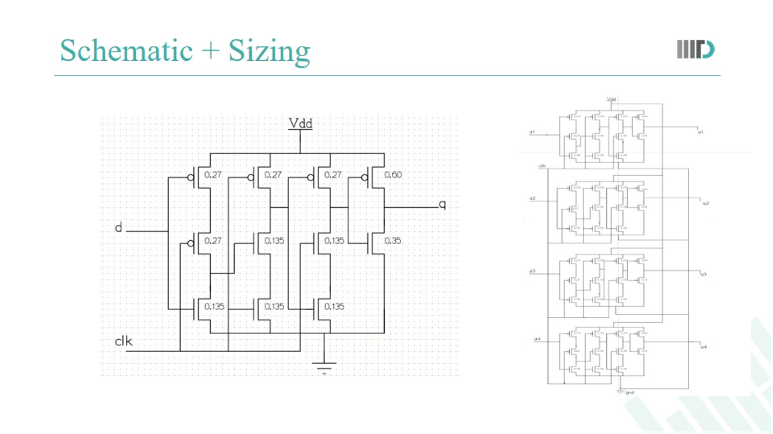
Schematic + Sizing

Slide 3
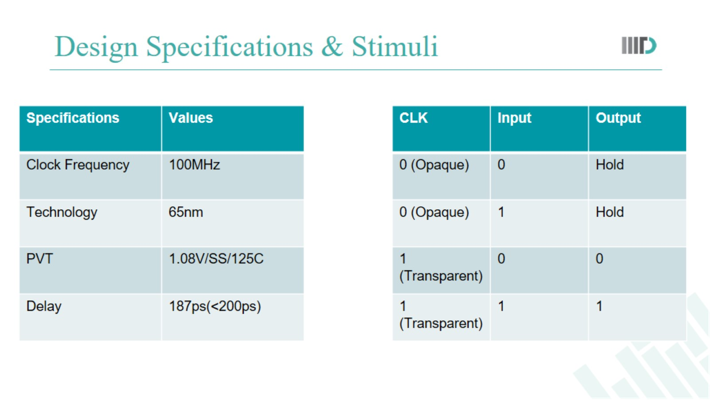
Design Specifications & Stimuli

Slide 4
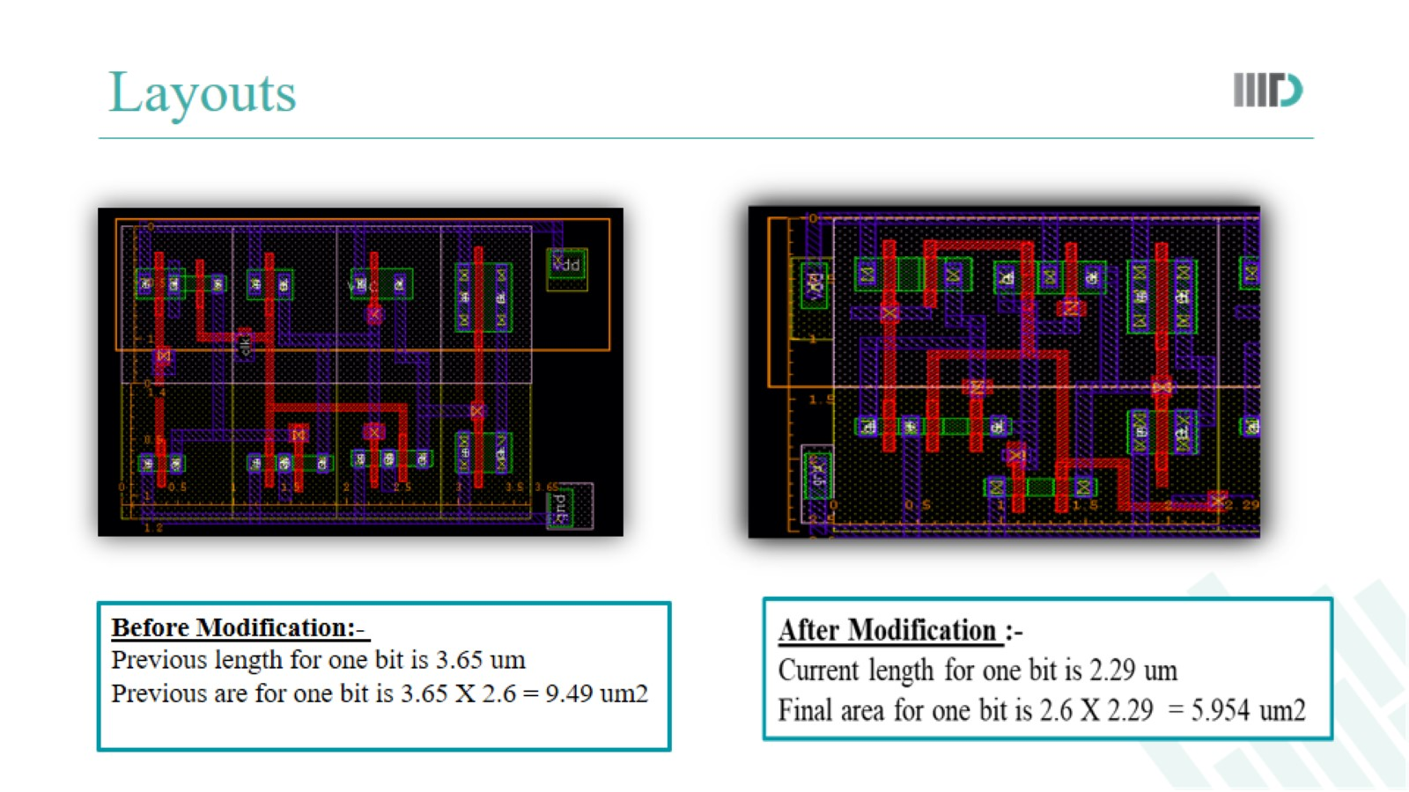
Layouts

Slide 5
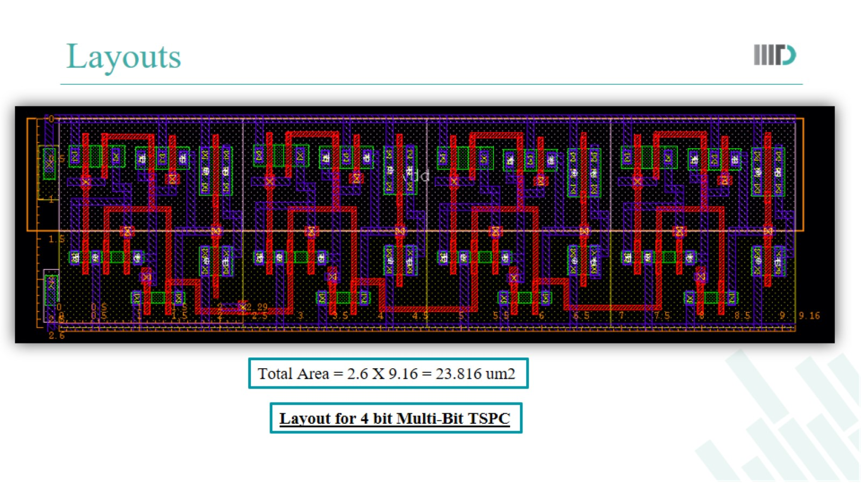
Layouts

Slide 6
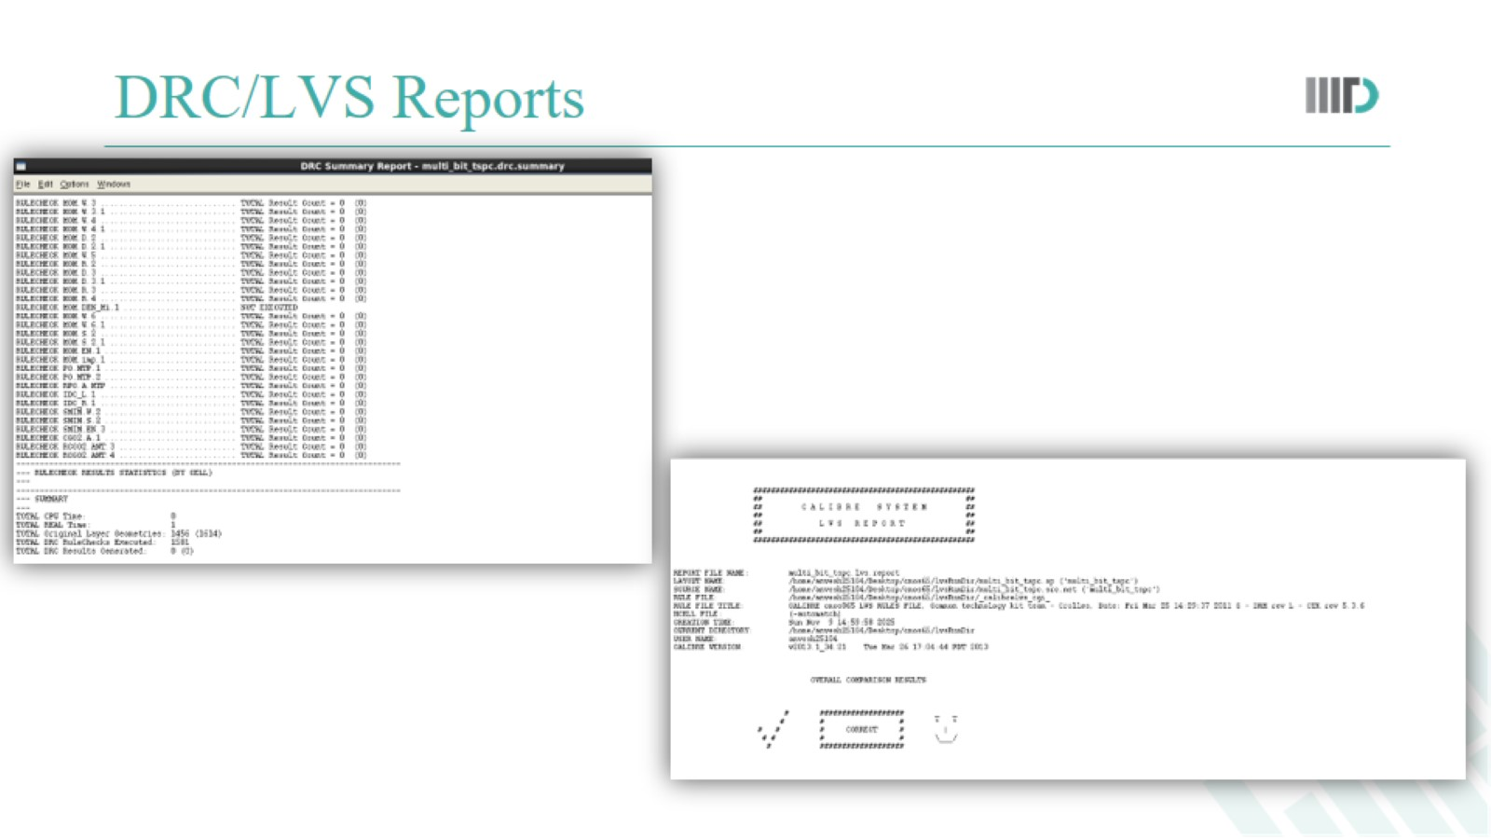
DRC/LVS Reports

Slide 7
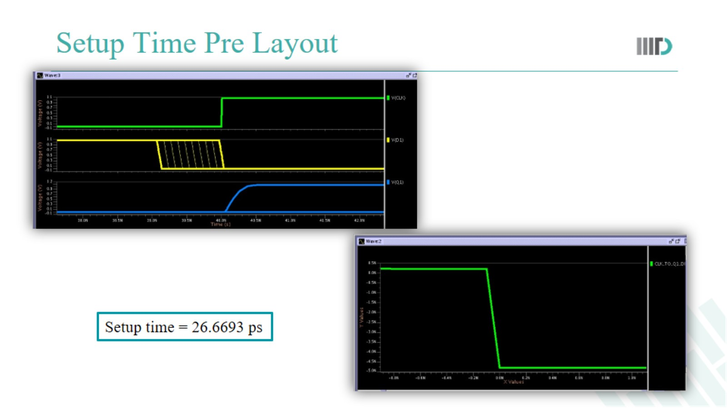
Setup Time Pre Layout

Slide 8
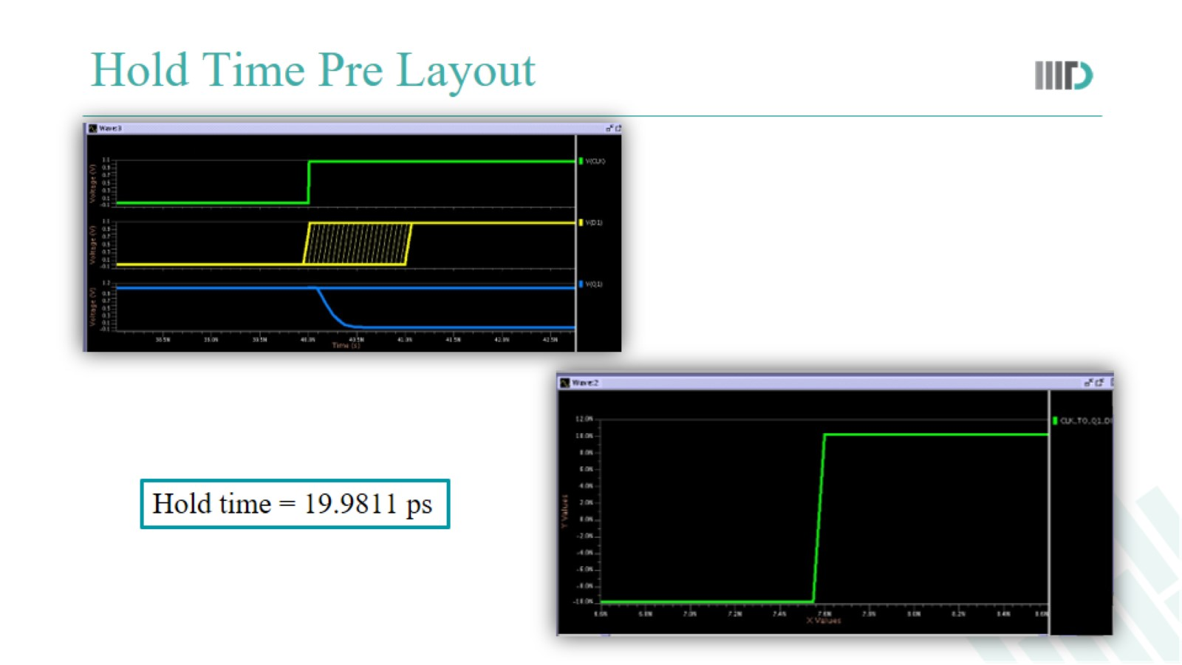
Hold Time Pre Layout

Slide 9
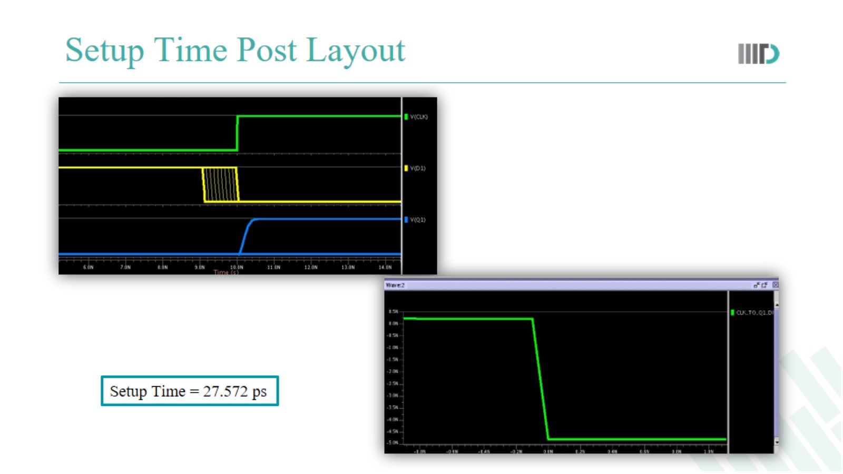
Setup Time Post Layout

Slide 10
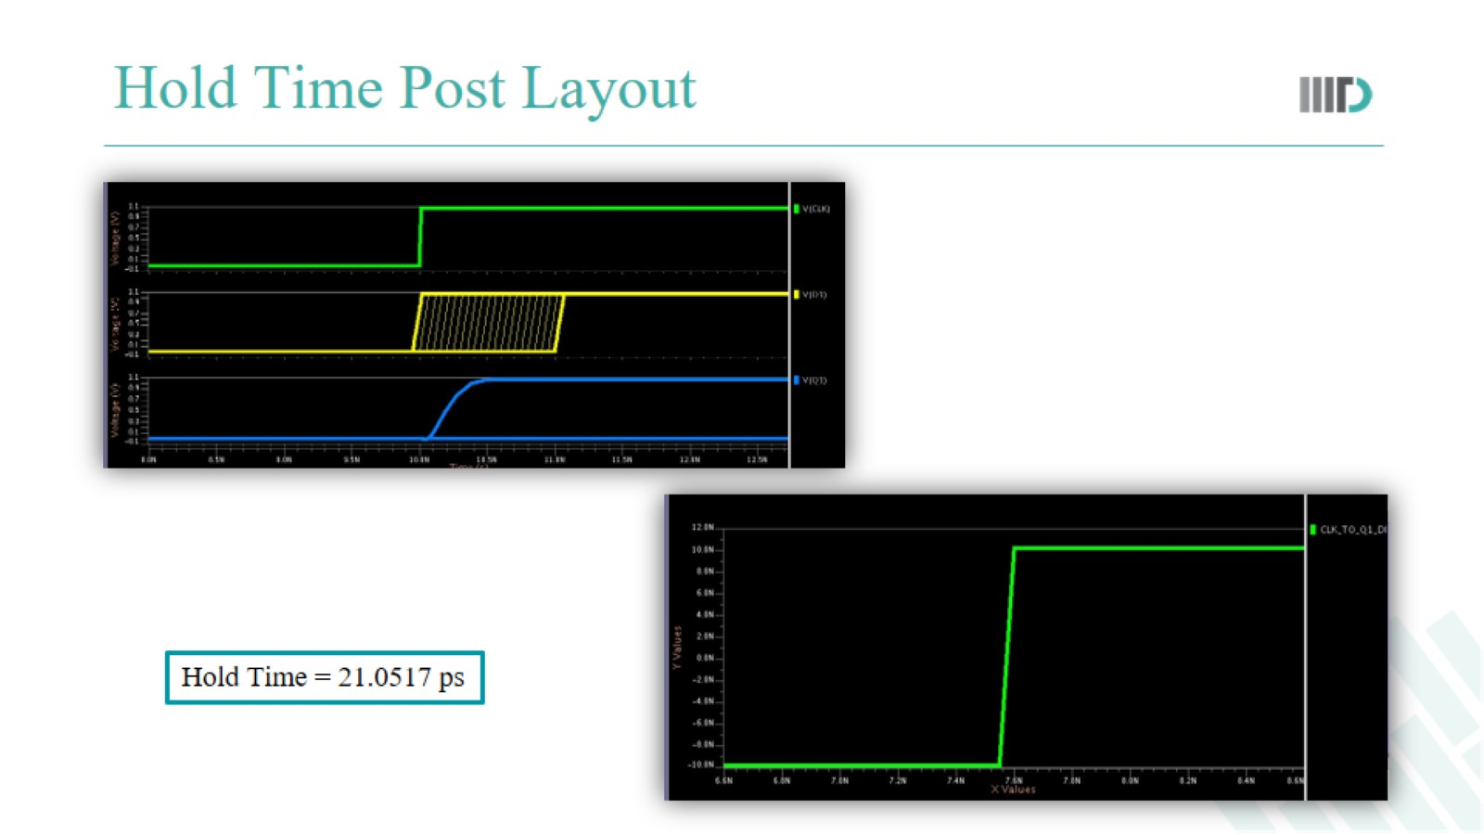
Hold Time Post Layout

Slide 11
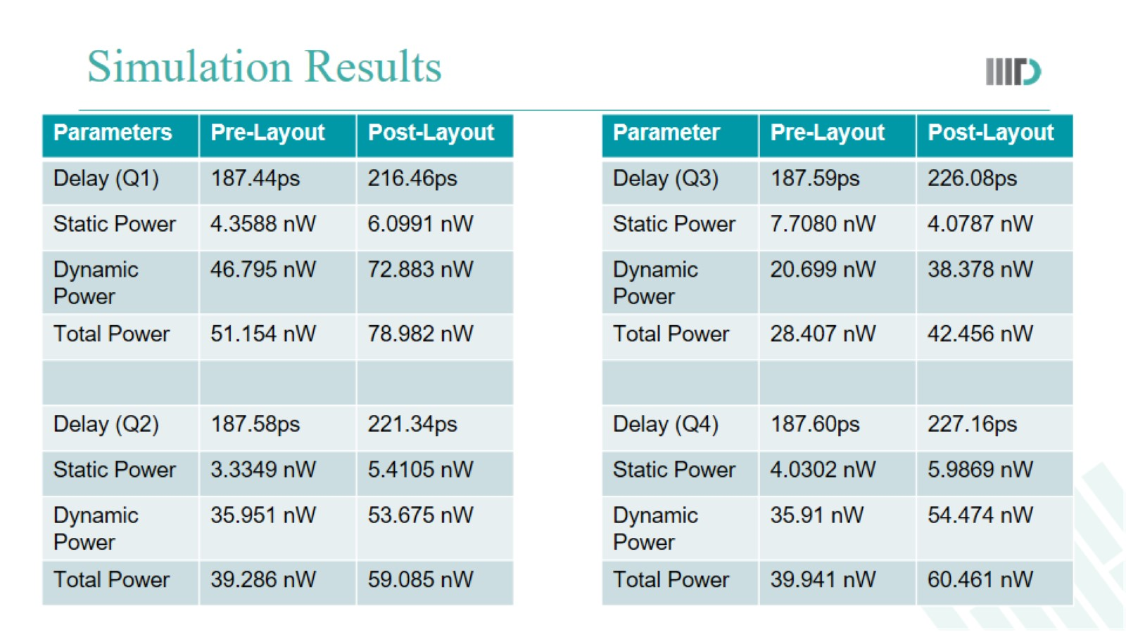
Simulation Results

Slide 12
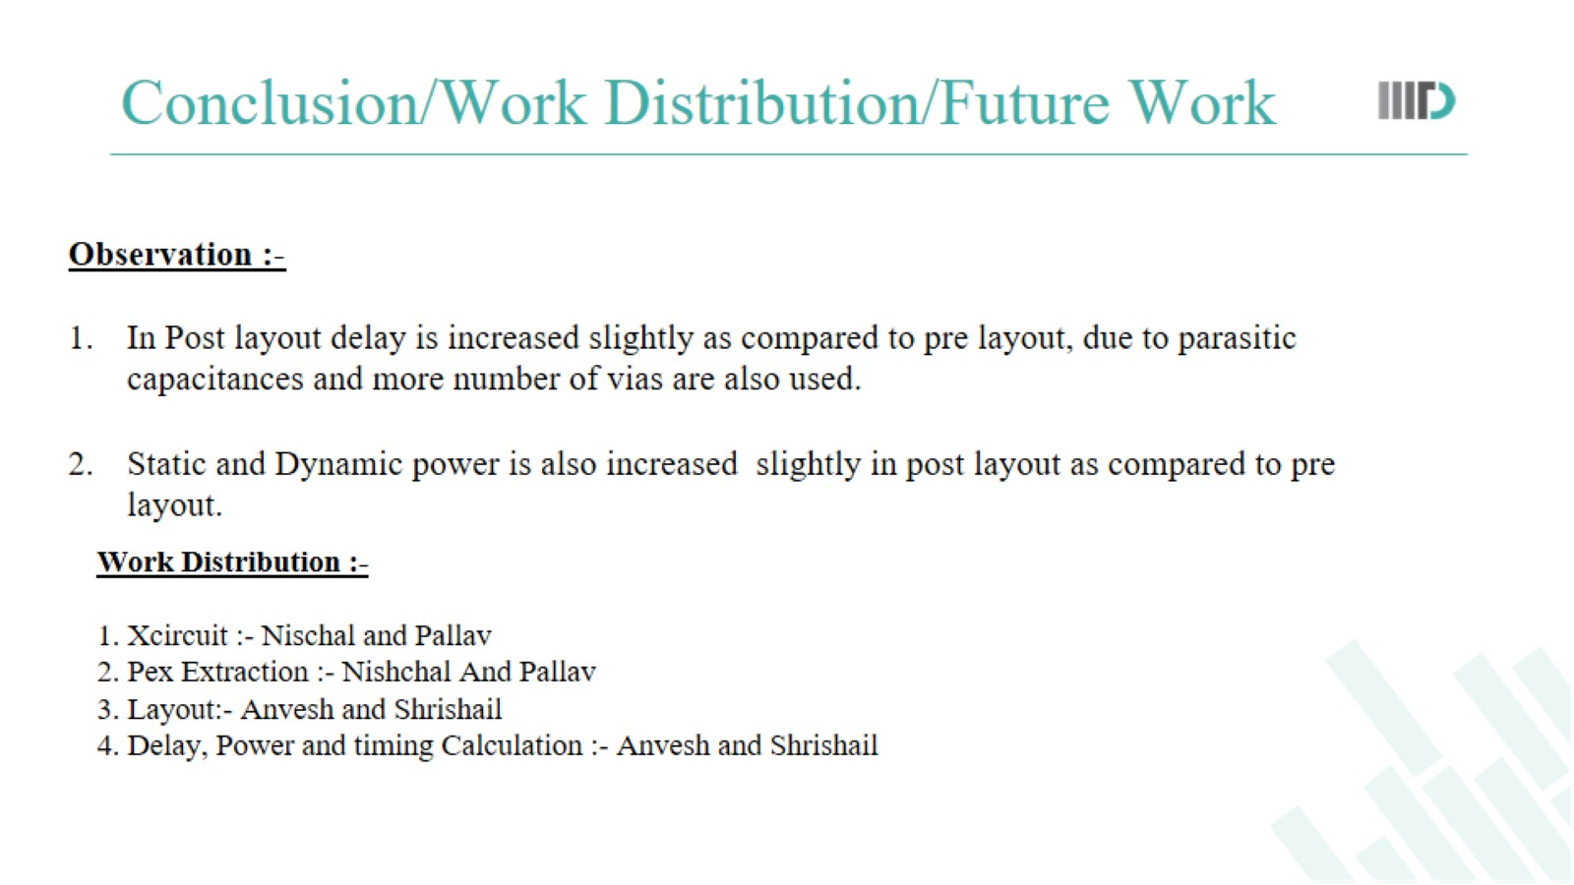
Conclusion/Work Distribution/Future Work

