Slide 1
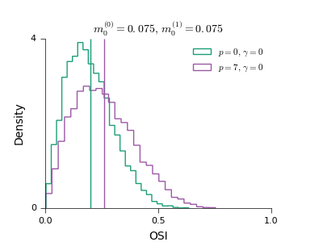
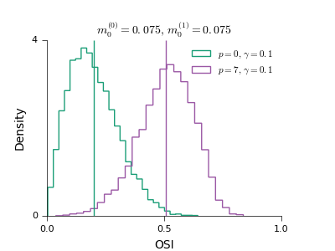
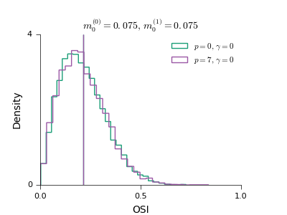
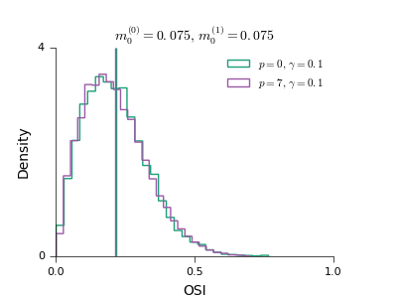
Functional specificity in EE
Functional specificity in EE, EI and IE (all equal to p)

Slide 2
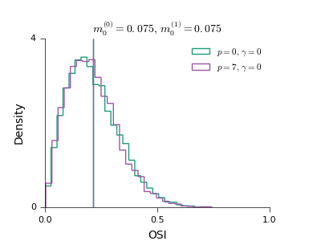
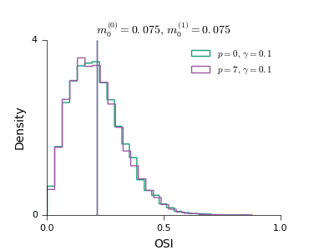
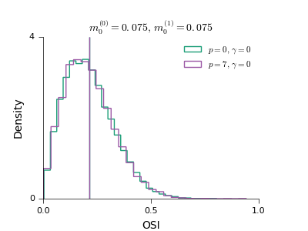
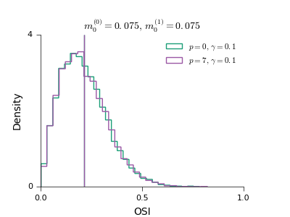
Functional specificity in EE, EI and IE (p_EE = p_IE = p and p_EI = 2p)
Functional specificity in EE, EI and IE (p_EE = p_IE = p and p_IE = 2p)

Slide 3
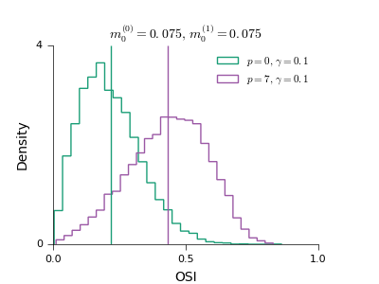
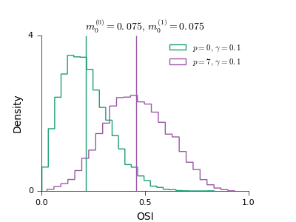
Functional specificity in EE and EI
Functional specificity in EE and IE

