Slide 1
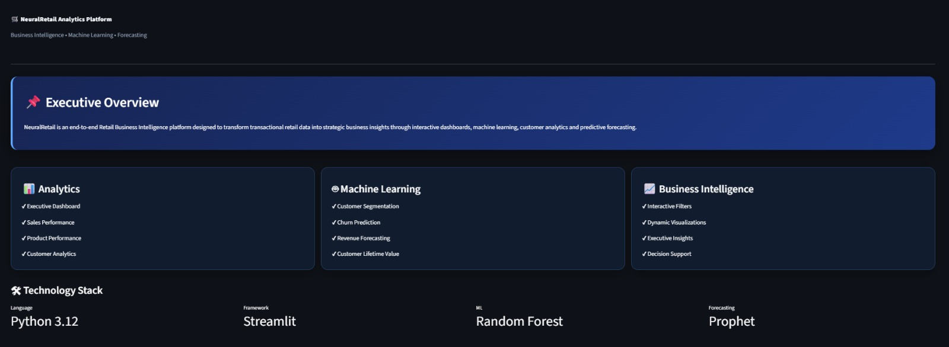
DATA SCIENCE & ANALYTICS INTERNSHIP
NeuralRetail
Analytics Platform
End-to-end retail analytics using Machine Learning & Business Intelligence — transforming raw transactions into predictive, actionable insight.
SS
Shraddha Shri
Data Science & Analytics Intern
Python
Streamlit
Pandas
Plotly
Scikit-Learn
Prophet
GitHub
Notes:
Good morning everyone. My project is NeuralRetail Analytics Platform. It is an end-to-end business intelligence solution developed using Python and Machine Learning. The project transforms raw retail transaction data into interactive dashboards and predictive insights such as customer segmentation, churn prediction and revenue forecasting.

Slide 2
THE CHALLENGE
Problem Statement
Retail businesses generate thousands of transactions every single day — yet most of that data goes unused.
1
Monitoring performance
2
Purchasing behaviour
3
Valuable customers
Hard to track performance manually across products & regions
Understanding how and why customers buy what they buy
No systematic way to identify high-value, loyal customers
4
Churn risk
5
Revenue forecasting
6
Decision speed
Predicting which customers are about to stop purchasing
Forecasting future revenue for planning & budgeting
Slow, manual reporting delays data-driven decisions
★
Project Goal
Develop an intelligent analytics platform that converts retail transaction data into actionable business insights.
NEURALRETAIL ANALYTICS PLATFORM
02
Notes:
Retail companies collect a huge amount of transactional data every day. Without analytics, this data cannot provide meaningful insights. The objective of this project is to automate analysis and help businesses make data-driven decisions.

Slide 3
WHAT WE SET OUT TO DO
Project Objectives
✓
Clean and preprocess retail transaction data
Dataset
↓
✓
Perform Exploratory Data Analysis (EDA)
Data Cleaning
Identify customer purchasing patterns
↓
✓
EDA
✓
Segment customers using RFM Analysis
↓
Feature Engineering
✓
Predict customer churn using Machine Learning
↓
Machine Learning
✓
Forecast future revenue
↓
Dashboard
✓
Build interactive dashboards using Streamlit
↓
Business Insights
Each objective maps directly to a dashboard or model shown later in this deck.
NEURALRETAIL ANALYTICS PLATFORM
03
Notes:
The project starts with data cleaning and preprocessing. After understanding the data through EDA, features are engineered for machine learning models. Finally, the processed data is visualized through interactive Streamlit dashboards.

Slide 4
THE RAW MATERIAL
Dataset Description
DATASET
Feature engineering transformed raw transaction fields into business-ready analytical signals used across every model in this platform.
Online Retail II Dataset
Dataset Features
Engineered Features
Invoice Number
Customer ID
Product Description
Quantity
Unit Price
Country
Invoice Date
Revenue
Month & Quarter
Customer Lifetime Value (CLV)
Customer Segments
Churn Status
Inventory Risk
1M+
4,300+
43
2 Yrs
Transactions
Unique Customers
Countries Covered
Historical Coverage
NEURALRETAIL ANALYTICS PLATFORM
04
Notes:
The project uses the Online Retail II dataset which contains transaction-level information. During preprocessing, additional business features such as Revenue, Customer Lifetime Value and Churn Status were generated to improve analytical capabilities.

Slide 5






BUILT WITH
Technology Stack
Programming Language
Core language powering the entire pipeline
Data Analysis
Data manipulation, cleaning & analysis
Python
Pandas · NumPy
Data Visualization
Interactive, drill-down visualizations
Machine Learning
Segmentation & churn prediction models
Plotly
Scikit-Learn
Forecasting
Time-series revenue forecasting
Dashboard
Interactive web application layer
Prophet
Streamlit
Version Control
Source control and collaboration
Deployment
Hosting and public access
Git & GitHub
Streamlit Cloud
Core Toolset
Python
Pandas
Plotly
Scikit-Learn
Streamlit
GitHub
NEURALRETAIL ANALYTICS PLATFORM
05
Notes:
I selected Python because of its extensive data science ecosystem. Pandas and NumPy were used for preprocessing, Plotly for interactive charts, Scikit-Learn for machine learning models, Prophet for revenue forecasting, and Streamlit for building the web application.

Slide 6
HOW IT ALL CONNECTS
Project Architecture
Online Retail Dataset
→
Data Cleaning
→
Exploratory Data Analysis
→
Feature Engineering
↓
Machine Learning
↓
RFM Segmentation
Churn Prediction
Revenue Forecasting
↓
Dashboard Dataset
↓
Streamlit Analytics Platform
● Clean analytical dataset
● Predictive insights
● Interactive business dashboards
NEURALRETAIL ANALYTICS PLATFORM
06
Notes:
This slide summarizes the complete project pipeline. Starting from raw retail data, I cleaned and transformed the dataset, applied machine learning models, generated business insights, and finally deployed everything into a Streamlit dashboard.

Slide 7
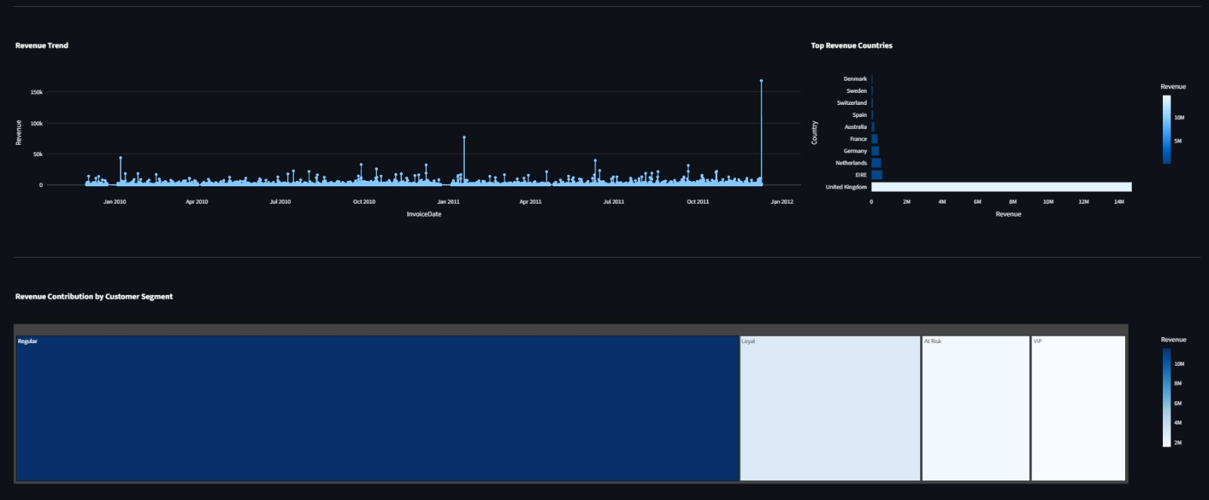
DASHBOARD 01
Executive Dashboard
Dashboard Features
Total Revenue
Total Orders
Total Customers
Average Order Value
Revenue Trend
Country-wise Performance
Business Value
Key Insight
Quick overview of business performance
Helps management monitor KPIs from a single dashboard
Enables faster data-driven decision-making
Highlights revenue trends and customer metrics, letting executives read overall performance at a glance.
NEURALRETAIL ANALYTICS PLATFORM
07
Notes:
This is the Executive Dashboard, designed for top-level management. It consolidates key performance indicators such as revenue, orders, customers, and average order value. Instead of reviewing multiple reports, executives can monitor the overall business from a single screen.

Slide 8
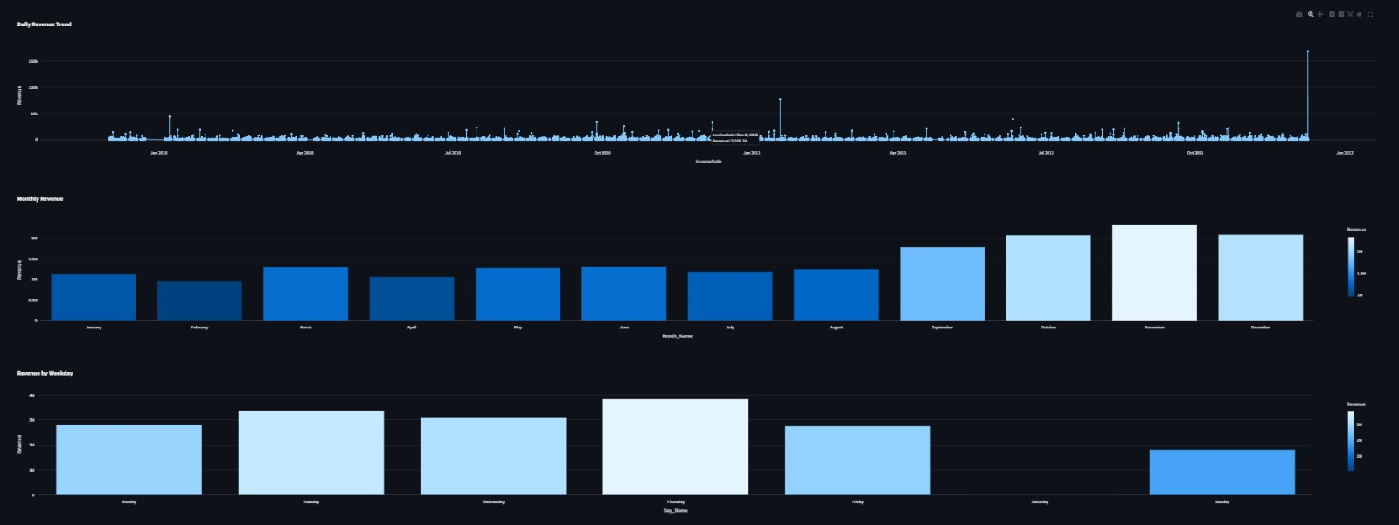
DASHBOARD 02
Sales & Product Dashboard
Dashboard Features
Monthly Sales Trend
Revenue Distribution
Best Selling Products
Seasonal Sales Analysis
Interactive Filters
Business Value
Key Insight
Identifies high-performing products
Tracks monthly revenue patterns
Supports inventory planning
Helps optimize sales strategies
Sales fluctuate seasonally — businesses should prepare inventory based on expected demand.
NEURALRETAIL ANALYTICS PLATFORM
08
Notes:
This dashboard focuses on sales analysis. It allows businesses to understand monthly revenue trends, identify top-performing products, and analyze seasonal demand. These insights support better inventory planning and sales optimization.

Slide 9
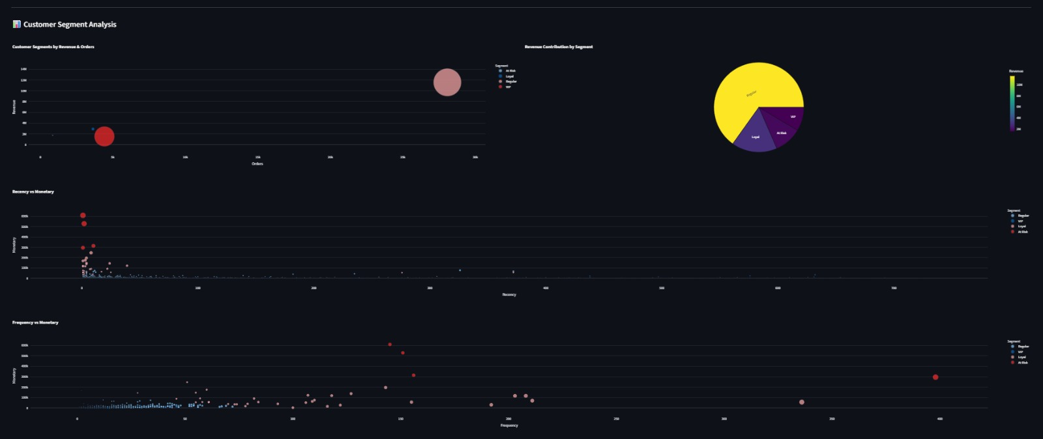
DASHBOARD 03
Customer Segmentation (RFM Analysis)
What Is RFM Analysis?
A customer segmentation technique based on purchasing behaviour.
R
Recency
How recently a customer purchased
F
Frequency
How often a customer purchases
M
Monetary
How much money a customer spends
NEURALRETAIL ANALYTICS PLATFORM
09
Notes:
Customer segmentation was performed using RFM Analysis. Customers were grouped based on how recently they purchased, how frequently they purchase, and how much they spend. This helps businesses target different customer groups with personalized marketing strategies.

Slide 10
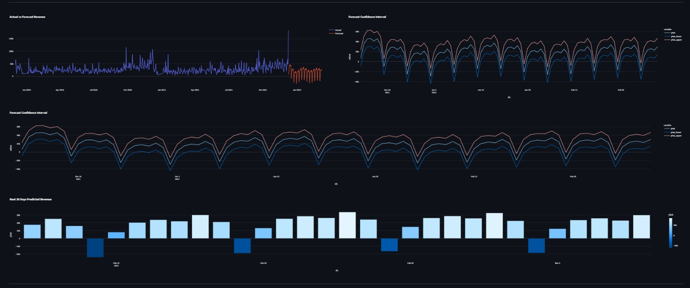
DASHBOARD 04
Revenue Forecasting
MODEL USED
Facebook Prophet
Time-series forecasting model developed by Meta
1
Historical Revenue
↓
2
Trend Detection
↓
3
Seasonality Analysis
↓
4
Future Revenue Prediction
Key Insight
● Inventory planning
The forecast identifies expected future sales trends, enabling proactive business planning across inventory, budget, and demand.
● Financial planning
● Demand forecasting
● Budget estimation
NEURALRETAIL ANALYTICS PLATFORM
10
Notes:
Revenue forecasting was implemented using Facebook Prophet. The model captures historical trends and seasonal patterns to predict future revenue. These forecasts help businesses plan inventory, budgeting, and future sales strategies.

Slide 11
UNDER THE HOOD
Machine Learning Models
1
2
3
Customer Segmentation
Customer Churn Prediction
Revenue Forecasting
RFM Analysis
Random Forest
Facebook Prophet
Identifies valuable customer groups by recency, frequency & monetary value.
Predicts customers likely to stop purchasing before they leave.
Forecasts future business revenue using time-series analysis.
Business Value
Together, these three models transform historical retail data into actionable business insight — supporting better customer retention, sharper marketing, and stronger strategic planning.
NEURALRETAIL ANALYTICS PLATFORM
11
Notes:
Three machine learning techniques were used. RFM Analysis segmented customers based on purchasing behavior. Random Forest predicted customer churn, and Prophet forecasted future revenue. Together, these models transform historical data into actionable business insights.

Slide 12
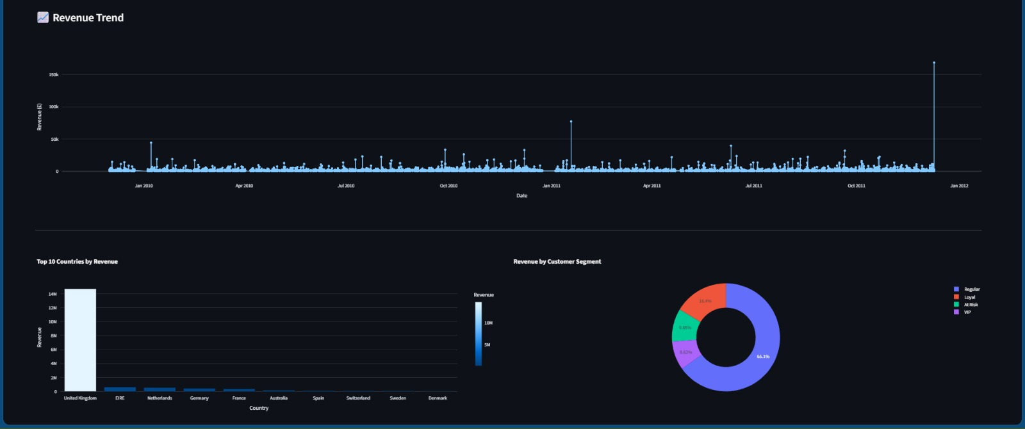
WHAT THE DATA TELLS US
Key Business Insights
Major Findings
UK generated the highest revenue by a wide margin
VIP customers contribute the highest revenue per customer
Sales show clear seasonal trends
Segmentation surfaces high-value customers
Churn prediction enables proactive retention
Forecasting supports future planning
Business Impact
Better customer targeting
Improved inventory mgmt.
Faster decision-making
Data-driven marketing
Increased efficiency
NEURALRETAIL ANALYTICS PLATFORM
12
Notes:
This project converts raw retail data into meaningful business insights. Management can identify top-performing markets, valuable customers, future revenue trends, and churn risks, allowing them to make informed decisions.

Slide 13
ROADBLOCKS & FIXES
Challenges Faced During the Project
1
Data Cleaning
2
Machine Learning
3
Deployment
Missing Customer IDs
Duplicate records
Cancelled invoices
Negative quantities
Data type inconsistencies
Selecting appropriate models
Feature engineering
Handling imbalanced data
Model evaluation
GitHub repository management
Large dataset handling
Streamlit Cloud deployment
Windows → Cloud file paths
How We Solved It
✓ Cleaned & validated the dataset
✓ Created engineered features
✓ Optimized dataset size for deployment
✓ Used GitHub + Streamlit Cloud for hosting
NEURALRETAIL ANALYTICS PLATFORM
13
Notes:
Throughout the project, I encountered several technical challenges, especially during data preprocessing and deployment. Missing values, cancelled invoices, and deployment issues required careful handling. These challenges improved my debugging and problem-solving skills.

Slide 14
WHAT'S NEXT
Future Scope
1
2
3
4
Cloud Database Integration (SQL)
Power BI Integration
AI-Based Product Recommendations
Advanced Demand Forecasting
5
6
7
8
User Authentication
Mobile Responsive Dashboard
Real-Time Data Streaming
Automated Business Reports
Short-Term
Mid-Term
Long-Term
Auth · Mobile UI
Power BI · SQL Cloud
AI Recommendations · Real-Time
Business Impact
Real-time analytics · Better scalability · Personalized recommendations · Improved decision-making
NEURALRETAIL ANALYTICS PLATFORM
14
Notes:
This project can be extended by integrating cloud databases, Power BI, and recommendation systems. These enhancements would make the platform more scalable and suitable for real-world business environments.

Slide 15
WRAPPING UP
Conclusion
Project Summary
Learning Outcomes
✓
Developed an end-to-end Retail Analytics Platform
Data Cleaning
Feature Engineering
✓
Performed data preprocessing & feature engineering
Machine Learning
Business Intelligence
✓
Implemented Customer Segmentation using RFM
Predicted Customer Churn
Dashboard Development
Cloud Deployment
✓
✓
Forecasted Revenue using Prophet
Project at a Glance
✓
Built 12 interactive Streamlit dashboards
16
Slides Delivered
6
Live Dashboards
✓
Deployed the application successfully
3
ML Models
7/7
Objectives Met
Final Outcome
The project successfully transformed raw retail transaction data into meaningful business insights, enabling better strategic and operational decision-making.
NEURALRETAIL ANALYTICS PLATFORM
15
Notes:
This project combines data engineering, machine learning, and business intelligence into a single platform. It demonstrates how analytical techniques can help organizations improve customer understanding, predict future trends, and support informed business decisions.

Slide 16
THANK YOU
NeuralRetail Analytics Platform · Shraddha Shri
Python
Streamlit
Pandas
Plotly
Scikit-Learn
Prophet
GitHub
neuralretail-analytics-platform.streamlit.app
NEURALRETAIL ANALYTICS PLATFORM
16
Notes:
Thank the audience, invite questions, and offer to walk through the live Streamlit dashboard or GitHub repository if time allows.

