Slide 1
Twitter Bootstrap
Designed for everyone, everywhere
Richa/Uday

Slide 2
Agenda
What is Twitter Bootstrap
Advantages and Disadvantages
Grid System
Responsive Utility Classes
Bootstrap Typography
Bootstrap Components

Slide 3
What is Twitter Bootstrap?
Originally named Twitter Blueprint
Developed by Mark Otto and Jacob Thornton
A framework to encourage consistency across internal tools
Faster and easier web development
Notes:
It includes HTML and CSS based design templates for common user interface components like Typography, Forms, Buttons, Tables, Navigations, Dropdowns, Alerts, Modals, Tabs, Accordion, Carousel and many other as well as optional JavaScript extensions

Slide 4
Advantages
Increases productivity
Responsive features
Consistent design
Easy to use
Browser compatiblity
Free & Open source
One framework, every device
Notes:
Productivity— Saves lots of time and efforts using the Bootstrap predefined design templates and classes and concentrate on other development work.
==========
Responsive features— Using Bootstrap you can easily create responsive designs. Bootstrap responsive features make your web pages to appear more appropriately on different devices and screen resolutions without any change in markup.
==========
Consistent design— All Bootstrap components share the same design templates and styles through a central library, so that the designs and layouts of your web pages are consistent throughout your development.
==========
Easy to use— Anybody with the basic working knowledge of HTML and CSS can start development with Bootstrap.
==========
Compatible with browsers — Bootstrap is created with modern browsers in mind
==========
CSS3 HTML5

Slide 5
Disadvantages
Similar design
Backward compatiblity
Heavy
Notes:
CSS weighing in at 126KB and 29KB of JavaScript

Slide 6
Bootstrap CDN
<!-- Latest compiled and minified CSS -->
<link rel="stylesheet" href="https://maxcdn.bootstrapcdn.com/bootstrap/3.3.5/css/bootstrap.min.css">
<!-- Optional theme -->
<link rel="stylesheet" href="https://maxcdn.bootstrapcdn.com/bootstrap/3.3.5/css/bootstrap-theme.min.css">
<!-- Latest compiled and minified JavaScript -->
<script src="https://maxcdn.bootstrapcdn.com/bootstrap/3.3.5/js/bootstrap.min.js"></script>

Slide 7
Download Bootstrap to local directory.
Download bootstrap from http://getbootstrap.com

Slide 8
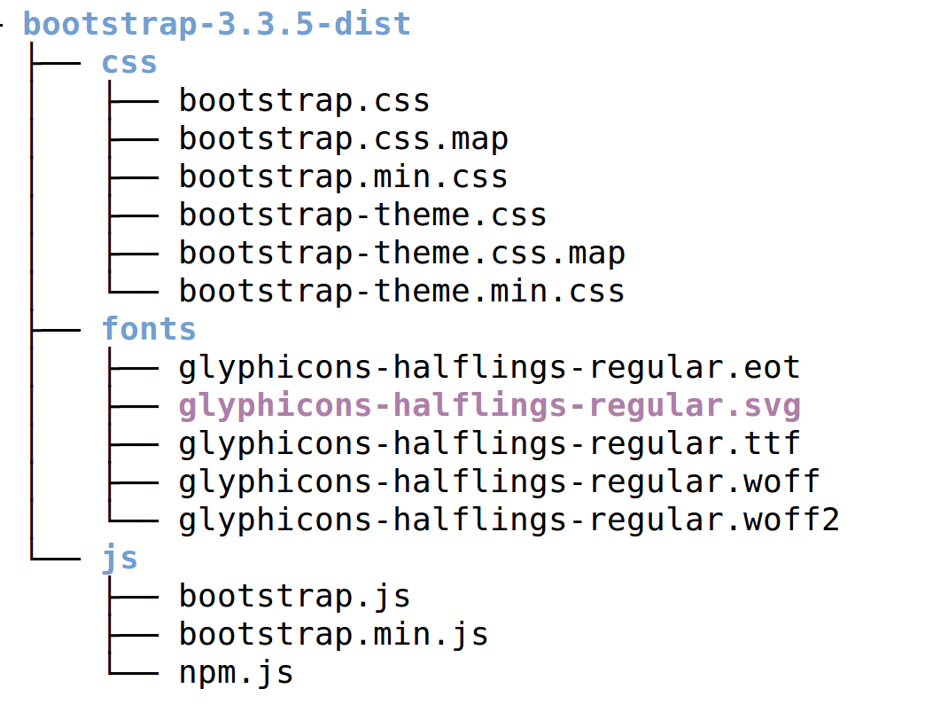
Directory Structure

Slide 9
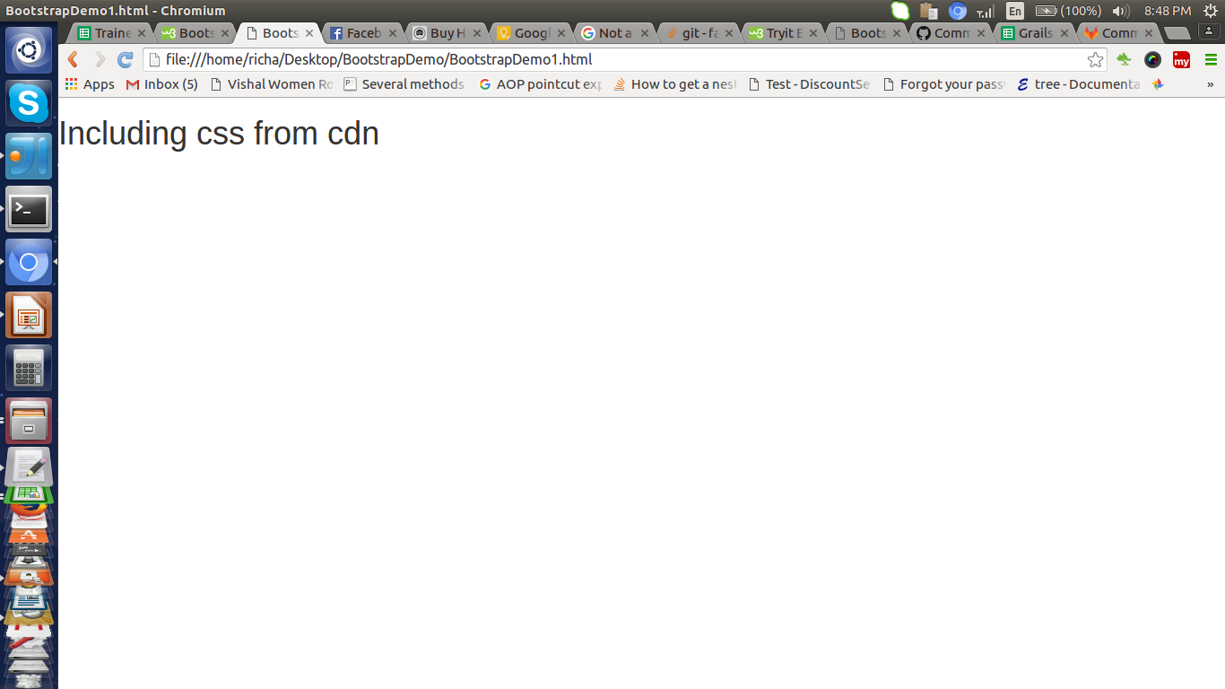

Demo
Github Url:
https://github.com/RichaIntelligrape/BootstrapNew/commits/basicDemo
Reference: http://getbootstrap.com/css/#overview

Slide 10

Bootstrap Grid System
Fastest and easy way to create a layout
Scales up to 12 columns
Classes
  .container / .container-fluid
  .row
  .col-xs-*, .col-sm-*, .col-md-*, .col-lg-*
Notes:
scales up to 12 columns as the device or viewport size increases
==========
.container for fixed width: 750 on small, 970 on medium, 1170 on large
.container-fluid-100% of viewport
==========
.clearfix to adjust column heights in conjuction with visible-*-*

Slide 11
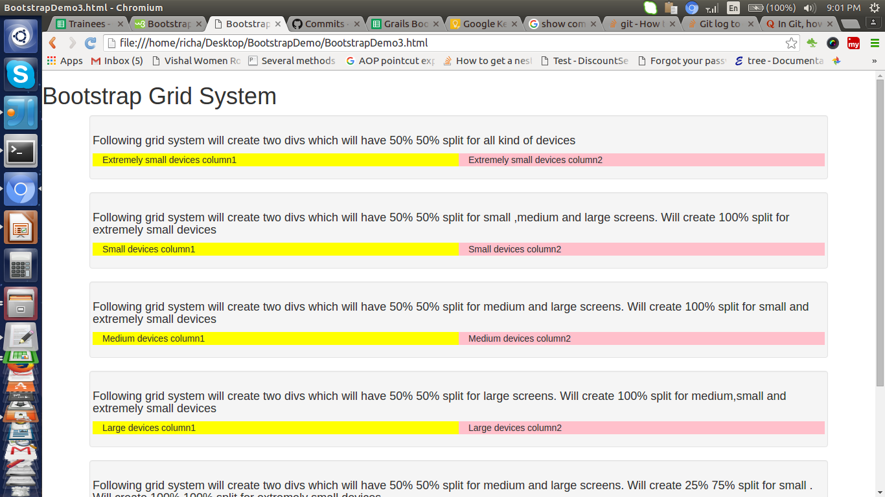
Demo
Github Url:
https://github.com/RichaIntelligrape/BootstrapNew/commits/gridSystem
Reference: http://getbootstrap.com/css/#grid

Slide 12
Bootstrap Responsive Utility Classes
For visiblity: .visible-*
To hide something: .hidden-*
Only visible during printing: .visible-print
Hidden during printing: .hidden-print
Eg: <p class="visible-md">Only for medium devices.</p>
Notes:
.visible-xs-inline
Xs/sm/md/lg
Inline/block/inline-block
==========
.visible-print-block- Hide block elements for browser rendering while visible for print.
.visible-print-inline
.visible-print-inline-block
.hidden-print- Hide elements for printing while visible on browser.
==========

Slide 13
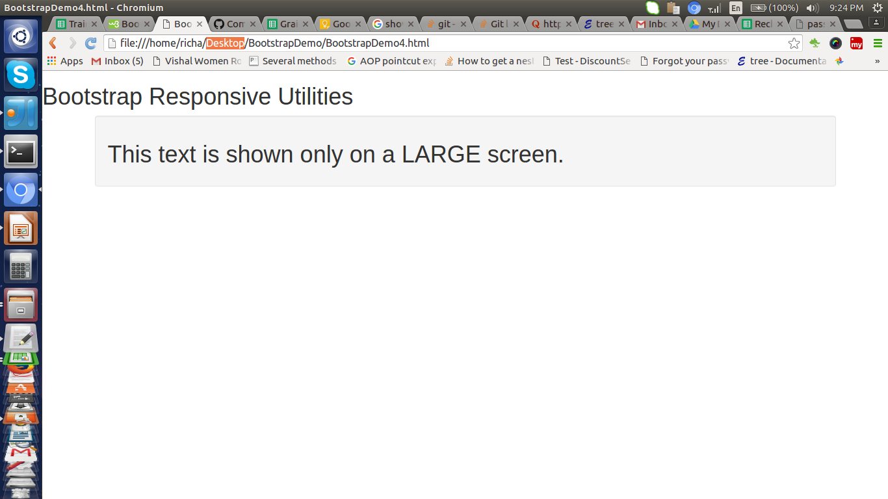
Demo
Github Url:
https://github.com/RichaIntelligrape/BootstrapNew/commits/responsive-utility-class
Reference: http://getbootstrap.com/css/#responsive-utilities

Slide 14
Exercise
Create paragraphs visible only on extra small, small, medium, large devices only.
Create paragraph visible only on browser
Create paragraph visible during printing only

Slide 15
Bootstrap Typography
Headings
Headers- .page-header
Paragraph
Text Formatting- strong/small/code/ins/del/sub/sup
Text Transformation- .text-lowercase/capitalize
Text Emphasis- .text-muted/primary/success/danger
Notes:
Heading elms from h1-h6 and .h1-.h6 classes for other elms
==========
Header: .page-header
==========
default font-size 14px, line-height of 1.428.
Applies to the <body> and all paragraphs.
A bottom margin of half their line-height (10px by default) is applied to the all paragraphs (<p>).
Stand out paragraph with .lead class
==========
Text Formatting- strong, i, small, b, big, code, mark, ins for inserted, del for deleted, sub and sup for subscript and superscript.
==========
TextTransform.: text-lowercase/uppercase/capitalize
==========
Text Emphasis: text-muted/primary/success/info/warning/danger
Color change
==========
Text-left/right/center/justify/nowrap

Slide 16
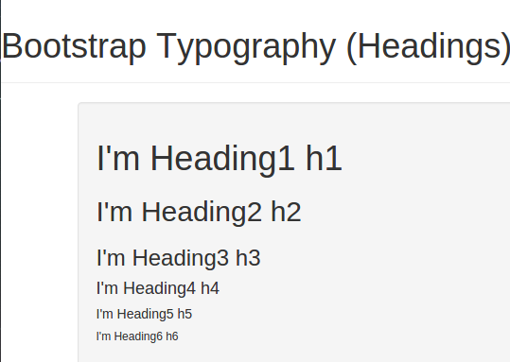
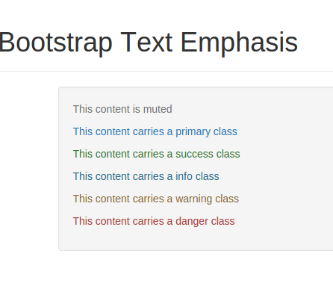
Demo
Github Url:
https://github.com/RichaIntelligrape/BootstrapNew/commits/bootstrap-typography
Reference: http://getbootstrap.com/css/#type

Slide 17
Bootstrap Labels & Badges
Inline Labels-
        to show important notes or warning.
Inline Badge-
        to show notification(eg: number of unread messages)
Create a <span>
Apply base class .label and label emphasis classes
Or apply .badge for creating a badge

Slide 18
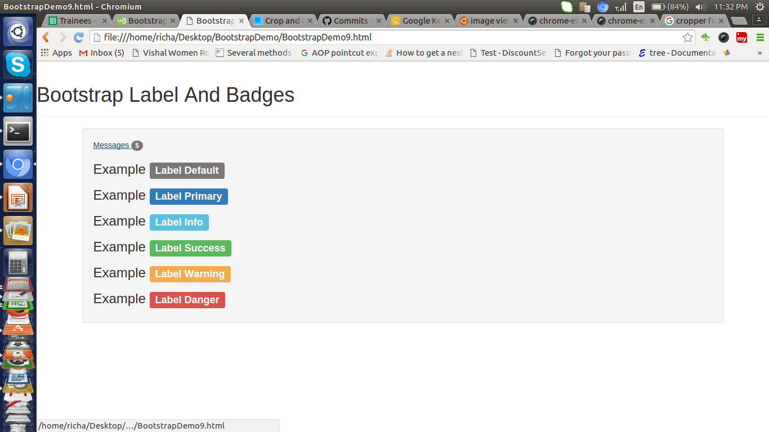
Demo
Github Url:
https://github.com/RichaIntelligrape/BootstrapNew/commits/bootstrap-labels-badges
Reference:http://getbootstrap.com/components/#labels
http://getbootstrap.com/components/#badges

Slide 19
Bootstrap Tables
Base class- .table
Alternate background- .table-striped
Border- .table-bordered
Hover- .table-hover
Condensed/Compact- .table-condensed
Emphasis Classes- .active/.warning/.info/.success..
Responsive table-
    wrap <table> inside a <div>
    apply .table-responsive

Slide 20
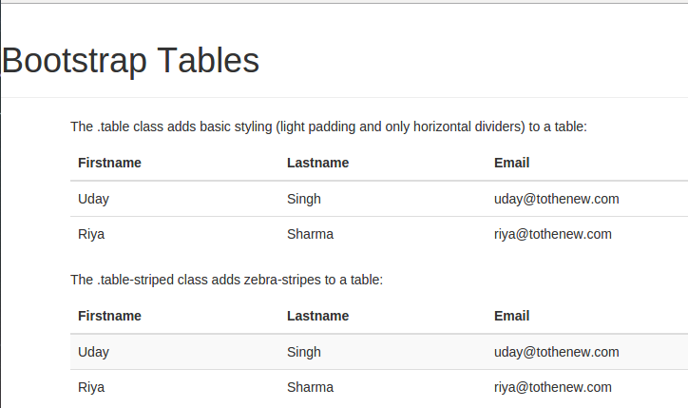
Demo
Github Url:
https://github.com/RichaIntelligrape/BootstrapNew/commits/bootstrap-tables
Reference: http://getbootstrap.com/css/#tables

Slide 21
Bootstrap Lists
Types:
    Unordered list
    Ordered list
    Definition list
List Groups- simply an unordered list with list items and proper classes
    <ul> with .list-group
    <li> with .list-group-item
    To create heading in list items- .list-group-item-heading
    Text to render under heading- .list-group-item-text

Slide 22
Bootstrap Lists (Cont..)
Horizontal definition list- a description list with terms and descriptions
  <dl class="dl-horizontal">
  <dt>User Agent</dt>
  <dd>Any device that interprets HTML documents.</dd>
  </dl>
Inline List- .list-inline
Contextual State: .list-group-item-success

Slide 23
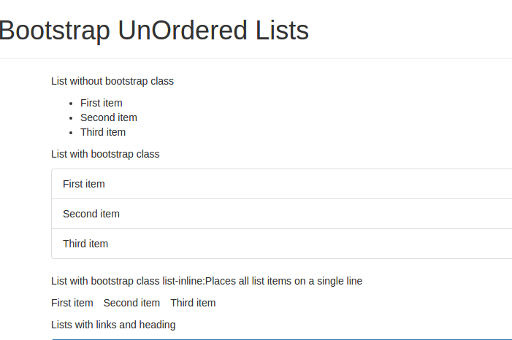
Demo
Github Url:
https://github.com/RichaIntelligrape/BootstrapNew/commits/bootstrap-list
Reference: http://getbootstrap.com/css/#type-lists

Slide 24
Bootstrap Forms
Form Layouts:
    Vertical Form(default)
    Horizontal Form- .form-horizontal
    Inline Form- .form-inline
Static Form Control on <p>- .form-control-static
Form controller- .form-control

Slide 25
Bootstrap Forms (Cont..)
Horizontal Form
    Apply .form-horizontal to the <form> tag.
    Wrap labels and form controls in a <div> tag and apply .form-group.
    Use separate <div> tags for wrapping label and form control.
    Use Bootstrap's predefined grid classes to align labels and form controls.
    Apply .control-label to the <label> tag.
    Apply .form-control to form elements

Slide 26
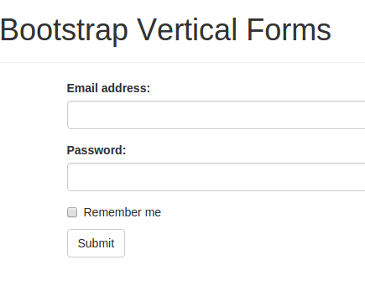
Demo
Github Url:
https://github.com/RichaIntelligrape/BootstrapNew/commits/bootstrap-forms
Reference: http://getbootstrap.com/css/#forms

Slide 27
Bootstrap Images
Rounded corenrs- .img-rounded
Circular Image- .img-circle
Thumbnail- .img-thumbnail

Slide 28
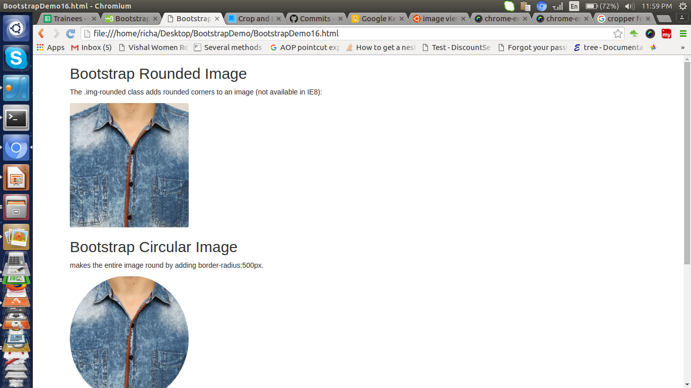
Demo
Github Url:
https://github.com/RichaIntelligrape/BootstrapNew/commits/bootstrap-image
Reference: http://getbootstrap.com/css/#images

Slide 29
Bootstrap Icons
Icons by Glyphicons
    More than 250 Glyphicons
    Available in font format
Usage
    Create a <span>
    Apply the class- .glyphicon
    Apply the icon class- .glyphicon-*
Eg: <span class="glyphicon glyphicon-class-name"></span>

Slide 30
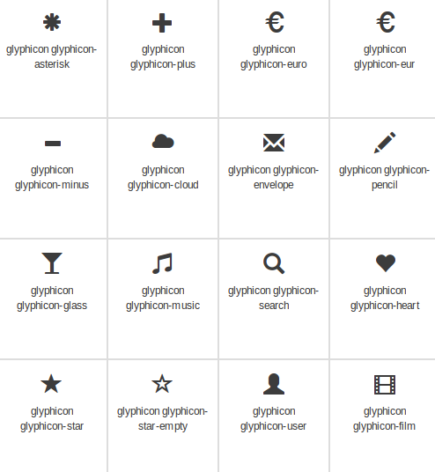

Slide 31
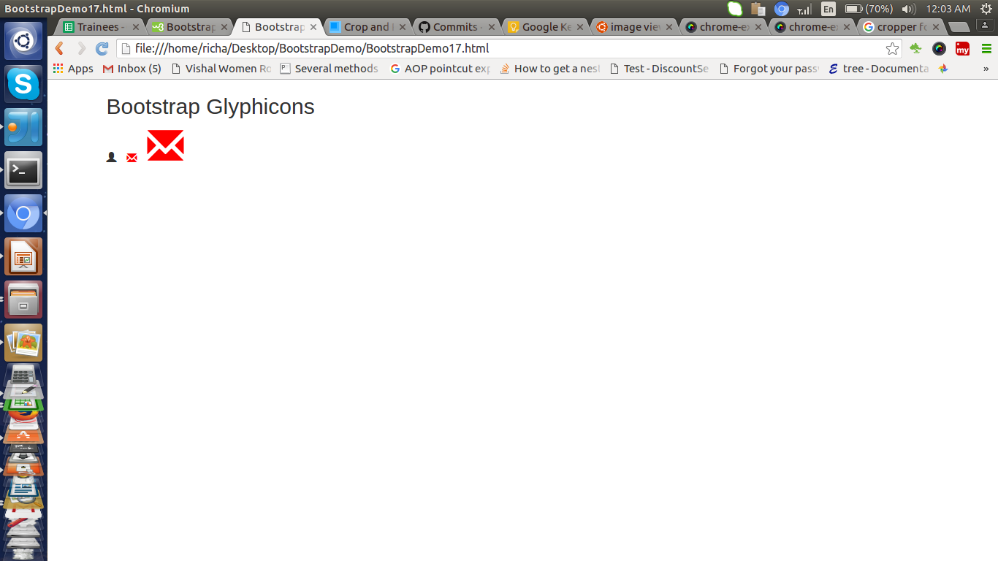
Demo
Github Url:
https://github.com/RichaIntelligrape/BootstrapNew/commits/bootstrap-icon
Reference: http://getbootstrap.com/components/#glyphicons

Slide 32

Exercise
Create an Inline media playback form
    Add following links with icons
        Play (color: green)
        Pause (color: blue)
        Stop (color: red)

Slide 33
Bootstrap Navbar <nav>
Create responsive navigation header
Horizontal as normal on medium and large devices
Collapsed on devices having smaller viewports
Different variations
    with dropdown menus
    with search box
    Scrollable navbar- .navbar-fixed-top/-bottom
    Static navbar- .navbar-static-top/-bottom

Slide 34
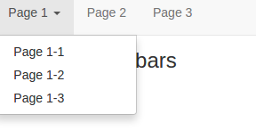
Demo
Github Url:
https://github.com/RichaIntelligrape/BootstrapNew/commits/bootstrap-navbars
Reference:http://getbootstrap.com/components/#navbar

Slide 35
Bootstrap Panels
A panel in bootstrap is a bordered box with some padding around its content:
Panels are created with the .panel class
Content inside the panel has a .panel-body class
The .panel-heading class adds a heading to the panel.
The .panel-footer class adds a footer to the panel
To group many panels together, wrap a <div> with class .panel-group around them.
To color the panel, use contextual classes (.panel-default, .panel-primary, .panel-success, .panel-info, .panel-warning, or .panel-danger):

Slide 36
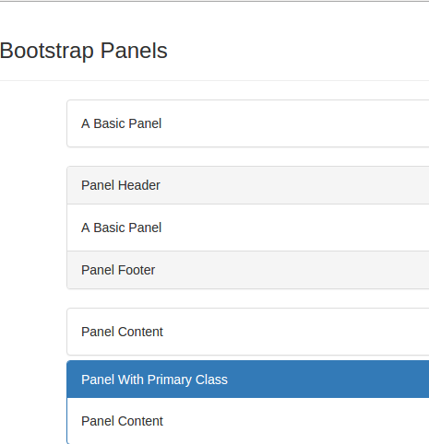
Demo
Github Url:
https://github.com/RichaIntelligrape/BootstrapNew/commits/bootstrap-panels
Reference: http://getbootstrap.com/components/#panels

Slide 37
Bootstrap Buttons
Mainly applied on <a>, <input>, <button>.
Primar class- .btn
Emphasis/Styling classes- .btn-primary/-default/-info/-link
Size classes- .btn-lg/-sm,/-md
Button Groups
    wrap a set of buttons inside <div>
    apply .btn-group to <div>
Button toolbar- .btn-toolbar: Combine sets of button groups into button toolbars for more complex components.
Notes:
Block buttons- covers full width of parent elm
==========
Button-Toolbar- Wrap sets of button groups in a <div> element and apply the class .btn-toolbar on it

Slide 38
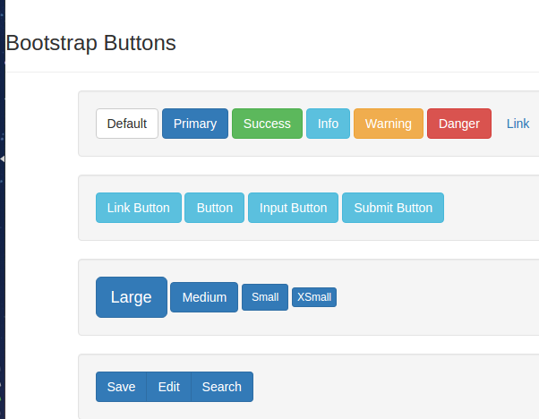
Demo
Github Url:
https://github.com/RichaIntelligrape/BootstrapNew/commits/bootstrap-buttons
Reference: http://getbootstrap.com/css/#buttons

Slide 39
Exercise
Create a button toolbar
  Create buttons using <button>
  Contains atleast two button groups
  Use different styling classes

Slide 40
Bootstrap Alerts
Base class- .alert
Contextual classes- .alert-warning/danger/info
Usage:
    Create a <div> tag
    add base classes and contextual classes to it
    wrap message in this tag

Slide 41
Bootstrap Alerts (Cont..)
To add close button
    add an <a>/<span>/<button> tag inside main <div>
    add class .close
    add attribute data-dismiss=”alert”
Eg: <span class="close" data-dismiss="alert">X</span>

Slide 42
Bootstrap Modals
Dialog box
    to display information to user
    to prompt user
Base class- .modal
Dialog class- .modal-dialog
Content class- .modal-content
Modal Header- .modal-header
Modal body- .modal-body
Modal Footer- .modal-footer
Notes:
abc

Slide 43
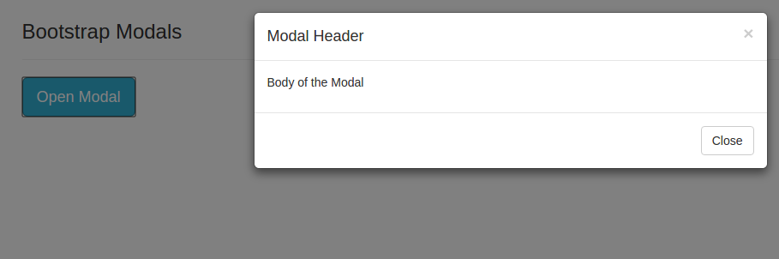
Demo
Github Url:
https://github.com/RichaIntelligrape/BootstrapNew/commits/bootstrap-alert-and-modals
Reference: http://getbootstrap.com/components/#alerts

Slide 44
Font Awesome Icons
To insert an icon, add the name of the icon class to any inline HTML element.
The <i> and <span> elements are widely used to add icons.
To use the Font Awesome icons, just add font awesome library inside the <head> section of your HTML page.
<link rel="stylesheet" href="http://cdnjs.cloudflare.com/ajax/libs/font-awesome/4.4.0/css/font-awesome.min.css">

Slide 45
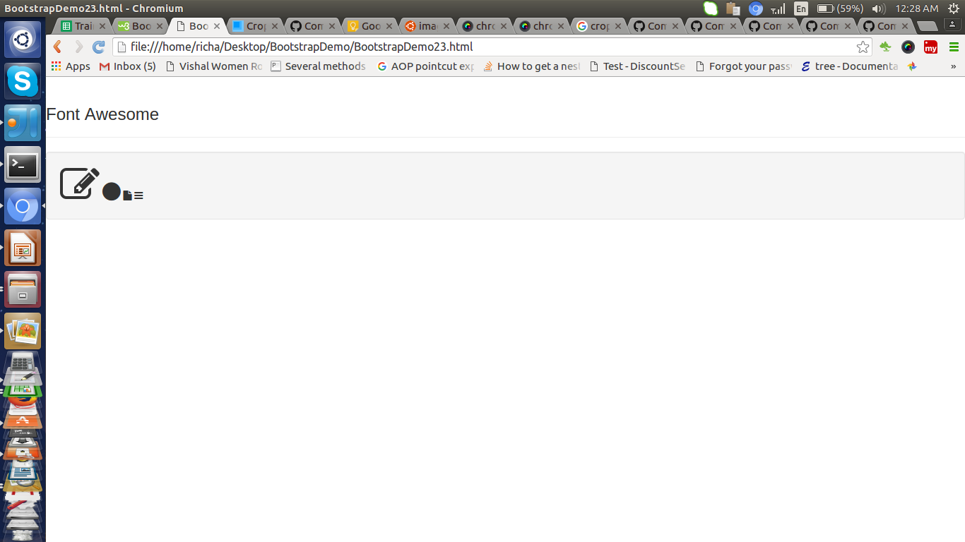
Demo
Github Url:
https://github.com/RichaIntelligrape/BootstrapNew/commits/fontawesome
Reference: https://fortawesome.github.io/Font-Awesome/icons/

Slide 46
Questions?

Slide 47
Exercise

Slide 48
References
Demos:
https://github.com/spoonia/TwitterBootstrapDemo
Tutorials:
http://www.tutorialrepublic.com/twitter-bootstrap-tutorial/
http://getbootstrap.com/getting-started/#examples
http://getbootstrap.com/components/

