Slide 1




Electrical Load Forecasting

Slide 2

Learning Objectives
Understand electricity consumption patterns over time.
Apply data preprocessing and visualization techniques.
Implement forecasting using machine learning models.
Build a user interface for load prediction using Streamlit.
GOAL
Goal : To forecast the electrical load demand in India using historical load and temperature data, enhancing planning and management of energy resources.
Source :
www.freepik.com/

Slide 3
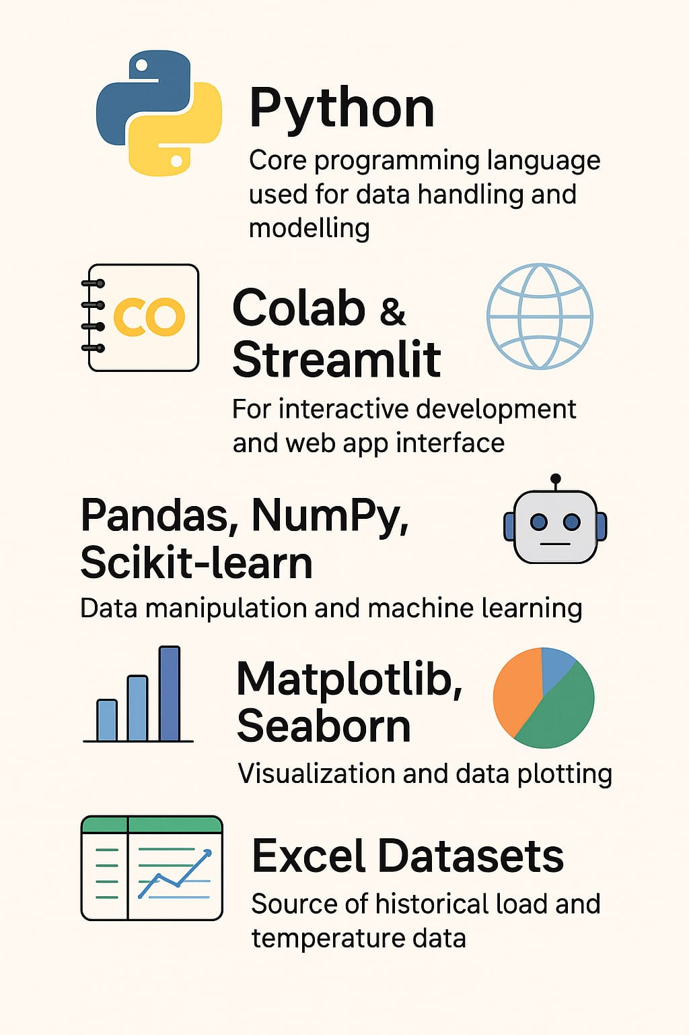
Tools and Technology used
🐍Python – Core programming language used for data handling and modelling
📓Colab notebook & 🌐Streamlit – For interactive development and web app interface
🧮Pandas, Numpy, 🤖 Scikit-Learn – Data manipulation and machine learning
📊Matplotlib , 🎨Seaborn – Visualization and data plotting
📈Excel Datasets – Source of historical load and temperature data

Slide 4
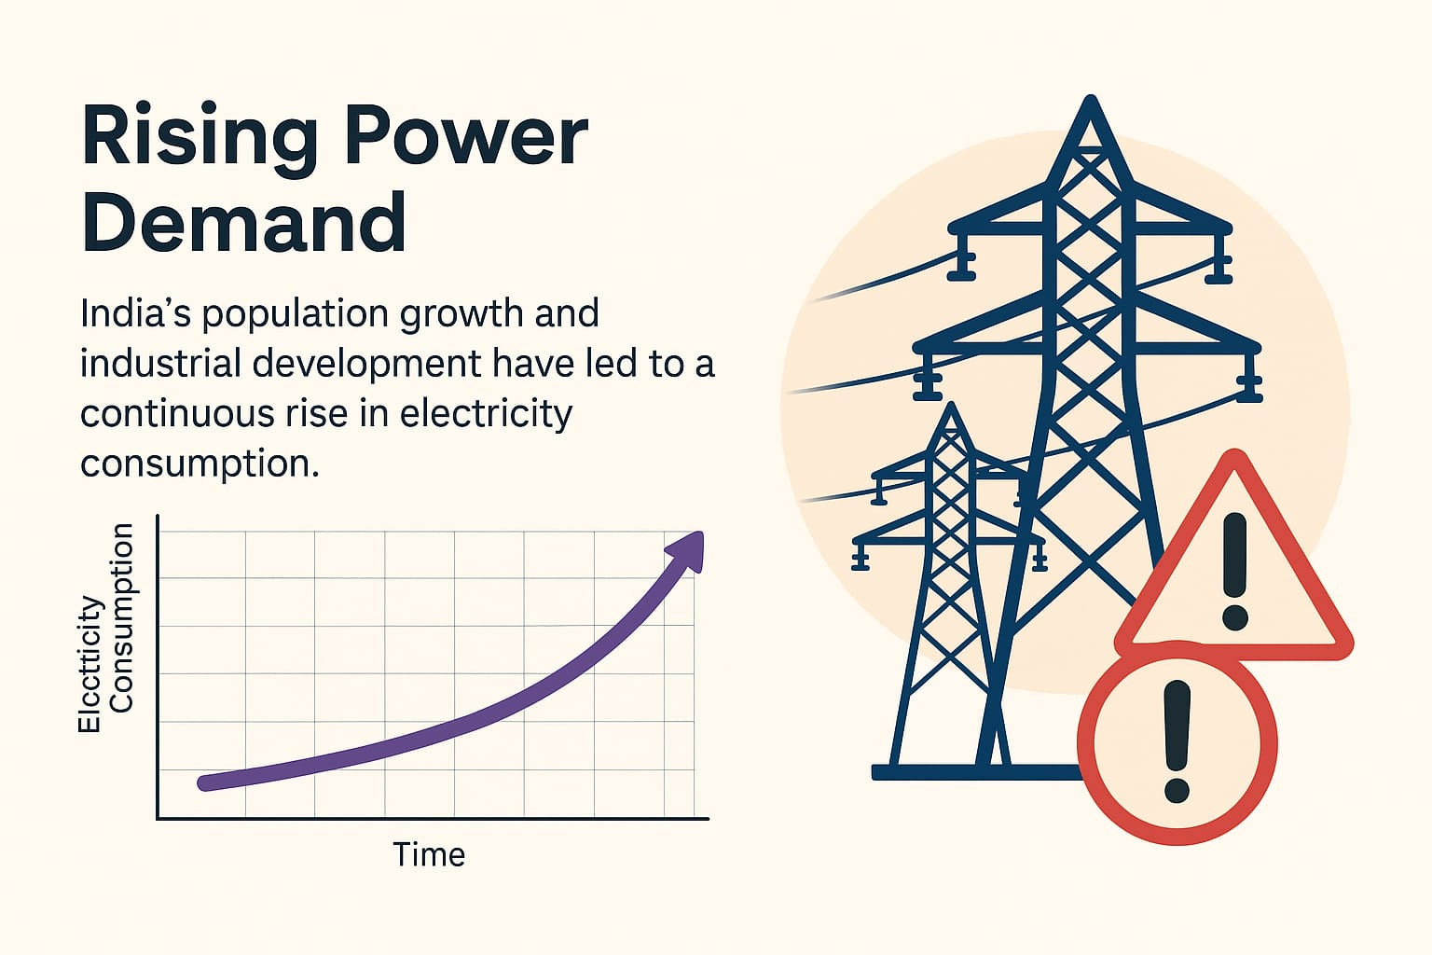
Methodology
📥 Data Collection – Gathered historical load and temperature records
🧹 Data Cleaning & Preprocessing – Handled missing values, formatted data
📊 Exploratory Data Analysis (EDA) – Analyzed trends and correlations
🤖 Model Selection – Applied algorithms like Linear Regression, Decision Trees
📈 Evaluation & Forecast Visualization – Measured performance and visualized predictions

Slide 5
Problem Statement:
⚡ Rising Power Demand: India’s population growth and industrial development have led to a continuous rise in electricity consumption.
📉 Risk of Power Imbalance: Without accurate forecasting, there is a high risk of overproduction (wasting resources) or underproduction (power outages, blackouts).
🏭 Load Planning Challenges: Utilities and grid operators struggle to match supply with demand, especially during peak hours or seasonal shifts.
🔍 Need for Predictive Insights: Traditional forecasting methods lack real-time adaptability and data-driven intelligence.
💡 Why Forecasting Matters: Accurate forecasting enables:
📊 Better energy resource planning
💰 Reduced operational costs
🌍 Support for sustainable energy management

Slide 6
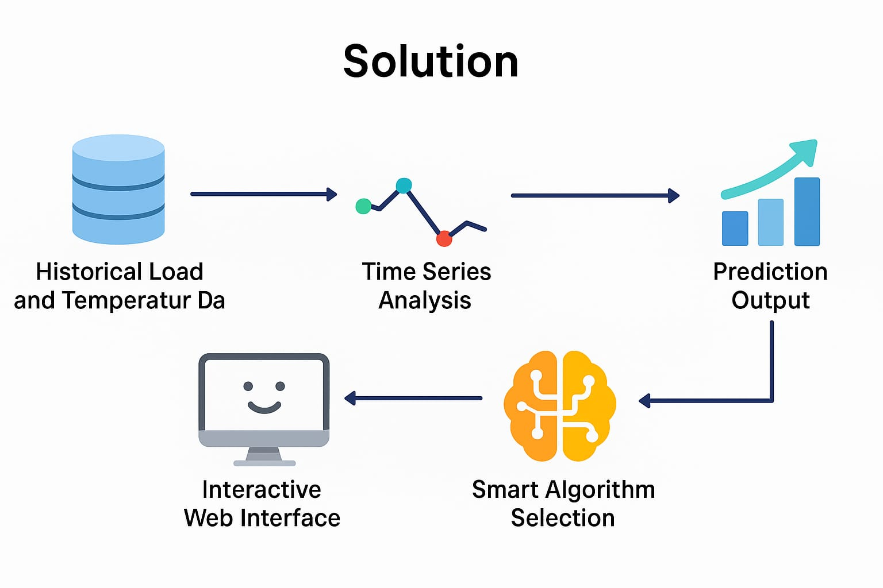
Solution:
🤖 Machine Learning-Based Forecasting Built models that learn from historical load and temperature data to predict future demand.
📅 Time Series Analysis Applied techniques suited for hourly and monthly patterns, improving prediction accuracy.
🧠 Smart Algorithm Selection Used models like Random Forest ,Decision Trees and Time Series Forecasting using prophet for accurate load forecasting.
🌐 Interactive Web Interface Developed a Streamlit app that lets users input parameters and view forecasts in real time.
📊 Clear Visualization & Output Displayed trends and predictions using graphs and plots for easy understanding.

Slide 7
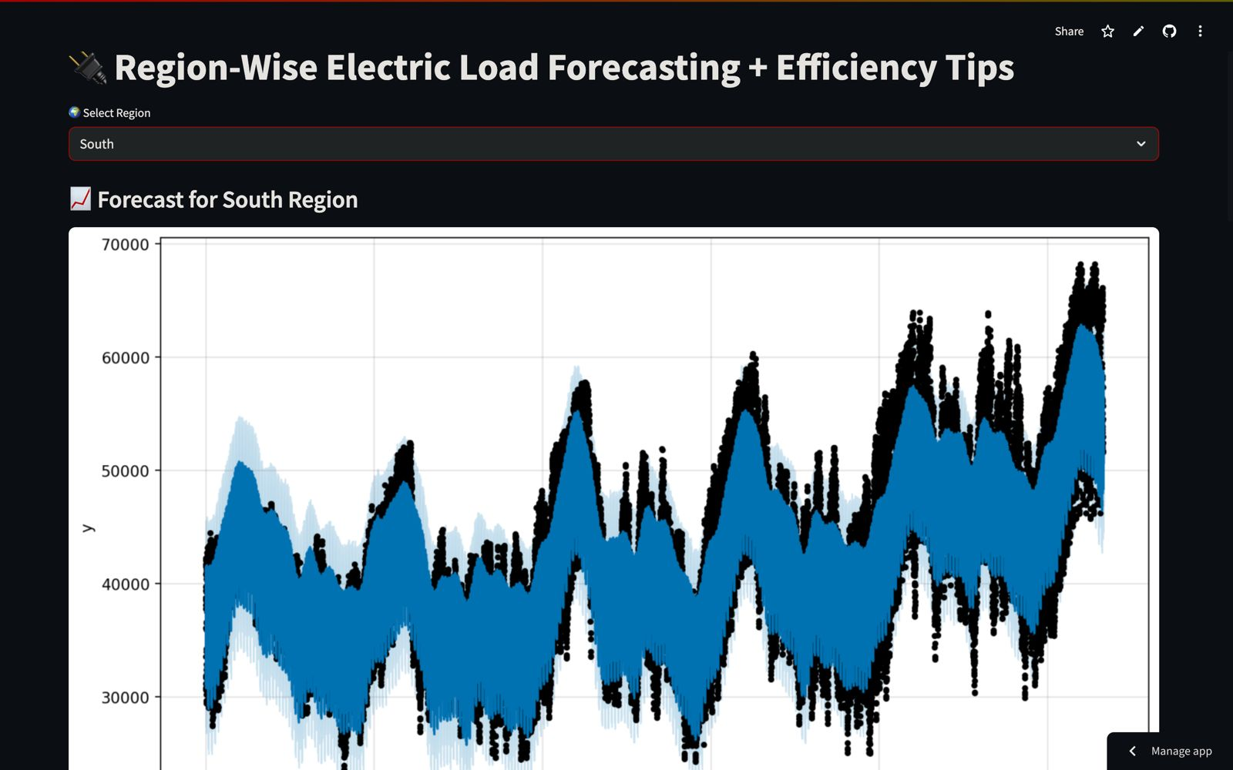
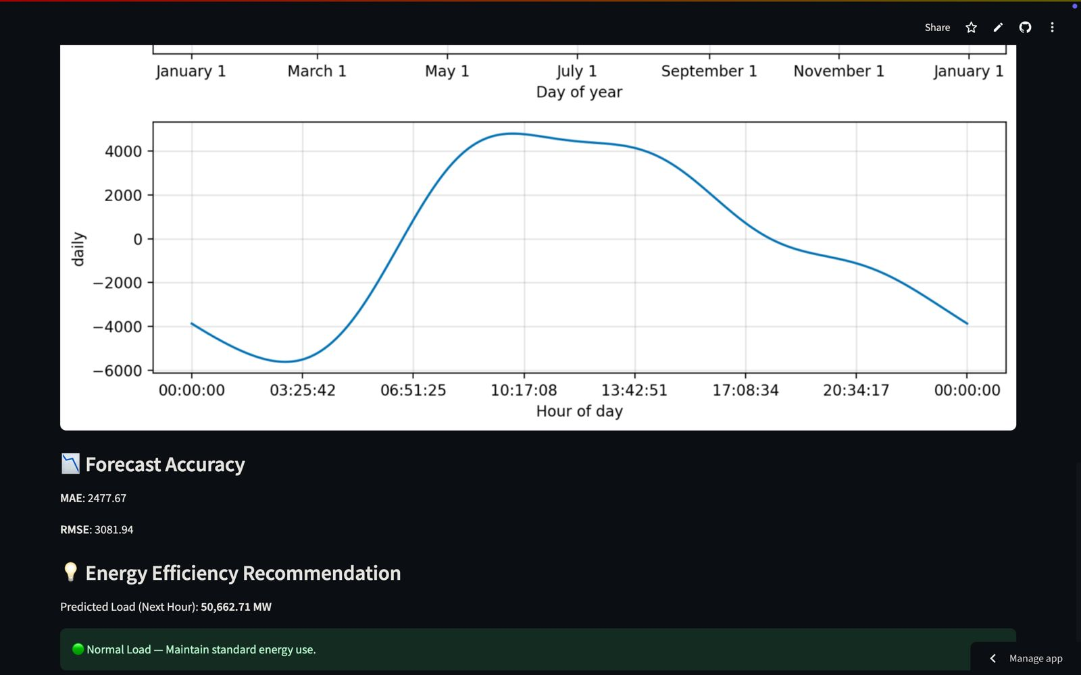
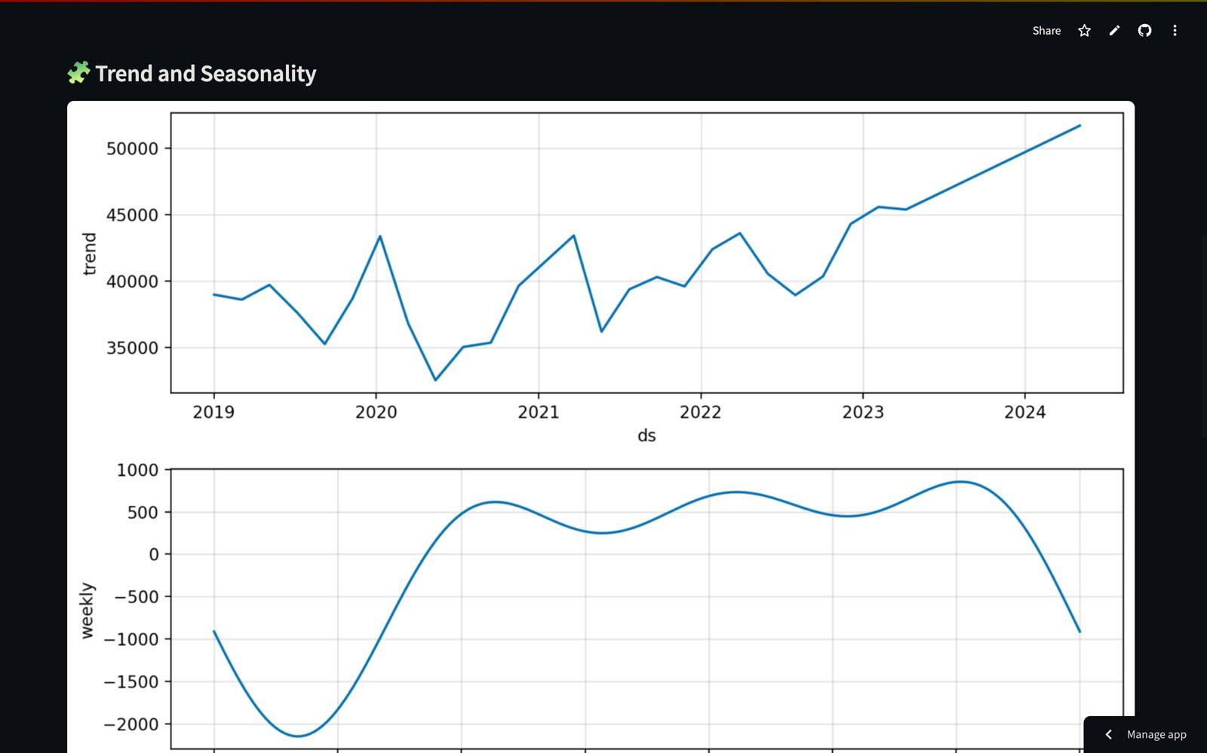
Screenshot of Output:

Slide 8
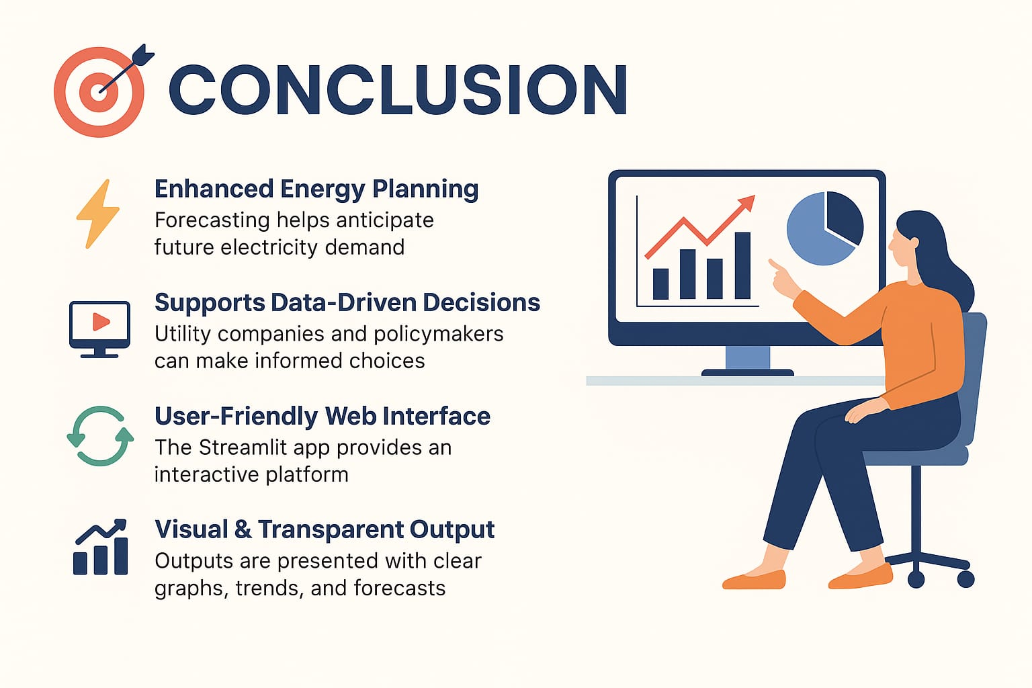
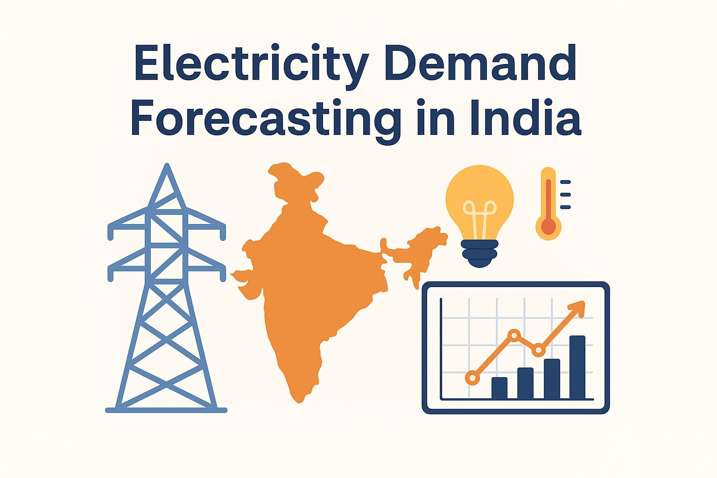
Conclusion:
⚡ Enhanced Energy Planning Forecasting helps anticipate future electricity demand, allowing better planning and efficient resource utilization.
📈 Supports Data-Driven Decisions Utility companies and policymakers can make informed choices based on predictive analytics and visual insights.
🖥️User – Friendly Web Interface
The Stream lit app provides an interactive platform where users can easily access predictions in real time
♻️ Promotes Sustainable Energy Use Helps reduce energy waste and supports eco-friendly electricity distribution.
📊 Visual & Transparent Output Outputs are presented with clear graphs, trends, and forecasts for better interpretation.

