Slide 1
DATA STORY / 01
AIRBNB
ANALYTICS
From a dashboard to business decisions
A classroom walkthrough of KPIs, charts, the map and the questions they help us answer.
THE BIG IDEA
A good dashboard does not just show numbers — it helps us ask better questions.

Slide 2
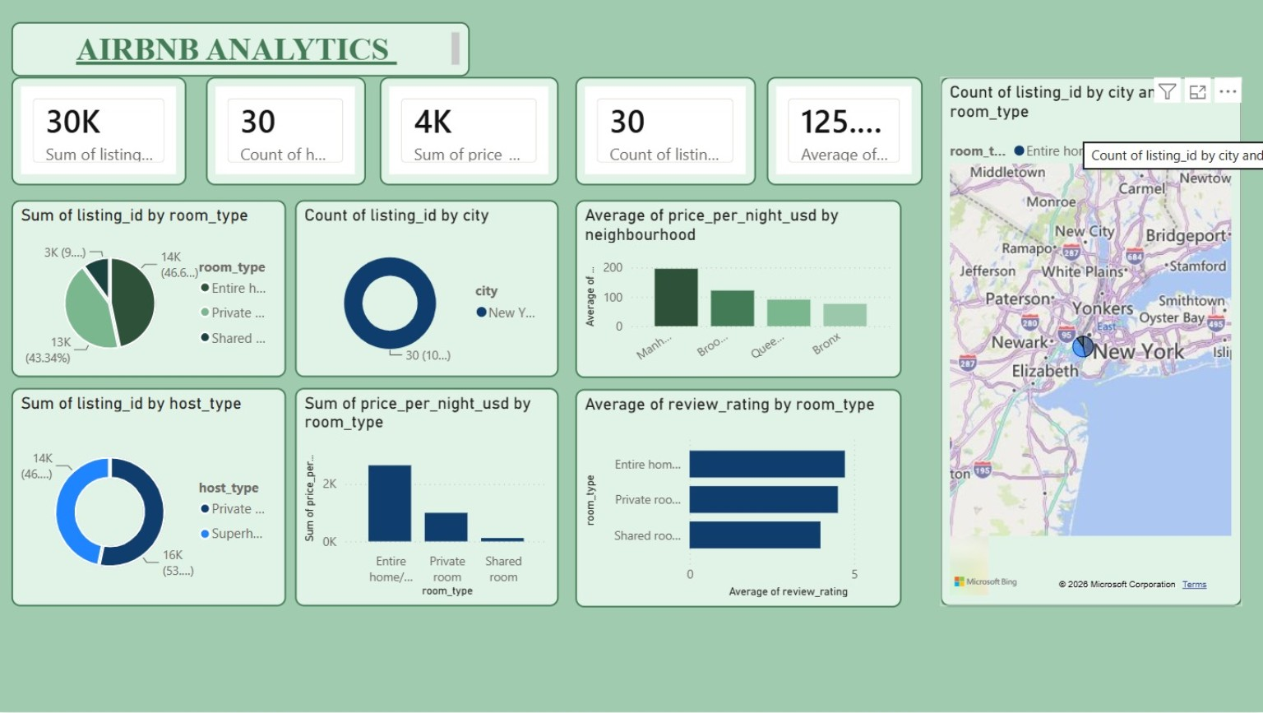
01 / STORY
02
What is this dashboard trying to tell us?
We explore Airbnb listings, room types, nightly prices, reviews and location.
THE DATA
Each row represents a listing or record.
THE QUESTIONS
Where are listings? Which room type dominates? How do price and ratings compare?
THE DECISION
Compare supply, pricing and guest experience to guide investigation.
Say: “Think of this as a mini market research report for short-term stays.”
AIRBNB ANALYTICS • CLASSROOM WALKTHROUGH

Slide 3
02 / KPI DECODING
03
The five headline cards — what do they mean?
KPIs are quick signals. Always check the field name and aggregation.
30K
30
4K
Sum of listing_id
Count of host…
Sum of price…
Adds ID numbers together; not a meaningful business total.
Count of records in a host-related field; label is cut off.
Total of the selected price field, if aggregation is correct.
30
125…
Count of listings…
Average of …
Likely counts non-empty listing records.
An average, but the field name is truncated.
Tip: don’t guess a cut-off label. Explain what is visible, then say what you would verify.
AIRBNB ANALYTICS • CLASSROOM WALKTHROUGH

Slide 4
03 / CHART 1
04
Room type mix: what kind of stays are listed?
The pie chart splits the total of listing_id by room_type.
ENTIRE HOME • ~47%
PRIVATE ROOM • ~43%
Largest segment in this view; entire-place stays form the biggest group.
Almost as large as entire homes — another major guest option.
SHARED ROOM • ~10%
BUSINESS QUESTION
A smaller share of the room types shown.
Is demand strong for both privacy and lower-cost shared options?
Important: use a count of listings by room type for a valid mix, not the sum of ID codes.
AIRBNB ANALYTICS • CLASSROOM WALKTHROUGH

Slide 5
04 / CHARTS 2–3
05
Host type and city: who supplies stays, and where?
These charts describe the supply side of the marketplace.
HOST TYPE MIX
CITY COUNT
Looks close to a split between private hosts and Superhosts; labels are truncated.
A count of listing IDs by city; “New Y…” is visible.
WHAT IT MAY MEAN
CHECK FILTERS
Compare ratings, price and occupancy by host type.
If several cities were expected, inspect the city field and filters.
Say: “Host type tells us who provides supply; city tells us where supply is concentrated.”
AIRBNB ANALYTICS • CLASSROOM WALKTHROUGH

Slide 6
05 / CHART 4
06
Nightly price by neighbourhood: location changes price
The column chart compares average price_per_night_usd across neighbourhood labels.
COMPARE
Manh… appears highest, followed by Broo…; Quee… and Bronx are lower.
$198
EXPLAIN
$122
Location, transport, attractions and property type may influence price.
$92
$78
DECIDE
Hosts can benchmark prices against similar listings in the same area.
Manh…
Broo…
Quee…
Bronx
Bars are approximate readings from the screenshot, not audited values. Verify in the source dashboard.
AIRBNB ANALYTICS • CLASSROOM WALKTHROUGH

Slide 7
06 / CHARTS 5–6
07
Guest ratings and the map: quality is also local
Bars compare average review rating by room type; the map adds geographic context.
Entire home
4.7/5
RATINGS
Entire homes look highest, while all three room types appear fairly close.
Private room
4.5/5
MAP
Shared room
4.2/5
The map places records around the New York region and gives location context.
NEXT QUESTION
Do high-price areas also earn high ratings? Filter by neighbourhood and room type.
Caution: average rating hides review volume. Compare the number of reviews too.
AIRBNB ANALYTICS • CLASSROOM WALKTHROUGH

Slide 8
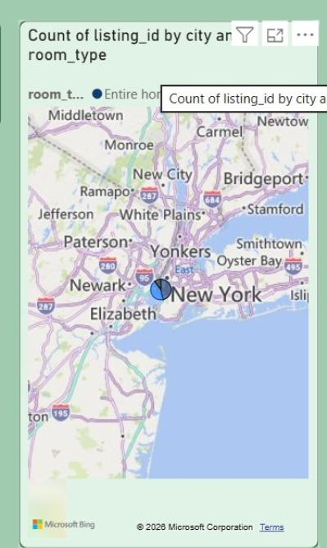
07 / LOCATION LENS
08
The map is more than decoration
A geographic view turns separate rows into a spatial story.
CLUSTERING
Marker clusters may suggest areas with more listings, if each marker represents one listing.
LOCATION STRATEGY
Investigate access to transit, attractions and business districts.
NEXT STEP
Filter by neighbourhood, then compare median price and ratings by area.
Ask: “If two listings cost the same, what location factors could make one more attractive?”
AIRBNB ANALYTICS • CLASSROOM WALKTHROUGH

Slide 9
08 / INSIGHTS
09
What can we responsibly conclude?
Separate what the dashboard shows from what still needs checking.
INSIGHT 1
INSIGHT 2
INSIGHT 3
Entire homes and private rooms make up most of the room-type mix shown.
Average nightly price differs across the neighbourhoods displayed.
Ratings appear fairly close, with entire homes slightly higher in this view.
VERIFY FIRST
VERIFY SECOND
VERIFY THIRD
Several visuals sum listing IDs. IDs should normally be counted, not summed.
Some labels are cut off; confirm fields, units and filters.
Price averages can be skewed; median is a useful companion.
Business takeaway: use this dashboard to spot patterns and generate questions — not claim causation.
AIRBNB ANALYTICS • CLASSROOM WALKTHROUGH

Slide 10
09 / ANALYST'S UPGRADE
10
How I would make this dashboard stronger
A distinctive dashboard makes decisions easy and keeps data trustworthy.
01
Fix KPI logic
Total listings = distinct count of listing_id; avoid summing IDs.
02
Improve price metrics
Show median and average price, currency and date range.
03
Make comparisons fair
Compare within neighbourhood and room type; filter invalid prices.
04
Add performance measures
Add occupancy, availability, review count and revenue if available.
05
Improve readability
Use full labels and filters for neighbourhood, room type and host type.
Analyst mindset: improve the question, validate the measure, then communicate the result.
AIRBNB ANALYTICS • CLASSROOM WALKTHROUGH

Slide 11
10 / CLOSE
The 30-second summary
“This Airbnb dashboard gives a snapshot of listing supply, room-type mix, host categories, neighbourhood prices, guest ratings and geographic spread. The charts suggest entire homes and private rooms dominate the mix, prices vary by neighbourhood, and ratings are fairly close across room types. Before making business decisions, I would validate KPI labels and replace sums of listing IDs with counts. That makes the dashboard more accurate and useful for hosts and analysts.”
CLASS QUESTION
IF ASKED ABOUT LIMITATIONS
Would you choose a cheaper listing or a higher-rated one?
Some labels are truncated and ID sums need correction before precise conclusions.
THANK YOU • QUESTIONS?

