Slide 1

INFO 6210 Data Management and Database Design
Grocery Store Inventory Management
Sai Srilakshmi Kanumuri
Shrishti Khanna
Tyler McCarthy
Ben Reynolds

Slide 2

Primary Business Problems
Allow Store managers to track Employees
Track the Inventory of Products available at each Store
Record all Orders and Shipments from Suppliers
Keep a record of all prior Customers
Maintain Sales records

Slide 3
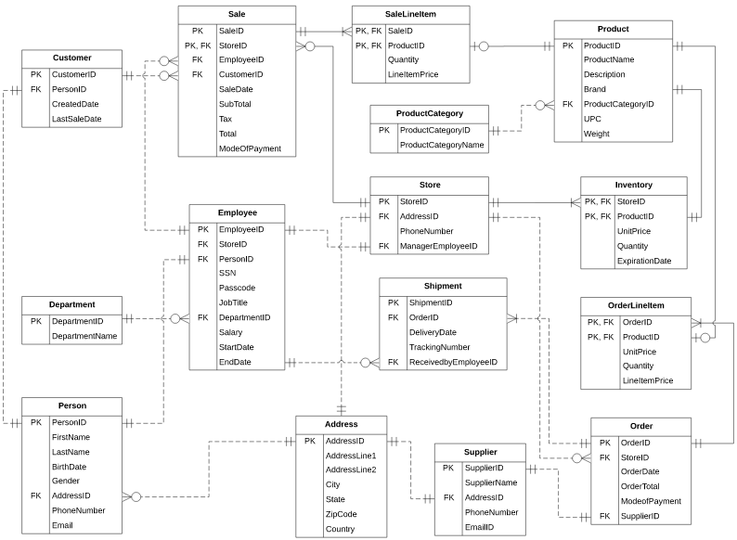
Entity Relationship Diagram

Slide 4

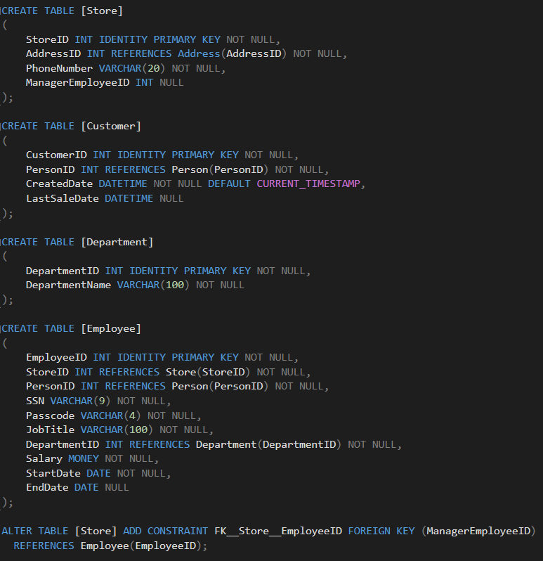
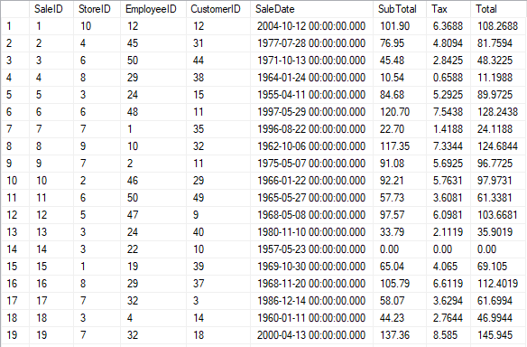
DDL (Excerpt) and Data Insertion
All tables were created with primary and foreign key relationships based on ERD. Sample data has been inserted in all of them.

Slide 5

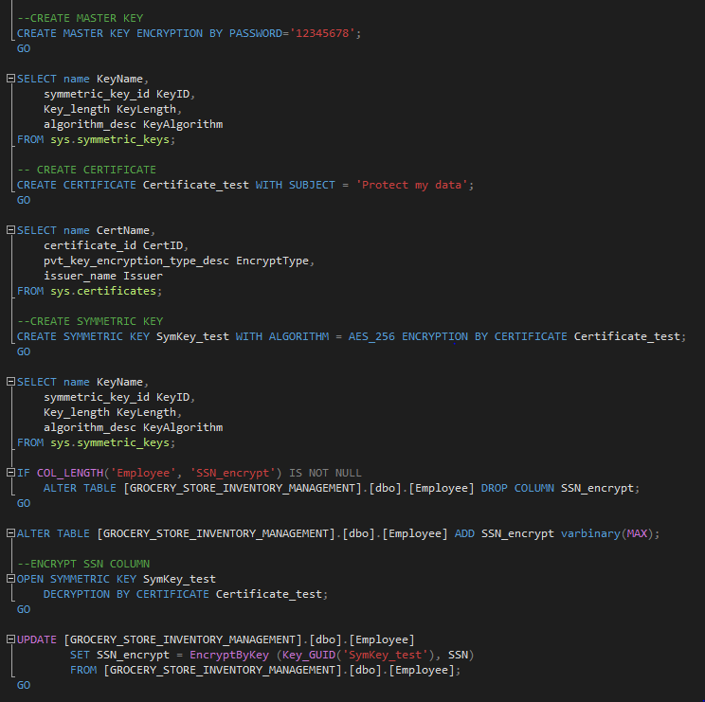
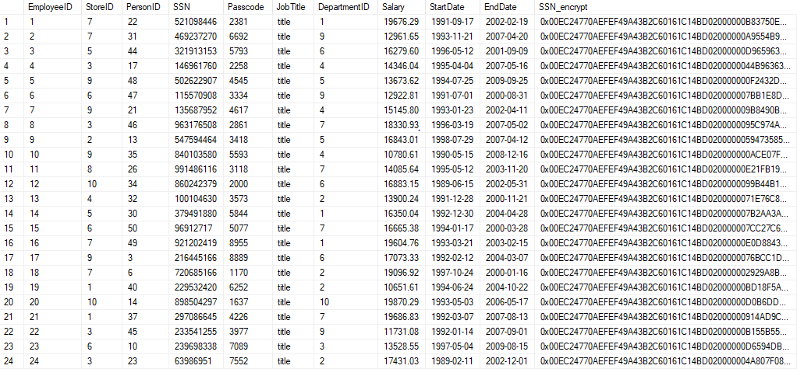
Encryption
We encrypted SSN column to ensure that it cannot be accessed by everyone. Only authorized persons like store managers/employees can access it with a symmetric key.

Slide 6

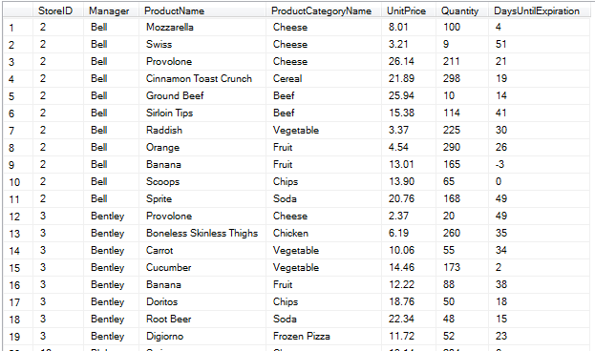
Views
This view was intended to show the inventory available in each store.
CREATE VIEW InventoryAmounts
AS
SELECT s.StoreID, pe.LastName AS [Manager],
pr.ProductName, pr.Brand,
pc.ProductCategoryName, i.UnitPrice,
i.Quantity,
DATEDIFF(day, GETDATE(), i.ExpirationDate) AS
[DaysUntilExpiration], pr.Description
FROM Inventory i JOIN Store s
ON i.StoreID = s.StoreID
JOIN Employee e
ON e.StoreID = s.StoreID
JOIN Person pe
ON pe.PersonID = e.PersonID
JOIN Product pr
ON pr.ProductID = i.ProductID
JOIN ProductCategory pc
ON pc.ProductCategoryID = pr.ProductCategoryID;

Slide 7

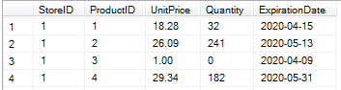
Constraints
We added this constraint to ensure that any item being added to a sale was in stock in the store’s inventory.
CREATE FUNCTION CheckStock
(@ProductID INT)
RETURNS INT
AS
BEGIN
DECLARE @Stock INT = 0;
SELECT @Stock = COUNT(ProductID)
FROM Inventory
WHERE ProductID = @ProductID
AND Quantity = 0;
RETURN @Stock;
END;
GO
ALTER TABLE SaleLineItem
ADD CONSTRAINT OutOfStock
CHECK (dbo.CheckStock(ProductID) = 0);
Inventory
Upon trying to purchase ProductID 3 from StoreID 1, we get the following error message:
Msg 547, Level 16, State 0, Line 98
The INSERT statement conflicted with the CHECK constraint "OutOfStock". The conflict occurred in database "GROCERY_STORE_INVENTORY_MANAGEMENT", table "dbo.SaleLineItem", column 'ProductID'.
The statement has been terminated.

Slide 8
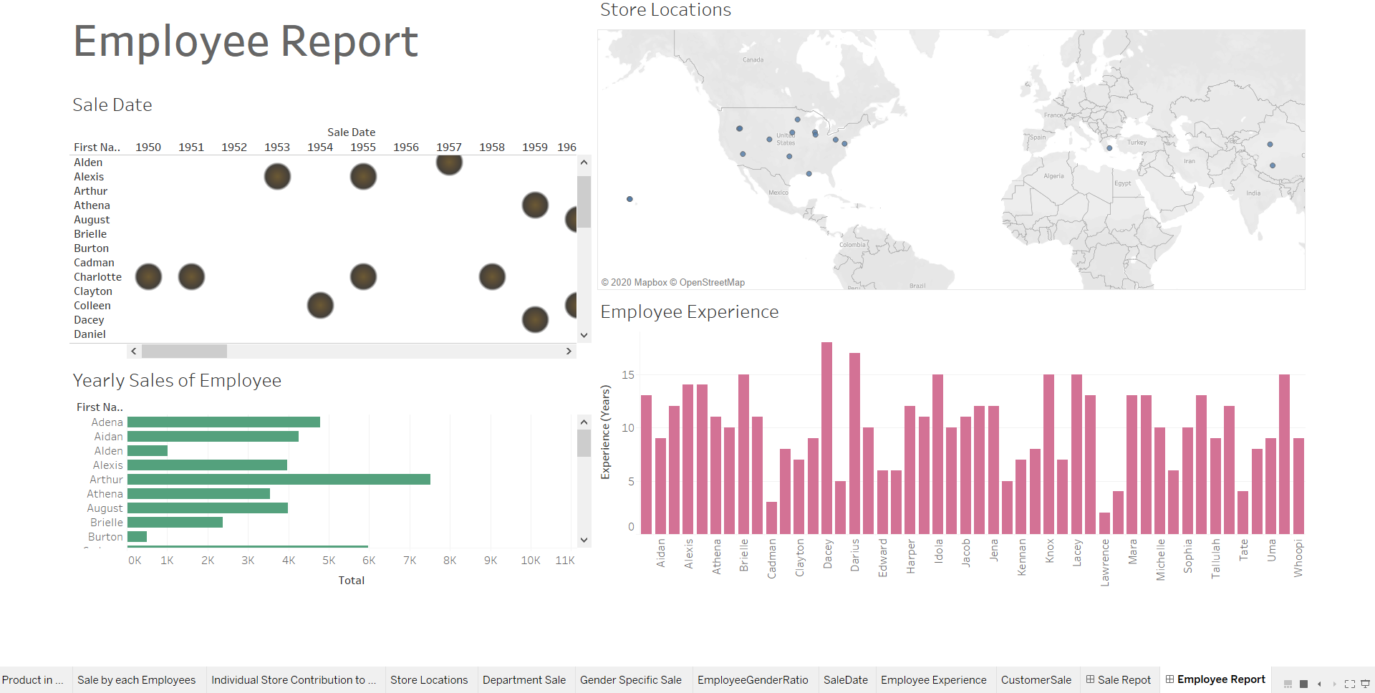
Tableau Report Visualizations
View store locations at a glance
Identifying the sale by the employees in each year
Identify your most experienced and loyal employees
See which employees generate the most revenue

Slide 9
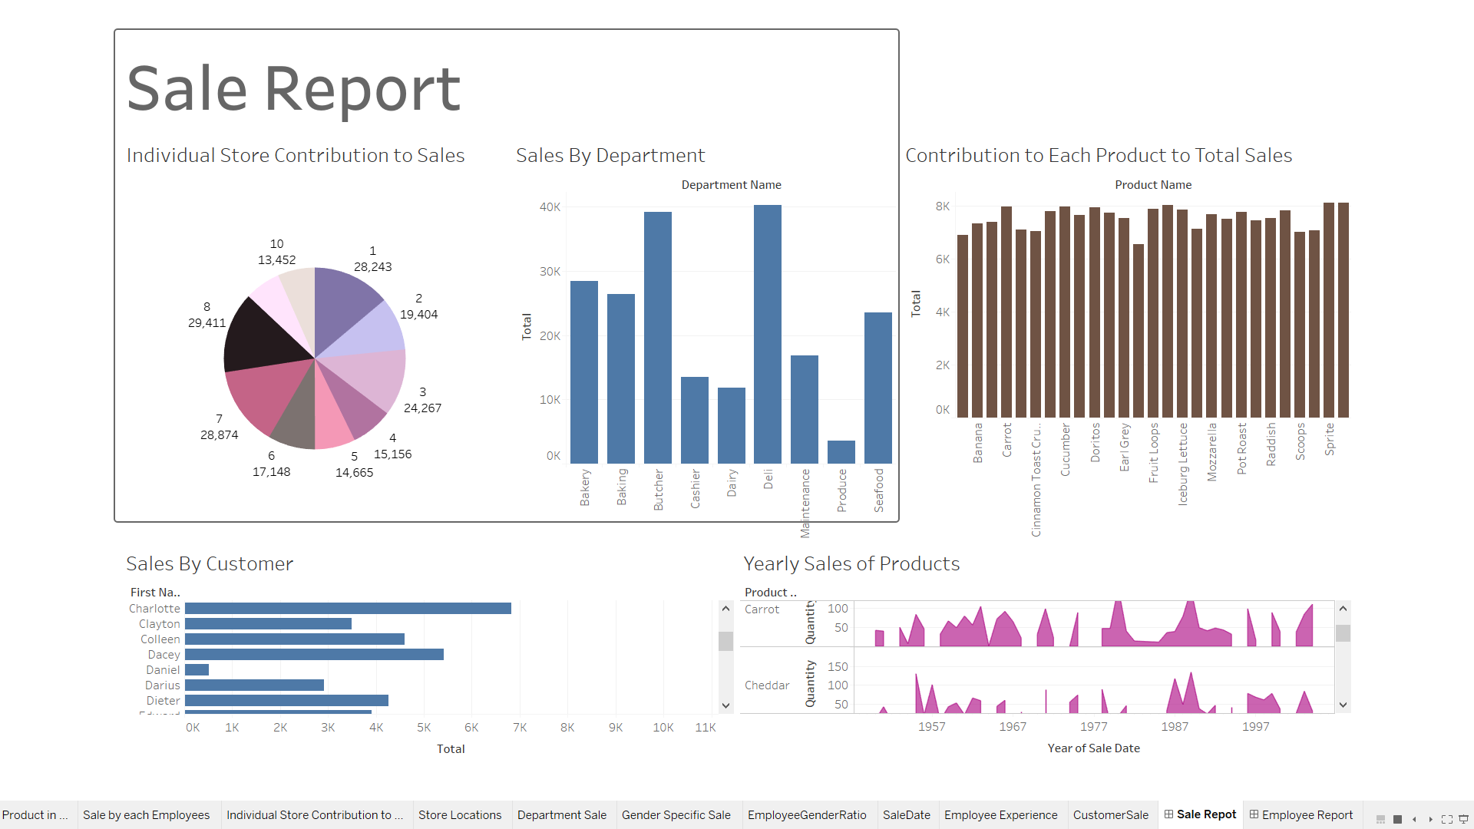
Tableau Report Visualizations
Identify the most profitable department
Identify the most profitable products
Identify the most profitable stores
Demonstrates the yearly Sales of Each Product
Identifying the most Loyal Customer

Slide 10

Any Questions ?

Slide 11

Thank you!

