Slide 1
Interactive Sales Dashboard Summary
Task 3 – Data Analyst Internship | Created by Shrishti Mishra

Slide 2
Objective
The goal of this project is to design an interactive dashboard using Power BI to help business stakeholders analyze sales data.
This dashboard facilitates dynamic filtering, KPI analysis, and uncovering trends across time, region, and product categories to improve data-driven decisions.

Slide 3
Dataset Overview
The dataset used is a transactional sales dataset containing fields such as:
- Order Date, Ship Mode, Category, Sub-Category
- Sales, Profit, Quantity, City, Region
- Product Name and Year
The data was cleaned and analyzed in Power BI.

Slide 4
KPIs and Metrics Tracked
Key Performance Indicators (KPIs) identified and visualized:
- Total Sales
- Sales by Region and City
- Sales Growth over Years
- Top Products and Ship Modes
- Interactive Filters by Category, Region, and Time

Slide 5
Key Insights from the Dashboard
- The West region has the highest sales, followed by East.
- New York City contributes significantly to overall revenue.
- Sales show consistent year-over-year growth, with a strong increase in 2018.
- Certain product categories dominate based on ship mode preferences.
- The dashboard supports multi-level filtering for better analysis.

Slide 6
Tools and Technologies Used
- Power BI for Dashboard Creation
- Microsoft Excel/CSV as data source
- GitHub for version control and submission

Slide 7
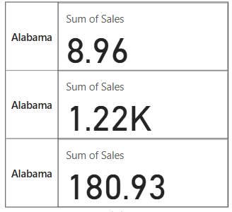

Slide 8
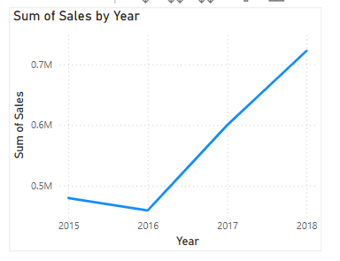

Slide 9
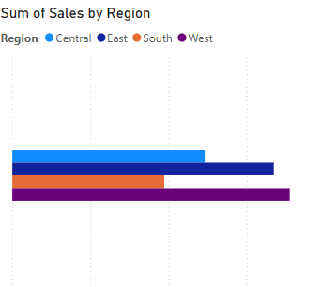

Slide 10
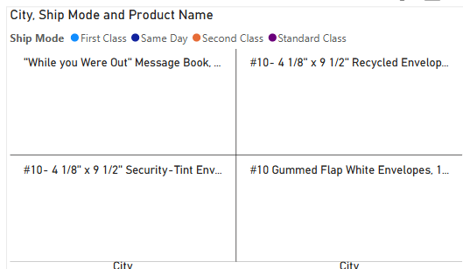

Slide 11
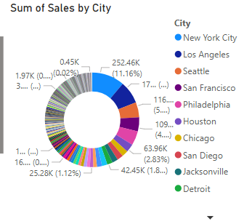

Slide 12
