Slide 1
Maximum Subarray problem

Slide 2


Slide 3
Naive Approach
Step 1: Read number of elements, n
Step 2: Read 'n' elements in the array
Step 3: Let max = minimum negative value
Step 4: for sub_array_size 1 to n repeat step 5 to 7
Step 5: Generate sub_array of size sub_array_size repeat step 6 and 7
Step 6: Compute sum_of_sub_array generated
Step 7: If sum_of_sub_array > max then make max as sum_of_sub_array

Slide 4
Naive Approach
Complexity - O(n^3)

Slide 5
Fine Tuned Naive Approach
Idea : We are not interested in the order of the elements but only sum
Traverse array once when you are in ith element find all possible sum of sub arrays that start at index 'i' and formed by including elements at index 'j' >= 'i'

Slide 6
Fine Tuned Naive Approach
Step 1: Read number of elements, n
Step 2: Read 'n' elements in the array
Step 3: Let max = minimum negative value
Step 4: for i in range 1 to n repeat step 5 to 8
Step 5: Let subarray_sum = 0
Step 6: for j in range i to n repeat step 7 and 8
Step 7: subarray_sum += element[j]
Step 8: If subarray_sum > max then make max as sum_of_sub_array

Slide 7
Naive Approach
Complexity - O(n^2)

Slide 8
Divide and Conquer Approach
Idea : any contiguous subarray A[i .. j] of A[low..high] must lie in exactly one of the following places:
entirely in the subarray A[low..mid], so that low ≤ i ≤ j ≤ mid,
entirely in the subarray A[mid + 1..high], so that mid < i ≤ j ≤ high, or
crossing the midpoint, so that low ≤ i ≤ mid < j ≤ high.

Slide 9
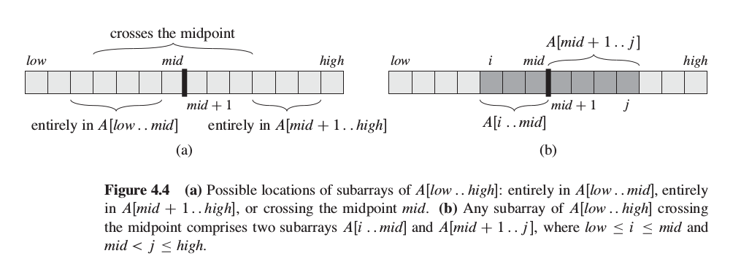
Divide and Conquer Approach

Slide 11
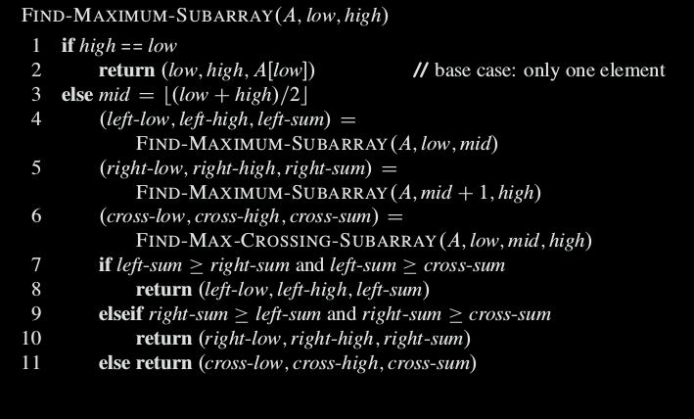
Divide and Conquer Approach

Slide 12
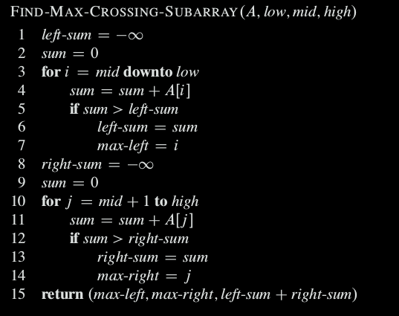
Divide and Conquer Approach

Slide 13
Divide and Conquer Approach
Complexity - O(n log n)

Slide 14
Linear Complexity Approach (Kanden's Algorithm)
Idea : If array contains only postive numbers then maximum sub array is the array itself
Negative values inbits the total sum of array
Negative values can also be part of maximum subarray provided elements around it gives a postive weightage

Slide 15
Linear Complexity Approach (Kanden's Algorithm)
Step 1: Read number of elements, n
Step 2: Read 'n' elements in the array
Step 3: Let global_max = first element of array, positive_sum_till_here = 0
Step 4: for i in range 1 to n repeat step 5 to 8
Step 5: positive_sum_till_here += elements[i]
Step 6: if positive_sum_till_here > global_max then global_max = positive_sum_till_here
Step 7: if positive_sum_till_here<0 then positive_sum_till_here = 0
Step 8: If subarray_sum > max then make max as sum_of_sub_array

Slide 16
Linear Complexity Approach (Kanden's Algorithm)
Complexity - O(n)

