Slide 1
C++ and STL Introduction
Dr M Janaki Meena

Slide 2
C++
Object-oriented programming and object-oriented design
Faster language and occupies lesser memory compared
Includes the first widely used modern implementation of a generic programming language
STL has implementation of most of the data structures

Slide 3
Benefits of STL
Data structures are fast
Saves us writing our own
The algorithms are probably efficient

Slide 4
History of STL
Software library originally designed by Alexander Stepanov for C++ in HP labs
He worked earlier for Bell Labs close to Andrew Koenig and tried to convince Bjarne Stroustrup to introduce something like Ada generics in C++
Ada was the first language to introduce genercity but it was not accepted outside defense

Slide 5
Components of STL
STL provides four components:
Containers
Functions
Iterators
Algorithms

Slide 6
Containers in STL
Holder object that stores a collection of other objects
Implemented as class templates, which allows great flexibility in the types supported as elements
manages the storage space for its elements and provides member functions to access them, either directly or through iterators

Slide 7
Containers in STL
Data structures with memory-management capabilities
Two categories of containers:
(i) Sequential containers
(ii) Associative containers

Slide 8
Sequential Containers in STL
Elements are in a sequential order implemented as class template
Examples
array - Static contiguous array
vector - Dynamic contiguous array
deque - Double-ended queue
forward_list - Singly-linked list
list - Doubly-linked list

Slide 9
Associative Containers in STL
Implement sorted data structures that can be quickly searched (O(log n) complexity)
Examples
set - Collection of unique keys, sorted by keys
map - Collection of key-value pairs, sorted by keys, keys are unique
multiset - Collection of keys, sorted by keys
multimap - Collection of key-value pairs, sorted by keys

Slide 10
Unordered Associative Containers in STL
containers implement unsorted (hashed) data structures that can be quickly searched (O(1) amortized, O(n) worst-case complexity)
Examples
unordered_set - Collection of unique keys, hashed by keys
unordered_map - Collection of key-value pairs, hashed by keys, keys are unique
unordered_multiset - Collection of keys, hashed by keys
unordered_multimap - Collection of key-value pairs, hashed by keys

Slide 11
Container Adaptors in STL
Provide a different interface for sequential containers
Examples
stack - Adapts a container to provide stack (LIFO data structure)
queue - Adapts a container to provide queue (FIFO data structure)
priority_queue - Adapts a container to provide priority queue

Slide 12
Function Object in STL
Construct allowing an object to be invoked or called as if it were an ordinary function, usually with the same syntax (a function parameter that can also be a function).
Function objects are often called functors.
In C++, a function object may be used instead of an ordinary function by defining a class that overloads the function call operator by defining an operator() member function.

Slide 13
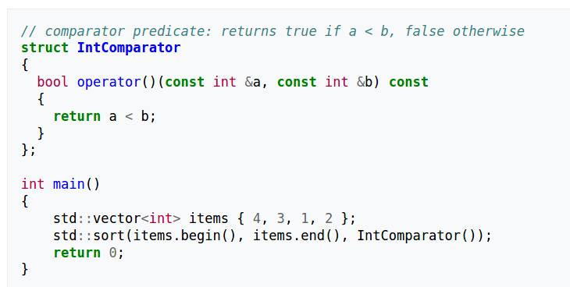
Function Object in STL

Slide 14
Function Object in STL
syntax for providing the callback to the std::sort() function is identical, but an object is passed instead of a function pointer
When invoked, the callback function is executed just as any other member function, and therefore has full access to the other members (data or functions) of the object.

Slide 15
Iterator in STL
Enables a programmer to traverse a container
Iterators are also comparable
There are five types of iterators:
Input iterators
Output iterators
Forward iterators
Bidirectional iterators
Random access iterators

Slide 16
Input Iterator in STL
Weakest as well as the simplest among all the iterators
Can be used in sequential input operations, where each value pointed by the iterator is read-only once and then the iterator is incremented
Can be used to modify data

Slide 17
Output Iterator in STL
Can be assigned values in a sequence, but cannot be used to access values
So, we can say that input and output iterators are complementary to each other.

Slide 18
Forward Iterator in STL
Combination of input as well as output iterators
Provides support to the functionality of both of them
Permits values to be both accessed and modified

Slide 19
Reverse Iterator in STL
to iterate backwards through a container

Slide 20
Bidirectional Iterator in STL
can be used to access the sequence of elements in a range in both directions
It is to be noted that containers like list, map, multimap, set and multiset support bidirectional iterators
This means that if we declare normal iterators for them, and then those will be bidirectional iterators, just like in case of vectors and deque they are random-access iterators

Slide 21
Random-access Iterator in STL
used to access elements at an arbitrary offset position relative to the element they point to, offering the same functionality as pointers.
Random-access iterators are the most complete iterators in terms of functionality.
All pointer types are also valid random-access iterators.

Slide 22
Algorithms in STL
Algorithms work into the process by providing a procedural means of manipulating data exclusively through the iterator interface.
STL contain an ocean of algorithms

Slide 23
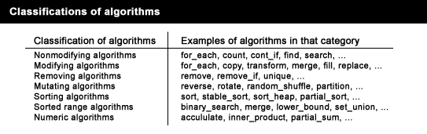
Algorithms in STL

Slide 24
Thank You

