Slide 1
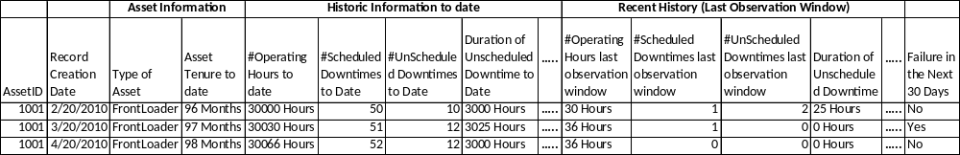
A Sliding window approach to prepare data for predictive maintenance
Observation Window : Time Elapsed since commissioning
Performance Window : Next One Month
1

