Slide 1

Project Title -Seasonal Agriculture Performance Analysis
Student Name-Shrishty Maheshwari
College Name- Career Point University
AICTE STU ID : STU69e468209d32e1776576544

Slide 2

PROBLEM STATEMENT
Agricultural activities are influenced by seasonal variations in environmental conditions, farming practices, resource availability and market conditions. As a result, agricultural performance may differ from one season to another. However, raw agricultural data does not clearly explain how agricultural performance changes across seasons or what patterns can be observed in different seasonal conditions. The problem is to analyze the given agricultural dataset and investigate seasonal differences in agricultural performance by identifying meaningful patterns, trends, relationships and variations within the available data.

Slide 3
Project Description This project analyze seasonal agriculture performance dataset containing 4,000 farm records covering environmental conditions, resource usage, and economic outcomes. The goal is to identify how agricultural performance, yield, production, profit, and resource efficiency varies across the Kharif, Rabi, and Zaid seasons. Using Python the dataset was cleaned, explored, and analyzed through season-wise comparisons, correlation analysis, and statistical techniques to form meaningful patterns and derive recommendations for better seasonal agricultural planning.

Slide 4

WHO ARE THE END USERS?
Farmers and agricultural planners - to make informed seasonal crop and resource decisions
Agricultural policy makers - for evidence based seasonal planning
Agro business and supply chain companies - to find seasonal yield and pricing trends
Researchers and students - studying seasonal agricultural patterns
Financial institutions - for finding seasonal risk in crop insurance and loans

Slide 5

Technology Used
Python
Pandas & NumPy (data cleaning and analysis)
Matplotlib & Seaborn (data visualization)
Google Colab

Slide 6
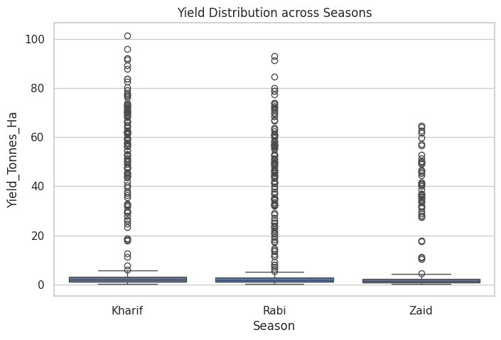
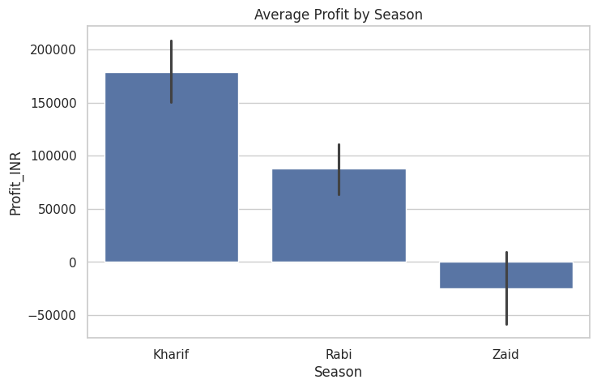
RESULTS

Slide 7
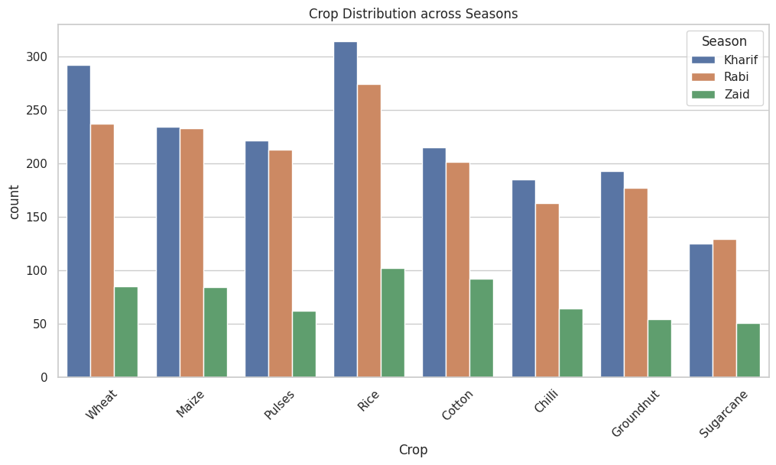
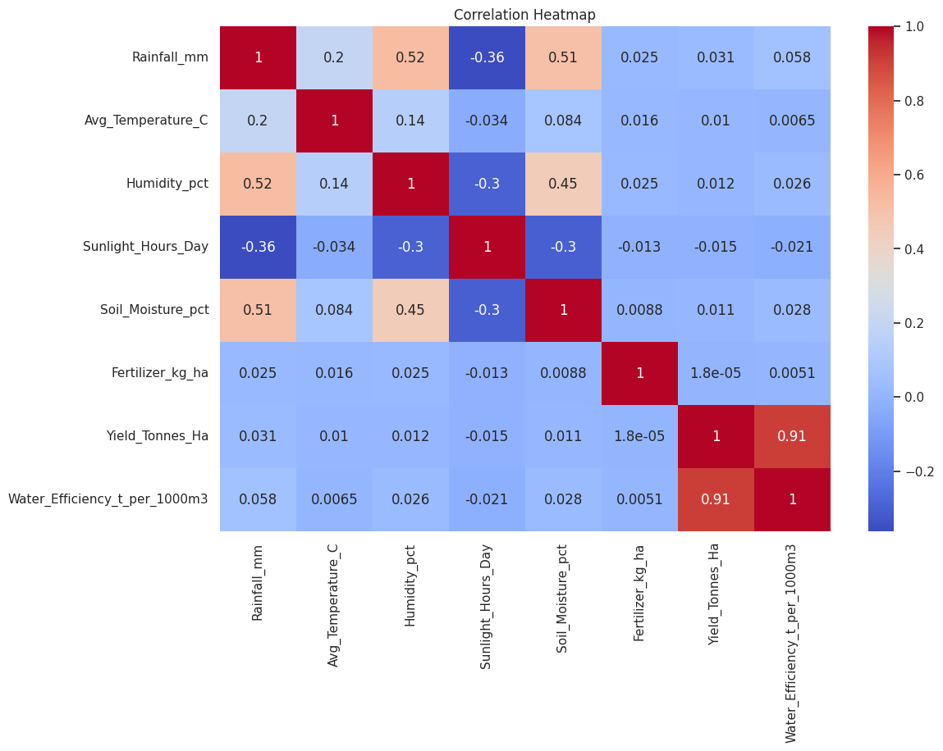
RESULTS

Slide 8
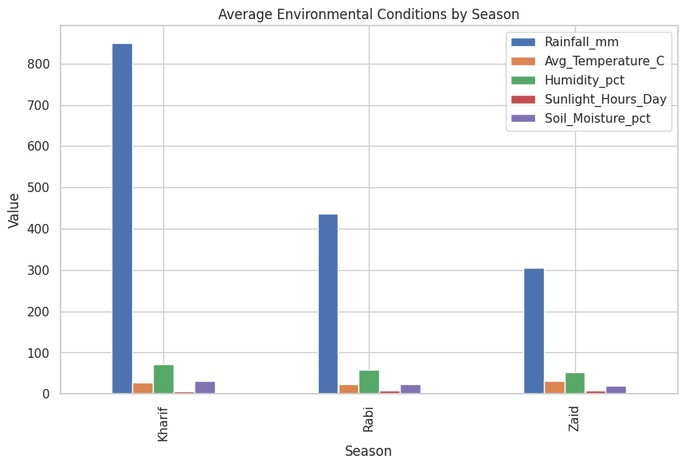
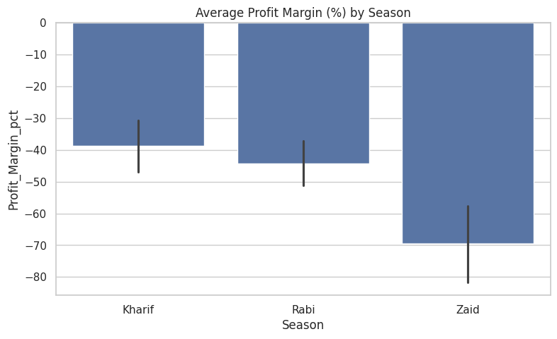
RESULTS
[Add screen shots of your code ]

Slide 9
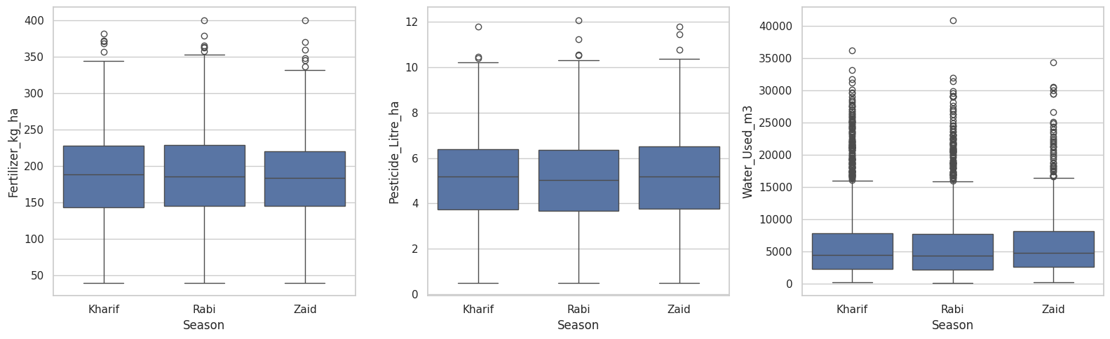
RESULTS
[Add screen shots of your code ]

Slide 10
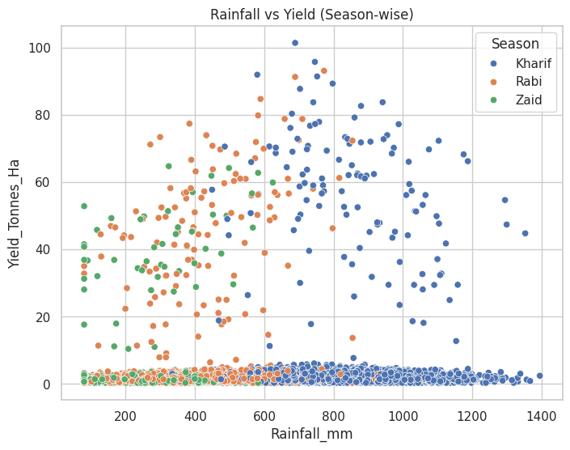
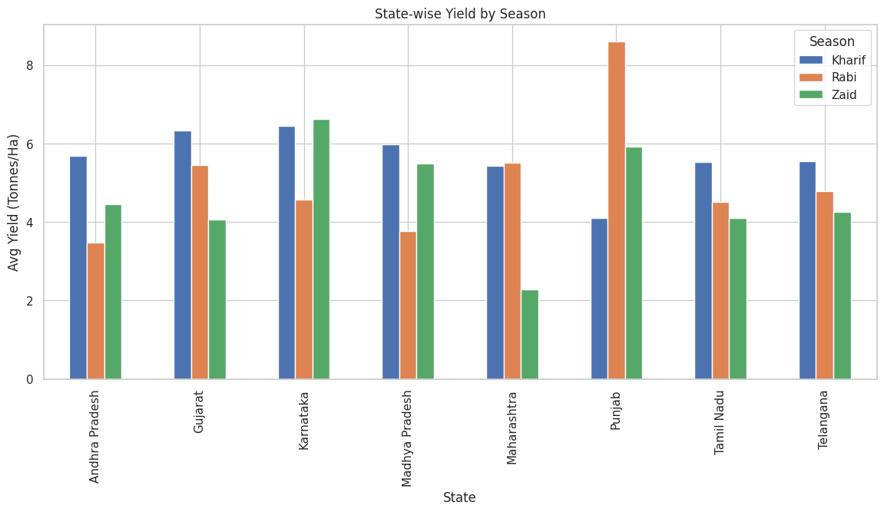
RESULTS
[Add screen shots of your code ]

Slide 11
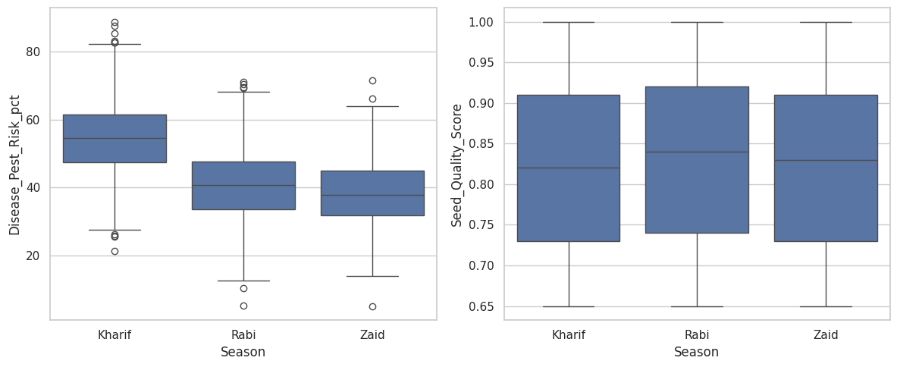
RESULTS
[Add screen shots of your code ]

Slide 12
Future scope
Extend analysis with multi year data to study long-term seasonal trend
Build a predictive model to forecast yield and profit based on seasonal conditions
Real time weather and market price data for dynamic recommendations
Develop a dashboard for farmers to get season-wise crop planning suggestions

Slide 13
GitHub Link
https://github.com/shrishtymaheshwari-afk/seasonal-agriculture-performance-analysis

Slide 14
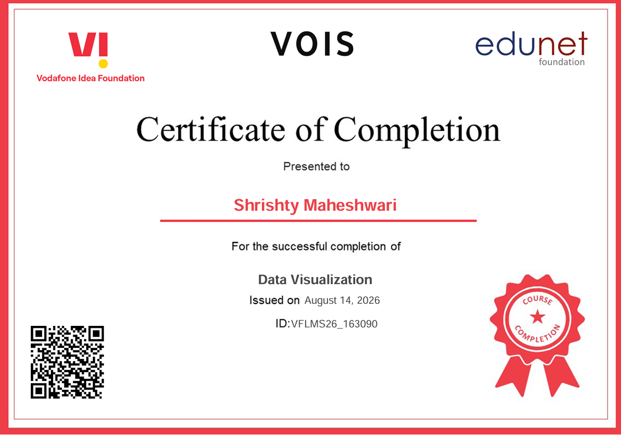
VOIS Course completion certificate - Course name- Data Visualization

Slide 15
Thank you
.
.

