Slide 1

JAIN COLLEGE OF ENGINEERING AND TECHNOLOGY DepartmentofComputer Science and Engineering Sai Nagar, Hubballi – 580 031
TOPIC – “EMPLOYEE LEAVE MANAGEMENT”
PRESENTED BY –
Mahboobkhan A S
Shrinidhi Potadar
Siddharth Daddi
Tajuddin Nadaf
GUIDED BY:
PROF.VISHWANATH H

Slide 2
Introduction
Our project addresses the challenge of efficiently managing employee leave requests and tracking leave balances within our organization. We've developed a user-friendly system that automates the leave application process,
provides real-time visibility of leave status, and enhances overall employee satisfaction and operational efficiency.
It gives smooth operation of organization while respecting employee rights and welfare.
Effective leave management system balances the needs of organization with the personal and professional needs of its employee.

Slide 3
LITERATURE SURVEY
1 Importance of Effective Leave Management
Effective leave management is critical for maintaining organizational productivity while ensuring employee satisfaction. It ensures that employees take necessary breaks without disrupting business operations, which is crucial for their health and work life balance.
2 Challenges in Leave Management
Despite its importance, many organizations struggle with managing employee leave efficiently. These challenges often result in disputes between employees and management, reduced employee morale, and potential legal issues. Identified several common challenges, including inadequate tracking systems, lack of transparency.
3 Technological Solutions
The advent of technology has provided several solutions to the challenges of leave management. Cloud based leave management systems offer automated tracking, real time data access, and improved compliance with legal requirements

Slide 4
Objective of the project
The objective of an employee leave management project is to ensure a seamless, efficient, and transparent process for handling employee leave requests.
This involves adhering to legal and regulatory requirements, streamlining application and approval procedures, and minimizing errors in leave records.
The project aims to enhance employee satisfaction by providing clear guidelines and fair leave policies, while also reducing the administrative workload for HR and Admins.

Slide 5
Implementation
Designing the User Interface
Login Page: Create a simple and secure login page.
Dashboard: Design a user dashboard with navigation to various functions (leave application, leave status, etc.).
Leave Application Form: Include fields for leave type, dates, reason, etc.
Leave Approval Workflow: Interface for Admin to approve or reject leave requests.
Reporting: Generate and view leave status.
Development
Technology Stack: Choose appropriate technologies ( HTML/CSS/JavaScript for front-end, Node.js, Php for back-end, SQL/mySQL for the database).
Authentication System: Implement user authentication and authorization.
Database Design: Create tables for users, leave requests, etc.
Designing the Admin Interface
Login Page: Create a simple and secure login page.
Dashboard: Design a admin dashboard with navigation to various functions ( display pending leaves , leave approve/reject, total leaves of employees, add/delete employees etc.).
Reporting: Generate and view leave status.

Slide 6
System Workflow
1. Employee Login and Leave Request Submission
Login:
Employee logs into the leave management system using their credentials.
Leave Request Form:
Employee accesses the leave request form.
Fills in details such as leave type (vacation, sick, etc.), start date, end date, and reason for leave.
Submit Request:
Employee submits the leave request.
2. Request Processing
Notification to Admin
3. Admin Review and Decision
Review Request:
Admin reviews the leave request details.
Decision:
Admin approves or rejects the request.
4. Notification and Update
Notification to Employee:
The system notifies the employee of the Admin's decision system notification.

Slide 7
Scope of the project
The scope of an employee leave management project includes developing and implementing a system to streamline the process of requesting, approving, and tracking employee leave.
This involves designing a user-friendly interface for employees to submit leave requests, an administrative dashboard for managing and approving these request.
The project aims to reduce administrative workload, and enhance transparency and accuracy in leave records.
Additionally, the project will cover the setup of reporting and analytics features to monitor leave patterns and support data-driven decision-making.

Slide 8
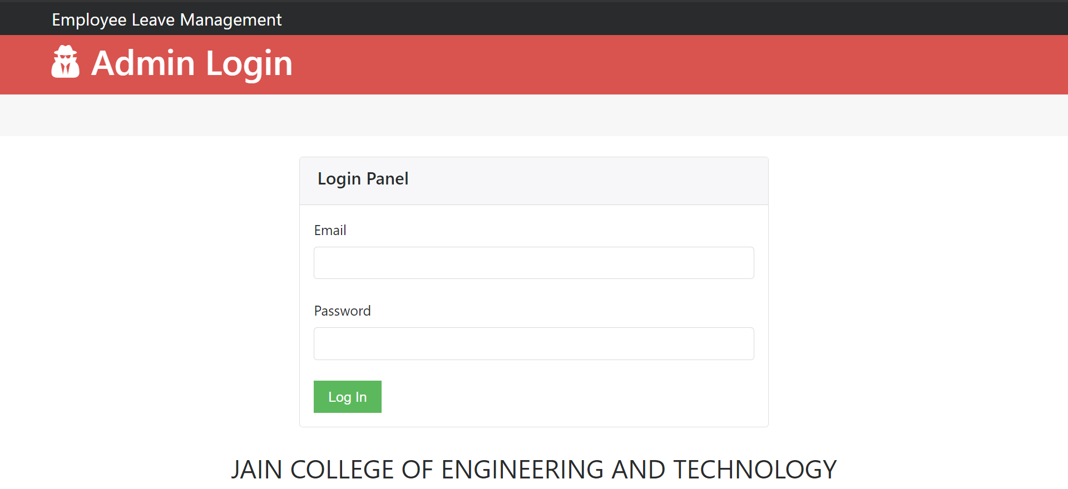
Results:
Admin Login Page

Slide 9
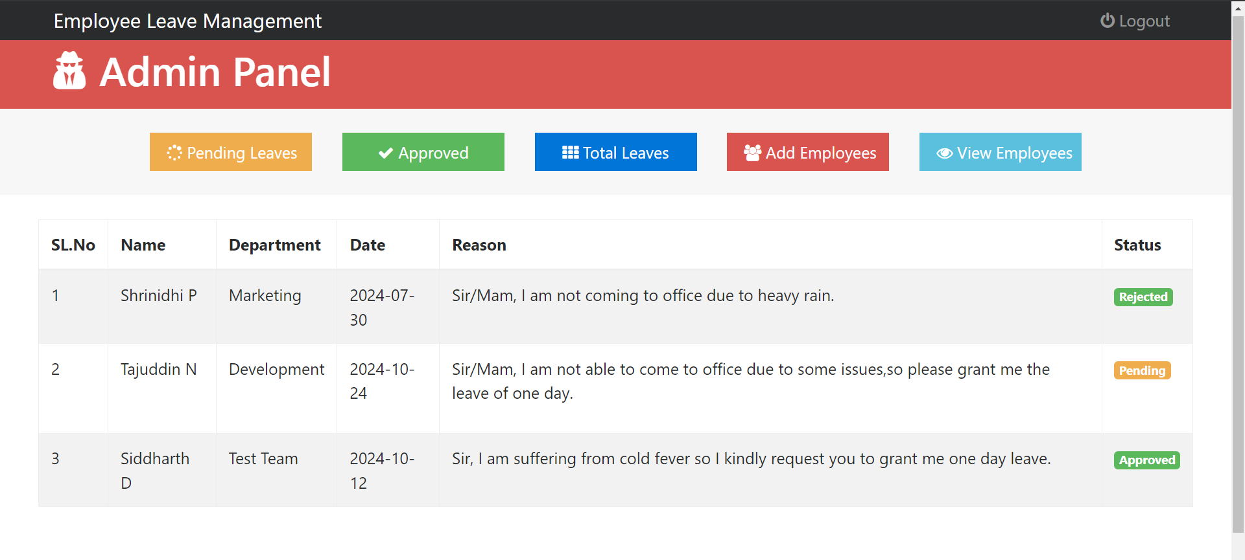
Admin Dashboard:
To view the leave requests of the employees.

Slide 10
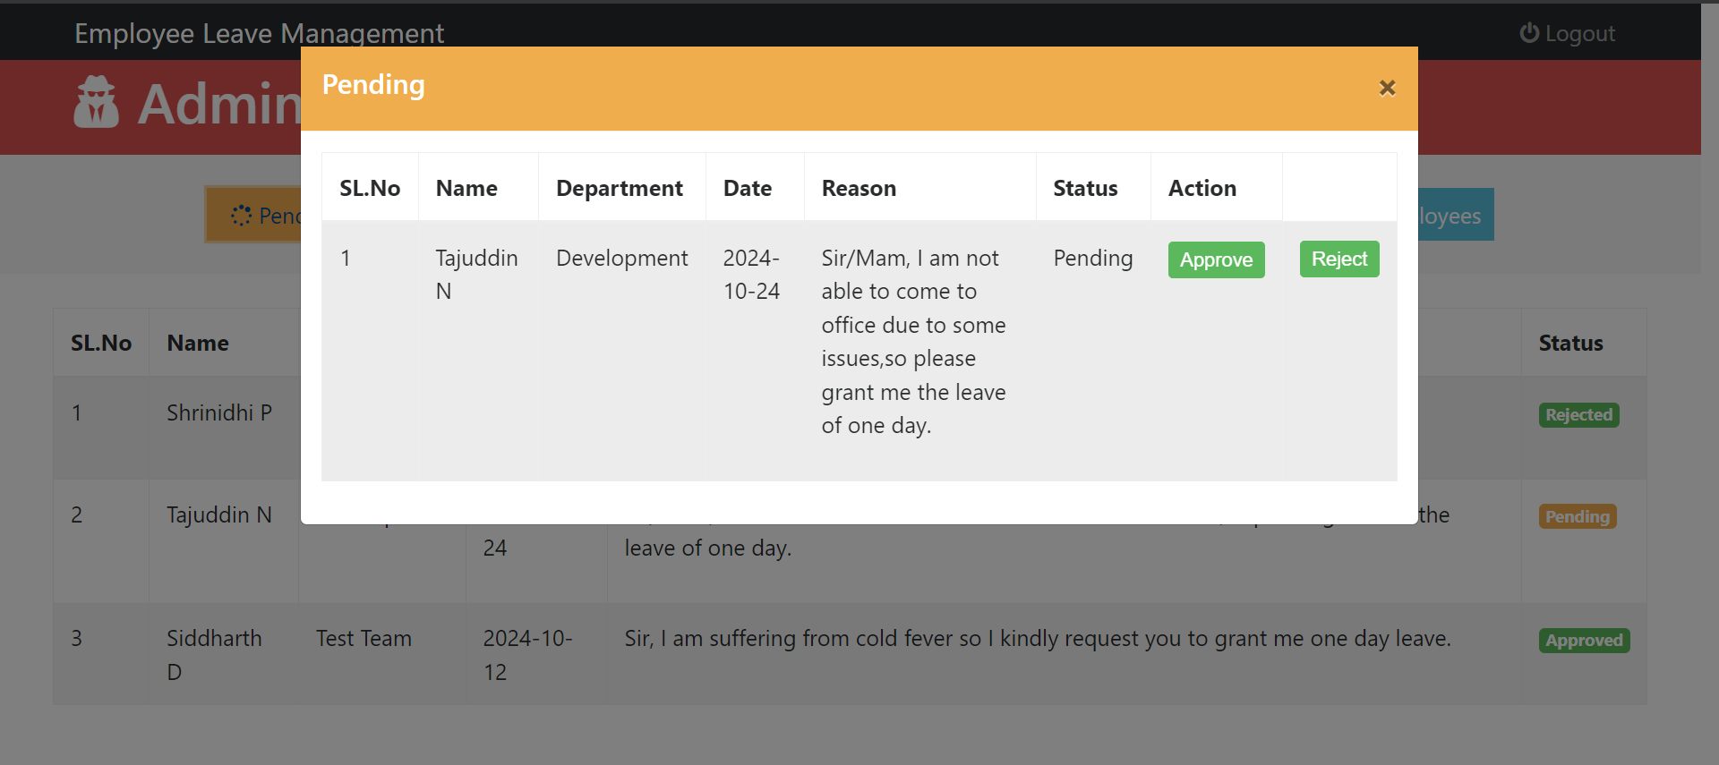
Pending Leaves:
List of leaves waiting for the approval.

Slide 11
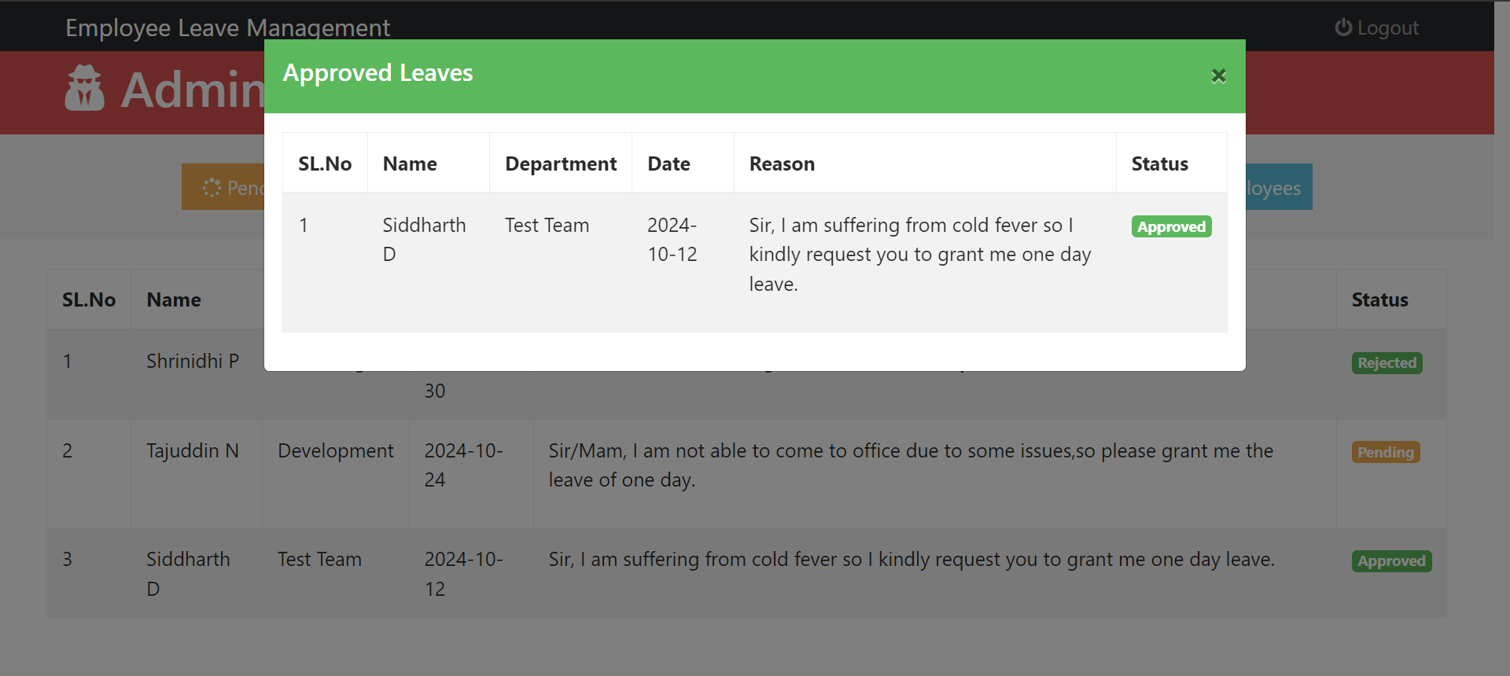
Approved Leaves:
Total list of approved leaves of employees.

Slide 12
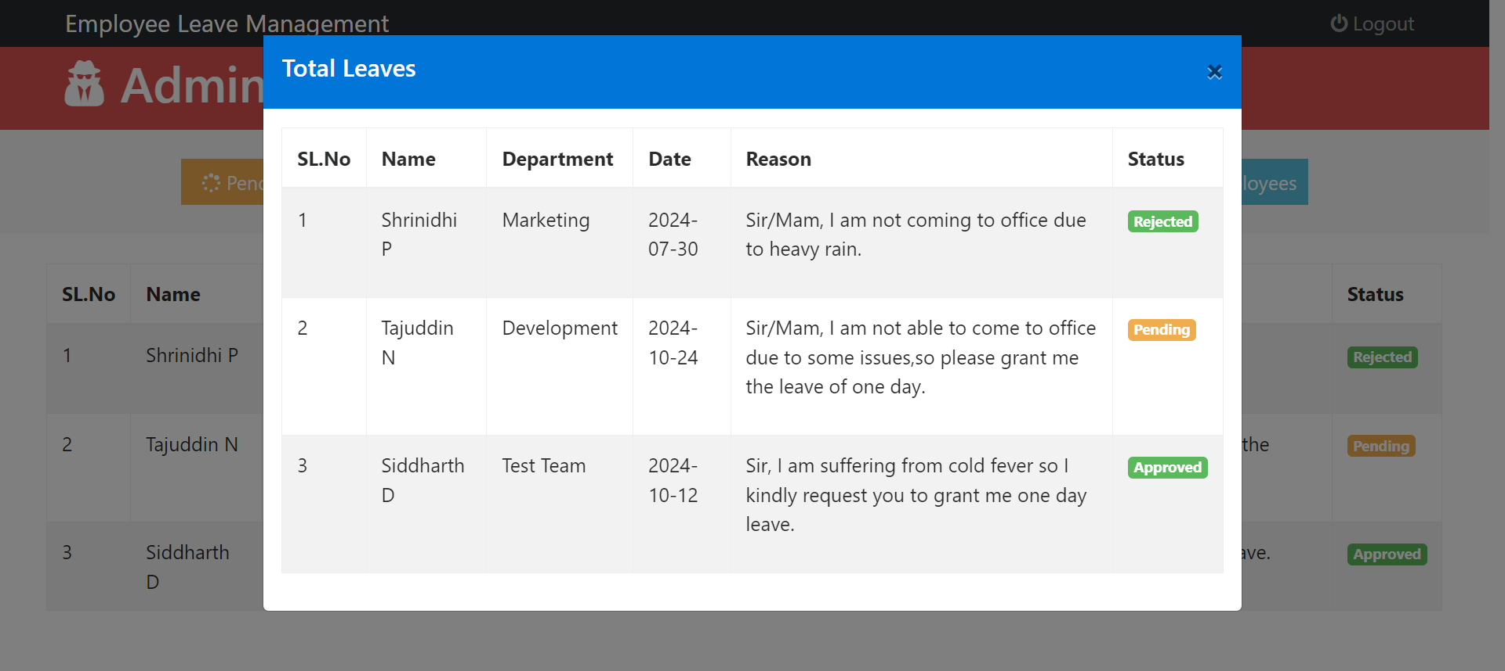
Total Leaves:
Total leaves applied by the employees.

Slide 13
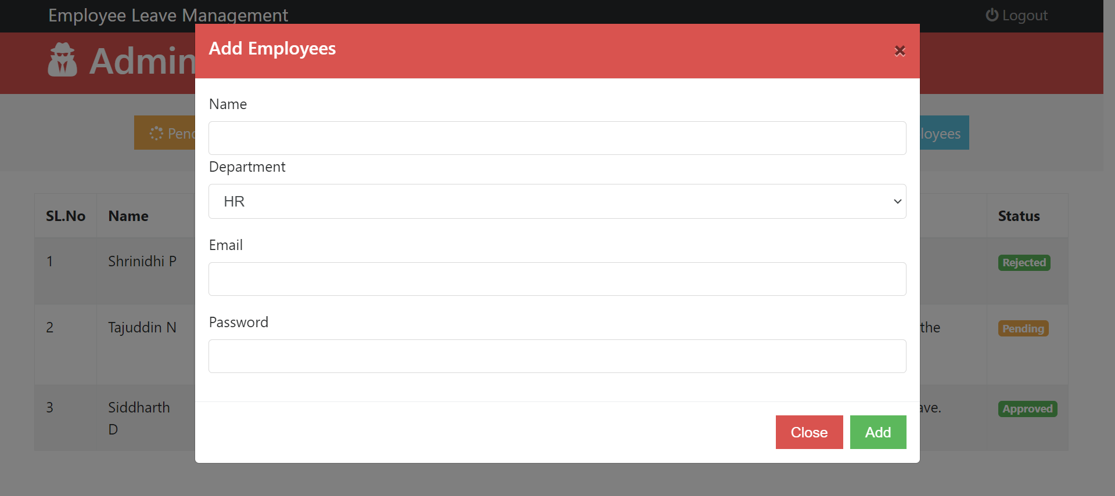
Add Employee:
Admin can add the employees.

Slide 14
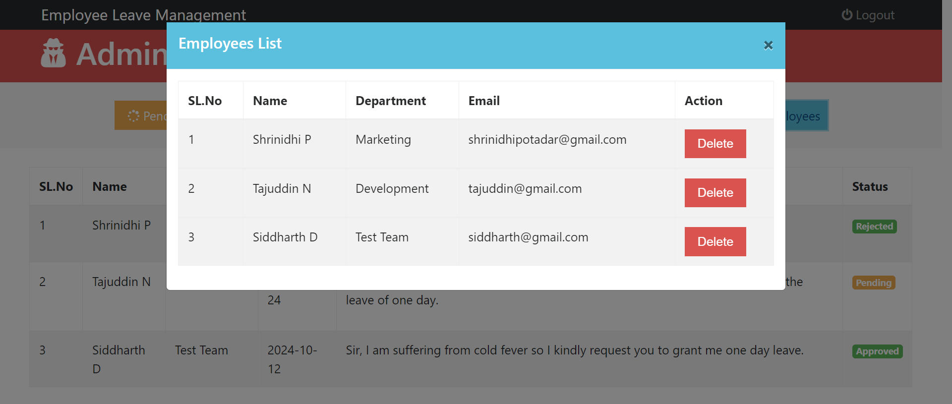
View/Delete Employee:
Admin can view the list of all employees and delete the employees.

Slide 15
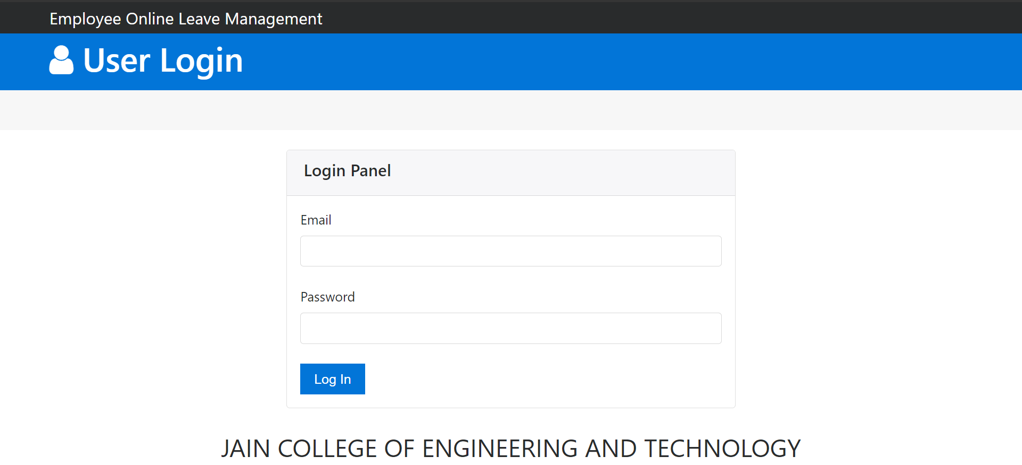
User Login Page:
User needs to add the email and password for the login.

Slide 16
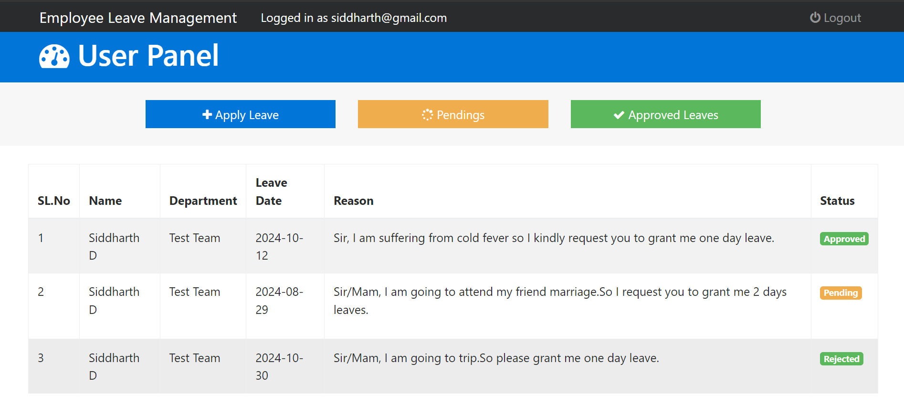
User Dashboard:
It contains the list of leaves that the user applied.

Slide 17
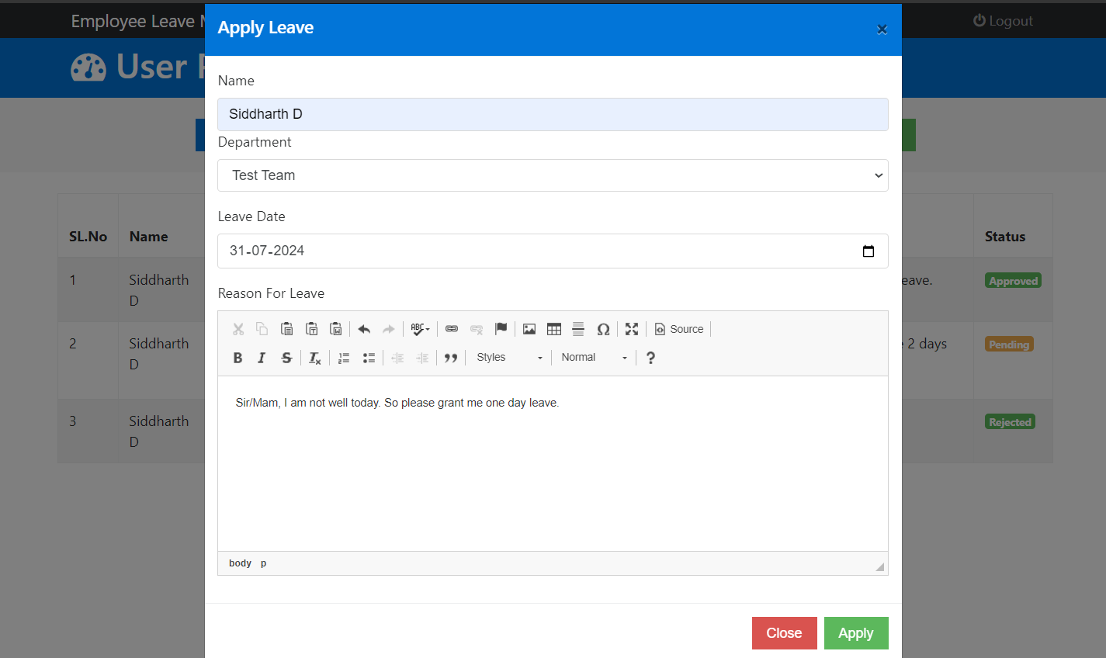
Apply leave:
The leave application form will be opened for applying the leave.

Slide 18
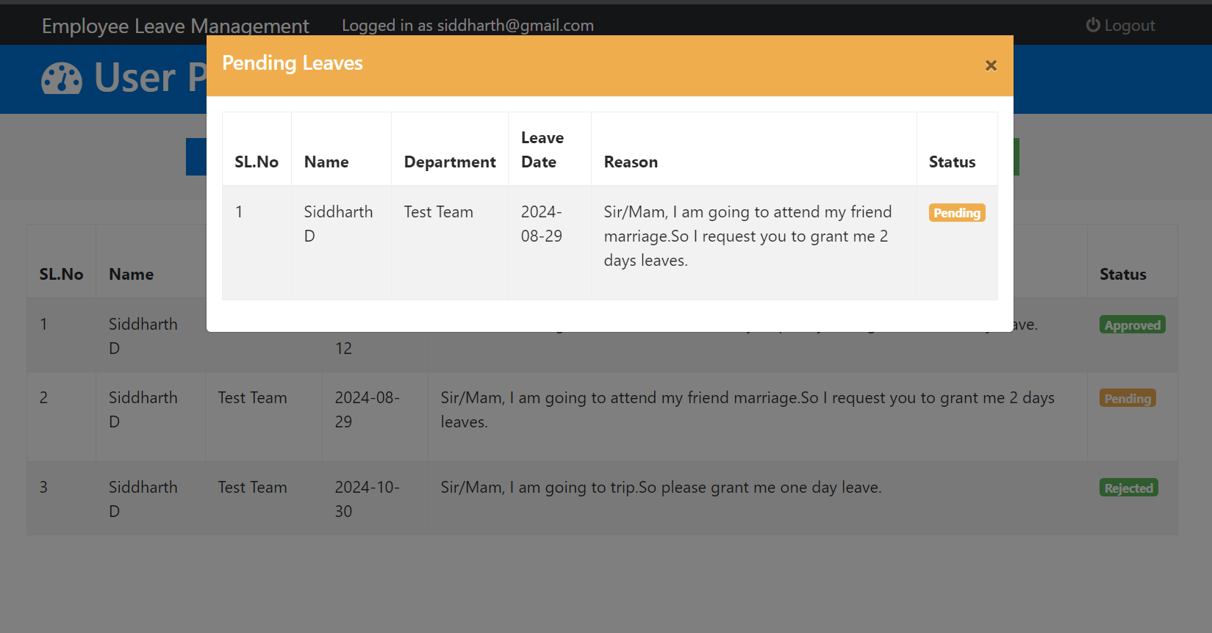
Pending Leave:
It will display the list of leaves which are at the pending.

Slide 19
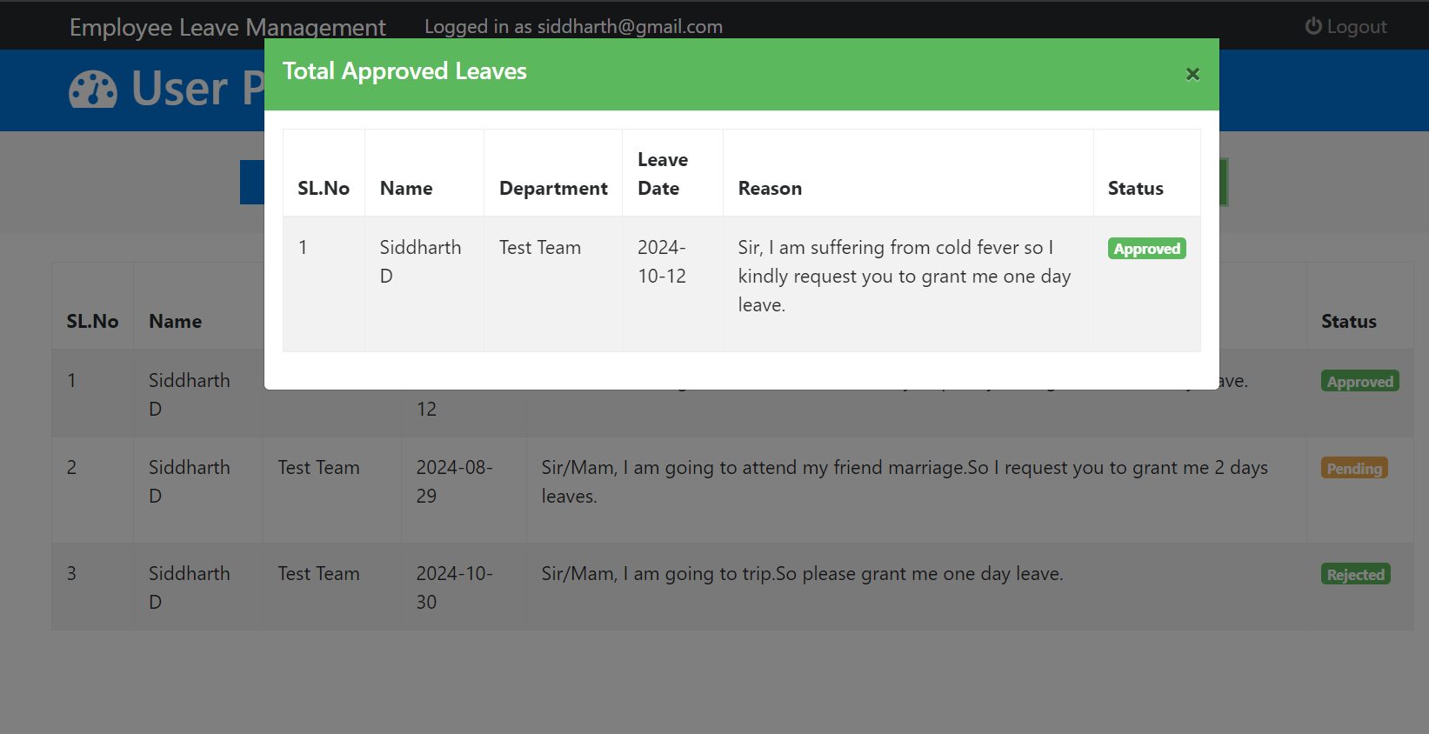
Approved Leave:
The total list of the leaves which are approved by the admin.

Slide 20
Conclusion
In conclusion, effective employee leave management is essential for maintaining a well-organized and productive workplace.
By implementing a streamlined system for handling leave requests, approvals, and tracking, reduce administrative burdens, and improve employee satisfaction.
A well-managed leave system not only supports employees in balancing their work and personal lives but also contributes to overall operational efficiency and better resource planning.

Slide 21
Future Scope
The future scope of employee leave management lies in leveraging advanced technologies and data analytics to further enhance efficiency and flexibility.
This includes integrating artificial intelligence to predict leave patterns and automate approvals, implementing more personalized leave policies through machine learning, and using real-time data to optimize workforce planning.
Additionally, the rise of remote work and flexible schedules will drive the need for more adaptive leave management solutions that accommodate diverse working arrangements and support a more dynamic work environment.

Slide 22
THANK YOU

