Slide 1


BIRLA INSTITUTE OF TECHNOLOGY, MESRA
Hand gesture recognition using artificial neural network
Project guide –
Group Member-
SHILPA MEENA 7BE/4143/10
SHRISTI PRIYA 7BE/4249/10
MAY 9, 2014

Slide 2
Contents
Introduction
Aim
Objectives
Artificial neural networks model
General description of hand gesture recognition methods
Proposed System Implementation Flow Chart
Samples
Observation table
Result
Conclusion
Scope and enhancement
Advantage and Disadvantage of Using Neural Network for Skin detection
References
MAY 9, 2014

Slide 3
AIM
The aim of this project is to develop Hand Gesture recognition system in MATLAB through image processing using Artificial Neural Network.
The Skin detection algorithm is implemented for skin segmentation followed by the geometrical method approach through which Image orientation is decided and thus the classification of the sample images with respect to the target images is done.
Optimization of result using NNTool is done.

Slide 4
OBJECTIVES
MATLAB is one of the tools used for gesture recognition.
In previous semester our project was focused on gesture recognition without skin detection using four different target images orientations (0 degree, 90 degree, 180 degree and 270 degree).
New algorithm was proposed for the different input samples to decide the orientation of input image. And the result was optimized using NNTool.
In this semester our main objectives are real time acquisition of hand gesture and skin detection of the captured images using eight different target images orientations (0 degree, 45 degree, 90 degree, 135 degree, 180 degree, 225 degree, 270 degree, 315 degree) then proposing algorithm to decide the orientation and further optimizing the results using the NNTool.

Slide 5
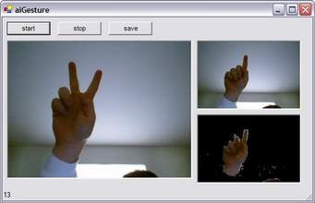
INTRODUCTION
In recent few years, hand gesture recognition systems received great attention because of their various applications, such as human computer interactive systems; they facilitate communication between the deaf, and hearing people in the real life situations.
This presents a general approach for hand gesture recognition systems using Artificial Neural Network
The essential aim is to develop real time hand gesture recognition system using NN tool in MATLAB by developing a natural interaction between human and computer.
MAY 9, 2014

Slide 6
Artificial neural network
Artificial neural network is a very general and one of the most used approaches for hand gesture recognition. Artificial Neural Networks are systems of interconnected "neurons" that can compute values from inputs by feeding information through the network.
These models are inspired by central nervous systems (brain) that are capable of machine learning and pattern recognition.
An Artificial Neural Network is an information processing paradigm that works by the way, as the biological nervous system (brain), process information.
MAY 9, 2014

Slide 7
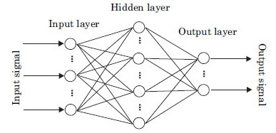
Artificial neural network (continued)
The key element of this paradigm is the novel structure of the information processing system. It is composed of a large number of highly interconnected processing elements called neurons, working in unison to solve specific problems.
MAY 9, 2014

Slide 8
Artificial neural network (continued)
NNTooL
In Matlab Neural Network Tool is used for generating the Artificial Neural Network used as the optimizing network for the gestures.
The Neural Network Toolbox software uses the network object to store all of the information that defines a neural network.
The Neural Network Design textbook includes:
1 An Instructor’s Manual for those who adopt the book for a class
2 Transparency Masters for class use

Slide 9
Artificial neural network (continued)
This gives us some idea of how the network object is organized. For many applications, we need not to be concerned about making changes directly to the network object, since that is taken care of by the network creation functions.
It is usually only when we want to override the system defaults that it is necessary to access the network object directly. Later topics will show how this is done for particular networks and training methods.
If we would like to investigate the network object in more detail, we will find that the object listing, such as the one shown above, contains links to help files on each sub object. Just click the links, and we can selectively investigate those parts of the object that are of our interest.

Slide 10
GENERAL DESCRIPTION OF HAND GESTURE RECOGNITION METHODS
Many researches have been suggested on gesture recognition system for different applications, with different recognition phases, but they all agree with the main structure of the gesture recognition system.
MAY 9, 2014

Slide 11
GENERAL DESCRIPTION OF HAND GESTURE RECOGNITION METHODS
Image Acquisition
2. Skin Detection
2.1 HSV Evaluation
2.2 YCbCr Evaluation
2.3 RGB Evaluation
3. Pre-processing
3.1 Segmentation
3.2 Edge detection
3.2 Background Removal
3.3 Noise Removal
4. Feature Extraction
4.1 Centroid Method
5. Classification

Slide 12
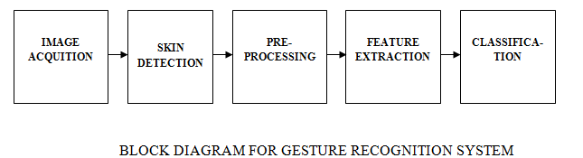
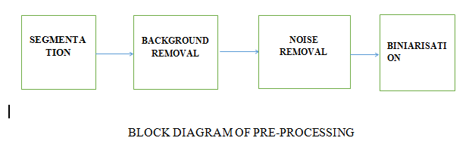
GENERAL DESCRIPTION OF HAND GESTURE RECOGNITION METHODS. (CONTINUED)
PREPROCESSING INCLUDE VARIOUS METHODS WHICH ARE IMPLEMENTED TO ENHANCE THE INFORMATION IN THE GIVEN IMAGES. IT INCLUDES THE STEPS AS
MAY 9, 2014

Slide 13
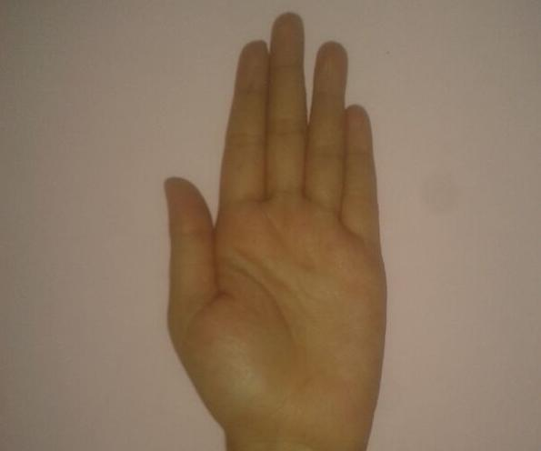
GENERAL DESCRIPTION OF HAND GESTURE RECOGNITION METHODS.(CONTINUED)
1.IMAGE ACQUISITION-
The first step of any vision system is the image acquisition step. Image acquisition is technique in which the data from an image are digitized and various mathematical operations are applied to the data in order to create an enhanced image that is to perform some of the interpretation and recognition tasks.
MAY 9, 2014

Slide 14
GENERAL DESCRIPTION OF HAND GESTURE RECOGNITION METHODS.(CONTINUED)
2. SKIN DETECTION
Skin detection process has two phases: a training phase and a detection phase. Training a skin detector involves three basic steps:
1. Collecting a database of skin patches from different images. Such a database typically contains skin-colored patches from a variety of people under different illumination conditions.
2. Choosing a suitable color space.
3. Learning the parameters of a skin classifier.
Given a trained skin detector, identifying skin pixels in a given image or video frame involves:
1. Converting the image into the same color space that was used in the training phase.
2. Classifying each pixel using the skin classifier to either a skin or non-skin.
3. Typically post processing is needed using morphology to impose spatial homogeneity on the detected regions.

Slide 15
GENERAL DESCRIPTION OF HAND GESTURE RECOGNITION METHODS.(CONTINUED)
PROCESS
In any given color space, skin color occupies a part of such a space, which might be a compact or large region in the space. Such region is usually called the skin color cluster.
A skin classifier is a one-class or two-class classification problem. A given pixel is classified and labeled whether it is a skin or a non-skin given a model of the skin color cluster in a given color space. In the context of skin classification, true positives are skin pixels that the classifier correctly labels as skin.
True negatives are non-skin pixels that the classifier correctly labels as non-skin. Any classifier makes errors: it can wrongly label a non-skin pixel as skin or a skin pixel as a non-skin. The former type of errors is referred to as false positives (false detections) while the later is false negatives.

Slide 16
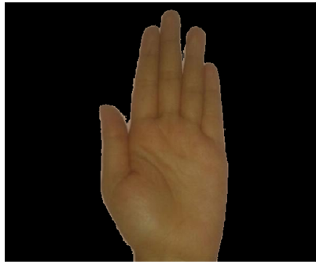
GENERAL DESCRIPTION OF HAND GESTURE RECOGNITION METHODS.(CONTINUED)
INPUT IMAGE - OUTPUT IMAGE-

Slide 17
GENERAL DESCRIPTION OF HAND GESTURE RECOGNITION METHODS.(CONTINUED)
2.PREPROCESSING-
After image acquisition we do pre-processing of the image, it is a very important part of the gesture recognition, as the image captured is needed to be made suitable for further processing i.e., feature extraction. Pre-processing include segmentation edge detection and noise removal of segmented image. In pre-processing, it is necessary to be able to distinguish the region of foreground and background in a given image, it involves detecting and extracting hand region from background.

Slide 18
GENERAL DESCRIPTION OF HAND GESTURE RECOGNITION METHODS.(CONTINUED)
2.1 SEGMENTATON-
The output of this step is a binary image in which skin pixels have value ‘1’ and non-skin pixels have value ‘0’. If we take close look to the segmented image after applying the Otsu algorithm on the original gray scale image we find that the segmentation is not perfectly done.
MAY 9, 2014

Slide 19
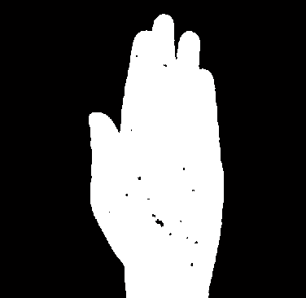
GENERAL DESCRIPTION OF HAND GESTURE RECOGNITION METHODS.(CONTINUED)
INPUT IMAGE OUTPUT IMAGE

Slide 20
GENERAL DESCRIPTION OF HAND GESTURE RECOGNITION METHODS.(CONTINUED)
2.2 EDGE DETECTION-
Edge detection of the hand by using an algorithm like Canny Edge Detection AND Enlargement of the edges of regions of foreground pixels by using Dilation to get a continuous edge, Filling of the object enclosed by the edge. THEN Storing the boundary of the object in a linear array AND Vectorization operation performed for every pixel on the boundary.

Slide 21
GENERAL DESCRIPTION OF HAND GESTURE RECOGNITION METHODS.(CONTINUED)
OUTPUT IMAGE-

Slide 22
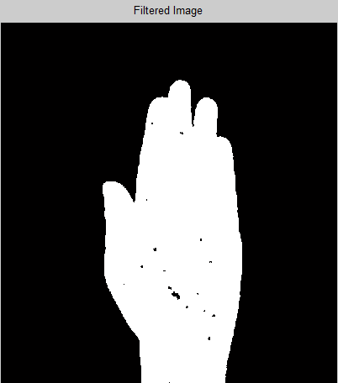
2.3 BACKGROUND REMOVAL- Background may have some 1s which is known as background noise and hand gesture may have some 0s that is known is gesture noise. 2.4 NOISE REMOVAL- These errors can lead to a problem in contour detection of hand gesture, so we need to remove these errors.
GENERAL DESCRIPTION OF HAND GESTURE RECOGNITION METHODS.(CONTINUED)

Slide 23
GENERAL DESCRIPTION OF HAND GESTURE RECOGNITION METHODS.(CONTINUED)
FEATURE EXTRACTIONS-
The features are the useful information that can be extracted from the segmented hand object by which the machine can understand the meaning of that posture. The numerical representation of these features can be obtained from the vision perspective of the segmented hand object which forms the feature extraction phase.
TWO METHODS
GEOMETRICAL- CENTROID METHOD
NON GEOMETRICAL- TEXTURE , COLOR, SKIN DETECTION and then implementation of the geometric method

Slide 24
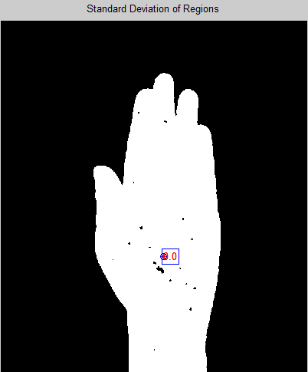
GENERAL DESCRIPTION OF HAND GESTURE RECOGNITION METHODS.(CONTINUED)
Geometric centroid method We have use region Crops function in matlab to calculate both the centroid and weighted centroid of objects in the image.
INPUT IMAGE - OUTPUT IMAGE-

Slide 25
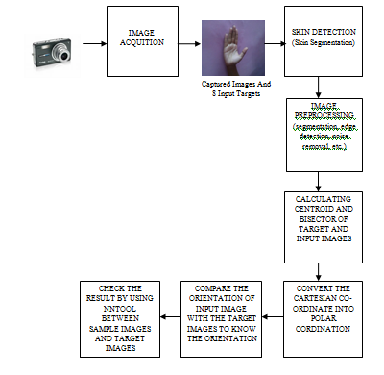
PROPOSED SYSTEM IMPLEMENTATION FLOW CHART

Slide 26
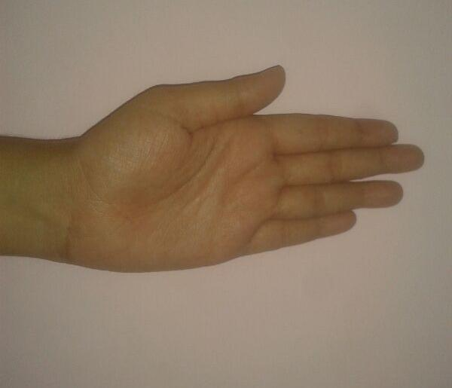
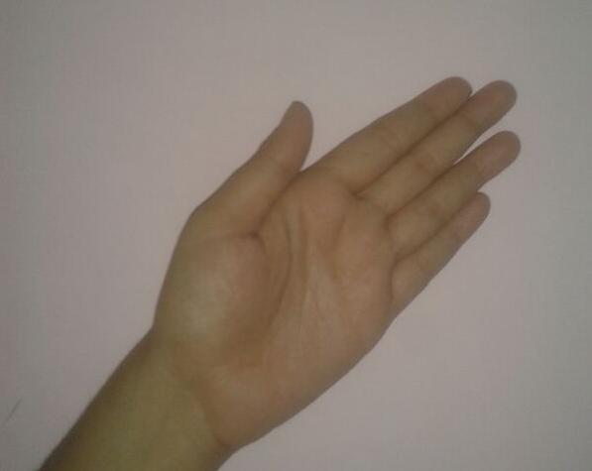
SAMPLES (TARGET SAMPLES)
1.TARGET IMAGES
ORIENTATION ZERO DEGREE
OREINTATION 45 DEGREE
MAY 9, 2014

Slide 27
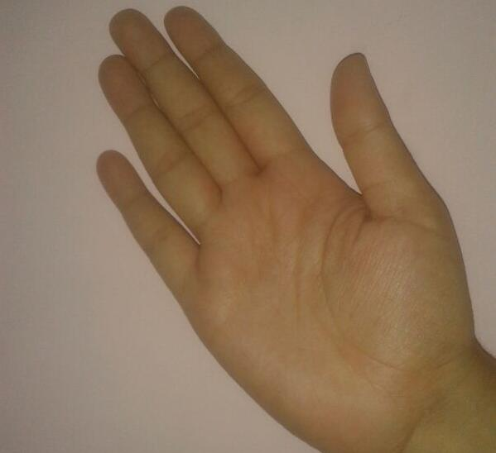
SAMPLES (TARGET SAMPLES)
OREINTATION 90 DEGREE
OREINTATION 135 DEGREEE
MAY 9, 2014

Slide 28
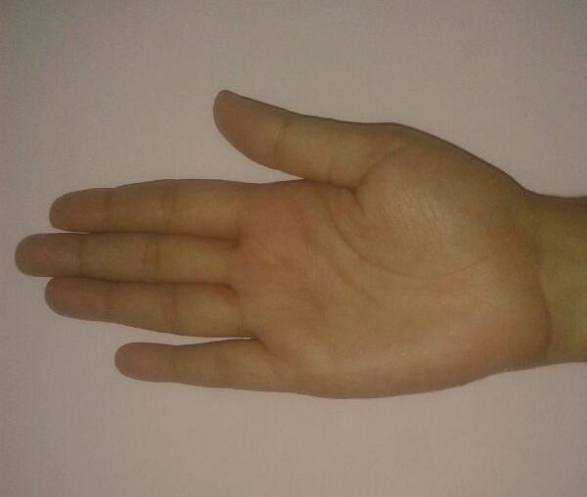
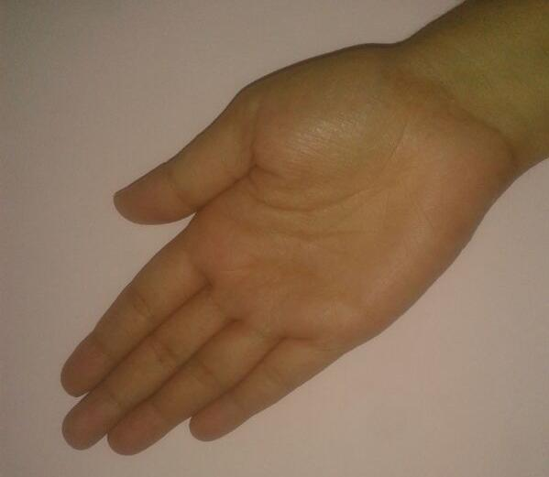
SAMPLES (TARGET SAMPLES)
ORIENTATION 180 DEGREE
OREINTATION 225 DEGREE

Slide 29
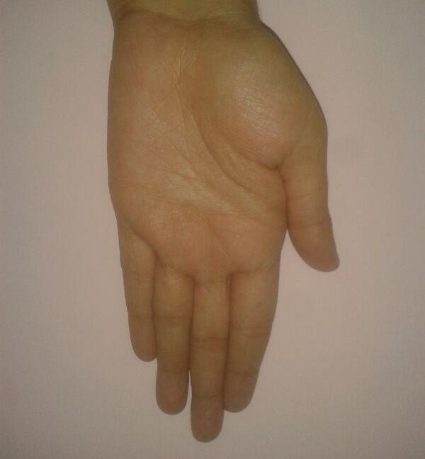
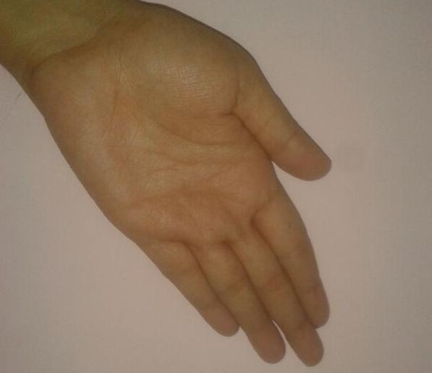
SAMPLES (TARGET SAMPLES)
OREINTATION 270 DEGREE
OREINTATION 315 DEGREE

Slide 30
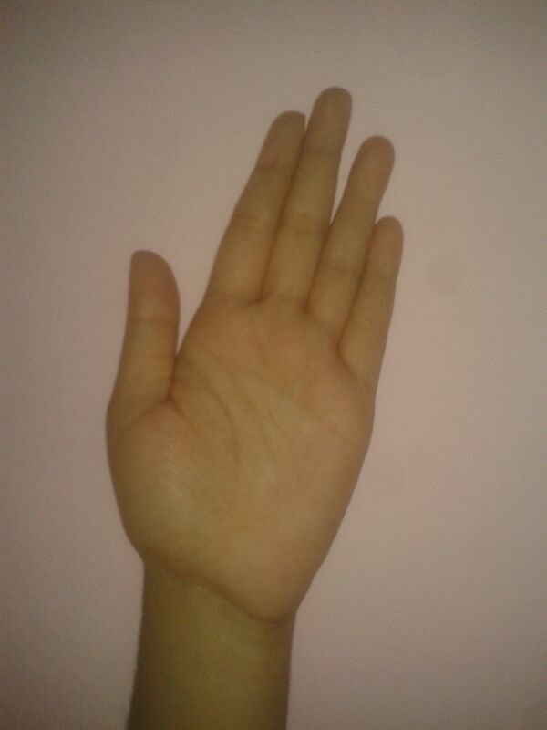
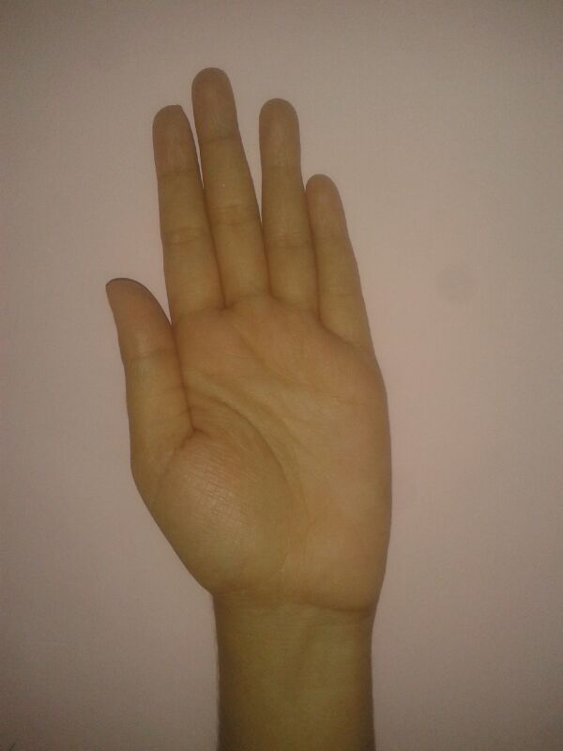
SAMPLES (INPUT SAMPLES)
Input 1
Input 2

Slide 31
Observation table
SKIN DETECTION

Slide 32
OBSERVATION TABLE (CONTINUED)
NOISE REMOVAL

Slide 33
Observation Table (CONTINUED)
Centroid

Slide 34
RESULT (COMPARISION RESULT)
th1 =312.0982 283.3707(Input1)
th2 =298.0000 248.5038(Target1)
th3 =299.0027 237.9975(Target2)
th4 =300.5009 258.0002(Target3)
th5 =299.0018 258.0049(Target4)
th6 =300.5003 324.4980(Target5)
th7 =299.9994 261.0008(Target6)
th8 = 300.5013 254.4999(Target7)
th9 =300.0002 274.5006(Target8)

Slide 35
RESULT (COMPARISION RESULT)
x1=th1-th2
x2=th1-th3
x3=th1-th4
x4=th1-th5
x5=th2-th3
x6=th2-th4
x7=th2-th5
x8=th3-th4
x9=th3-th5
x10=th4-th5

Slide 36
RESULT (COMPARISION RESULT)
The output of the above comparisons
x1 =14.0982 34.8670 a=x1(2)
x2 =13.0956 45.3732 b=x2(2)
x3 =11.5973 25.3705 c=x3(2)
x4 =13.0964 25.3658 d=x4(2)
x5 = -1.0026 10.5062 e=x5(2)
x6 = -2.5009 -9.4965 f=x6(2)
x7 = -1.0018 -9.5012 g=x7(2)
x8 = -1.4983 -20.0027 h=x8(2)
x9 = 0.0009 -20.0074 i=x9(2)
x10 = 1.4992 -0.0047 j=x10(2)
A=[a b c d e f g h i j]
B=min(A)

Slide 37
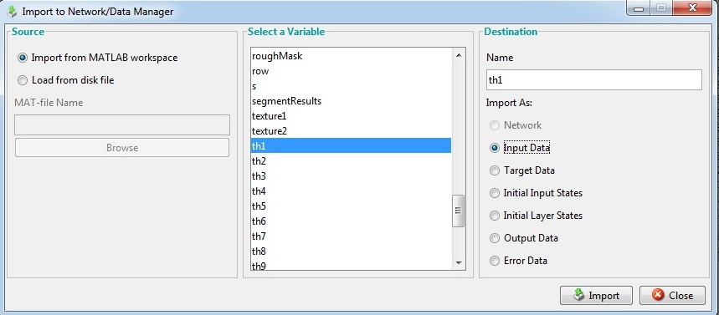
RESULT (OPTIMISATION USING NNTOOL)
Import from MATLAB the value of theta of Input Data

Slide 38
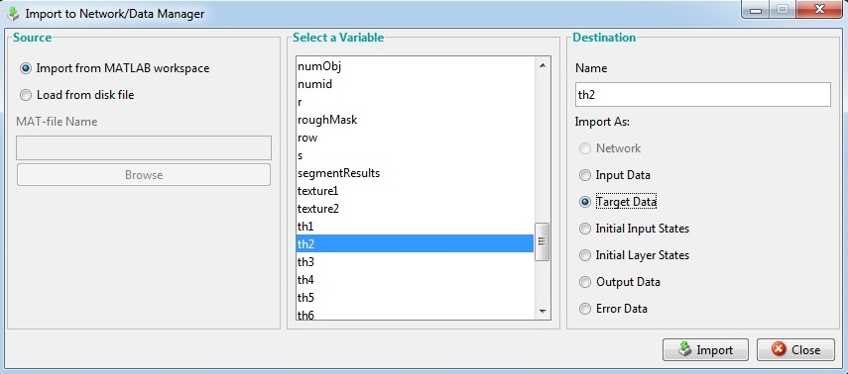
RESULT(OPTIMISATION USING nnTOOL)
Import from MATLAB the value of theta of Target Data

Slide 39
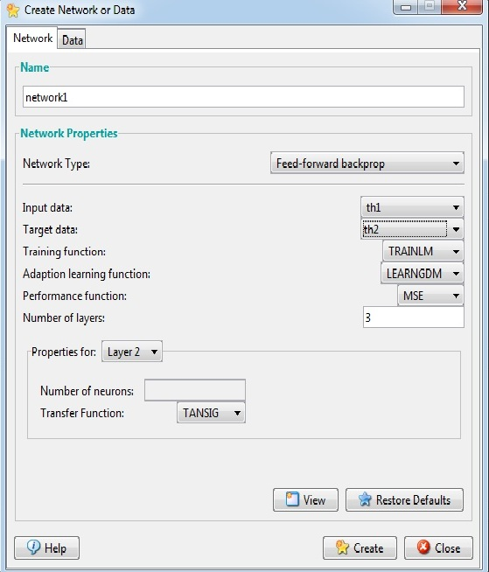
RESULT(OPTIMISATION USING nnTOOL)
Creating Networking

Slide 40
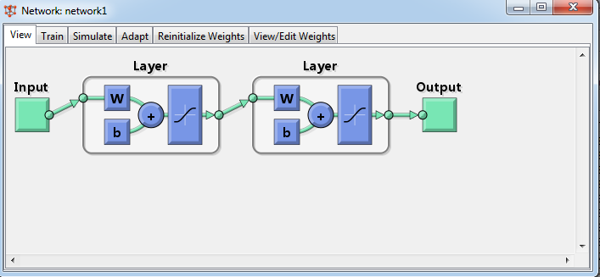
RESULT(OPTIMISATION USING nnTOOL)
Networks 1 created

Slide 41
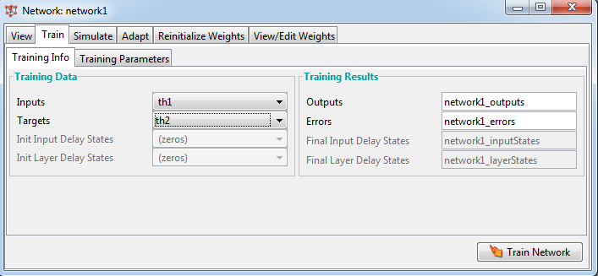
RESULT(OPTIMISATION USING nnTOOL)
Training

Slide 42
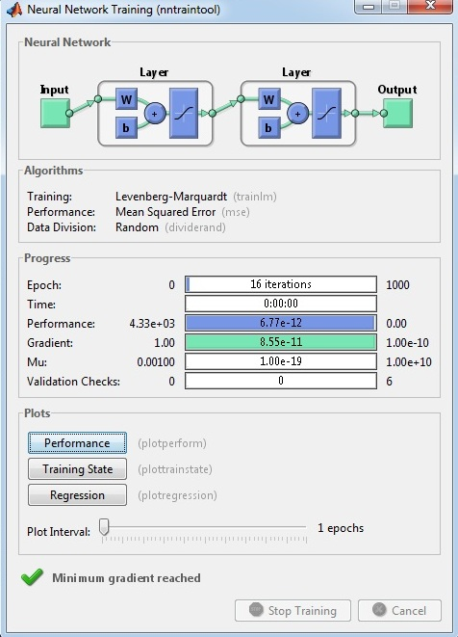
Training of the network

Slide 43
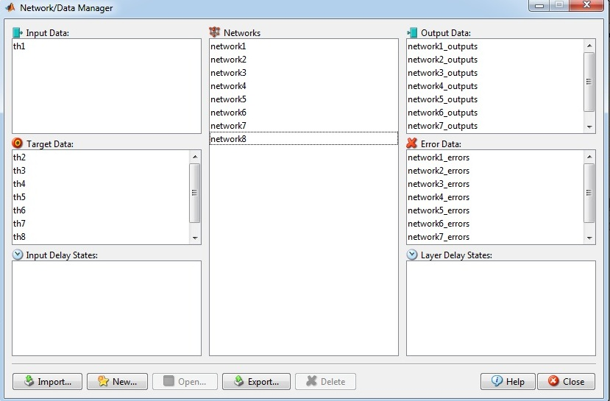
Network Data Manager describing all the networks’ output data and error data

Slide 44
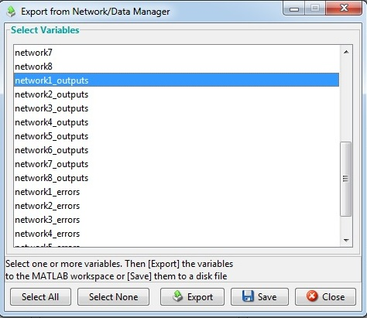
Variables of the network
are exported to the
workspace

Slide 45
The errors obtained by the NNTool for the sample and target images are given below:
Error for network 1
[-1.7008e-006 2.5708e-007]
Error for network 2
[-2.0179e-006 1.008e-006]
Error for network 3
[-1.3909e-009 0]
Error for network 4
[-2.2332e-006 5.9765e-008]
Error for network 5
[-9.9629e-007 2.5492e-006]
Error for network 6
[-4.1408e-007 2.2096e-006]
Error for network 7
[-3.4937e-006 1.158e-006]
Error for network 8
[-3.2673e-006 1.4828e-006]

Slide 46
Result Of NNTool
The minimum error of input image is optimized. For input image 1 the networks are created between the sample and the targets and the neural network is trained which gives the network errors. The network errors give us the information regarding how much the input or the sample image is closer or falls in the category of the target image. Here the second network created gives us the minimum error and thus we can conclude that the input image falls in the category of target image 2 of orientation of 45 degrees. Thus this approach of using NNTool can be used for different image orientations analysis.

Slide 47
CONCLUSION
In this project, we have discussed how hand gestures recognition can be done using MATLAB and optimization of results is done using NNTool in MATLAB. NNTool is based on Artificial Neural Network concept.
We are using camera as a detecting device as well as input device for Reality System. One of the most effective of software computing techniques is Artificial Neural Networks that has many applications on hand gesture recognition problem.
The eight target images of different orientations (0 degree, 45 degree, 90 degree, 135 degree, 180 degree, 225 degree, 270 degree, 315 degree) and input samples are captured using image acquisition toolbox and went under skin segmentation where skin detection algorithm is applied on them.
The image is converted in skin pixel and non skin pixels and further the preprocessing is done on the skin detected images like edge detection, background removal, noise removal, and binarization.

Slide 48
CONCLUSION
Then feature extraction must be done, different methods can be used like geometric features or non-geometric features, geometric features that use angles and orientations, palm center.
Non geometric such as color, silhouette and textures, but they are in adequate in recognition. Here we have used geometric feature extraction using various geometric algorithms.
Then the geometric feature of input sample images were compared with the eight target images of different orientations (0 degree, 45 degree, 90 degree, 135 degree, 180 degree, 225 degree, 270 degree, 315 degree).

Slide 49
CONCLUSION
Centroid method of geometrical feature extraction is used and thus theta value is calculated for each target and input samples. And these theta values are given as input and target values for creating 8 different networks giving using us the network errors such that we can decide the orientation of the input sample with respect to different targets images.
The network giving the minimum error is decided as the best network for the input sample and the target values.
Here the second network created gives us the minimum error and thus we can conclude that the input image falls in the category of target image 2 of orientation of 45 degrees.
Thus this approach of using NNTool can be used for different image orientations analysis.

Slide 50
ADVANTAGE AND DISADVANTAGE OF USING NEURAL NETWORK FOR GESTURE RECOGNITION
ADVANTAGE OF NEURAL NETWORK COMPUTING
There are a variety of benefits that an analyst realizes from using neural networks in their work.
1. Pattern recognition is a powerful technique for harnessing the information in the data and generalizing about it. Neural nets learn to recognize the patterns which exist in the data set.
2. The system is developed through learning rather than programming. Programming is much more time consuming for the analyst and requires the analyst to specify the exact behavior of the model. Neural nets teach themselves the patterns in the data freeing the analyst for more interesting work.
3. Neural networks are flexible in a changing environment. Rule based systems or programmed systems are limited to the situation for which they were designed--when conditions change, they are no longer valid. Although neural networks may take some time to learn a sudden drastic change, they are excellent at adapting to constantly changing information.

Slide 51
ADVANTAGE AND DISADVANTAGE OF USING NEURAL NETWORK FOR GESTURE RECOGNITION
4. Neural networks can build informative models where more conventional approaches fail. Because neural networks can handle very complex interactions they can easily model data which is too difficult to model with traditional approaches such as inferential statistics or programming logic.
5. Performance of neural networks is at least as good as classical statistical modeling, and better on most problems. The neural networks build models that are more reflective of the structure of the data in significantly less time.
6. Neural networks now operate well with modest computer hardware. Although neural networks are computationally intensive, the routines have been optimized to the point that they can now run in reasonable time on personal computers. They do not require supercomputers as they did in the early days of neural network research.

Slide 52
ADVANTAGE AND DISADVANTAGE OF USING NEURAL NETWORK FOR GESTURE RECOGNITION
LIMITATION OF NEURAL NETWORK COMPUTING
1. It is difficult to extract rules from neural networks. This is sometimes important to people who have to explain their answer to others and to people who have been involved with artificial intelligence, particularly expert systems which are rule-based.
2. It can take time to train a model from a very complex data set. Neural techniques are computer intensive and will be slow on low end PCs or machines without math-coprocessors. It is important to remember though that the overall time to results can still be faster than other data analysis approaches, even when the system takes longer to train.
3.Processing speed alone is not the only factor in performance and neural networks do not require the time programming and debugging or testing assumptions that other analytical approaches do.

Slide 53
SCOPE AND ENHANCEMENT
This project recognizes hand gesture to work under the real time purposes. Hand recognition system can be useful in many fields like robotics, computer human interaction and so making this system for real time will be the future work to do.
Support Vector Machine can be modified for reduction of complexity. Reduction of complexity leads us to a less computation time. Reduced complexity provides us less computation time so we can make system to work real time.
Further the project extends its approach by recognizing hand postures independently of the hand orientation while using a better representation of the hand compared to the mostly available ones.
It can be used in security system. It will bring new opportunities for mechanical engineering based companies to use Augmented Reality for simplification of their complex tasks.

Slide 54
REFERNCES
[1] Artificial Neural Network –an introduction by Kelvin L. Priddy and Paul E. Keller
[2] Artificial Neural Network in real life application by Jaun R. Raunal and Julin Dorado
[3] C. L. Lisetti and D. J. Schiano ,“Automatic classification of single facial images,” Pragmatics Cogn., vol. 8, pp. 185–235, 2000.
[4] G. R. S. Murthy, R. S. Jadon. “A Review of Vision Based Hand Gestures Recognition,” International Journal of Information Technology and Knowledge Management, vol. 2(2), pp. 405-410. 2009.
[6]C. L. Lisetti and D. J. Schiano, “Automatic classification of single facial images,” Pragmatics Cogn., vol. 8, pp. 185–235, 2000.
[7]P. Garg, N. Aggarwal and S. Sofat. “Vision Based Hand Gesture Recognition,” World Academy of Science, Engineering and Technology vol. 49, pp. 972-977, 2009.
[8] Real-Time Gesture Recognition by Means of Hybrid Recognizers, Volume 2298, pp 34-47,2002
[9] J. Mathews: “An Introduction to Edge Detection: The Sobel Edge Detector,” 2002.

Slide 55
[10] Joseph J. LaViola Jr.,“A Survey of Hand Posture and Gesture Recognition Techniques and Technology,” Master Thesis, NSF Science and Technology Center for Computer Graphics and Scientific Visualization, USA, 1999.
[11] M. M. Hasan, P. K. Mishra. “HSV Brightness Factor Matching for Gesture Recognition System”, International Journal of Image Processing (IJIP), vol. 4(5), pp. 456-467.2010
[12] J. Canny, “A computational approach to edge detection,” IEEE Trans. Pattern Anal. Machine. Intel1, vol. 8, no. 6, pp. 679–698, Nov. 1986.
[13] Shi, J., Malik, J.: Normalized cuts and image segmentation. IEEE Transactions on Pattern Analysis and Machine Intellignece 22 (2000)
[14] http://www.mathworks.in
[15]Lalit Gupta and Suwei Ma “Gesture-Based Interaction and Communication: Automated Classification of Hand Gesture Contours”, IEEE transactions on systems, man, and cybernetics—part c: applications and reviews, vol. 31, no. 1, February 2001
[16] http://www.mathworks.in/matlabcentral/fileexchange/28565-skin-detection
[17] Final Report - Hand Gesture Recognition using Neural Networks by UNIS

Slide 56
THANK YOU !!
MAY 9, 2014

