Slide 1

Prediction of Energy Consumption using Machine Learning Techniques
By,
Feljose Arockia Shristeca

Slide 2

Roadmap
Introduction
Literature Review
Methodology Used
Conclusion
Future Work

Slide 3

Introduction
Electricity is regarded as one of the most significant driving forces of economic development and is deemed essential in our daily life.
Rapid development of economy has led to fast growing electric power demand all over the world.
Prediction of electricity consumption has become urgent and important for a country or region.
Residential sector consumes a considerable amount of energy and it is important to analyse its requirements.

Slide 4

Advantages
Planning the electricity expenditure in household.
Helpful on the supply side for planning electricity demand for a specific household.
Provide valuable information for the electricity system operators to formulate policies and plans that is vital for the management of power system.
Notes:
Managing electricity demand for the households

Slide 5
Literature Review
Year | Research Datasets | Feature Selection | Algorithms Used | Result
2017 | Data collected from 114 apartments in Western Massachusetts for the period from year 2014 to 2016. Metering frequency is 1 min, 15 min. Hourly weather information | Random Forest-Recursive Feature Elimination | Power LSTM model proposed. Compared with Gradient Boosting Tree and Support Vector Regression | MSE and MAPE
2018 | Data of Spain for a period of 9 years 6 months with a 10 minute interval. |  | Stacking Level 0 - Evolutionary Tree, ANN and RF Level 1 - Generalized boosting model Compared with the individual algorithm and methods like Linear Regression, ARIMA, Deep learning and Decision Tree | MRE, MAE, SMAPE, R2 and RMSE
2012 | The Ontario and Alberta electricity market price data collected for a day. | Relief and CFS | DT, KNN, NB, MLP and Feed forward Neural Network | MPCE and confusion matrix
2017 | USA daatset of the year 2014 with 237 instances |  | DT and RF | Misclassification error and accuracy were accomplished using MATLAB.
Notes:
Many papers related to the topic was gone thro and discussing 4 papers that led to the ideology of the project

Slide 6

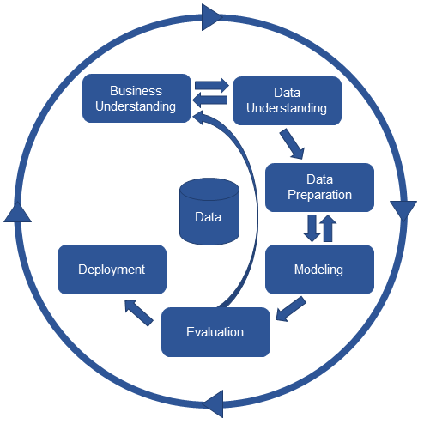
Methodology Used
A crisp dm methodology is followed, is an industry-proven way to guide through the data mining efforts.
It is a flexible model and a good workflow for data science projects.
The six major iterative phases are,
Business Understanding
Data Understanding
Data Preparation
Modeling
Evaluation
Deployment
Notes:
We ll go thro the 6 phases wrt to our topic

Slide 7
Business Understanding
Objective - Prediction of energy used in households mainly focusing on the electric energy. The energy used calculated in KWH will act as the target.
Project Plan – To get the all the specific details, inputs, outputs, necessary resources and dependencies.
Tools and techniques – Inorder to achieve the goal a machine learning model is proposed and compared with few other models using Python and R.

Slide 8

Data Understanding
Initial data collection - The Residential Energy Consumption Survey Data (RECS) containing information about the energy usage in U.S. homes updated by U.S. Energy Information Administration was taken for this research purpose.
Analysis - The dataset contains data of 12,083 households in 16 states of U.S. for the period February to August 2010. The survey included the type and number of energy-consuming devices, usage patterns, structural characteristics of the home, household demographics, and energy supplier information.
Notes:
940 columns

Slide 9

Data Preparation
Cleaning the data
Replacing missing values
‘NaN’ is replaced by the most frequent values
Removing highly correlated features
Features with correlation 90% and above has been identified and removed.
Removing features with a single unique value
All features that have only one value
Removal of unwanted columns
All irrelevant columns are removed.
Data is segregated into 3, 5 and 10 classes to find the best split
Notes:
We can and manipulate the data so that It can be analysed accurately. 394 after preprocessing

Slide 10
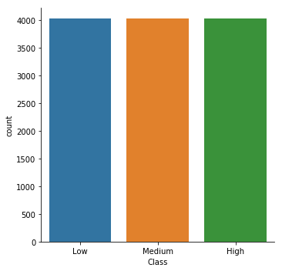
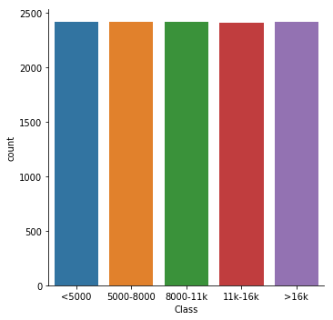
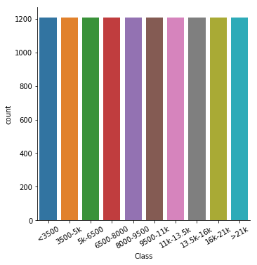
The target variable is discretised into classes for classification purpose.

Slide 11

Construct required data
Not all parameters are required for predicting the electricity consumption for an entire area. To select only the required parameters feature selection is used.
3 Feature Selection Methods
Relief – Relief calculates a feature score for each feature which can then be applied to rank and select top scoring features for feature selection. If a feature value difference is observed in a neighboring instance pair with the same class (a 'hit'), the feature score decreases. Alternatively, if a feature value difference is observed in a neighboring instance pair with different class values (a 'miss'), the feature score increases.
Package – ‘CORElearn’
Mutual Information (MI) – It generally measures the dependence between the variables. Entropy must be calculated inorder to get the information between two variables.
Package – ‘Fselector’
CFS – Features on the basis of the following hypothesis: "Good feature subsets contain features highly correlated with the classification, yet uncorrelated to each other".
Package – ‘Fselector’
Notes:
Relief cal the wight of the features. It feature wights are updated depending on the neighbouring features. Done in R programming. Done for all 3 classifications and with a maximum of 10 features.

Slide 12
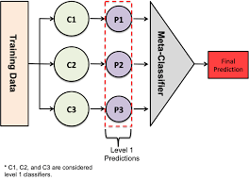
Modeling
Selection of model technique
The proposed model is a stacking ensemble technique. This method combines various models in order to improve the prediction results.
Level 1 Classifiers: KNN, MLP Classifier and Random Forest.
Meta Classifier: XGBoost
Notes:
Level 0 will predict the data and their result is fed as the input to level 1

Slide 13
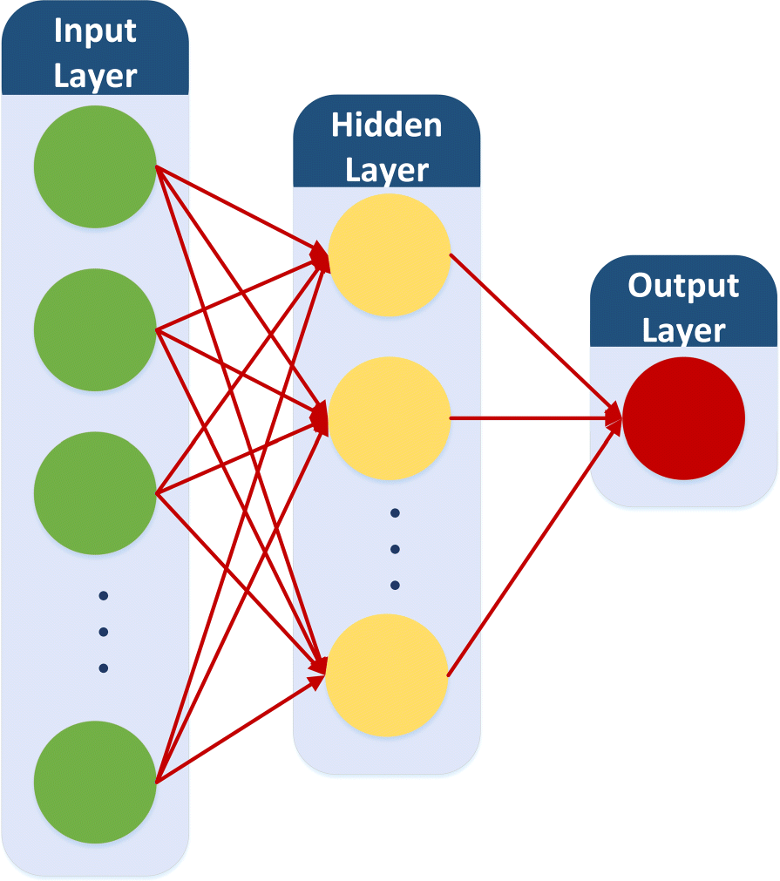
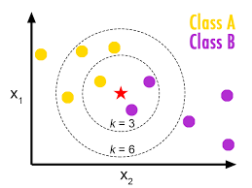
Models used for comparison
KNN
It predicts the class of the target variable by finding the nearest class neighbours. The distance of the new data point with other training data points are calculated.
MLP Classifier
MLPClassifier is a simple supervised linear feedforward classifier that relies on an underlying Neural Network to perform the task of classification.
Notes:
Calculations are performed in the hidden layer using the neurons.

Slide 14
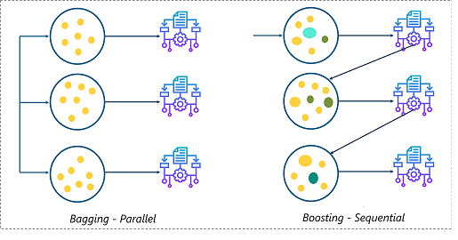
Random Forest
It consists of a collection of tree-structured classifiers where each tree is trained on different samples and then takes the maximum voting.
Gradient Boosting
Gradient Boosting is also based on sequential ensemble learning where the base learners are generated sequentially in such a way that the present base learner is always more effective than the previous one.
Notes:
In GB the model is generated sequentially, ie the next model created will be stronger than the previous base model in order to work with the misclassified data.

Slide 15

Generating the test design
The dataset in our research is split up into 75% of training set and 25% of testing set and the modeling is carried out.
Building the model
The models were performed for all datasets with and without feature selection using python programming language. All models were built following the same pattern.
All categorial features are changed to numeric using the LabelEncoder.
The training and testing data are seperated as x_train, y_train, x_test, y_test.
x_train and x_test contains training and testing data predictor variables and y_train and y_test contains their response variable.
The classifiers are imported from the libraries with which the model is built.
The train data is fitted into the model for training the model.
Now the test set is predicted.
And the predicted values are evaluated.

Slide 16

Gradient Boosting
KNN
MLP Classifier
Random Forest

Slide 17
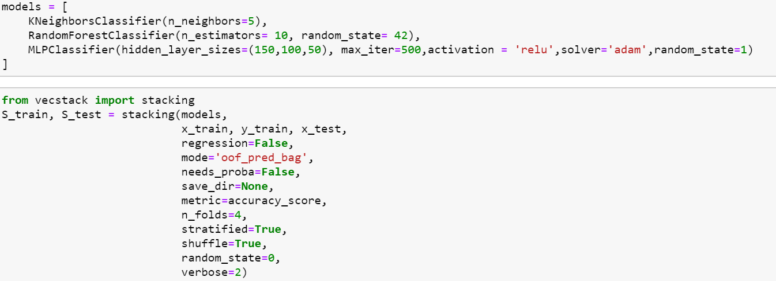
Stacking Generalization
Level 0
Level 1
Notes:
We predict the test data of all the folds and after that the mean of all the prediction is calculated and given as input to the meta classifier level
Meta learner just learns frm the prediction made by the base learner.

Slide 18
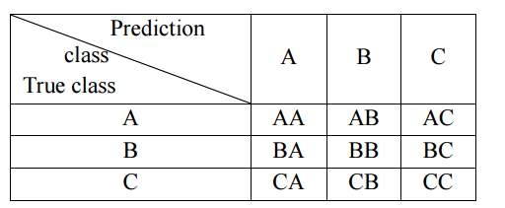
Evaluation
Two evaluation metrics chosen are Classification Accuracy and Confusion matrix. It is basically the ratio of the number of correct predictions made to the total number of input samples. To add more information to the accuracy score, a confusion matrix is introduced. This matrix gives us a clear picture of how many sample are predicted right and how many has been wrongly classified.

Slide 19
3 CLASS CLASSIFICATION | CFS | Mutual Info | ReliefF | Without Feature Selection
Gradient Boosting | 97.94 | 97.91 | 91.19 | 97.84
KNN | 88.41 | 87.22 | 86.69 | 80.13
MLP Classifier | 84.77 | 65.21 | 78.18 | 94.53
Random Forest | 96.22 | 95.92 | 89.9 | 86.79
Ensemble Learner | 96.25 | 96.09 | 90.1 | 93.84
5 CLASS CLASSIFICATION | CFS | Mutual Info | ReliefF | Without Feature Selection
Gradient Boosting | 88.44 | 95.13 | 83.78 | 93.41
KNN | 74.77 | 77.82 | 76.43 | 66.79
MLP Classifier | 21.58 | 40.45 | 56.14 | 84.37
Random Forest | 88.21 | 91.72 | 82.09 | 70.53
Ensemble Learner | 87.95 | 91.98 | 82.29 | 89.67
10 CLASS CLASSIFICATION | CFS | Mutual Info | ReliefF | Without Feature Selection
Gradient Boosting | 76.53 | 82.38 | 58.98 | 77.98
KNN | 56.76 | 58.55 | 47.4 | 47.83
MLP Classifier | 29.79 | 10.32 | 13.1 | 67.36
Random Forest | 75.2 | 80.6 | 60.04 | 44.85
Ensemble Learner | 76.76 | 81.26 | 60.14 | 67.72
Notes:
For ensemble learner the less accuracy is because of the base learner. One reason the algorithms with similar results will not enhance the model performance.

Slide 20
Hypothesis Testing
T-score = (acc1-acc2) / sqrt(acc1*(1-acc1)/n + acc2*(1-acc2)/n)
If the difference between the two models are
> 1.64 = statistical difference at 90% confidence level
> 1.96 = statistical difference at 95% confidence level
> 2.32 = statistical difference at 99% confidence level
For 3 class classification the t-score calculated is 6.44 > 2.32 and hence the models have a statistical difference at 99% confidence interval.
For 5 class classification t-score calculated is 20.17 > 2.32 and hence the models have a statistical difference at 99% confidence interval.
For 10 class classification t-score calculated is 2.86 > 2.32 and hence the models have a statistical difference at 99% confidence interval.
Both models varies significantly.
Notes:
The models vary very much from each other.

Slide 21

Conclusion
Gradient Boosting model achieves better accuracy when compared to the proposed ensemble learner.
The features selected using CFS method led to higher accuracy rate for 3 class classification.
For 5 and 10 class classification, the features selected with Mutual Information produced higher accuracies.
There is not much of difference in the accuracies obtained by the models with and without feature selection.
Lesser number of classes improves the performance leading to higher accuracy.
Neural network needs larger number of parameters to be estimated.

Slide 22
Limitations
The data collected are random samples for a period of 6 months and hence prediction for a specific area or a house in a time frame cannot be done with this data.
Based on the literature review only 3 feature selection methods have been used for selecting feature which is not enough for good comparison. More types of methods can be experimented.
Notes:
The collection of data is randomly taken between 6 months

Slide 23
Future Work
The selected model will be tested on different data sets like time series forecasting, hourly, sub hourly prediction datasets etc and improving the model as needed.
Other feature selection methods can be done.
Algorithm tuning.
Notes:
H2o consumes less memory and it will be stored in cloud and can be easily accessed by any platforms like R, python and scala

Slide 24
Thank you

