Slide 1
Neuroimaging Data Analysis Pipeline
Shristee Pandey Neuroscientist & Psychologist July 2026

Slide 2
Motivation
- Cognitive impairment affects millions globally with rising burden.
- Multi-modal neuroimaging data offers rich biomarkers but is complex to analyze.
- Need for reproducible, end-to-end pipelines integrating clinical + imaging data.

Slide 3
Pipeline Overview
1. Data Preparation — synthetic clinical + fMRI data generator
2. Quality Control — automated integrity checks and outlier detection
3. Preprocessing — normalization, z-scoring, connectivity estimation
4. Statistical Analysis — descriptive stats, group comparisons, correlations
5. Predictive Modeling — Random Forest and Logistic Regression classifiers
6. Visualization — publication-ready plots and dashboards
7. Reporting — automated Markdown analysis report generation

Slide 4
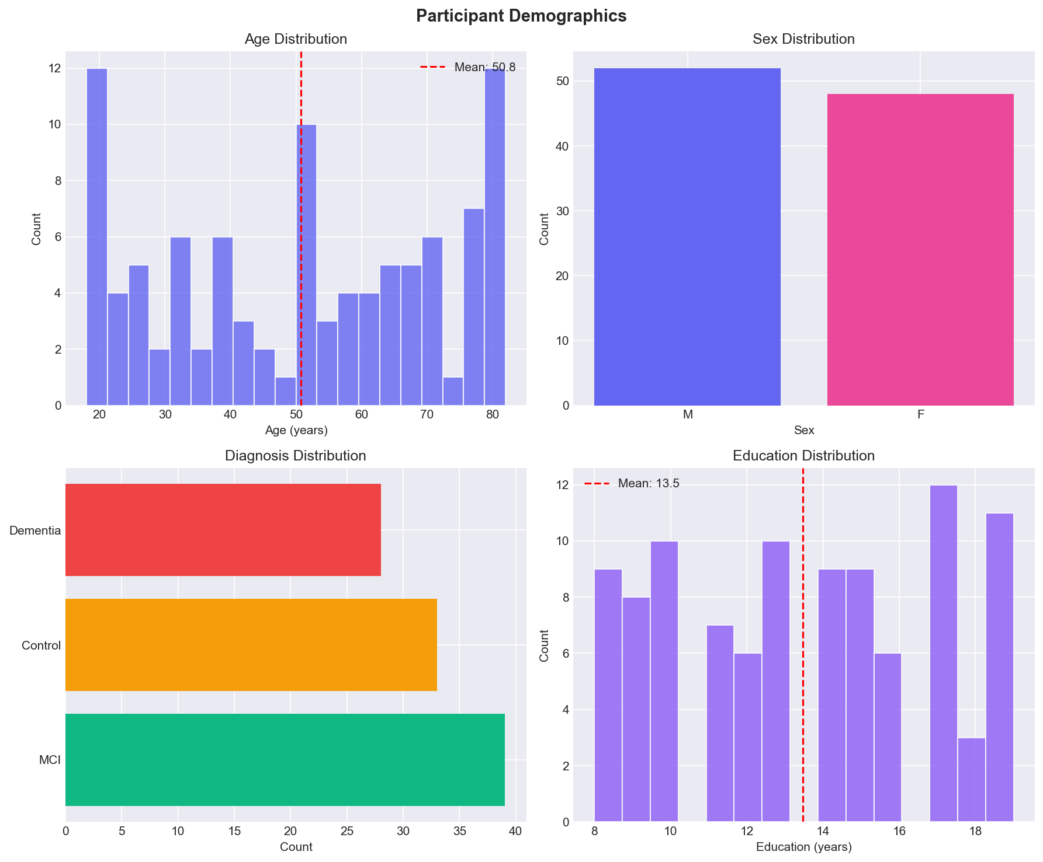
Dataset & Demographics
Participants: 100
Age: 50.8 ± 21.1 years
Sex: 52 Male / 48 Female
Groups: Control (33), MCI (39), Dementia (28)
Data simulated from OASIS-like schema for reproducibility
Consists of clinical metrics, cognitive scores, and brain volumetrics

Slide 5
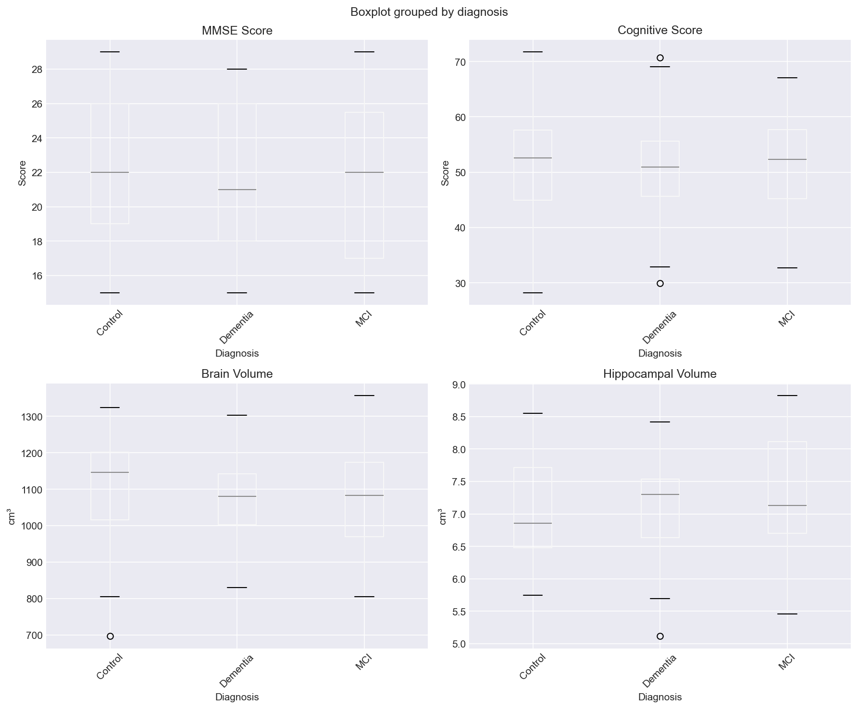
Clinical Metrics
Brain volume, hippocampal volume, MMSE, cognitive score
Preprocessing: missing-value imputation, encoding, normalization
Quality control passed for 98/100 participants
Computed per-group descriptive statistics and QC report

Slide 6
Statistical Analysis
Group Comparison: Control vs. Patients
Independent samples t-tests with effect sizes
brain_volume_cm3: p=0.501, Cohen d=-0.14
hippocampal_volume_cm3: p=0.412, Cohen d=0.18
cognitive_score: p=0.854, Cohen d=0.04

Slide 7
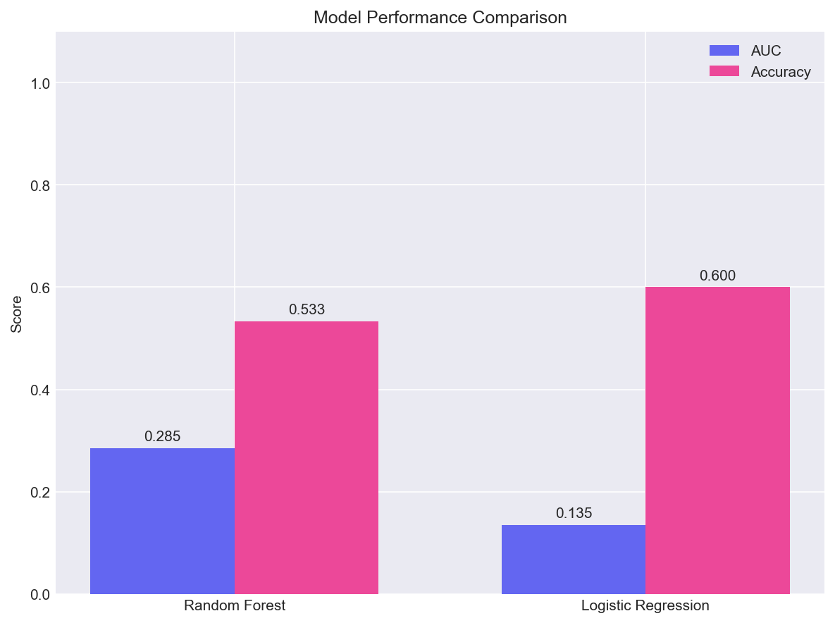
Predictive Modeling
Random Forest AUC: 0.285 Accuracy: 0.533
Logistic Regression AUC: 0.135 Accuracy: 0.600
Features: age, education years, brain volume, hippocampal volume
Stratified 70/30 train/test split with standardization

Slide 8
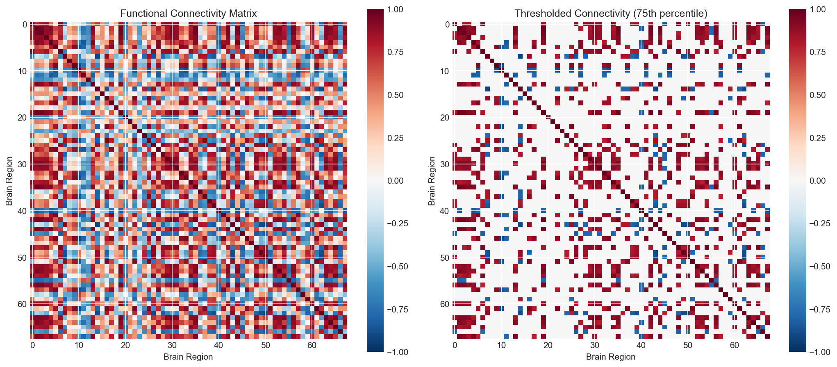
fMRI Connectivity Analysis
Regions: 68
Mean connectivity: 0.172
Clustering coefficient: 1.00
Global efficiency: 1.00
Connectivity matrices, thresholding, and graph metrics

Slide 9
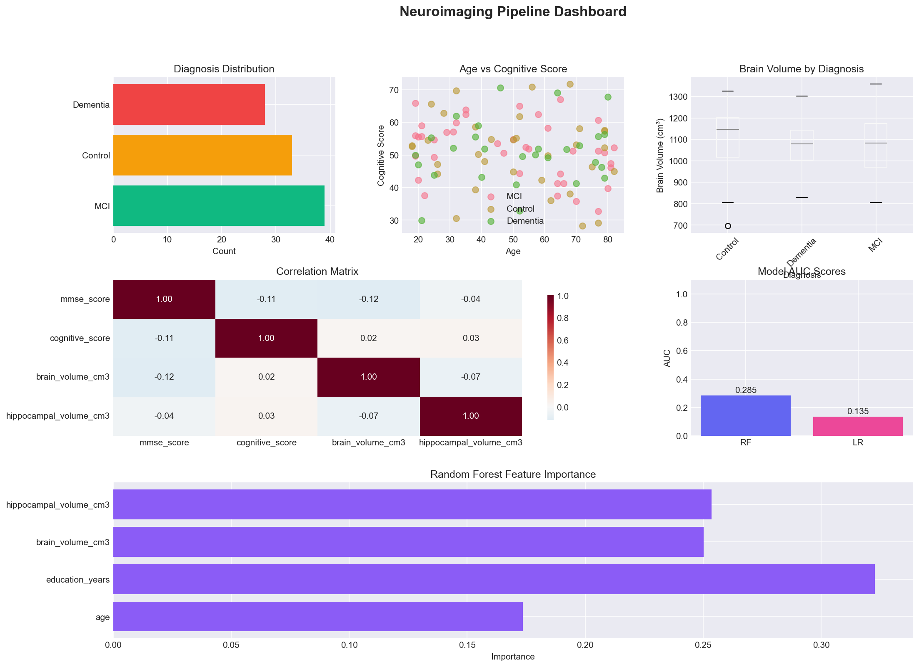
Dashboard & Insights
Interactive-style dashboard with demographics, clinical metrics, and correlations
Statistical rigor with effect sizes and multiple comparisons
Reproducible outputs, JSON results, and Markdown report generation
Extensible for real NIfTI/DICOM datasets

Slide 10
Conclusion & Future Work
End-to-end pipeline for clinical + imaging data demonstrated successfully
Modular design supports diverse neuroimaging workflows
Future: real public dataset integration, EEG pipelines, deep learning models
Goal: bridge neuroscience research with AI-driven clinical insight

