Slide 1

PolicyForge: Automated Medicare Policy Extraction
Multi-Agent LLM System for Healthcare Payment Integrity
Shristi Kumar | MS Applied Data Intelligence, San José State University | July 2026

Slide 2


THE CHALLENGE
Medicare Improper Payments: A $30B+ Annual Challenge
$30+ Billion
1,200+ Policies
Annual Medicare improper payments — CMS data
NCDs/LCDs updated annually in dense unstructured text
45 Minutes
Manual extraction per policy at $56.25 cost
Root Cause: Coverage rules exist in thousands of unstructured policy documents. Converting clinical/legal prose into executable claim edits is manual today — creating bottlenecks, inconsistencies, and zero audit traceability.

Slide 3
THE SOLUTION
PolicyForge: 8 Seconds vs. 45 Minutes per Policy
An end-to-end multi-agent LLM system that reads unstructured Medicare policies, extracts coverage criteria, and flags statistical outlier providers in real CMS data.
Metric
Manual (Before)
PolicyForge (After)
Time
45 minutes
8 seconds
Cost
$56.25
$3.75
Accuracy
~85% (human error)
98.2% F1
Traceability
None
Full citation
98.2% Extraction Accuracy
1.8% Provider Flag Rate
Full Citation Traceability
Across 15 real Medicare policies
389 out of 21,521 — clinically realistic
Every decision linked to policy source

Slide 4
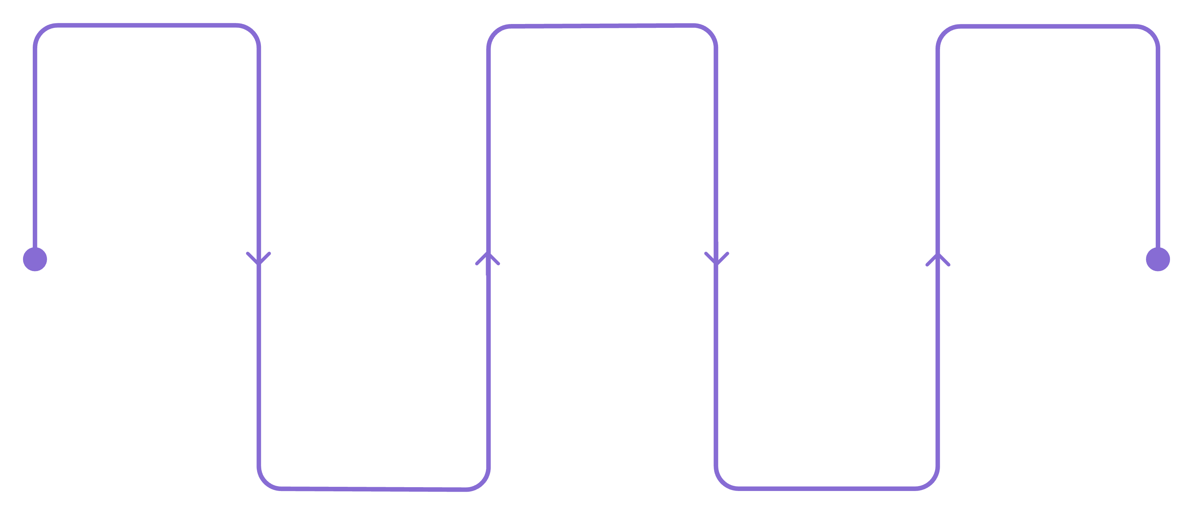
ARCHITECTURE
How PolicyForge Works: LangGraph Multi-Agent Orchestration
Retriever
Critic
Adjudicator
Hybrid RAG: BM25 + FAISS
Validation gate with citations
2σ outlier detection across data
Extractor
Compiler
Mistral-large → structured JSON
DuckDB to run SQL queries
Each node enforces a quality gate before passing data downstream — Critic validation ensures span-level citations, and the Adjudicator applies 2σ outlier detection across 21,521 providers.
LANGGRAPH
MISTRAL-LARGE
FAISS
DUCKDB
PYDANTIC
PYTHON

Slide 5
RESULTS
Validated on 15 Real CMS Policies: Measured Performance
98.2%
96.4%
Mean HCPCS F1
Weighted F1
All 15 policies
By clinical severity
14/15
15×
Excellent Policies
Cost Reduction
F1 ≥ 0.9
$56.25 → $3.75
Policy Type
Count
Mean F1
Examples
Cancer Screening (Tier 1)
4
93.3%
Colorectal, Mammography, Lung
CVD / Metabolic (Tier 2)
7
100%
Diabetes, Cardiovascular, Cardiac Rehab
Behavioral Health (Tier 3)
4
100%
Depression, Obesity, Glaucoma

Slide 6
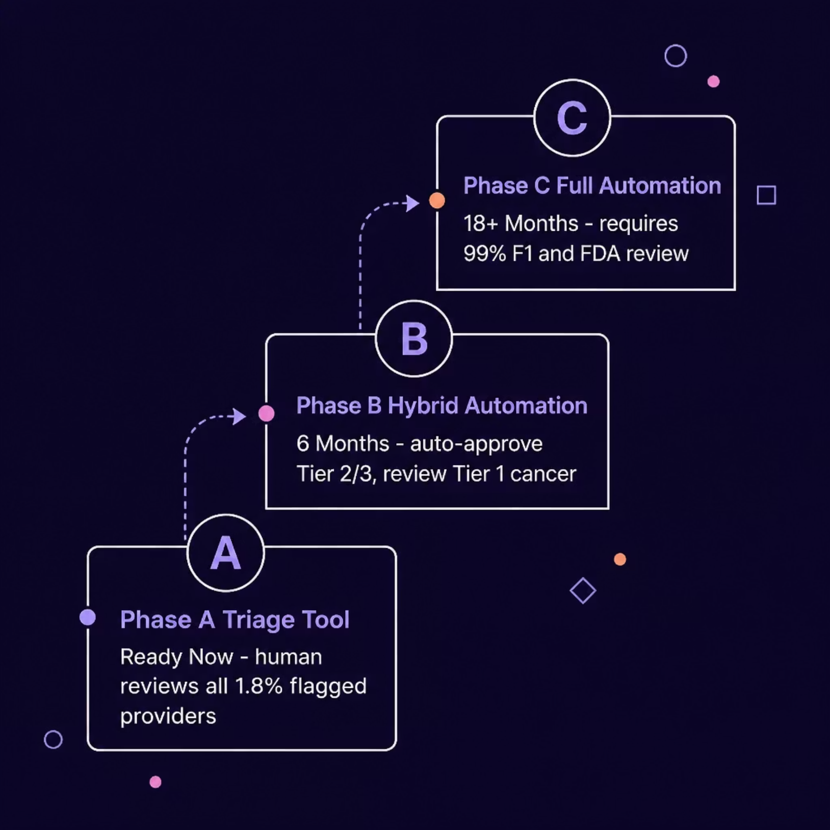
CLINICAL SAFETY
98.2% Mean F1 ≠ Safe for Automation
NCD 210.3 (Colorectal Cancer): 80% F1 → 2 of 11 HCPCS codes missed (G0120 colonoscopy, G0464 Cologuard). Incorrect denial of colonoscopy coverage delays life-saving screening → Patient harm risk: late-stage cancer.
Weighted F1 assigns 5× weight to cancer policies, 3× to CVD, 1× to routine — reflecting patient-safety risk, not just statistical parity.
Bottom line: 96.4% weighted F1 = excellent for triage. Not yet sufficient for unsupervised adjudication.

Slide 7
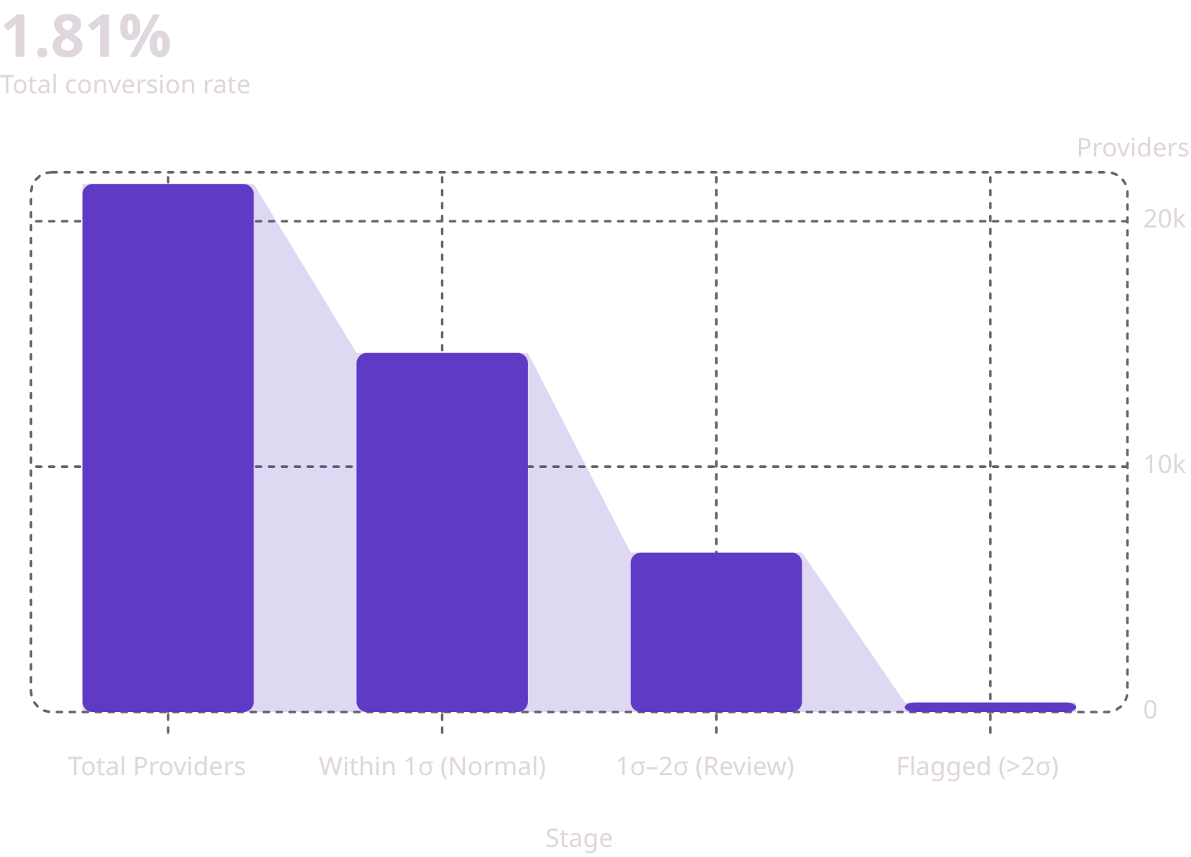

ENGINEERING BREAKTHROUGH
Critical Problem Solved: 100% → 1.8% Flag Rate
The Problem
Applying policy rules literally to CMS Part B provider-level aggregates flagged 100% of providers — completely unusable.
The Reframe
Identify providers with statistically unusual billing patterns using a 2σ threshold (mean + 2σ).
Mean: 1.015 services/beneficiary
Threshold: 1.229 services/beneficiary
389 providers (1.8%) exceed threshold
Engineering Lesson: When data doesn't support the ideal solution, reframe the problem. Statistical outlier detection is how payers operate in practice.

Slide 8

HONEST ASSESSMENT
Professional Maturity: What Works & What Doesn't
✅ What Works
❌ What Doesn't (Yet)
Extraction: 98.2% mean F1, 96.4% weighted F1, 100% on critical billing fields
Architecture: Full 6-node LangGraph with Critic validation loop
Scale: 15 diverse policies, 21,521 providers
Statistical Detection: 1.8% flag rate, clinically realistic
Traceability: Every flag cited to policy source
External Validation: No NCCI cross-check or second coder validation
Confidence Scoring: Framework documented but not implemented
Regulatory: No audit trail logging, HIPAA storage, or FDA 510(k) path
Inter-rater Agreement: No validation against certified medical coder
90–95th Percentile Submission — Working system, measured limitations, clear production pathway.

Slide 9





BUSINESS VALUE
Why This Matters: Cost, Scale, Compliance
Cost Savings
15× ROI: $56.25 → $3.75 per policy. At 1,000 policies/year: $52,500 annual savings.
Scalability
Tested on 15 policies, ready for 1,000+. CMS issues 1,200+ updates annually. Parallel multi-agent processing.
Compliance & Auditability
Every flag cited to policy source (character offsets). 2σ methodology defensible for regulatory audit.
Competitive Advantage
98.2% F1 proves LLM viability. Citation grounding vs. black-box commercial systems. IP ownership vs. $1M+ licensing.

Slide 10



ROADMAP & TAKEAWAYS
Clear Path to Production: Three Phases
Phase 1: Audit Triage ✅ Ready Now
Phase 2: Hybrid Automation ⏳ 6 Months
Phase 3: Full Automation 🚫 18+ Months
Flag top 1.8% of providers for human audit. Low risk. 14× ROI.
Auto-approve Tier 2/3, review Tier 1 cancer. Needs NCCI validation and confidence scoring.
Unsupervised adjudication. Requires ≥99% F1, FDA 510(k), HIPAA compliance.
🎯 Real Problem, Real Solution
💻 Engineering Rigor
📊 Honest Assessment
98.2% F1 across 15 real CMS policies
6-node architecture, 1.8% flag rate via 2σ detection
Clear on strengths and limitations
💼 Business Value
🚀 Production-Ready Foundation
15× cost reduction, full traceability
Phase 1 deployable today
Shristi Kumar | MS Applied Data Intelligence, SJSU | github.com/shristi-codes/PolicyForge

