Slide 1
AI KHETI SATHI agent
CAPSTONE PROJECT
Presented By: SHRISTI SHARMA
Student name : SHRISTI SHARMA
College Name & Department : UNIVERSITY OF ENGINEERING & MANAGEMENT, KOLKATA –B.Tech(CSE)

Slide 2
OUTLINE
Problem Statement
Technology used
Wow factor
End users
Result
Conclusion
Git-hub Link
Future scope
IBM Certifications

Slide 3
Problem Statement
Small and marginal farmers lack access to timely, accurate, and location-specific agricultural information — such as weather, crop choices, pest control, and market prices — in a language they understand. This knowledge gap leads to poor farming decisions, crop losses, and reduced income.
Proposed Solution: An AI-powered Smart Farming Agent that uses Natural Language Processing (NLP) and Retrieval-Augmented Generation (RAG) to deliver real-time, location-specific agricultural advice to small and marginal farmers.
The agent retrieves trusted information from government sources, weather services, and agritech platforms to provide guidance on:
Suitable crops based on soil, season, and weather
Pest and disease management (organic and chemical)
Fertilizer and irrigation recommendations
Current mandi (market) prices
Weather forecasts
Farmers can interact in their local languages, ask natural questions, and receive simple, actionable advice, helping them make informed decisions that reduce risk and increase yield and income.

Slide 4
Technology used
IBM cloud lite services
Natural Language Processing (NLP)
Retrieval Augmented Generation (RAG)
IBM Granite model

Slide 5
IBM cloud services used
IBM Cloud Watsonx AI Studio
IBM Cloud Watsonx AI runtime
IBM Cloud Agent Lab
IBM Granite foundation model

Slide 6
Wow factors– AI Agent for Smart Farming Advice
This agent empowers grassroots farmers with AI, providing real-time, localized, and multilingual farming advice that was previously inaccessible or difficult to understand. It bridges the digital divide and helps farmers make better, data-backed decisions that directly impact productivity, income, and sustainability.
Unique features:
Multilingual support (Hindi, Marathi, etc.)
Location-based mandi prices, crop advice, and weather
Pest & fertilizer recommendations using local data
RAG-powered retrieval from a custom knowledge base
Natural language Q&A with simple, farmer-friendly responses

Slide 7
End users
Small and marginal farmers
Krishi Vigyan Kendras (KVKs) and local agri extension workers
Agri-input dealers who assist farmers
Agri-tech students or educators working on rural outreach

Slide 8
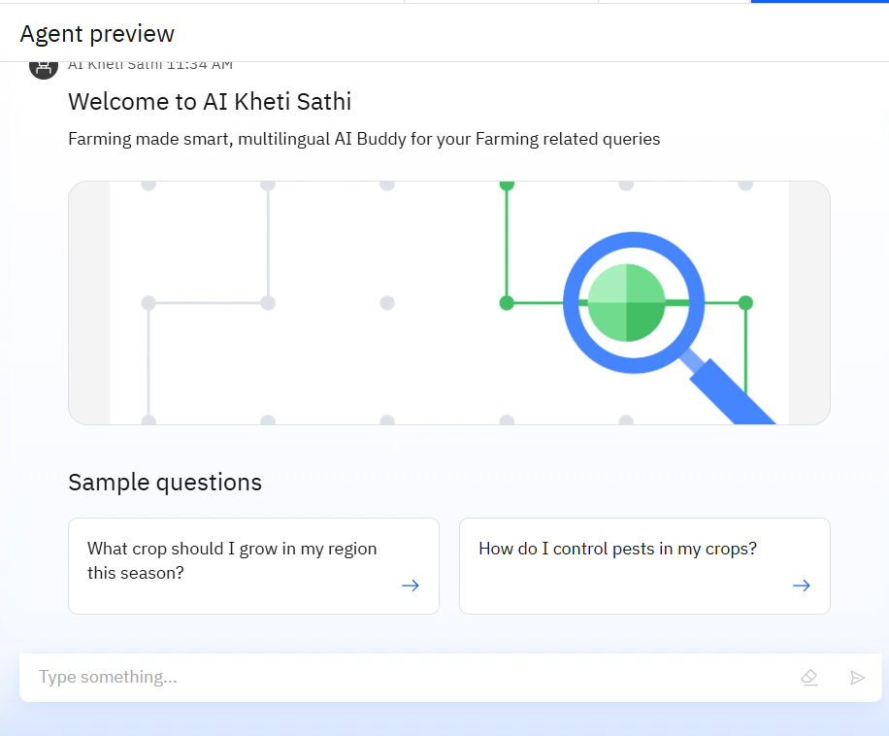
Results

Slide 9
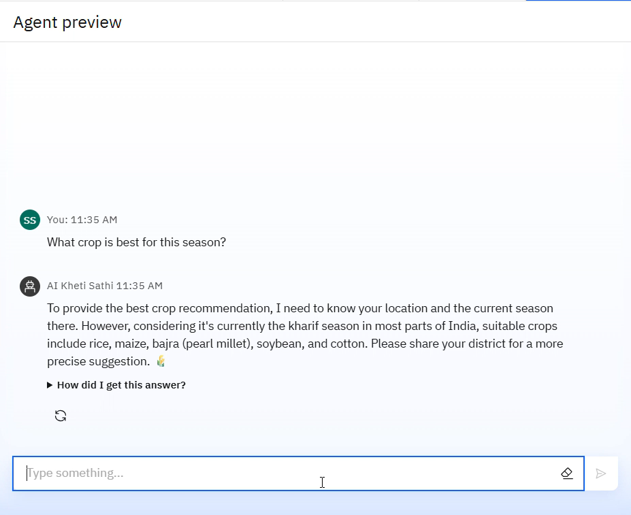
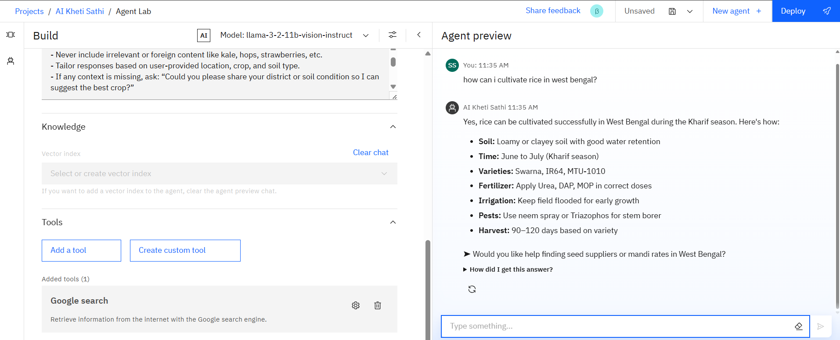
Results

Slide 10
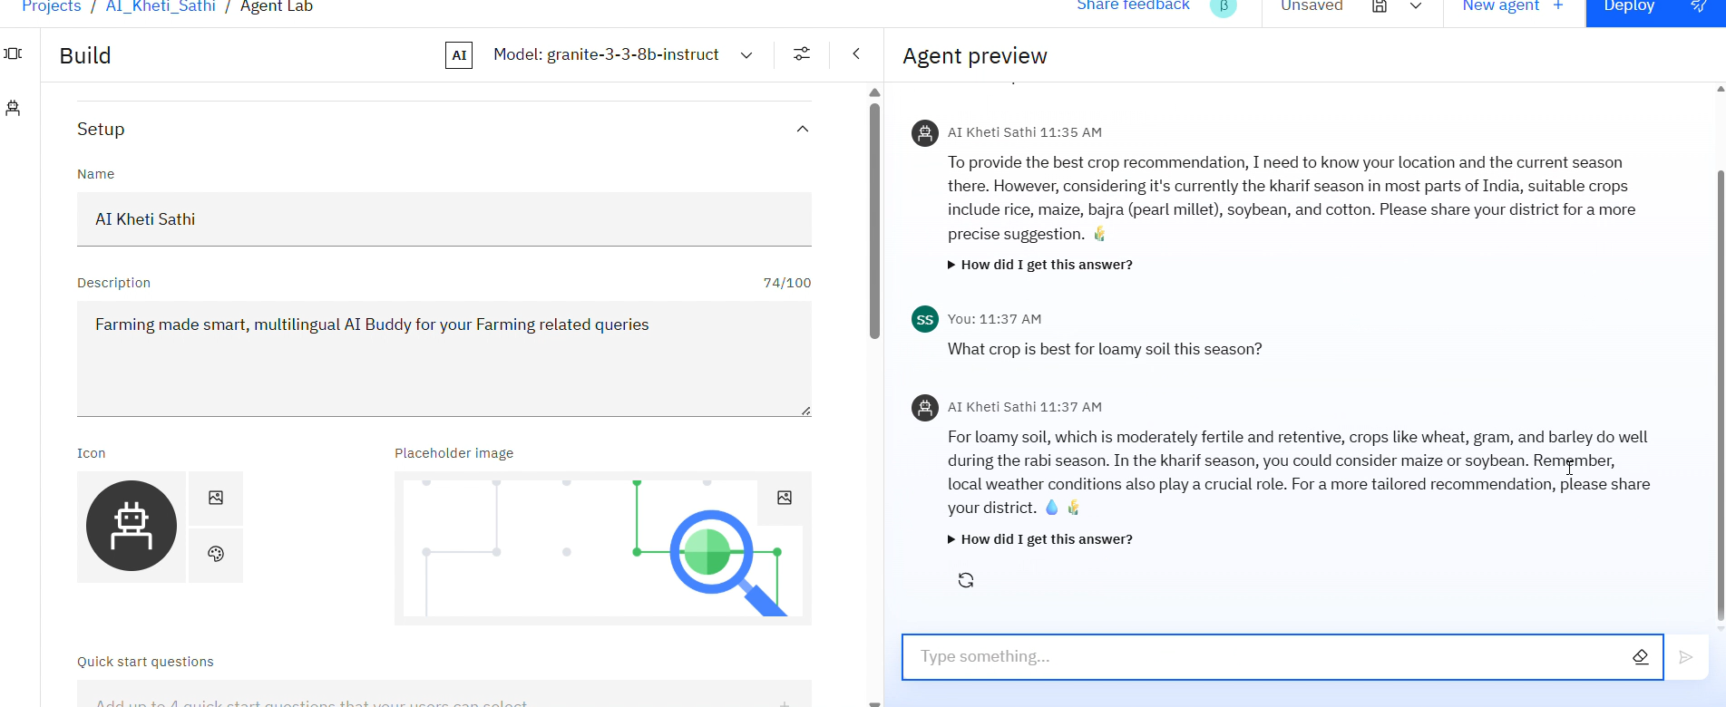
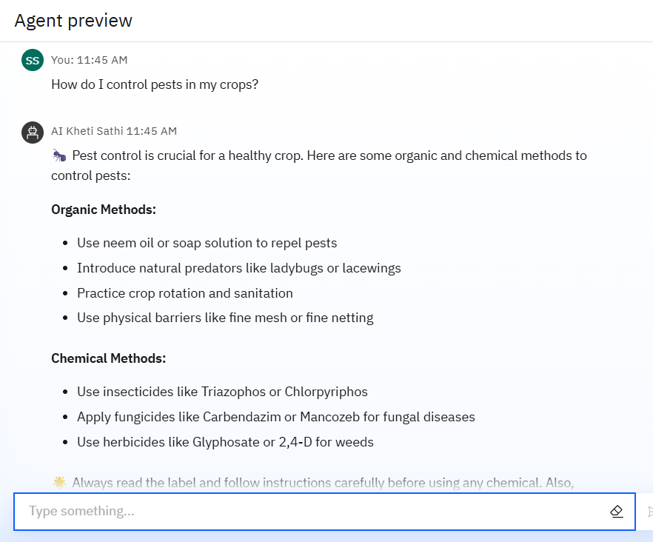
Results

Slide 11
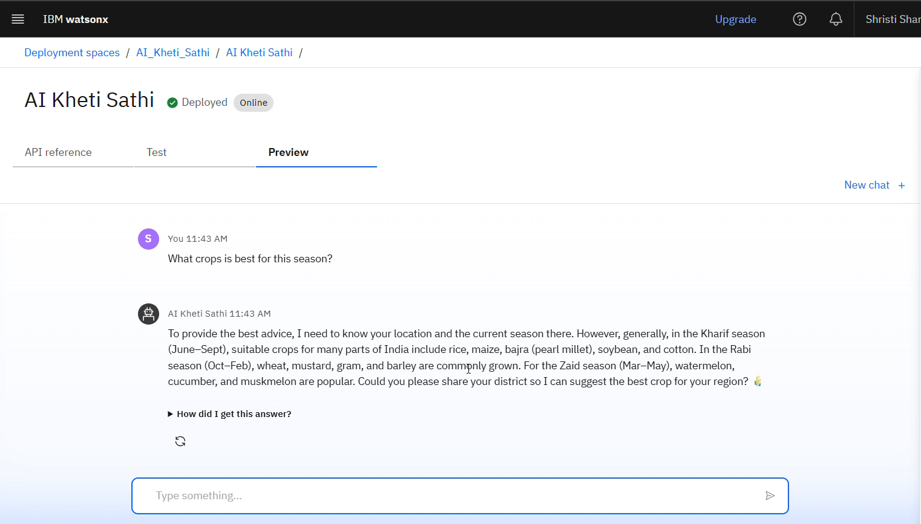
Results
Deployed AI Agent

Slide 12
Conclusion
The AI agent delivers real-time, location-specific advice on crops, pests, fertilizers, and mandi prices.
It uses RAG-based retrieval to provide accurate, data-driven guidance from trusted sources.
Designed for multilingual and simple interaction, making it accessible to small and marginal farmers.
Helps improve yield, reduce risks, and boost farmer income, promoting smart and sustainable agriculture.

Slide 13
GitHub Link
GitHub Link: https://github.com/shristi005/AI_Kheti_Sathi

Slide 14
Future scope
Voice support in local languages
Offline or low-data mode
Live weather API integration
Use of satellite/IoT data
Crop disease detection via AI
Auto-generated farm reports
Link to agri-experts/helplines

Slide 15
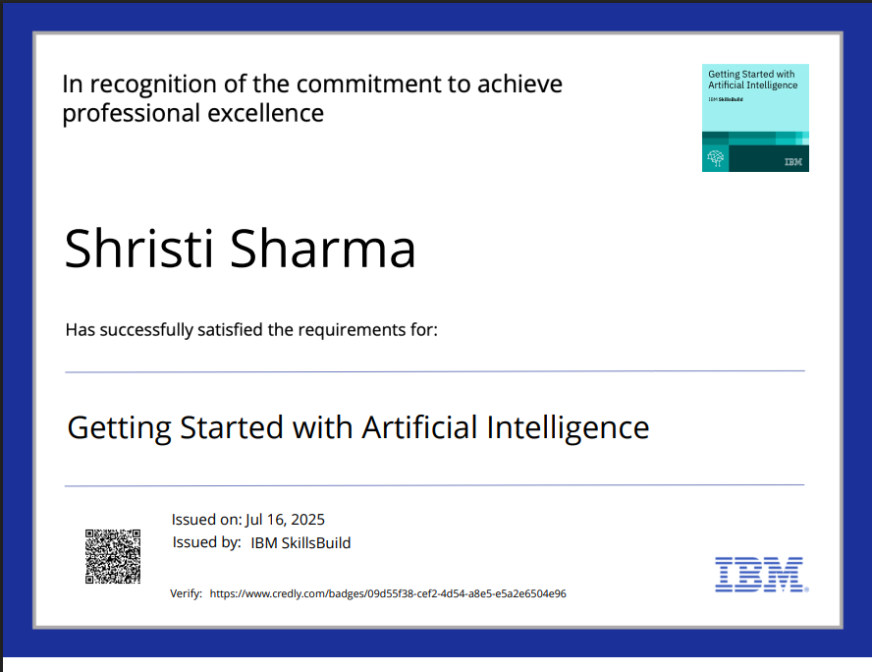
IBM Certifications
CREDLY CERTIFICATE( GETTING STARTED WITH AI)

Slide 16
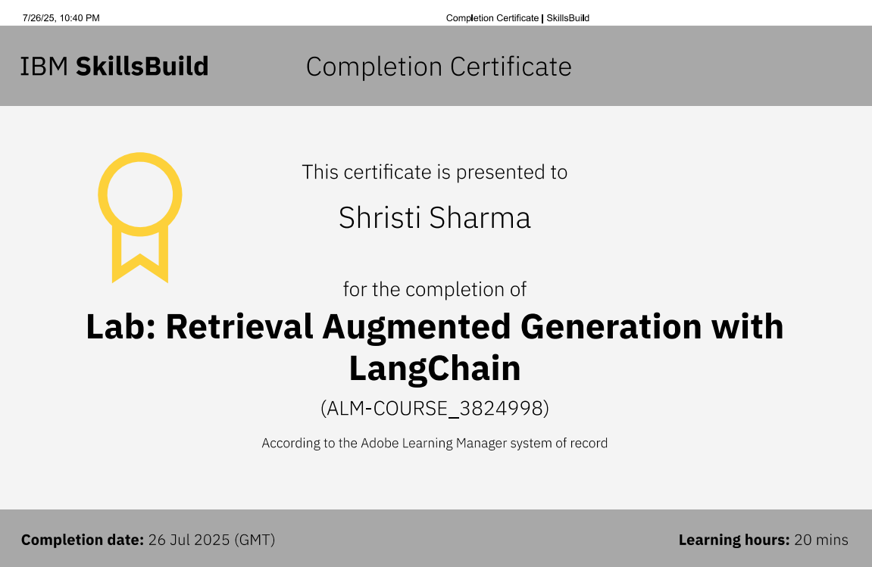
RAG LAB CERTIFICATE

Slide 17
THANK YOU

