Slide 1
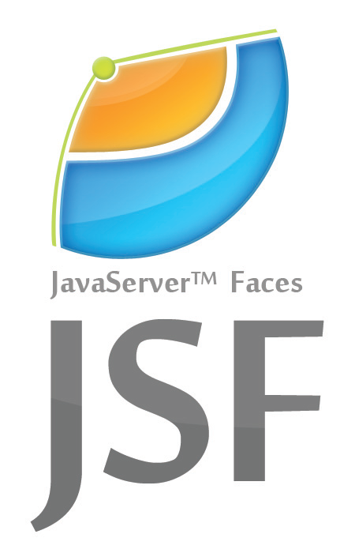
Presentation on
JavaServer Faces
Presented by : Shristi Dongol

Slide 2
Overview
Introduction to JSF
Benefits of JSF
What scope to use when?

Slide 3
Introduction to JSF
Java Server Faces (JSF) is a server side new standard Java framework to develop web applications.
JSF provides a well-defined programming model and consists of rich API and tag libraries.
JSF provides a facility to connect UI widgets with data sources and to server-side event handlers.
JSF simplifies development by providing a component-centric approach to developing Java web user interfaces.

Slide 4
Benefits of JFS
Providing reusable UI components
Making easy data transfer between UI components
Managing UI state across multiple server requests
Enabling implementation of custom components
Wiring client-side event to server-side application code
Easy and Prompt Web Development
Default exception handling

Slide 5
What scopes to use when?
Request scope:
In request scope bean created when a request involving this bean comes and destroyed after completing response.
View scope:
In view scope bean created when a request involving this bean comes an destroyed when view changed.
Session scope:
In session scope bean created when first request involving this bean comes and destroyed when session is terminated.

Slide 6
What scopes to use when?(Contd.)
Application scope
In application scope bean created when first request involving this bean comes and remains lives for whole duration of web application. An application scope managed bean is shared in all requests and sessions.

Slide 7
THANKYOU !!

