Slide 1


Slide 2
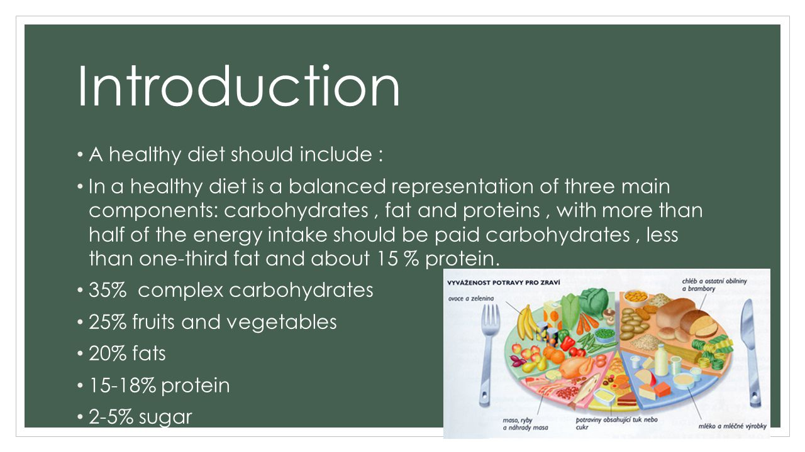

Slide 3
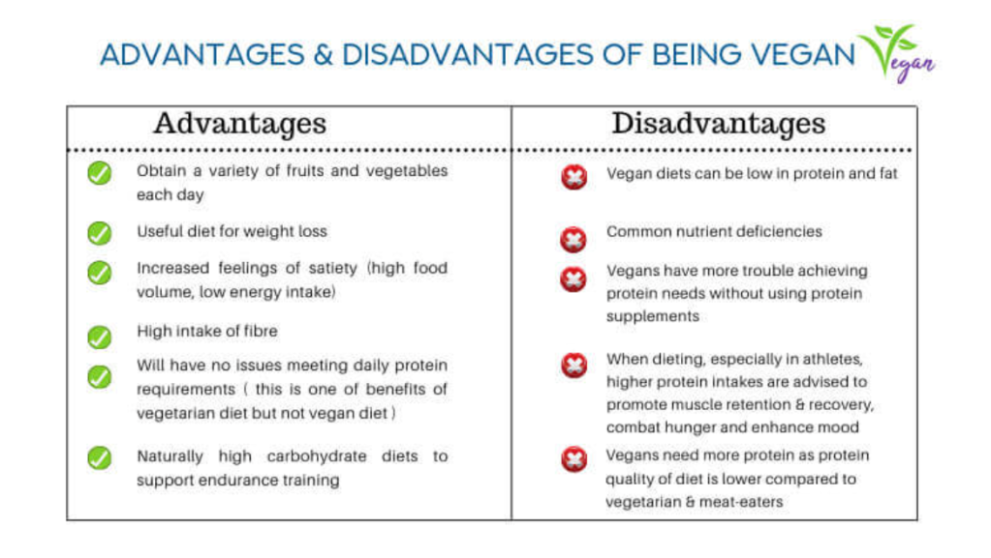

Slide 4
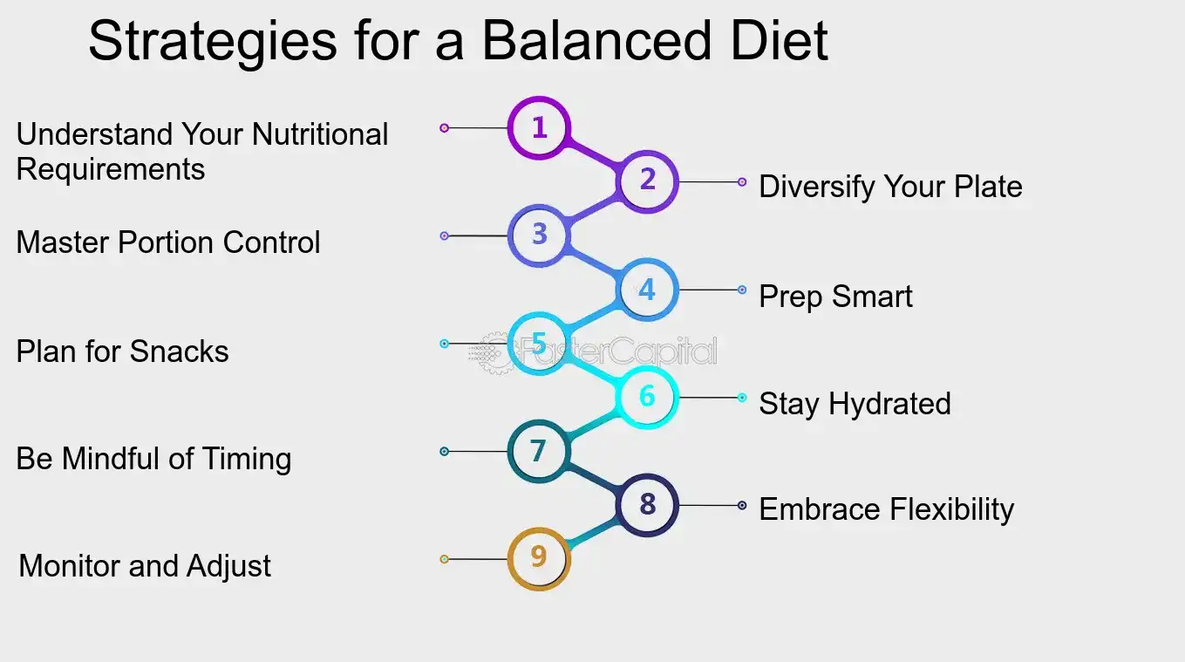

Slide 5
HOW TO USE BALANCE DIET
growth & development.
muscles,
bones and teeth
energy.
healthy bodies.
fighting disease.
good brains.
healthy organs.

Slide 6
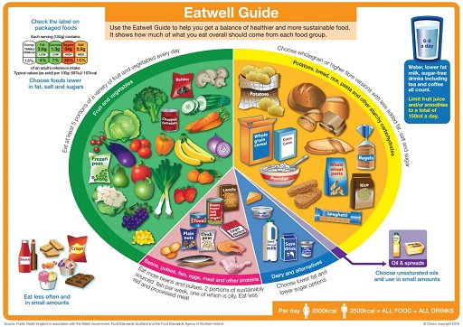
A balanced diet consists of six main nutrient groups; proteins, carbohydrates, lipids, vitamins, minerals and water

Slide 7
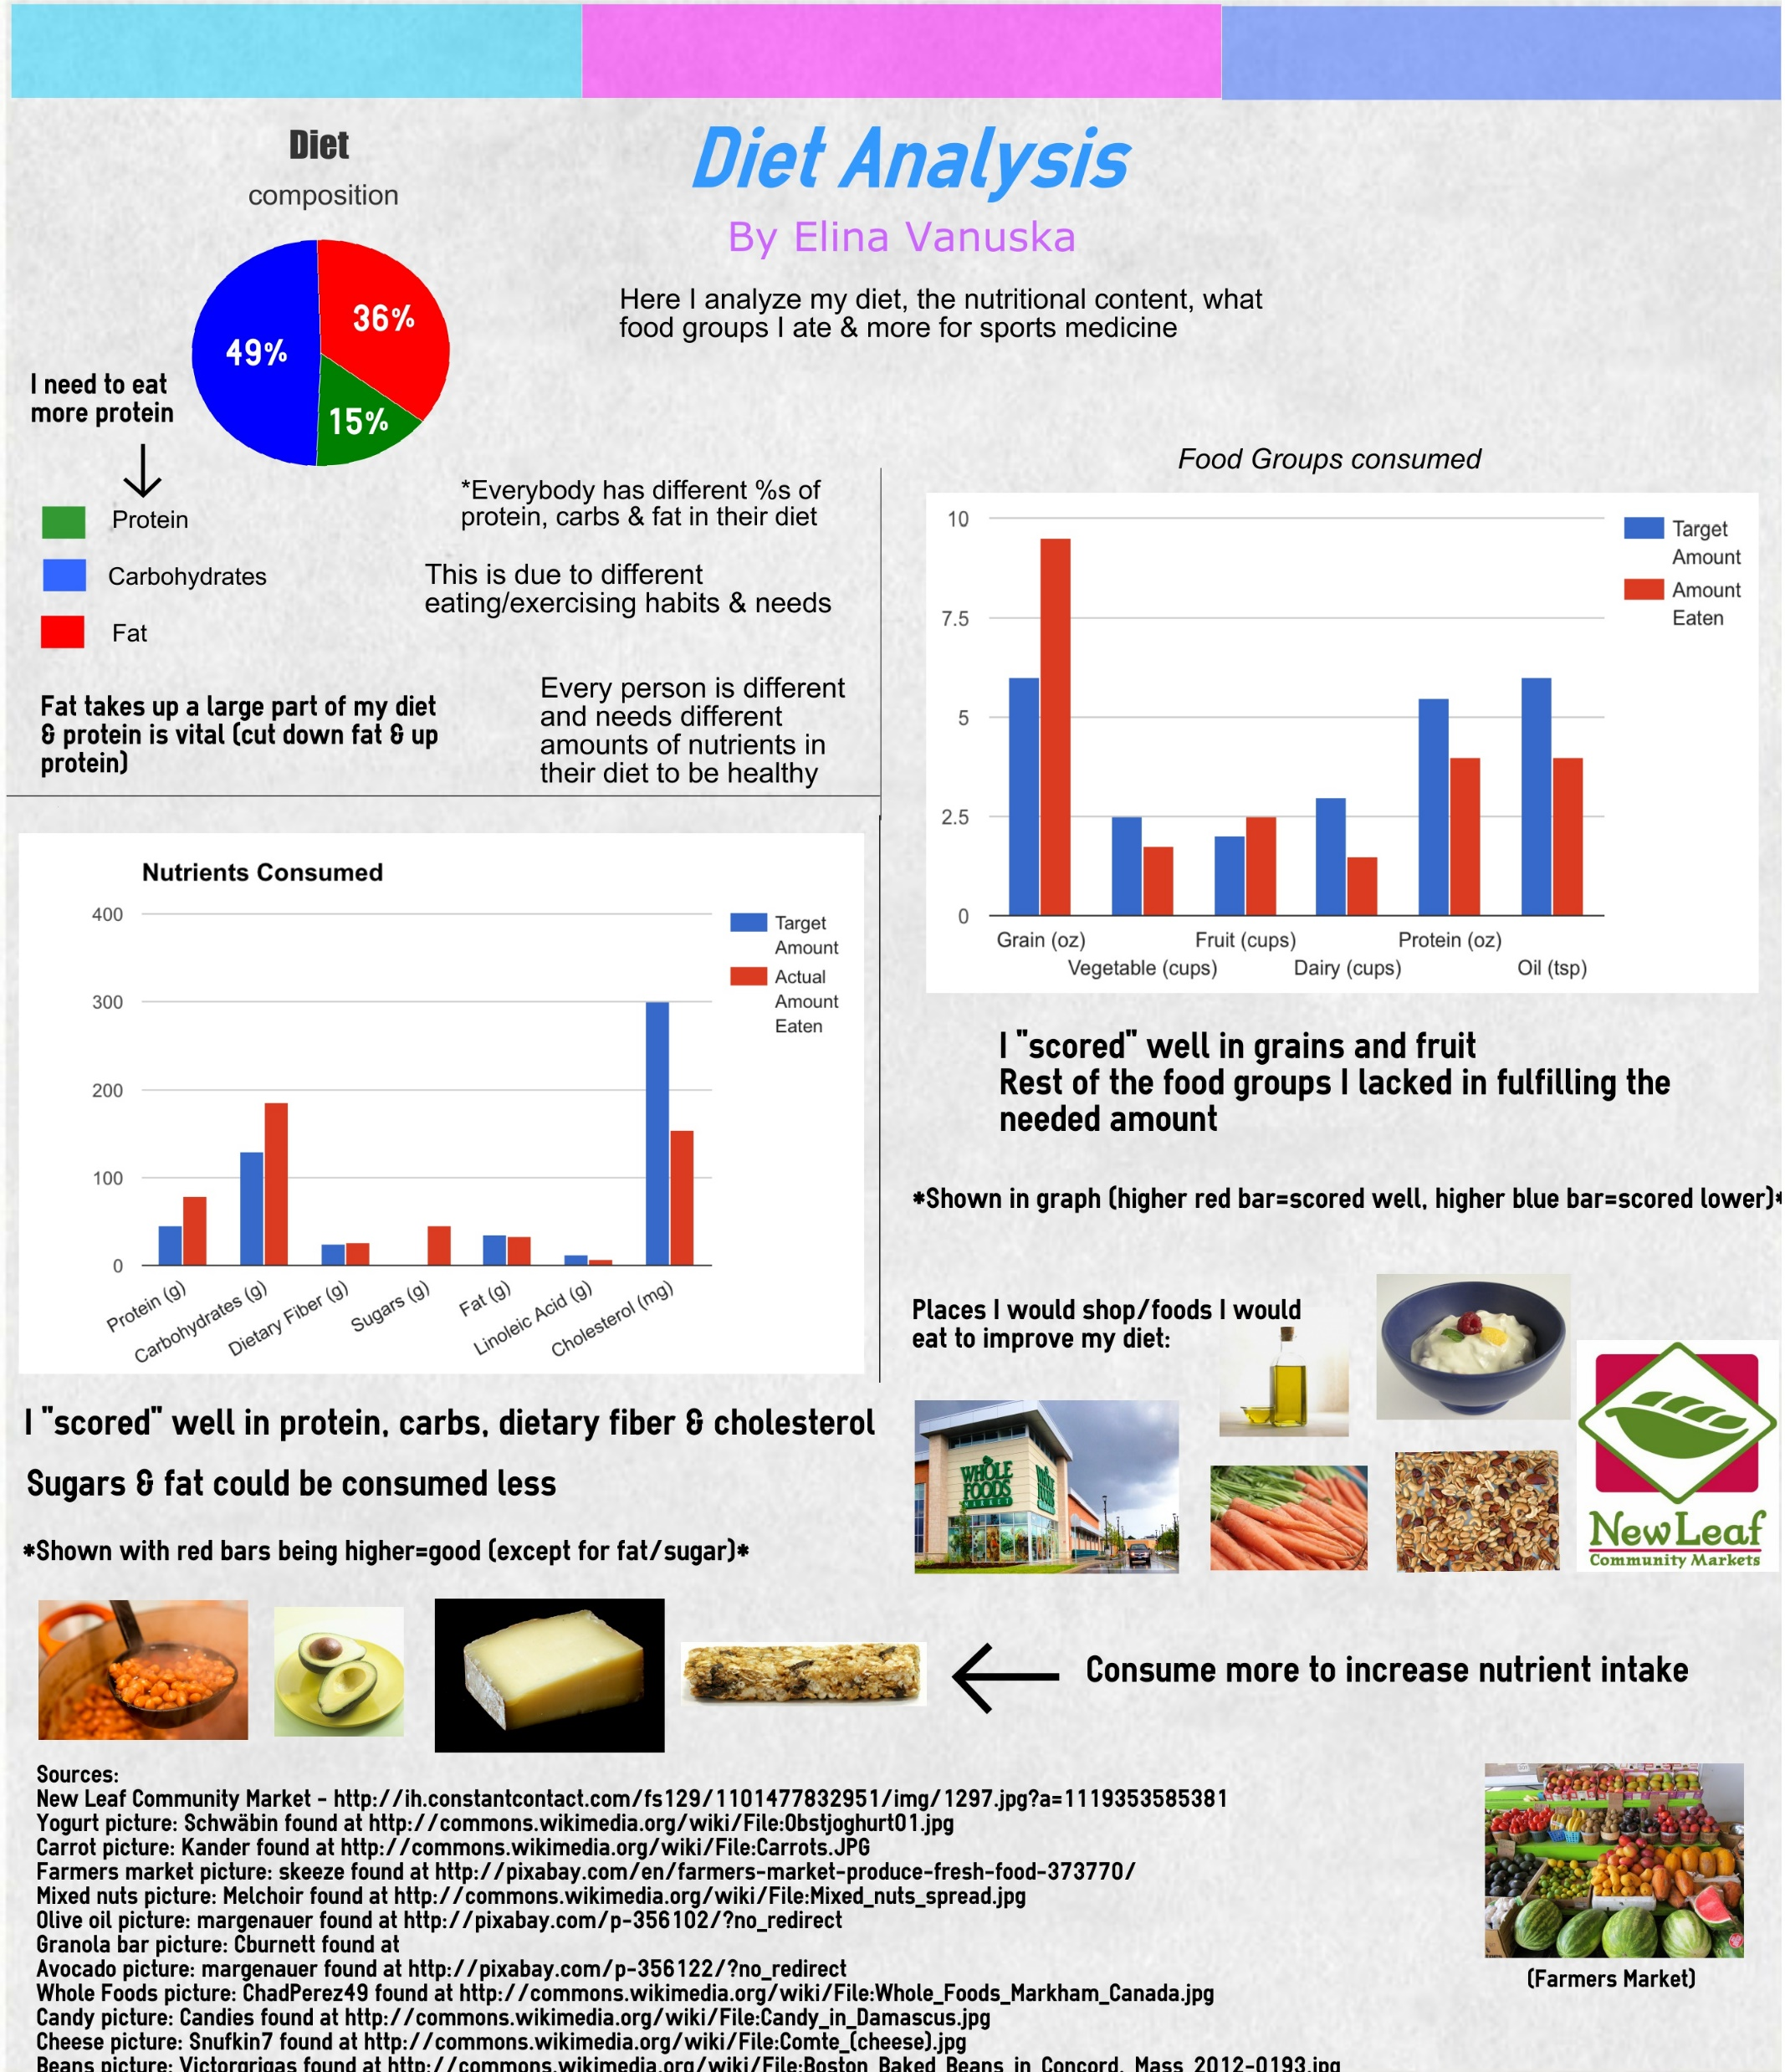

Slide 8
