Slide 1

NON-TEACHING CREDIT COURSE · MINOR PROJECT · 2026
A Comparative Study of Trends in Income, Expenditure and Investment Across Socio-Economic Groups
Amity Institute of Applied Sciences
Department of Statistics
BSTAT(H/HWR)
SEM-7 BATCH-2023-2027
PRESENTED BY
ENROLMENT NO.
FACULTY GUIDE
Shristi Singh
A90555923007
Ms. Tinni Chaudhuri
Notes:
Good morning. My name is Shristi Singh, enrolment number A90555923007. My NTCC minor project is titled A Comparative Study of Trends in Income, Expenditure and Investment Across Socio-Economic Groups, done under the guidance of Ms. Tinni Chaudhuri. I use official government data from 2022-23 and 2023-24.

Slide 2
CONTENTS
What this presentation covers
Motivation
3
Data visualisation (Obj 1–3)
14–17
Motivation
3
Research gap and contribution
13
Aim & objectives
4–5
Findings: levels, inequality, FE
18–20
Aim of the study
4
Findings and interpretation
14-16
Key terms
6
Random effects & Hausman
21–22
Objectives
5
Future targets
17
Data & methodology
7–8
Conclusion & limitations
23–24
Key terms in simple words
6
References
19
Literature review (4 papers)
9–12
Future work
25
Data and sources
7-8
Research gap
13
References
26
Literature review
9-12
Shristi Singh · A90555923007 · Guide: Ms. Tinni Chaudhuri · Amity University Kolkata
2
Notes:
This is the order of my talk. First why I chose the topic, then the aim and objectives, a few key terms, the four papers I reviewed, my data and method, the results, the limitations, and finally my future targets.

Slide 3
MOTIVATION
Why this topic?
1
Income is measured in parts
2
MPCE as the welfare proxy
3
The guide's suggestion
Earnings are in PLFS and assets in AIDIS. No one official survey gives total household income by social group and State.
Monthly Per Capita Consumption Expenditure is what HCES actually reports, and the standard proxy for household welfare.
Go beyond expenditure: bring in income, taxation and unemployment. Hence NSDP, stamp duty and PLFS rates.
Statement of the problem
Two new HCES rounds have arrived after a long gap in official consumption surveys, yet nobody has read them alongside state income, a state-set tax and the labour market for the same states and the same years.
Shristi Singh · A90555923007 · Guide: Ms. Tinni Chaudhuri · Amity University Kolkata
3
Notes:
Why this topic? India does collect income-related data, such as earnings in PLFS and assets in AIDIS. What it does not have is one official survey of total household income by social group and State. So the comparable welfare measure here is what households spend, MPCE from HCES. My guide asked me to go beyond spending and bring in income, a tax and unemployment. In one line: two new surveys have come out, and no one has yet studied them together with State income, a State tax and jobs.

Slide 4
AIM
Aim of the study
To compare trends in income, expenditure and investment across socio-economic groups and across States of India using the latest published official data, and to test whether state consumption is explained by state income, taxation and unemployment.
Expenditure
Income
Investment
HCES MPCE for ST, SC, OBC and Others, rural and urban
Per-capita NSDP, Economic Survey
AIDIS 2019 household assets, used as context
Shristi Singh · A90555923007 · Guide: Ms. Tinni Chaudhuri · Amity University Kolkata
4
Notes:
My aim is to compare income, spending and investment across social groups and across States, and to test whether State income, a State tax and unemployment explain how much people spend. Expenditure comes from HCES, income from per capita NSDP, and investment from the AIDIS 2019 asset survey, which I use only as background.

Slide 5
OBJECTIVES
Three objectives
1
Social-group comparison of MPCE
Compare average MPCE across Scheduled Tribes, Scheduled Castes, OBC and Others, separately for rural and urban India, and measure the change from 2022-23 to 2023-24.
2
Measure inequality
Use the fractile-class MPCE distribution, that is the top 5% to bottom 5% ratio, with the published Gini coefficient for both sectors and both years.
3
Build and estimate a state panel
Join state MPCE with per-capita NSDP, urban stamp duty and PLFS unemployment, estimate fixed- and random-effects models, and choose between them with a Hausman test.
Shristi Singh · A90555923007 · Guide: Ms. Tinni Chaudhuri · Amity University Kolkata
5
Notes:
I have three objectives. One: compare spending of Scheduled Tribes, Scheduled Castes, OBC and Others, in villages and cities, across the two years. Two: measure inequality using the Gini coefficient and the gap between the richest and poorest 5 per cent. Three: build a State-level panel and run fixed-effects and random-effects models, and use the Hausman test to choose between them.

Slide 6
KEY TERMS
Words you will hear in the viva
MPCE
NSDP
Monthly Per Capita Consumption Expenditure — average spending per person per month. Our welfare measure.
Net State Domestic Product per capita — average income produced in a State. Our income variable.
Gini
Fractile
A number from 0 to 1 for inequality. 0 = everyone equal; closer to 1 = more unequal.
A spending class from poorest to richest (e.g. bottom 5%, top 5%).
Fixed effects
Random effects
Looks only at changes inside each State over time. Removes permanent State differences.
Uses both within-State and between-State differences. Needs a strong assumption.
Hausman test
Stamp duty
Checks whether FE and RE coefficients agree. If they differ, trust Fixed Effects.
State-set tax on property transfer. Used instead of GST because GST does not vary by State.
Shristi Singh · A90555923007 · Guide: Ms. Tinni Chaudhuri · Amity University Kolkata
6

Slide 7
DATA AND SOURCES
Four official sources, one State–year panel
1
HCES 2022-23 & 2023-24
2
Economic Survey 2025-26
MPCE by social group, fractile and State (MoSPI factsheets)
Per capita NSDP at current prices — Table 1.11A
3
State IGR schedules
4
PLFS via RBI Handbook
Urban stamp duty on property transfer (State-set tax)
Usual-status unemployment, age 15+ (Tables 8 & 9)
Sample rule for Objective 3
All-India kept for description only. Models use a complete-case balanced panel of 18 major States × 2 years × rural/urban = 72 observations. Blank cells stay blank — nothing is imputed.
Shristi Singh · A90555923007 · Guide: Ms. Tinni Chaudhuri · Amity University Kolkata
7

Slide 8
METHODOLOGY
From four sheets to FE, RE and Hausman
1
Stack the panel
2
Pooled OLS
3
Fixed effects
State × Year × Sector long format; flag All-India; keep 18 complete States.
Baseline: MPCE on NSDP, unemployment, urban dummy (ignores State effects).
State dummies / within transformation — uses only within-State change.
4
Random effects
5
Hausman test
6
Robustness
Uses within and between variation; can estimate stamp duty.
Compare FE and RE coefficients; large χ² → prefer Fixed Effects.
Two-way FE with year effects as a check that NSDP stays significant.
Shristi Singh · A90555923007 · Guide: Ms. Tinni Chaudhuri · Amity University Kolkata
8

Slide 9
REVIEW OF LITERATURE 1 OF 4
Deaton & Drèze (2002)
Deaton, A. & Drèze, J. (2002). Poverty and Inequality in India: A Re-examination. Economic and Political Weekly, 37(36), 3729-3748.
SUMMARY OF THE STUDY
Rebuilds comparable poverty and inequality estimates for India and the major states across NSS rounds 43, 50 and 55.
Corrects the recall-period change in the 55th round, so the official fall from 36% to 26% poverty is not a comparable figure.
Poverty did fall, but by less; growth was regionally uneven and inequality rose between states and within urban areas.
How this project differs:
the two newest HCES rounds are read by social group and placed in a state panel with income, a state tax and unemployment.
Shristi Singh · A90555923007 · Guide: Ms. Tinni Chaudhuri · Amity University Kolkata
9
Notes:
The first paper is Deaton and Dreze, 2002. They rebuilt India's poverty and inequality numbers from older NSS surveys, because a change in the survey method had made official poverty look lower than it was. Their gap for me: no social-group split, data end in 1999-2000, and no tax or panel model. My project uses the newest surveys, by social group, in a panel.

Slide 10
REVIEW OF LITERATURE 2 OF 4
Zacharias & Vakulabharanam (2011)
Zacharias, A. & Vakulabharanam, V. (2011). Caste Stratification and Wealth Inequality in India. World Development, 39(10), 1820-1833.
SUMMARY OF THE STUDY
Measures caste-wise household wealth, that is assets net of debt, using AIDIS 1991-92 and 2002-03, rural and urban separately.
Applies the ANOGI Gini decomposition, which adds an overlap or stratification index to the between- and within-group split.
Wealth Gini is about 0.65 and stable; only about 13% is between castes, so most inequality sits within groups.
How this project differs:
consumption replaces wealth as the outcome, and income, stamp duty and unemployment are added for the same states and years.
Shristi Singh · A90555923007 · Guide: Ms. Tinni Chaudhuri · Amity University Kolkata
10
Notes:
The second paper is Zacharias and Vakulabharanam, 2011. They measured wealth by caste and found most wealth inequality lies within castes, not between them. But they measure wealth, not spending, their data stop in 2002-03, and they have no tax or unemployment. My project studies spending and adds income, stamp duty and unemployment.

Slide 11
REVIEW OF LITERATURE 3 OF 4
Kijima (2006)
Kijima, Y. (2006). Caste and Tribe Inequality: Evidence from India, 1983-1999. Economic Development and Cultural Change, 54(2), 369-404.
SUMMARY OF THE STUDY
Asks why Scheduled Caste and Scheduled Tribe households still have lower living standards after decades of targeted policy.
Uses NSS consumption rounds from 1983 to 1999 and decomposes the gap into an endowment part and a returns part.
About 30% to 50% of the welfare gap comes from lower returns to assets, not only from owning fewer assets.
How this project differs:
the social-group comparison is updated to 2022-23 and 2023-24 and reported for ST, SC, OBC and Others from published HCES tables.
Shristi Singh · A90555923007 · Guide: Ms. Tinni Chaudhuri · Amity University Kolkata
11
Notes:
The third paper is Kijima, 2006. It asks why SC and ST households stay poorer and finds that 30 to 50 per cent of the gap comes from lower returns to education and assets, not just owning less. It ends in 1999 and uses unit-level data. My project updates the comparison to the two latest HCES rounds, using published tables.

Slide 12
REVIEW OF LITERATURE 4 OF 4
Chancel & Piketty (2019)
Chancel, L. & Piketty, T. (2019). Indian Income Inequality, 1922-2015: From British Raj to Billionaire Raj? Review of Income and Wealth, 65(S1), S33-S62.
SUMMARY OF THE STUDY
Reconstructs the distribution of Indian income from 1922 to 2015 by combining tax tabulations, household surveys and national accounts.
The top 1% received under 21% of total income in the late 1930s, about 6% in the early 1980s and about 22% recently.
Argues that household surveys understate the top, so income and wealth statistics need to be more transparent.
How this project differs:
state consumption is the outcome and per-capita NSDP is the income measure, so the claims stay within what published aggregates can support.
Shristi Singh · A90555923007 · Guide: Ms. Tinni Chaudhuri · Amity University Kolkata
12
Notes:
The fourth paper is Chancel and Piketty, 2019. They traced Indian income inequality from 1922 to 2015 and showed the top 1 per cent's share fell to about 6 per cent in the early 1980s and rose to about 22 per cent recently. It is national income, not State spending by social group. My project works at the State level with spending as the outcome.

Slide 13
RESEARCH GAP
Gap in the literature and Novelty
Four official sources in one table
Social group as a main axis
HCES MPCE, per-capita NSDP, urban stamp duty and PLFS unemployment joined for the same State and the same year.
ST, SC, OBC and Others for rural and urban in both rounds, eight cells a year, with growth rates and group ratios.
Stamp duty as the state tax
GST is set nationally and cannot identify a state effect; urban stamp duty is set by each state and genuinely varies.
Shristi Singh · A90555923007 · Guide: Ms. Tinni Chaudhuri · Amity University Kolkata
13
Notes:
So what is new in my work? Four things. I join four official sources for the same State and year. I compare social groups using the newest surveys. I use urban stamp duty as the tax, because GST is the same in every State and cannot show differences.

Slide 14
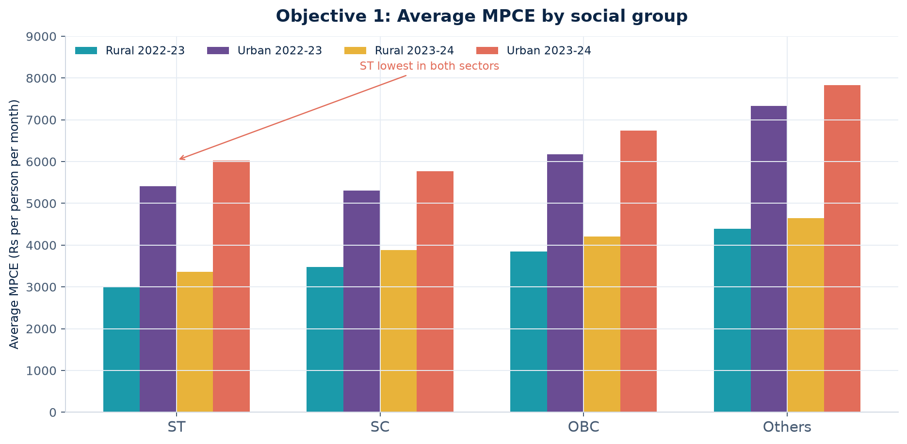
OBJECTIVE 1 · DATA VISUALISATION
Social-group MPCE: ST remains at the bottom
How to explain this
1
ST households have the lowest MPCE in rural and urban India in both years.
2
Others spend the most; the urban gap Others–ST is wider than the rural gap.
3
Every group spends more in urban areas than in rural areas.
4
Source: MoSPI HCES factsheets — published averages only.
Shristi Singh · A90555923007 · Guide: Ms. Tinni Chaudhuri · Amity University Kolkata
14

Slide 15
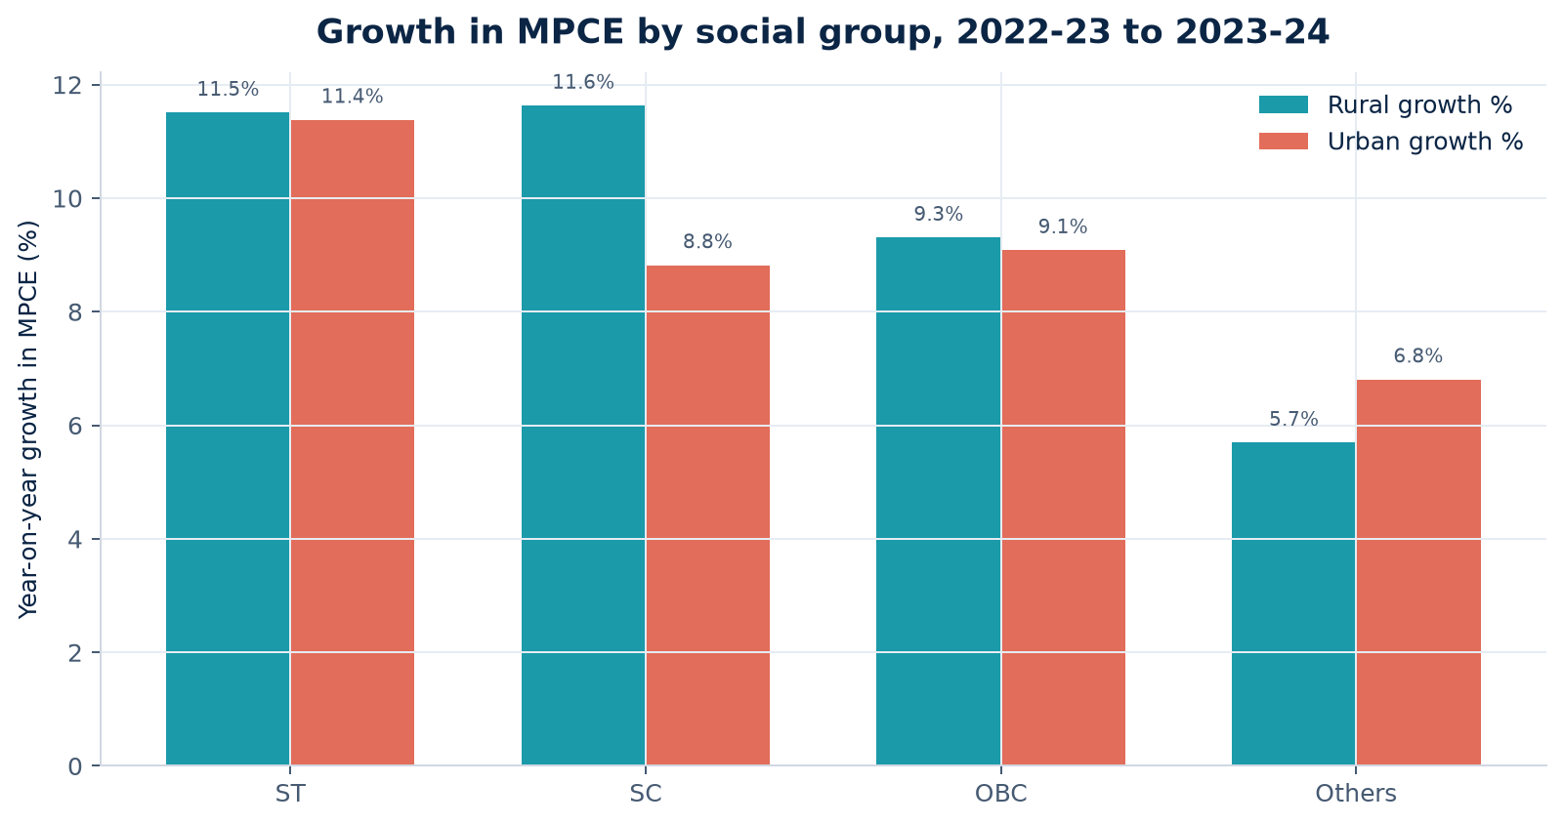
OBJECTIVE 1 · CHANGE OVER TIME
Year-on-year growth in MPCE by social group
Talking point
Growth is positive for every group, but two years are not a long trend. Report the rise; do not claim a permanent catch-up.
Shristi Singh · A90555923007 · Guide: Ms. Tinni Chaudhuri · Amity University Kolkata
15

Slide 16
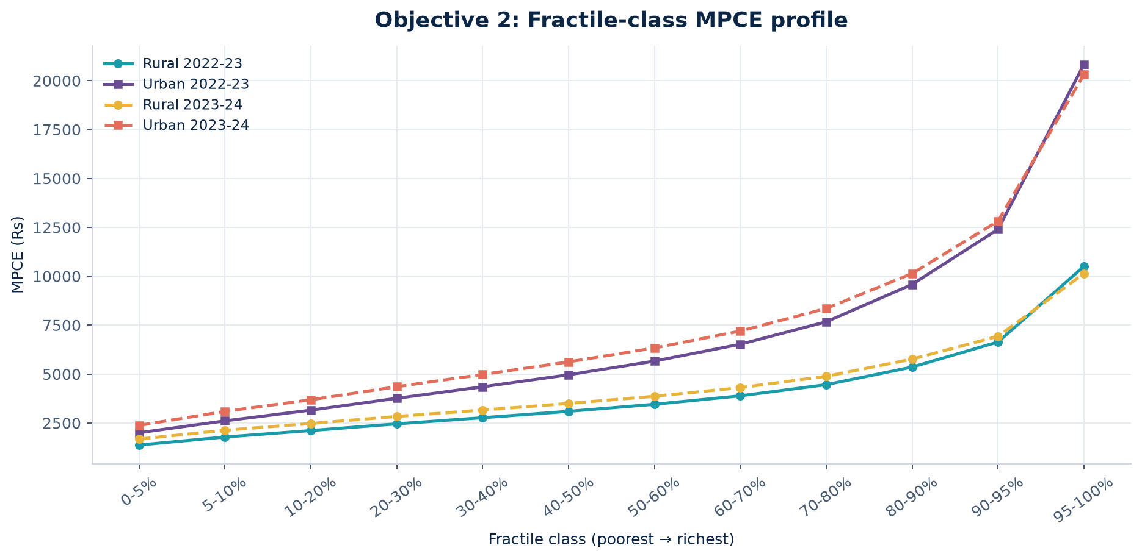
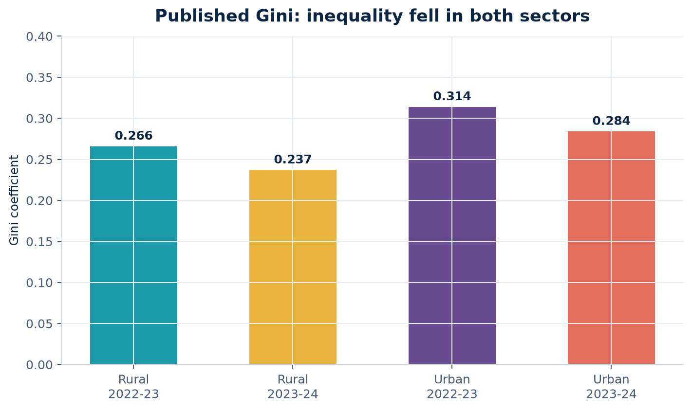
OBJECTIVE 2 · DATA VISUALISATION
Fractiles, top–bottom spread and the Gini
What you can say
Urban curves sit above rural curves and fan out more — urban spending is more unequal. Published Gini fell from 0.266→0.237 (rural) and 0.314→0.284 (urban). Top 5% / bottom 5% ratios: rural 7.7×→6.0×, urban 10.4×→8.6×. Report this as what the tables show, not a proven structural change.
Shristi Singh · A90555923007 · Guide: Ms. Tinni Chaudhuri · Amity University Kolkata
16

Slide 17
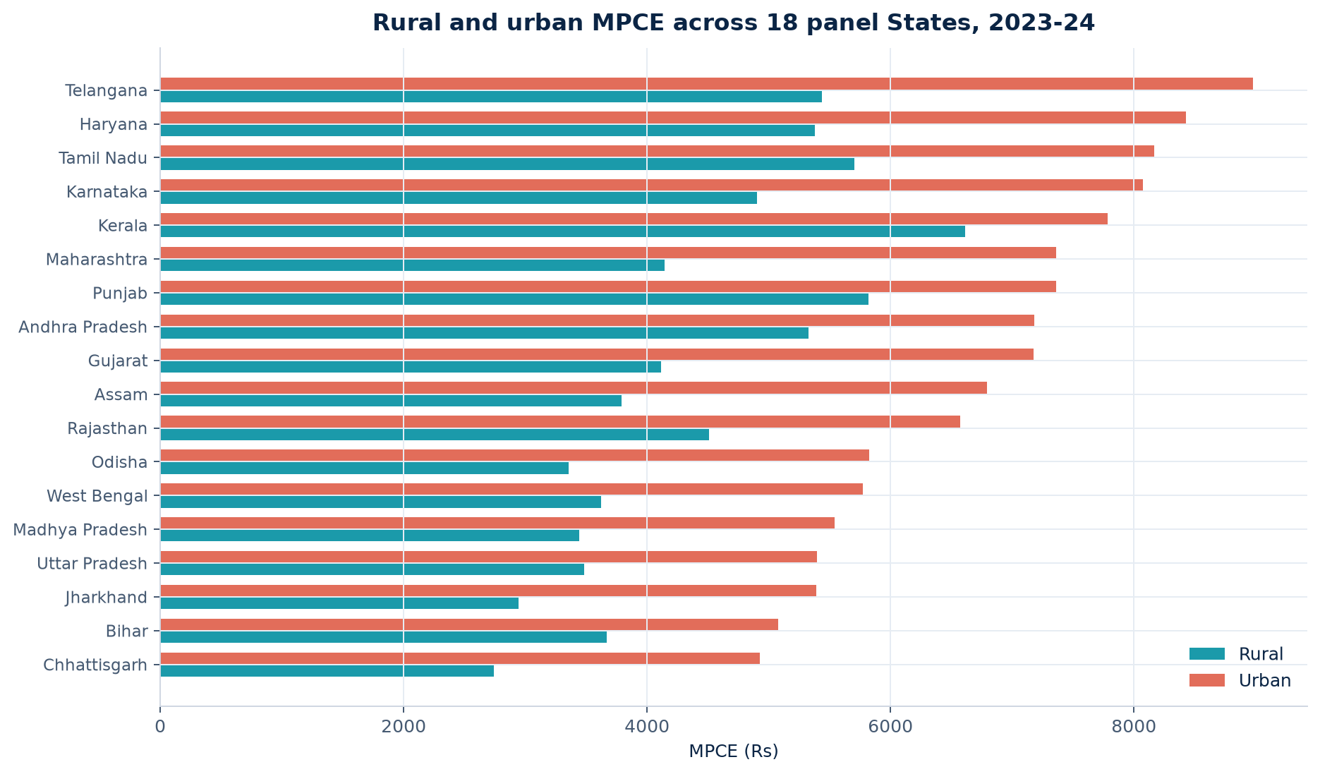
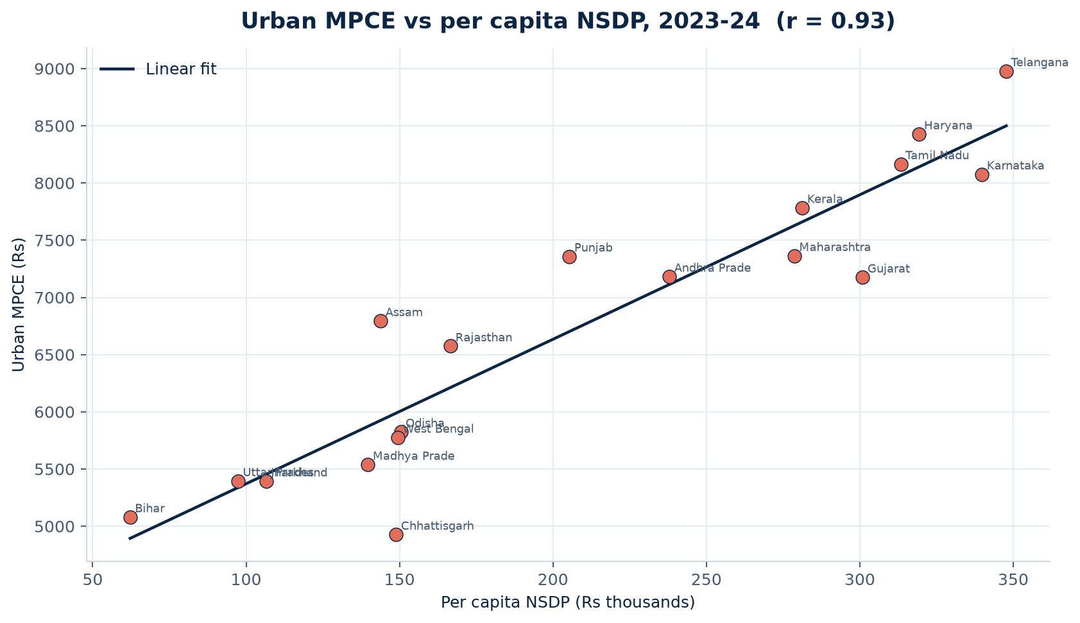
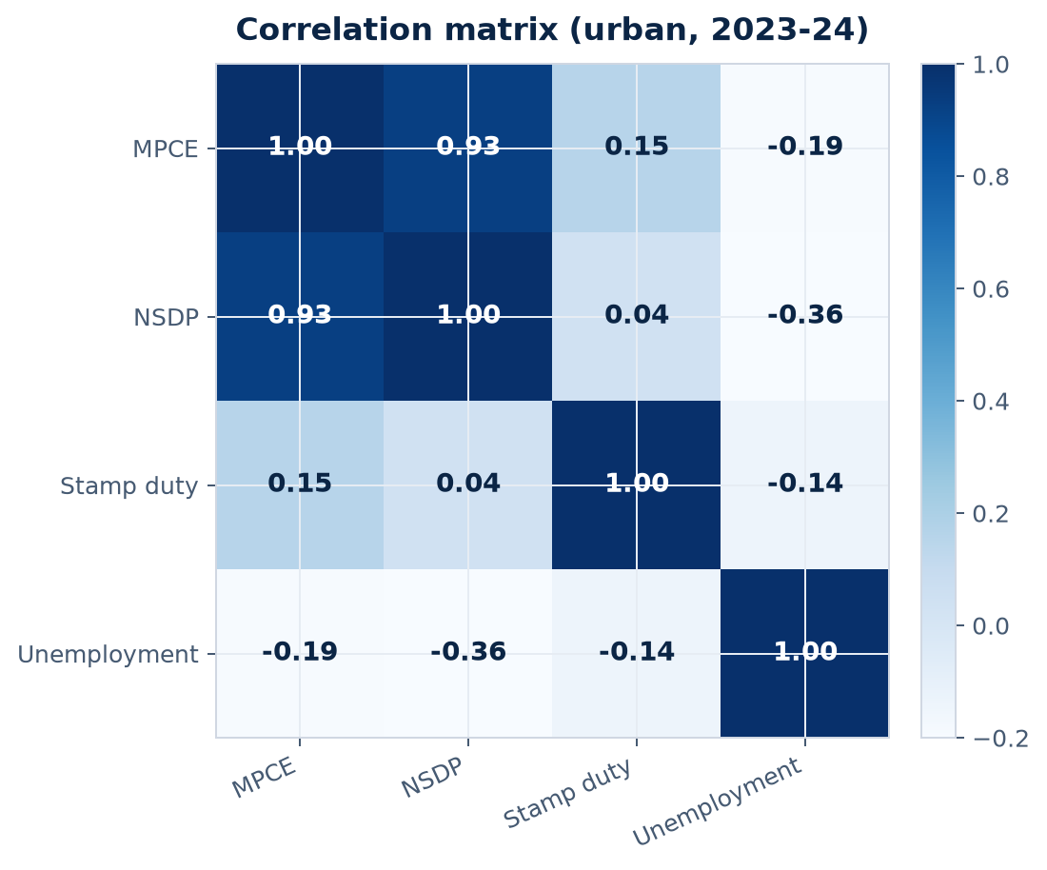
OBJECTIVE 3 · DATA VISUALISATION
States: spending, income and correlation
Shristi Singh · A90555923007 · Guide: Ms. Tinni Chaudhuri · Amity University Kolkata
17

Slide 18
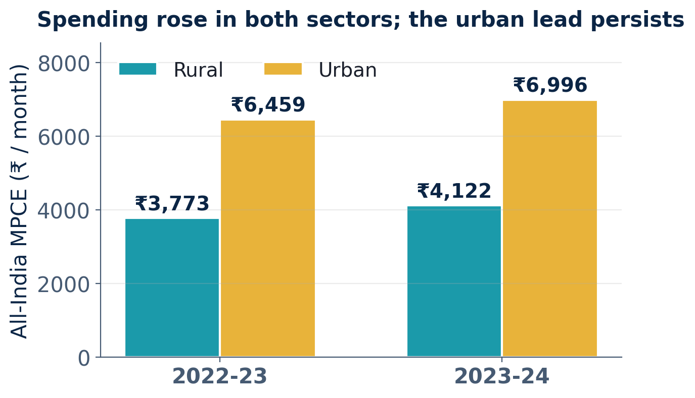
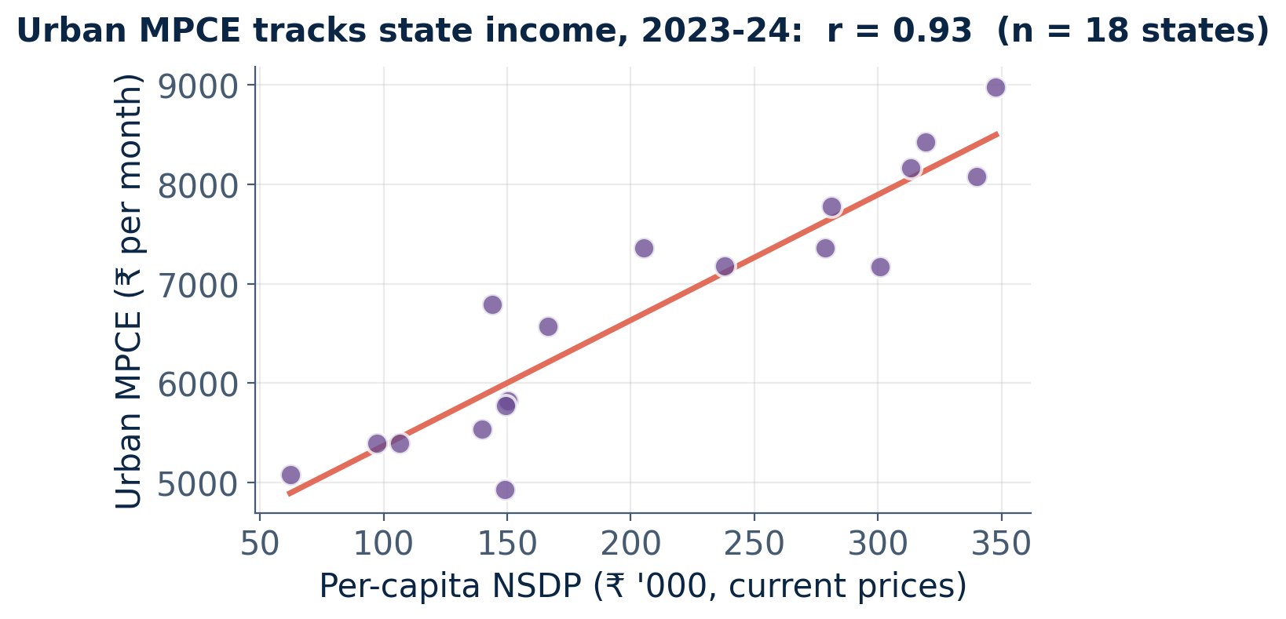
FINDINGS 1 OF 3
Expenditure levels and state income
₹4,388
₹6,767
r = 0.93
Mean rural MPCE across the 18 panel states, 2023-24
Mean urban MPCE for the same states and year, about 54% higher
Urban MPCE with per-capita NSDP: income and spending move together
Shristi Singh · A90555923007 · Guide: Ms. Tinni Chaudhuri · Amity University Kolkata
18
Notes:
rural spending went from Rs 4,870 to Rs 5,327, urban from Rs 6,782 to Rs 7,182, while urban unemployment fell from 6.5% to 5.9%."First results. In 2023-24, across the 18 States, urban spending averages about Rs 6,767 a month against about Rs 4,388 in rural areas, around 54 per cent higher. The scatter plot shows richer States spend more: the correlation between urban spending and State income is 0.93, which is very strong.

Slide 19
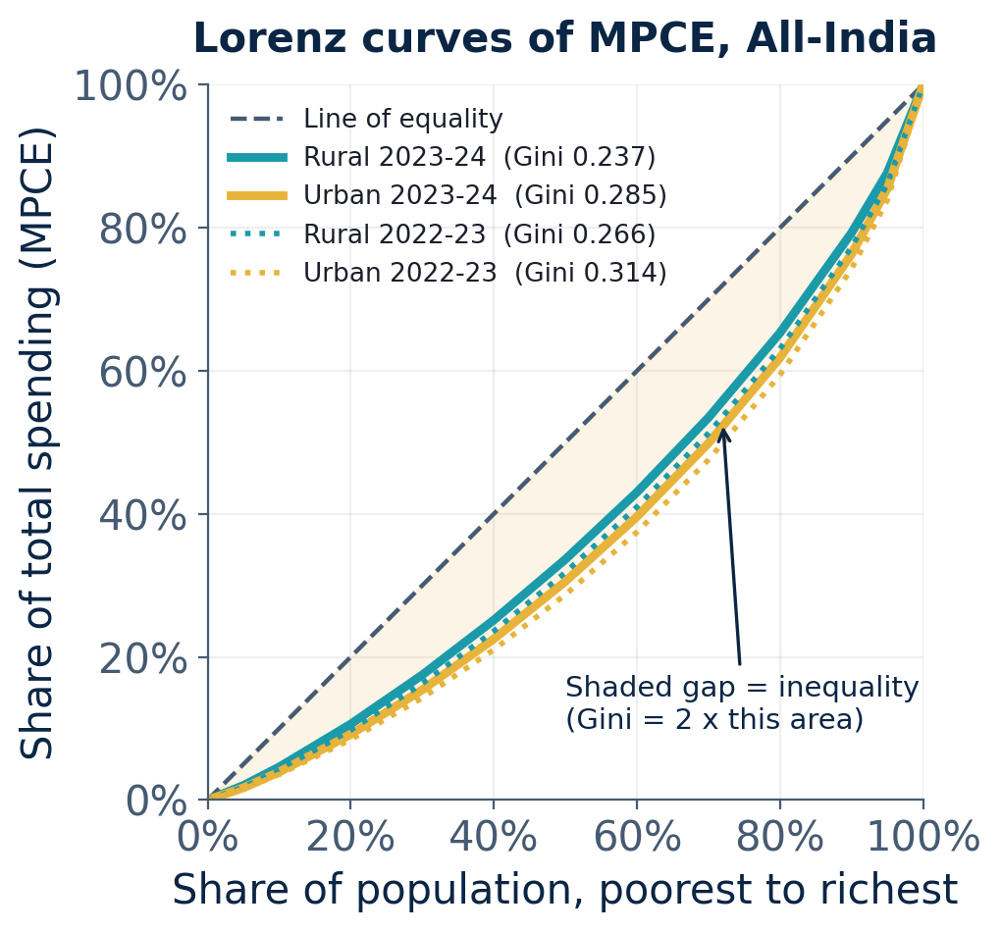
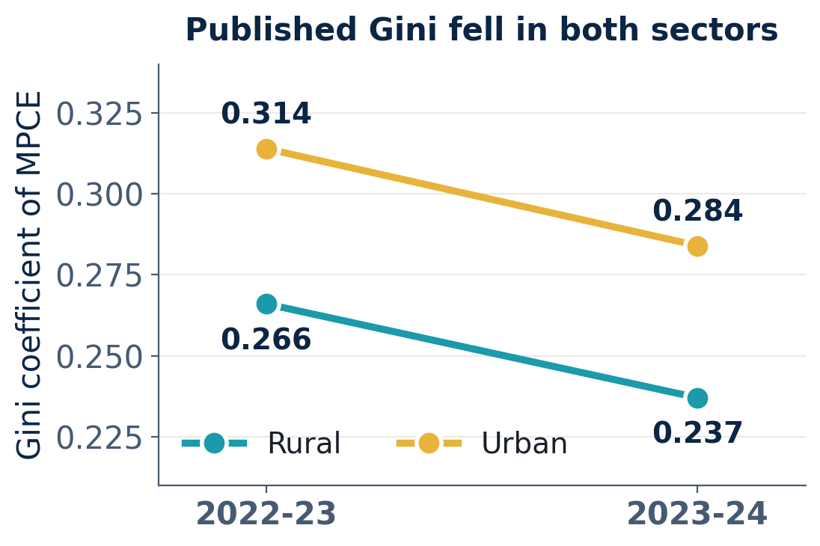
FINDINGS 2 OF 3
Inequality: Lorenz curve and Gini coefficient
HOW TO READ THE LORENZ CURVE
The dashed line is perfect equality: the poorest 20% would spend 20% of the total.
The further a curve sags below that line, the more unequal spending is. The urban curve sags more than the rural curve.
Curves are built from the 12 published fractile classes; the Gini from them closely matches the published Gini.
Both curves moved closer to the line between the rounds, which is why the published Gini fell.
Shristi Singh · A90555923007 · Guide: Ms. Tinni Chaudhuri · Amity University Kolkata
19
Notes:
This slide is about inequality. The dashed line is perfect equality: the poorest 20 per cent would spend 20 per cent of the total. The Lorenz curve shows what actually happens. The more it sags below the line, the more unequal spending is. The urban curve sags more than the rural curve, so urban spending is more unequal. The Gini coefficient is twice the area between the line and the curve. Both curves moved closer to the line between the two rounds, and the Gini fell: rural from 0.266 to 0.237, urban from 0.314 to 0.284. I built the curves from the twelve published fractile classes, and the Gini I get from them matches the published figure.

Slide 20
FINDINGS 3 OF 3
The chosen model
FIXED-EFFECTS ESTIMATES (STATE EFFECTS)
WHY FIXED EFFECTS
Variable
Coefficient
t-value
p-value
Reading
Hausman χ²(3) = 54.02, p < 0.001: random effects is rejected.
Per capita NSDP (Rs '000)
20.46
8.73
< 0.001
+Rs 1,000 income, +Rs 20 MPCE
Within R² = 0.92: the model explains most of the change inside each State.
Unemployment rate (%)
23.17
0.32
0.75
Not significant
Urban dummy
2,222.29
7.56
< 0.001
Urban spends about Rs 2,200 more
Stamp duty is significant only under random effects (β = 233, p = 0.0096).
Urban stamp duty (%)
absorbed
-
-
Does not change within a State
72
54.02
0.92
Observations (18 States, 2 years, 2 sectors)
Hausman statistic, 3 degrees of freedom
Within R² of the fixed-effects model
Findings are reported as what the published tables show, not as a proven structural improvement.
Shristi Singh · A90555923007 · Guide: Ms. Tinni Chaudhuri · Amity University Kolkata
20
Notes:
Now the model. The Hausman test gave 54.02, well above the cut-off, so random effects is rejected and fixed effects is the right model. In it, State income is strongly significant: about Rs 20 more monthly spending for every Rs 1,000 more income per person. Unemployment is not significant. Urban areas spend about Rs 2,200 more than rural areas in the same State. Stamp duty does not change within a State in two years, so fixed effects cannot measure it; it shows up only under random effects. The within R-squared is 0.92.

Slide 21
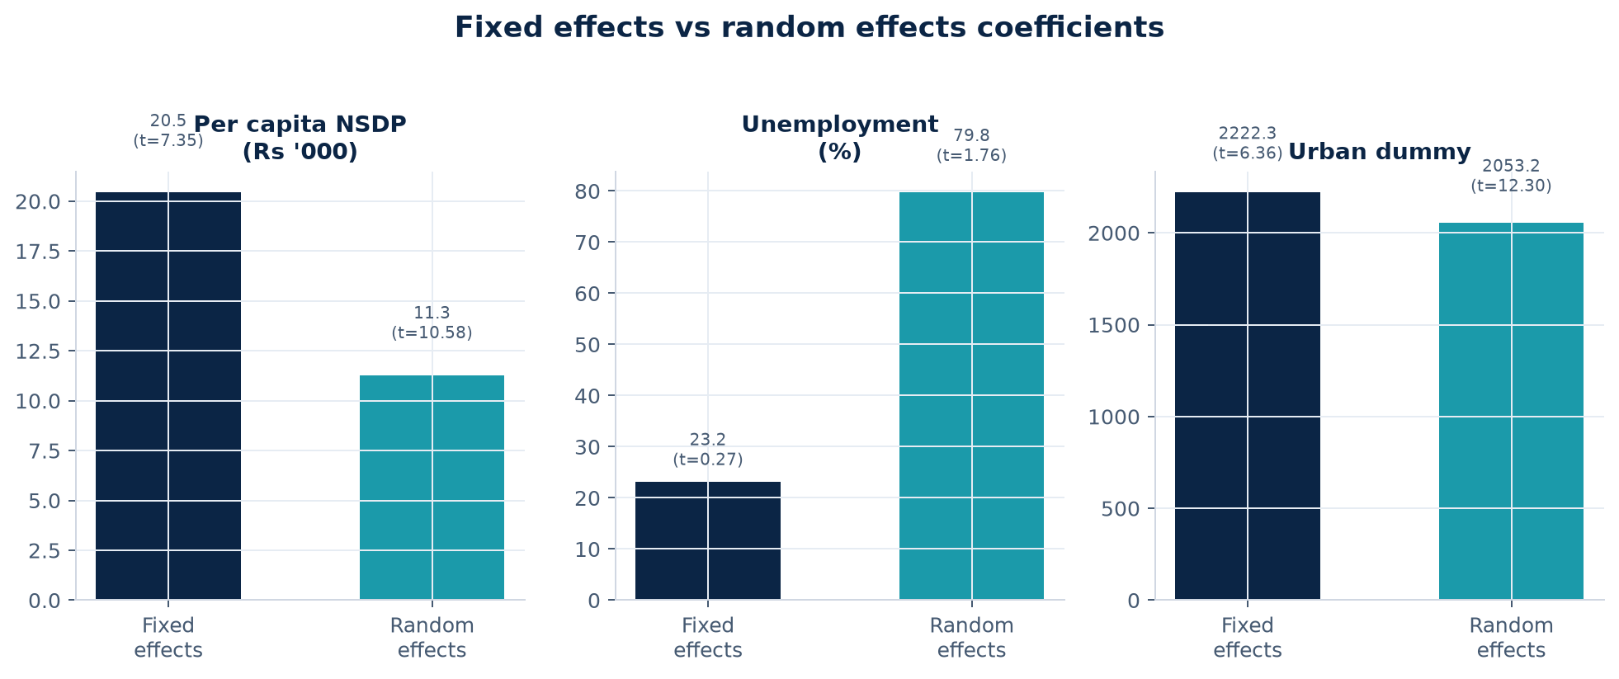
OBJECTIVE 3 · RANDOM EFFECTS
Random-effects estimates (and where stamp duty appears)
RE coefficients
Variable
Coef
Reading
NSDP (Rs '000)
11.3
Still positive
Unemployment
79.8
Not strong
Urban dummy
2,053
Urban higher
Stamp duty %
233
Sig. in RE only
Stamp duty barely changes inside a State over two years, so Fixed Effects cannot estimate it. Discuss it only from RE, and call that a limitation.
Shristi Singh · A90555923007 · Guide: Ms. Tinni Chaudhuri · Amity University Kolkata
21

Slide 22
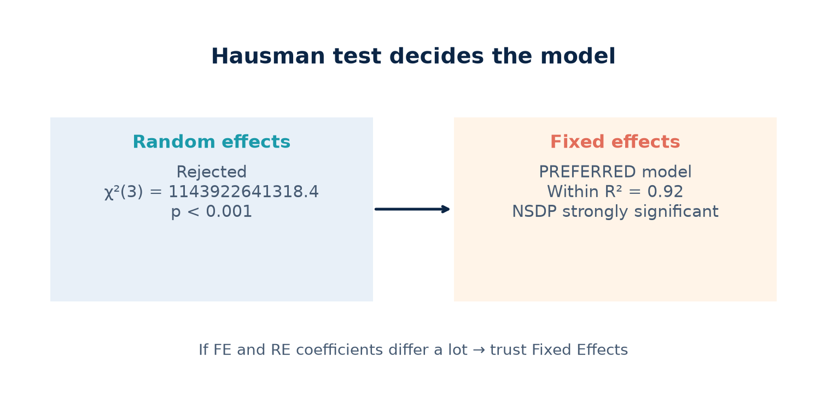
OBJECTIVE 3 · MODEL CHOICE
Hausman test: why Fixed Effects wins
Viva script (30 seconds)
1. FE and RE answer the same question with different assumptions.
2. Hausman checks whether their coefficients agree.
3. χ²(3) = 54.0, p < 0.001 → RE assumption fails.
4. So I report Fixed Effects as the preferred model.
5. Under FE: NSDP is strongly significant; unemployment is not.
72
54.0
0.92
Observations
Hausman χ²(3)
Within R² (FE)
Shristi Singh · A90555923007 · Guide: Ms. Tinni Chaudhuri · Amity University Kolkata
22

Slide 23
CONCLUSION
What this project shows — and what it does not claim
1
Objective 1
ST households have the lowest MPCE in both sectors; the social-group ranking is clear in both HCES rounds.
2
Objective 2
Urban inequality exceeds rural inequality; published Gini and top–bottom ratios both fall between the two rounds.
3
Objective 3
Hausman (54.0) selects Fixed Effects. Per capita NSDP strongly tracks MPCE; unemployment does not.
4
Contribution
Joins newest HCES rounds with State income, a State-set tax and unemployment — a gap left by the four reviewed papers.
Shristi Singh · A90555923007 · Guide: Ms. Tinni Chaudhuri · Amity University Kolkata
23

Slide 24
LIMITATIONS
Honest limits protect full marks
1
Only two survey years
2
Published aggregates
This is a short-run change between two points, not a long historical trend.
No unit-level microdata, so no Deaton–Drèze recall-period correction and no standard errors by group.
3
Stamp duty in FE
4
AIDIS 2019 for investment
Almost constant within States over two years, so State effects absorb it; RE significance is not the main claim.
Used only as context because the year does not match HCES 2022-23 / 2023-24.
Shristi Singh · A90555923007 · Guide: Ms. Tinni Chaudhuri · Amity University Kolkata
24

Slide 25
SCOPE FOR FURTHER WORK
Future targets
FE, RE and Hausman are done — next steps are presentation-ready extensions
Fixed effects model
Random effects model
Discrete analysis
1
Unit-level HCES
2
Longer panel
Practise reading the FE output line by line and explaining what a within-state coefficient means.
Re-estimate with RE and compare the two coefficient columns side by side.
Dummy variables for Rural/Urban and for ST, SC, OBC and Others; compare group means.
If microdata access is granted later, repeat Objective 1 with standard errors and a recall-period check.
Add future HCES rounds so two years become a real time series.
3
Simple OLS first
More tables and charts
Hausman test practice
Social-group dummies
4
Viva readiness
Run a plain pooled OLS as a baseline, then see how much FE and RE change it.
Extra descriptive tables, a correlation heatmap and state-wise MPCE bar charts.
Explain the FE-versus-RE test in plain words so the model choice can be defended.
In a microdata setting, add ST/SC/OBC dummies inside the State panel.
Practise the 30-second Hausman script and the stamp-duty limitation answer.
All of these use the panel that is already built. A simple logit or probit is an optional step after that.
Shristi Singh · A90555923007 · Guide: Ms. Tinni Chaudhuri · Amity University Kolkata
25
Notes:
My future targets are beginner steps: read the fixed-effects output line by line, compare it with random effects, add dummy variables for rural and urban and for social groups, run a simple pooled OLS as a baseline, make more charts, and practise explaining the Hausman test.

Slide 26
REFERENCES
References and bibliography
APA style: cited literature and official data sources
Baltagi, B. H. (2013). Econometric analysis of panel data (5th ed.). John Wiley & Sons.
Chancel, L., & Piketty, T. (2019). Indian income inequality, 1922-2015: From British Raj to Billionaire Raj? Review of Income and Wealth, 65(S1), S33-S62.
Deaton, A., & Drèze, J. (2002). Poverty and inequality in India: A re-examination. Economic and Political Weekly, 37(36), 3729-3748.
Inspector General of Registration and Stamps, State Governments of India. (2024). Stamp duty schedules on transfer of immovable property (urban / standard rates). State IGR departments.
Kijima, Y. (2006). Caste and tribe inequality: Evidence from India, 1983-1999. Economic Development and Cultural Change, 54(2), 369-404.
Ministry of Finance, Government of India. (2026). Economic Survey 2025-26, Table 1.11A: Per capita net state domestic product at current prices. New Delhi.
Ministry of Statistics and Programme Implementation. (2024). Household Consumption Expenditure Survey 2022-23 and 2023-24: Factsheets. Government of India, New Delhi.
Ministry of Statistics and Programme Implementation. (2024). Annual report, Periodic Labour Force Survey (PLFS) 2023-24. Government of India, New Delhi.
Reserve Bank of India. (2024). Handbook of statistics on Indian states. RBI, Mumbai.
Wooldridge, J. M. (2016). Introductory econometrics: A modern approach (6th ed.). Cengage Learning.
Zacharias, A., & Vakulabharanam, V. (2011). Caste stratification and wealth inequality in India. World Development, 39(10), 1820-1833.
Shristi Singh · A90555923007 · Guide: Ms. Tinni Chaudhuri · Amity University Kolkata
26
Notes:
These are my references in APA style: the four papers, two econometrics textbooks, and the official data sources I used.

Slide 27
Thank You
PRESENTED BY
ENROLMENT NO.
FACULTY GUIDE
Shristi Singh
A90555923007
Ms. Tinni Chaudhuri
Amity University Kolkata · Non-Teaching Credit Course, Minor Project 2026
Notes:
Thank you for listening. I am happy to take any questions.

