Slide 1
Data Streaming: PostgreSQL to S3 using Kafka Connect
Shristi Gupta
DevOps Specialist

Slide 2
Demonstrate streaming data from PostgreSQL to S3 via Kafka Connect
Steps Involved :
Set up PostgreSQL with sample data
Deploy Confluent Kafka cluster using Docker
Configure JDBC Source Connector
Configure S3 Sink Connector
Verify data flow

Slide 3
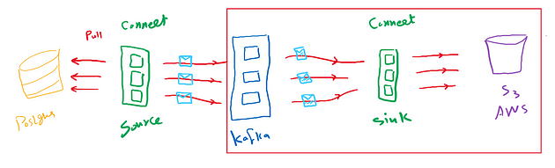
DATA STREAMING: POSTGRESQL TO S3 USING KAFKA CONNECT

Slide 4
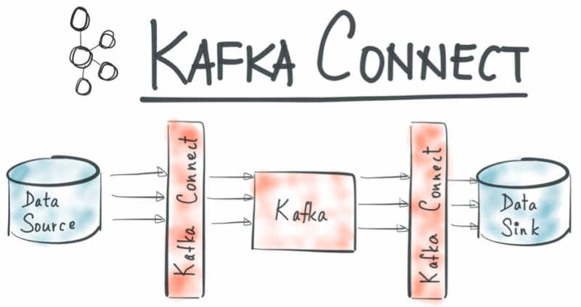
Kafka connect

Slide 5
Step 1 - PostgreSQL Setup
Actions:
Spin up PostgreSQL using Docker.
Create sample schema and table
Insert sample rows.

Slide 6
Step 2 - Kafka Cluster Setup
Components:
Zookeeper for managing cluster metadata.
Kafka Brokers for storing and streaming messages.
Kafka Connect for integrations.

Slide 7
Step 3 - JDBC Source Connector
Key Points:
Connects to PostgreSQL via JDBC.
Monitors for changes using polling.
Writes data to Kafka topics (e.g., postgres-large_data_table).
Configuration Highlights:
Incremental mode: Tracks new/updated rows.
Poll Interval: Regular data checks.

Slide 8
Step 4 - S3 Sink Connector
Key Points:
Reads from Kafka topics.
Writes data to S3 in JSON format.
Configurable storage format (JSON, Avro, Parquet).
Configuration Highlights:
AWS credentials for access.
Topic-to-S3 mapping

Slide 9
Why This Architecture Works
PostgreSQL:
Business-critical data source.
Kafka:
Reliable middleware for streaming.
S3:
Scalable, cost-effective storage solution.
Configurable storage format (JSON, Avro, Parquet).

Slide 10
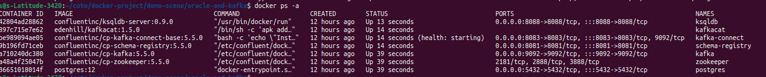
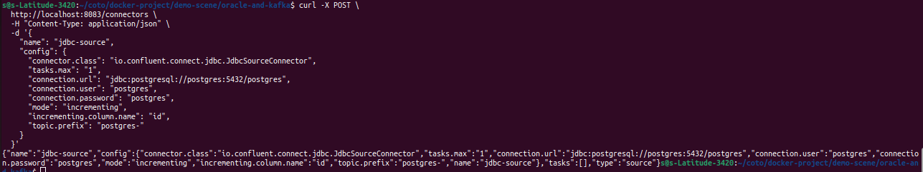
Step 1 - Set Up JDBC Source Connector

Slide 11
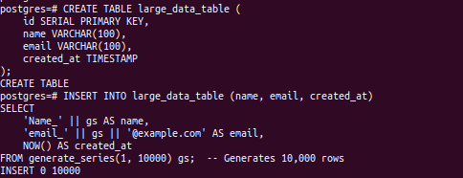
Step 2 - Create Sample Data in PostgreSQL docker exec --tty --interactive postgres bash -c 'psql -U $POSTGRES_USER $POSTGRES_DB'

Slide 12
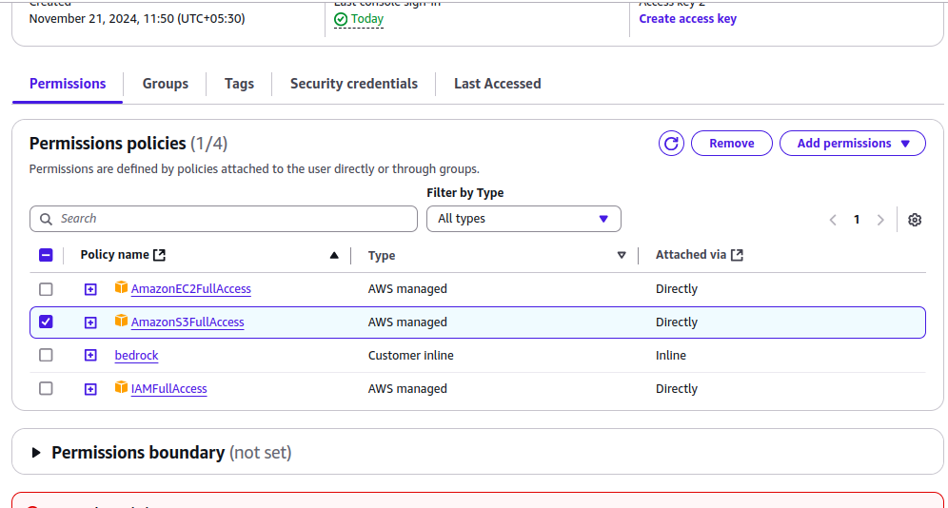
Step-3 Configure AWS IAM User and Policy
Configure AWS IAM User and PolicyCreate a new IAM user via the AWS Console.
Attach a policy granting access to the S3 bucket (mykafkabucketconnector).
Specify the required permissions for S3 (read/write access).

Slide 13
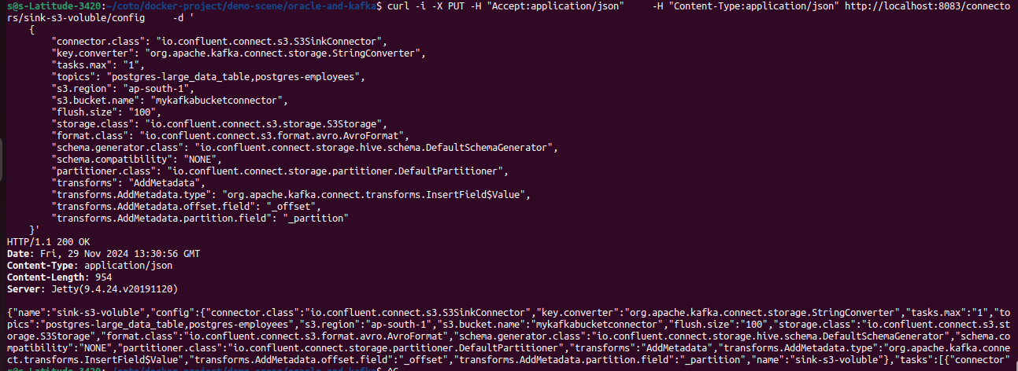
Step-4 Set Up S3 Sink Connector

Slide 14
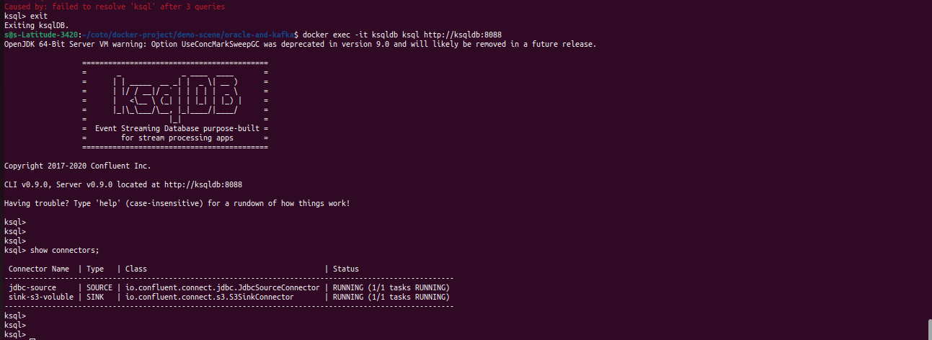
Step-5 Verify Connectors

Slide 15
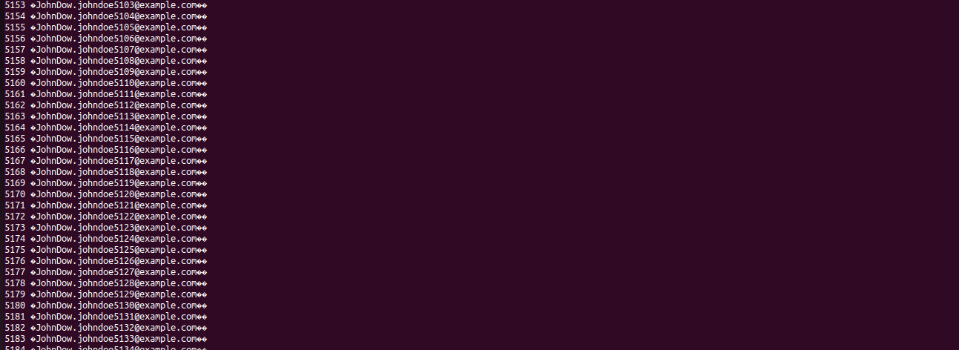
Step-6 Inspect Kafka Topics
kafkacat -b localhost:9092 -t postgres-large_data_table -C -o beginning -f '%o %s\n'

Slide 16
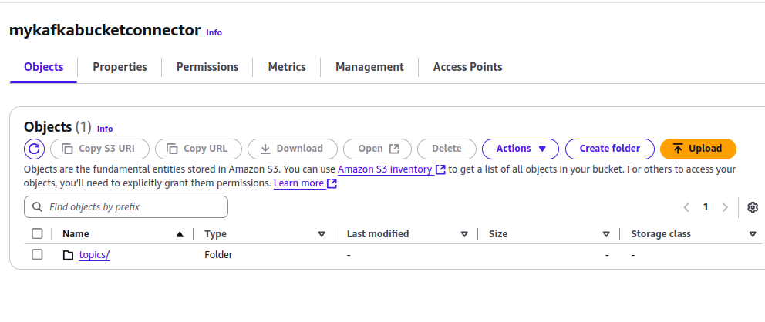
Step-7 Topic-to-S3 mapping

Slide 17
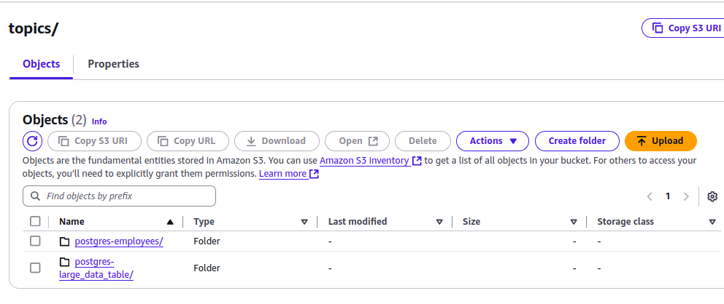

Slide 18
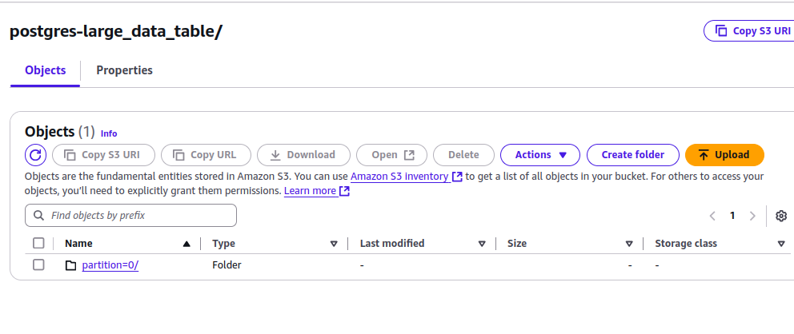

Slide 19
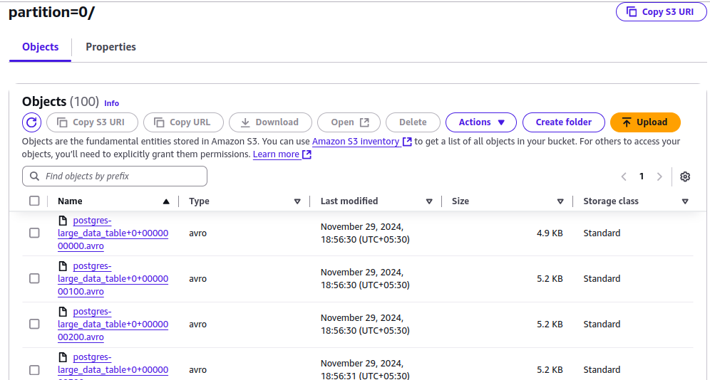

Slide 20
THANK YOU

