Slide 1
Deep Learning Based Smart Security Surveillance
Enhancing Safety with 3D CNN and LSTM Models
Project Team ID: MP24ML010
Guide Name – Mr. Priyank Pandey(Asst. Professor)
Member1 – Shristy Chaudhary University Roll NO. - 2019498

Slide 2
Introduction
This presentation explores a deep learning-based smart security surveillance system designed to enhance safety measures. The system employs 3D Convolutional Neural Networks (3D CNN) and Long Short-Term Memory (LSTM) models to detect abnormal activities in real-time, providing instant notifications. Additionally, a website was developed using the MERN stack to interface with this surveillance system, showcasing its functionality and user-friendliness.

Slide 3
01
Intro & Problem

Slide 4
Overview of Smart Security Surveillance
Smart security surveillance systems leverage advanced technologies to monitor environments, ensuring safety and security. These systems utilize machine learning, particularly deep learning techniques, to analyze video feeds and recognize suspicious activities. By detecting anomalies in real-time, such systems can alert security personnel promptly, significantly reducing response times and enhancing overall safety.

Slide 5

Challenges in Current Systems
Despite advancements in surveillance technology, existing systems face numerous challenges. Many traditional systems rely on basic motion detection, which can result in high false positive rates. Additionally, they often lack integration with advanced analytics, limiting their ability to assess threats accurately. Privacy concerns also hinder the deployment of surveillance systems, as individuals may feel uncomfortable being constantly monitored.

Slide 6
Need for Enhanced Safety Measures
As urban environments grow and the need for security increases, conventional surveillance methods become inadequate. The rise in crime rates and safety threats in public spaces highlight the urgent need for enhanced security measures. Advanced surveillance systems can analyze vast amounts of data quickly, helping to mitigate risks and improve public safety. By implementing deep learning techniques, these systems can evolve to become more effective, reducing reliance on human intervention and increasing overall efficiency.

Slide 7
02
Literature Survey

Slide 8
Previous Work in Deep Learning for Surveillance
A significant body of research has focused on the use of deep learning for video surveillance solutions. Studies have shown the effectiveness of applying various neural network architectures to interpret video data. For instance, Convolutional Neural Networks (CNNs) have been instrumental in image processing tasks, while Long Short-Term Memory (LSTM) networks are particularly beneficial for sequential data analysis. This literature review highlights various methodologies and performance metrics employed in these studies.

Slide 9
3D CNN and LSTM Applications
3D CNNs are designed to analyze spatial and temporal hierarchies, making them suitable for video data where both dimensions are crucial. By extracting features from three-dimensional data, these networks can detect complex patterns representing human actions or object movements. LSTM networks complement this by learning long-term dependencies in sequential data, enabling the effective prediction of future events based on past observations. Together, these technologies enhance the accuracy and reliability of surveillance systems.

Slide 10
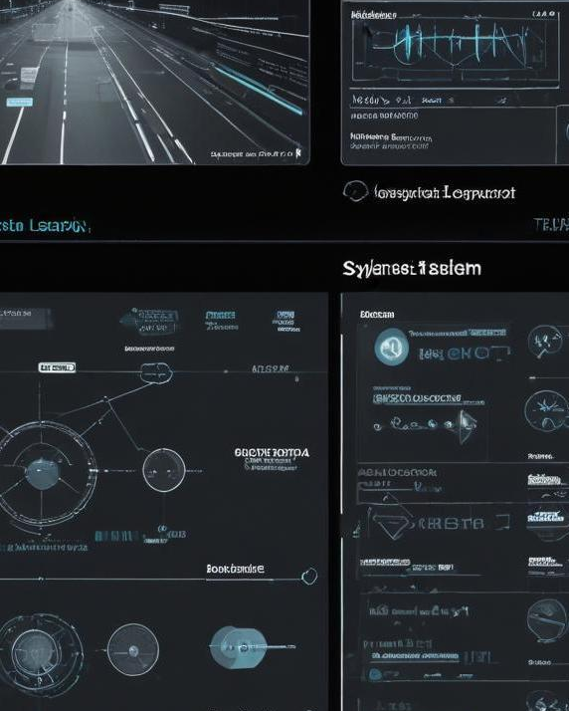
Comparative Analysis of Existing Solutions
Various surveillance systems exist, each employing different methodologies ranging from traditional video analysis to advanced machine learning techniques. Current solutions can be classified based on their architecture, data input methods, and the algorithms used for analysis. This comparative analysis evaluates the strengths and weaknesses of top-performing systems, assessing factors like detection accuracy, processing speed, and real-time capabilities. The insights gained from this analysis can guide future developments in smart surveillance technologies.

Slide 11

Conclusions
In conclusion, the integration of deep learning-based methods, particularly 3D CNNs and LSTMs, offers a transformative approach to enhancing smart security surveillance systems. These advancements not only improve the detection of abnormal activities but also streamline notifications for timely responses. The literature survey confirms a growing trend towards adopting sophisticated algorithms to address the limitations of traditional systems. Continued research and development in this field is essential for optimizing safety measures in our increasingly complex environments.

