Slide 1

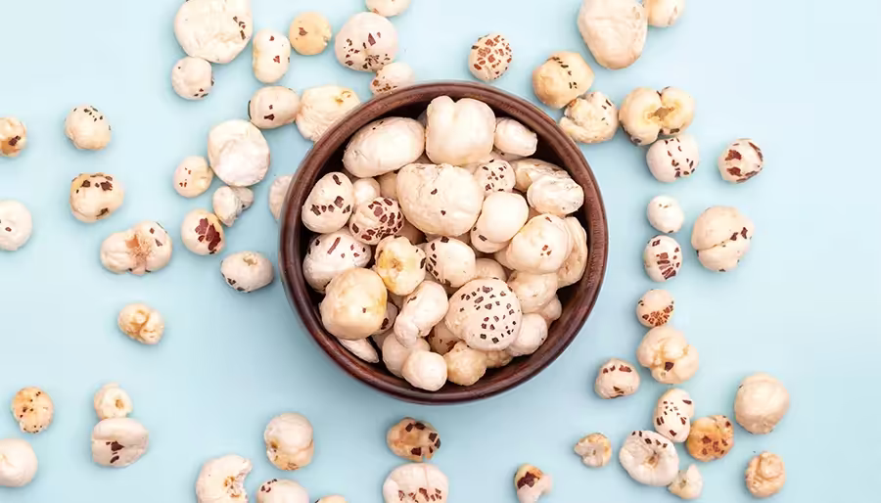

GLOBAL MAKHANA
Presented by
SHRISTY KUMARI

Slide 2

Bihar produces 85–90% of India's total makhana
Annual production: 56,400+ tonnes (2023–24)
Cultivation area: 27,800+ hectares
Supports thousands of families in Mithila
Global makhana market: USD 120M by 2030
From Bihar ponds to global Market.

Slide 3

Idea Expression
•For: Health-conscious consumers & global snack buyers
•Who: Want clean, protein-rich, authentic Indian superfoods
•Our product is: Premium farm-to-pack makhana brand
•Provides: Traceable quality, export-standard processing
•Unlike: Unorganized sellers with poor consistency
•We offer: Direct sourcing + processing + global reach via TradeIndia & IndiaMART

Slide 4



Invisioning The Idea
PROBELM
PLAYER
•Farmers: Low income, no direct premium buyers
•Export Buyers: Inconsistent quality, not export-ready
•Consumers: Lack of trustworthy brands, few flavours
Farmers
Export Buyers
B2B Platform

Slide 5


Context
Consequences
• Bihar is the world’s largest makhana producer
• Farmers sell raw at low margin
• Global demand rising, premium supply limited
• Export buyers face inconsistency
• Bihar loses value-add income
• Farmers underpaid
• Export potential untapped

Slide 6

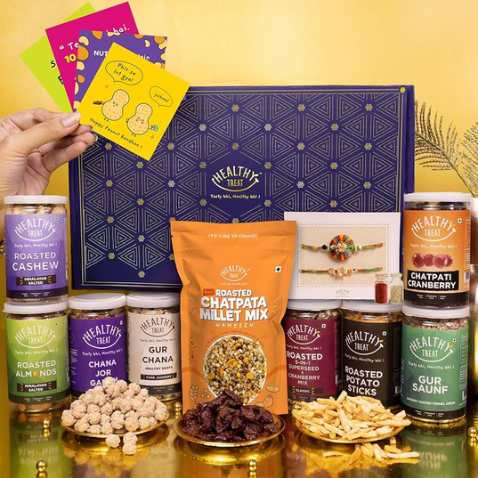
Alternatives
Almonds
Healty Snack

Slide 7

Solutions
•Premium farm-to-pack makhana brand
Key Pillars:
1. Direct partnership with farmers
2. In-house roasting & grading
3. Global reach via TradeIndia & IndiaMART
4. Premium product line (plain, roasted, flavoured)

Slide 8
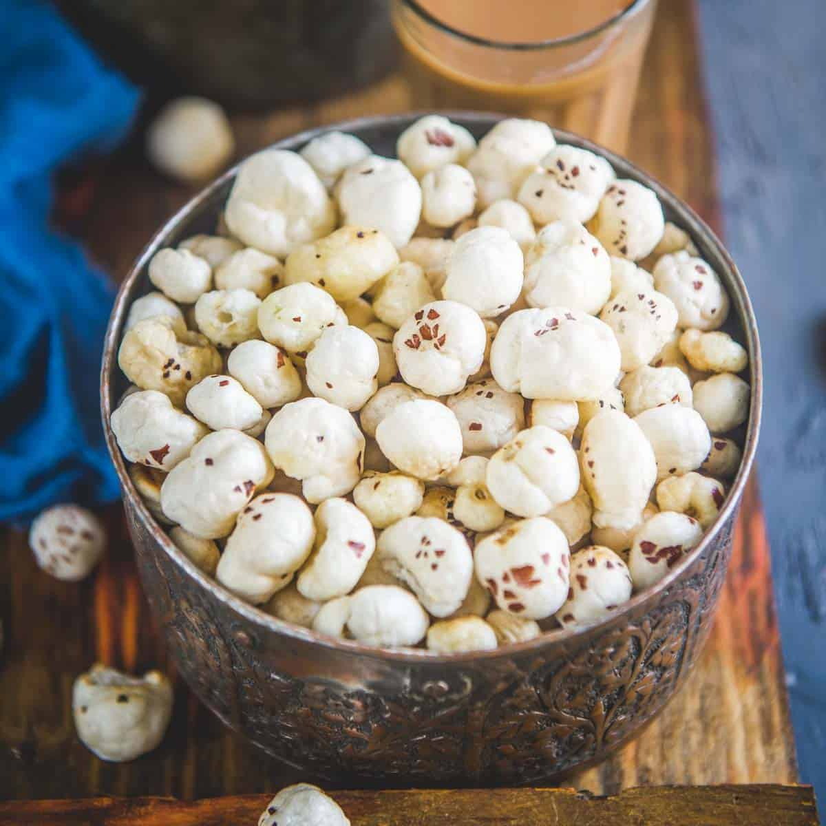

WHY NOW?
•Global plant-based snack trend
•Rising demand globally
• Makhana recognized as superfood
• Improves BIhar Economy

Slide 9

WHY ME ?
• Bihar-native sourcing insight
• Strong B2B platform ties
• Ability to scale brand globally

Slide 10

Business Model
PROCESSING
SORUCING
Roasting
Flavouring
Packaging
Farmers
SALES CHANNEL
REVENUES
Tradeinida , IndiaMart
Bulk B2B Export

Slide 11
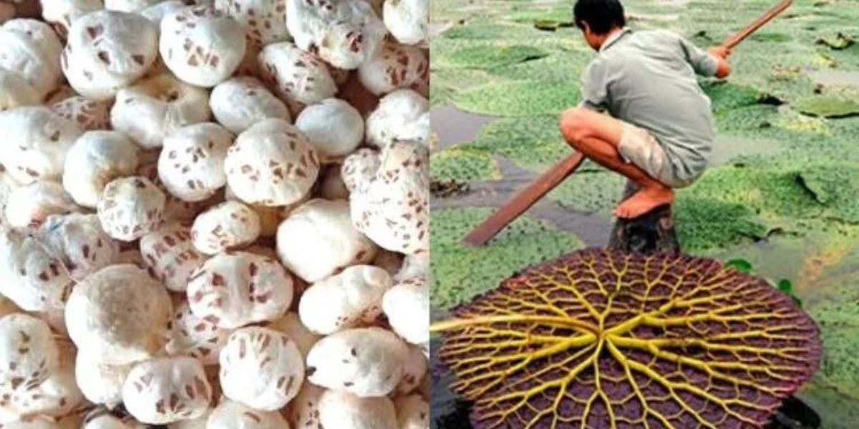
•Bihar’s Superfood, Made Global
•“Empowering farmers. Elevating Bihar. Feeding the world.”

Slide 12

THANK YOU

