Slide 1
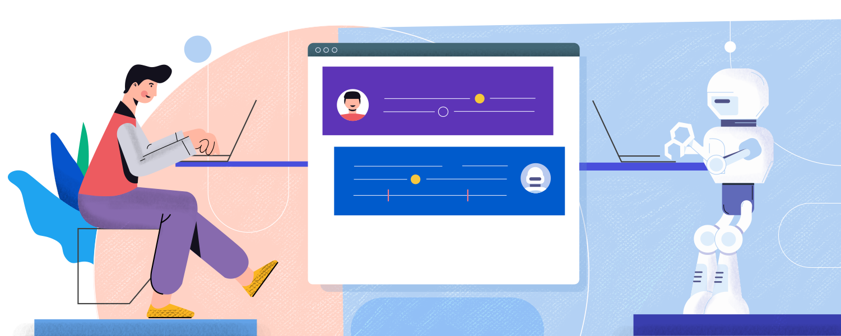
Customer service - Chatbot
PresentedBy:-
Shriti Datta

Slide 2
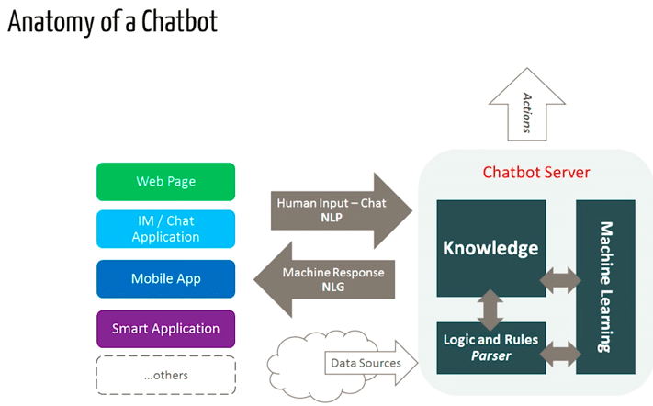
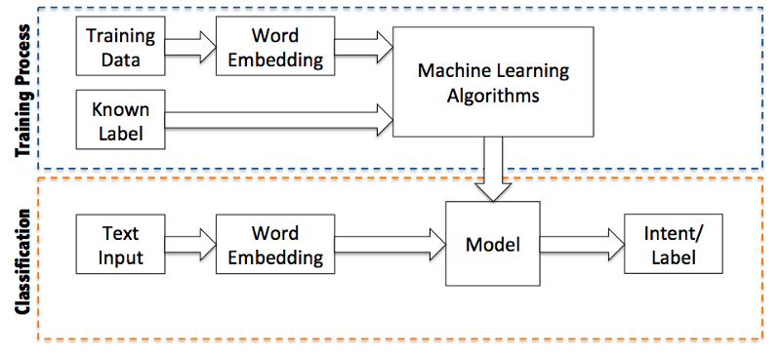
Q1. What is the System Design (architecture diagram) for the chatbot application?

Slide 3
Q2. What kind of algorithm you will use?
Machine Learning Algorithms:
A. Classification Algorithms: Random Forest, Decision Tree, Word2Vec, NLP (algorithms – NER, TF-IDF, BERT), etc.
B. Neural Networks – LSTM, etc.

Slide 4
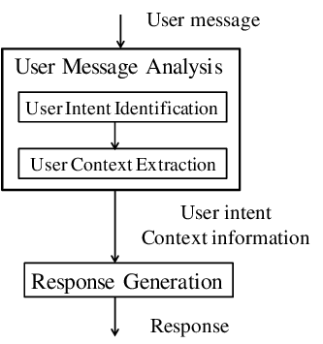
Q3. How does the bot understand what the customer is saying?

Slide 5
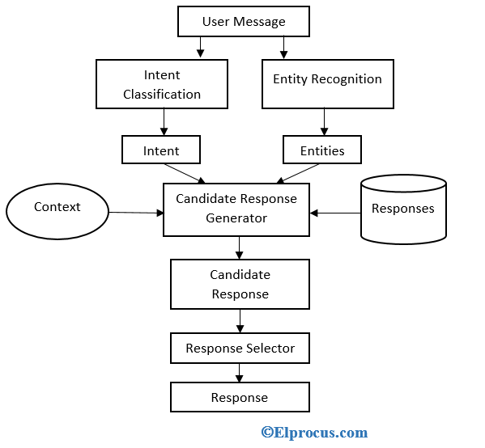
Q4. What if you encounter with a new question that bot didn’t see while training?
Q5. How does the bot continue to learn once it’s live? Or how can I make sure that my bot won’t turn crazy and start speaking nonsense?

Slide 6
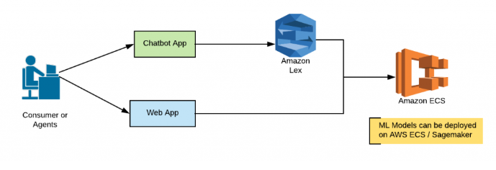
Q6. How would you optimize when thousands of users will be interacting with the bot?

Slide 7
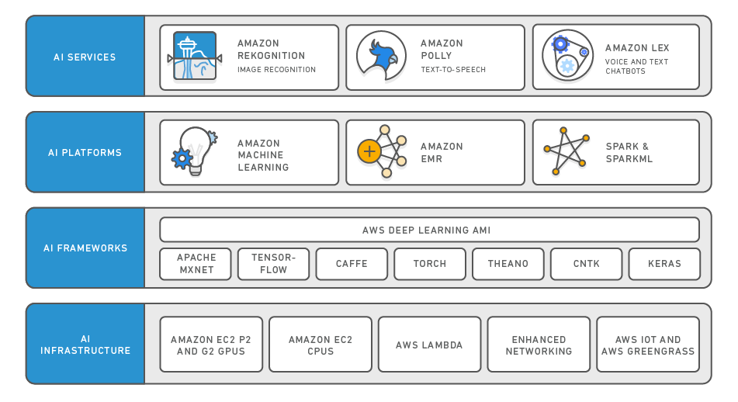
Cont...

Slide 8
Thankyou
All Image Reference:https://www.google.com

