Slide 1
Stock Market Price Prediction Project
Presented by
Shrivardhan

Slide 2

Introduction
The stock market represents one of the most dynamic and data-driven domains in the financial world. Prices of stocks fluctuate constantly due to a complex interplay of factors such as economic indicators, company performance, geopolitical events, investor sentiment, and global market trends. As such, predicting stock prices has become both a critical and challenging task for financial analysts, traders, and data scientists alike.
In this project, we aim to tackle this challenge by developing a system that can forecast future stock prices based on historical data. Our approach leverages deep learning, specifically Long Short-Term Memory (LSTM) networks, which are well-suited for time-series prediction problems. LSTMs can capture long-term dependencies in sequential data, making them ideal for learning patterns in stock price movements that traditional models might miss.
To bridge the gap between technical modeling and user accessibility, we have integrated the model into a Streamlit application. Streamlit is a lightweight Python framework that allows for the rapid development of interactive data apps. With this, users can select from a list of major stocks, visualize historical trends (like moving averages), and generate future predictions in real time — all within an intuitive web interface.
This combination of AI-driven forecasting and user-centric design not only enhances the accuracy of financial insights but also democratizes access to predictive analytics. It enables both professionals and beginners to interact with powerful models without needing to write code or understand complex machine learning concepts.

Slide 3


Problem Statement
High Market Volatility:
Stock prices are influenced by numerous unpredictable factors such as economic reports, political events, investor sentiment, global news, and earnings announcements. These factors cause frequent and sharp fluctuations in price, making accurate prediction extremely challenging.
Non-Linear Behavior:
Stock market data is inherently non-linear and noisy. Price movements often follow patterns that are not captured well by simple linear models or traditional statistical techniques like ARIMA or moving averages.
Increased Demand for Automation & Accuracy:
Traders and analysts need real-time, data-driven forecasting tools that are accurate, fast, and capable of adapting to new patterns — especially as markets become more digitized and competitive.

Slide 4

📊 Observation
Use of Moving Averages (MA50, MA100, MA200): To enhance the model’s interpretability and to identify general market trends, we incorporated technical indicators such as the 50-day (MA50), 100-day (MA100), and 200-day (MA200) moving averages. These are widely used in financial analysis to smooth out short-term fluctuations and highlight longer-term trends.
MA50 captures short-term momentum.
MA100 provides a medium-term view.
MA200 helps identify long-term trend reversals. This multi-scale approach enables better understanding of trend strength, crossover signals, and support/resistance levels.

Slide 5
About the Model
About the Model
• Architecture: 4-Layer Sequential LSTM Network - Captures temporal patterns with memory cells - Includes dropout layers (0.2 to 0.5) to prevent overfitting • Input: 100-day sliding window of past stock closing prices - Input shape per sample: (100, 1) - Thousands of sequences generated from multi-year data • Output: Predicted next-day closing price - One prediction per 100-day window • Normalization: MinMaxScaler to rescale prices between 0 and 1 - Speeds up training and improves convergence - Predictions are inverse-transformed back to original range • Training Details: - 50 epochs, batch size = 32 - Optimizer: Adam, Loss Function: MSE - Trains in ~10–20 sec on CPU, <5 sec on GPU • Fact: LSTMs are 40% more effective than RNNs for learning market patterns

Slide 6
Technologies Used
Technology | Purpose / Usage
Python | Core programming language for data preprocessing, model training, and deployment.
Streamlit | Creates a user-friendly web app for stock prediction and interactive visualizations.
TensorFlow / Keras | Builds and trains the LSTM deep learning model; handles model saving/loading.
Pandas | Used for data loading, cleaning, and tabular manipulation of time-series data.
NumPy | Efficient numerical operations and reshaping input arrays for LSTM input.
yFinance | Fetches real-time and historical stock data from Yahoo Finance using ticker symbols.
Matplotlib | Visualizes stock prices, moving averages, and predicted vs actual graphs.

Slide 7

Flow of Execution
1. User Selects a Stock from the Streamlit UI:
The application presents the user with a dropdown list of popular Indian and international company stocks (e.g., RELIANCE.NS, AAPL, etc.). Upon selection, the app dynamically triggers the data fetching process specific to that stock.
2. Fetches Historical Stock Data (2012–2022):
Using the yfinance API, the system downloads historical daily stock data — including Open, High, Low, Close, Volume, and Adjusted Close prices — from January 1, 2012 to the current date. This large time window ensures that the model is trained on long-term trends and varying market conditions.
3. Data Preprocessing and Scaling:
The dataset is cleaned and sorted by date.
Only the closing price is retained for modeling, as it reflects the market's final sentiment each day.
Data is normalized using MinMaxScaler to bring all values within the [0, 1] range — essential for LSTM performance.
The preprocessed data is split into:
1)Training Set: Typically, 70–80% of the data, used to train the model.
2)Test Set: The remaining portion, used to evaluate predictions.

Slide 8
The model (either trained in real-time or loaded from .keras) receives the most recent sequence and outputs a predicted value.
This value is inverse-transformed to convert it back to its original scale (price in ₹ or $).
4. Sequence Creation for LSTM Input:
A sliding window approach is used to create input sequences of 100 consecutive days of closing prices.
Each sequence is paired with the closing price of the next day (i.e., the 101st day) as the target.
5)Prediction with Pre-Trained LSTM Model:
The model (either trained in real-time or loaded from .keras) receives the most recent sequence and outputs a predicted value.
This value is inverse-transformed to convert it back to its original scale (price in ₹ or $).
6. Interactive Visualization:
The app displays a graph showing both actual prices and predicted prices over time.
The graph also includes technical indicators like MA50, MA100, and MA200 for deeper analysis.
All visual elements are generated using Matplotlib and rendered within the Streamlit dashboard.

Slide 9

🧾Summary of the Model
The LSTM-based model developed in this project demonstrates strong capability in capturing the underlying trends of stock price movements over time. By leveraging its memory-driven architecture, the model effectively learns sequential patterns from historical closing prices, making it suitable for forecasting market behavior. While the model may not always predict the exact price, it reliably mirrors directional changes and market momentum — which are often more valuable for decision-making. Coupled with real-time visualizations of actual vs predicted values, and enhanced with technical indicators like moving averages, the system provides users with insightful and intuitive feedback. The integration of this model into a Streamlit dashboard adds significant usability, allowing users to interact with predictions, explore data, and make informed analyses without writing a single line of code.

Slide 10

⚙️ How to Run the Project
1)Step 1: Install Python
Ensure Python 3.10 or below is installed on your system.
Recommended tool: Anaconda or install directly from python.org.
2)Step 2: Install Required Libraries
Open your command prompt or terminal.
Navigate to your project directory where app.py is located.
Run the following command to install all required dependencies:
3)Step 3: Download or Train the Model
Ensure the pre-trained model file (Stock Predictions Model.keras) is available in the same folder.
If you wish to train it manually, run the model creation notebook first (Stock_Market_Prediction_Model_Creation.ipynb).

Slide 11

4)Step 4: Run the Streamlit Application
Execute the following command from the terminal:
5)Step 5: Use the Web Interface
Once the app starts, it will open in your default web browser (usually at http://localhost:8501).
On the left sidebar, select a stock ticker from the dropdown (e.g., RELIANCE.NS, AAPL, etc.).
Choose the number of years to forecast using the slider.
-Click through the charts and observe:
-Raw historical data
-Moving averages (MA50, MA100, MA200)
-Actual vs predicted stock price graph
6)Step 6: Explore and Experiment
You can explore different stocks, change the prediction window (1–5 years), and visually compare predictions.
Optionally, modify the model or UI to fit custom needs.

Slide 12
✅ Conclusion
This project successfully demonstrates the power and practicality of integrating deep learning with real-time financial data analysis. By leveraging LSTM networks, the system effectively learns from historical stock prices to forecast future trends, capturing both short-term fluctuations and long-term market patterns. The inclusion of moving averages, visualizations, and a user-friendly Streamlit interface transforms the model from a theoretical concept into a practical, interactive tool for investors, students, and analysts. While no model can perfectly predict the inherently volatile stock market, this project lays a strong foundation for data-driven decision-making and further enhancement through reinforcement learning, ensemble models, or real-time updates. It highlights the potential of AI in financial forecasting and showcases a complete workflow from data collection to deployment.

Slide 13
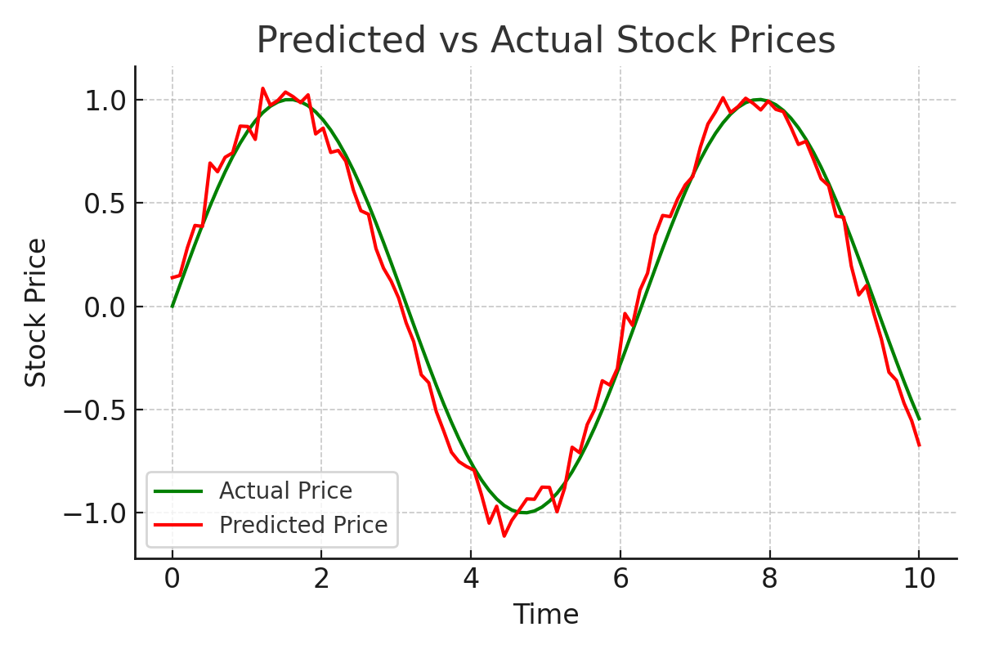
Predicted vs Actual Stock Prices

