Slide 1
Real-Time IoT Platform for
Forensic Evidence Tracking and Audit
Logging
Presented by
1)Sanjay.S (722822106139)
2)Saran.K (722822106145)
3)Shanjith.V (722822106150)
4)Shrivarshan.C (722822106154)
Guided by
Mr. Surenderkumar S
ASSISTANT PROFESSOR (B.E.,M.E.,(Ph.D))
DEPARTMENT OF ECE
SRI ESHWAR COLLEGE OF ENGINEERING.
19-11-2025
Batch no : 10
‹#›
Notes:
Don’t include any decorative contents ( images , animations , sounds etc..)
Don’t change background in to different colors.
Ensure that date of presentation & batch number is updated before sending this ppt.
‹#›

Slide 2
Presentation Outline
  Introduction
  Abstract
  Literature Survey
  Objective
  Block Diagram
  Methodology of the Proposed work
  Results
  Conclusion and Future Scope
  References
19-11-2025
Batch no : 10
‹#›
Notes:
This order can be varied based on the project Domain
‹#›

Slide 3
Introduction
In modern criminal investigations, managing forensic evidence accurately and securely is crucial to ensure justice and maintain public trust.
Traditional paper-based evidence handling systems are prone to human error, tampering, and data inconsistency, leading to breaks in the chain of custody.
To overcome these challenges, our project introduces a Digital Forensics and Evidence Management System that leverages emerging technologies to create a secure and transparent workflow.
The primary goal is to enhance efficiency, accountability, and integrity in evidence management, helping law enforcement and judicial bodies make data-driven and trustworthy decisions.
19-11-2025
Batch no : 10
‹#›
Notes:
About the domain of your project (i.e embedded, wireless n/w , Iot etc….)
Problems related to your project can be highlighted (Context and background of the idea)
‹#›

Slide 4
Abstract
The Digital Forensics and Evidence Management System replaces traditional paper-based logs with a secure web-based platform, ensuring transparency, accuracy, and reliability in evidence handling.
RFID technology enables real-time tracking of evidence movement, maintaining a continuous and verifiable chain of custody throughout the investigation process.
Blockchain-backed data storage guarantees tamper-proof record keeping, preserving the integrity and authenticity of all evidence transactions.
Through role-based access control and biometric authentication, the system strengthens security, accountability, and trust, modernizing forensic and judicial operations for greater transparency and efficiency.
19-11-2025
Batch no : 10
‹#›
Notes:
Discuss about the problem statement identified in your project and their solutions (not in paragraphs ….only bulletins )
‹#›

Slide 5
Literature Survey
Paper Title | Journal details | Methodology | Disadvantages
RFID Technology in Forensic Evidence Management: An Assessment of Barriers, Benefits, and Costs | Williams, S. R., Taylor, M., Ireland, J., and Mehta, A. (2014) [1] | RFID technology applied to forensic evidence management to enable environmental monitoring, real-time tracking, and improve efficiency. | High initial costs, signal interference, lack of standardization, complex staff training, and infrastructure requirements.
Blockchain-Based Chain of Consent in Digital Forensics | Bonomi, S., Casini, M., Ciccotelli, C. (2018) [2], | Ethereum smart contracts to automate evidence recording with traceability.. | Prototype inefficiency and difficulty in real-world adoption.
Blockchain-Based Forensic Evidence Preservation for IoT | Brotsis, S., Kolokotronis, N., Limniotis, K., Shiaeles, S., Kavallieros, D. (2019) [3] | Blockchain smart contracts store metadata for integrity and verification | Scalability and latency issues, no large-scale validation.
Blockchain-Based Evidence Logging System | Akhtar, M. S. and Feng, T. (2022) [5] | Blockchain on EAI platform to secure logs for traceability in IoT forensics. | Data protection issues in Hyperledger; needs privacy-preserving methods.
13-10-2025
13-09-2025
Batch no : 10
Batch no : 10
‹#›
‹#›
Notes:
A minimum of 4 journal papers to be used. (select papers from the Journals like IEEE, Springer, Elsevier, Wiley)
Paper details : title of the paper
Journal Detail : Name of the journal , year , volume no , issue no
Methodology : Technique , Algorithm, Domain etc…
‹#›

Slide 6
Literature Survey
Paper Title | Journal details | Methodology | Disadvantages
A blockchain-based solution for custody of digital files | M. Lusetti et al., (2020) | Hybrid platform that records transparent access histories on a blockchain to prove custody and access events | Storage and privacy concerns for storing file metadata on-chain; operational costs and access-control complexity.
An Enhanced Blockchain-Based IoT Digital Forensics Architecture Using Fuzzy Hash | W. A. Mahrous, M. Farouk & S. Darwish | Combines fuzzy hashing with blockchain Merkle trees so investigators can detect similar/modified files while preserving integrity. | Simulated proof-of-concept (no large-scale deployment); PoW-like costs and latency
Digital Forensics: Maintaining Chain of Custody Using Blockchain | S. Chopade & A. Khan IEEE Big Data (2017) | Prototype blockchain “chain-of-custody” app to log evidence events and timestamps immutably. | Early-stage prototype: scalability, legal admissibility and standardized procedures remain open issues
13-09-2025
Batch no : 10
‹#›
Notes:
A minimum of 4 journal papers to be used. (select papers from the Journals like IEEE, Springer, Elsevier, Wiley)
Paper details : title of the paper
Journal Detail : Name of the journal , year , volume no , issue no
Methodology : Technique , Algorithm, Domain etc…
‹#›

Slide 7
Objective
To ensure secure and tamper-proof evidence management from the crime scene to court submission.
To enable real-time tracking and monitoring of evidence using RFID and a blockchain-backed website.
To maintain a transparent and verifiable chain of custody where only higher authorities with proper authorization and biometric authentication can access evidence records.
13-10-2025
Batch no : 10
‹#›
Notes:
Mention the problem statement ….(what is your project work in statements …….not in paragraph ………only bulletin points)
‹#›

Slide 8
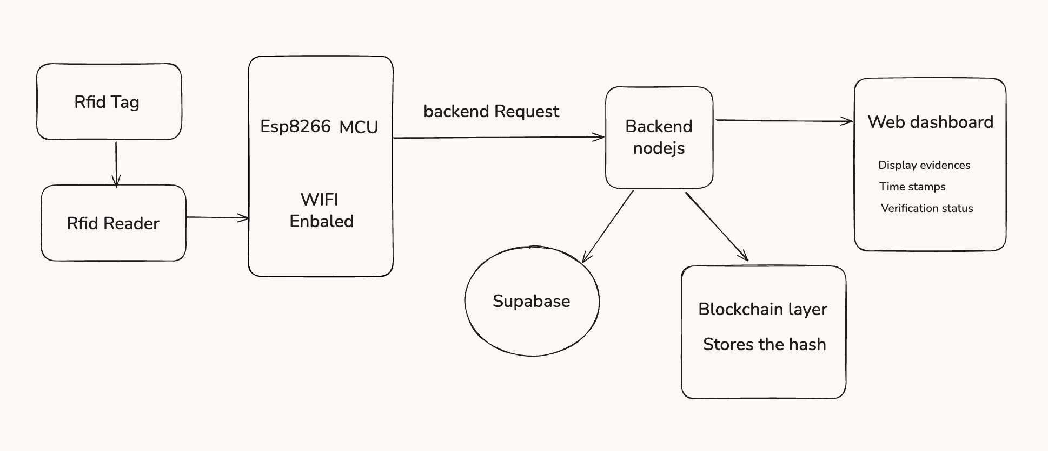
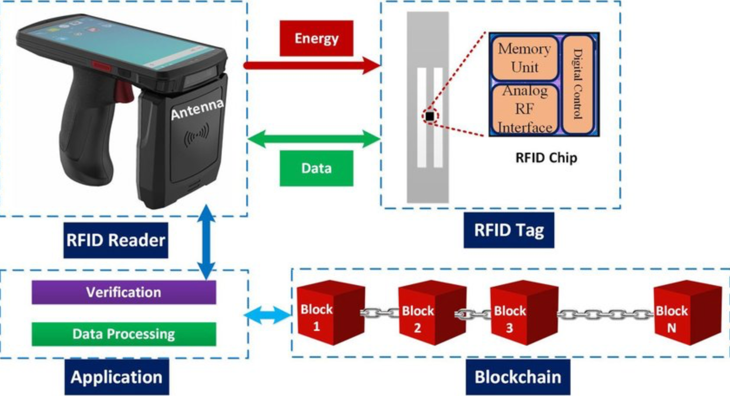
Block Diagram
19-11-2025
Batch no : 10
‹#›
Notes:
‹#›

Slide 9
Explanation
RFID Reader & Tag:
The RFID reader emits energy to power the RFID tag.
The tag responds by sending data (via its Memory Unit & Analog RF Interface).
Data Flow:
The reader captures the RFID tag data and sends it to the Application layer.
The application performs verification and data processing.
Blockchain Storage:
Verified data is recorded as blocks in a blockchain (Block 1 → Block 2 → … → Block N).
Ensures immutability, security, and traceability of RFID transactions.
Purpose:
Enhances supply chain, asset tracking, or secure data management by combining RFID automation with blockchain integrity.
13-10-2025
Batch no : 10
‹#›
Notes:
Explain about the proposed work
‹#›

Slide 10
Hardware / Software Details
Hardware
1)RFID Reader/Receiver
2)RFID Tags
3)Arduino
Software
1)MERN STACK
2)Cloud Technologies(AWS)
3)Block Chain
4)Arduino IDE
13-10-2025
Batch no : 10
‹#›
Notes:
Provide Hardware / Software Details
‹#›

Slide 11
Methodology for the Proposed work
Evidence Initialization & Tagging:
Each evidence item is assigned a unique RFID tag, and metadata such as case ID, investigator, location, and timestamp is recorded for accurate identification.
Data Collection:
The RFID reader and ESP32 capture tag details along with GPS coordinates and timestamps, ensuring real-time traceability of evidence.
Secure Data Transmission:
All information is transmitted using TLS 1.3 protocols, with backup mechanisms to prevent data loss.
Blockchain Integration:
Evidence records are stored as SHA-256 hashes in a permissioned blockchain, guaranteeing immutability and integrity of data.
Access & Monitoring:
A web-based dashboard provides real-time monitoring, while role-based and biometric authentication ensure secure and transparent evidence retrieval.
19-11-2025
Batch no : 10
‹#›
Notes:
Project work flow
‹#›

Slide 12
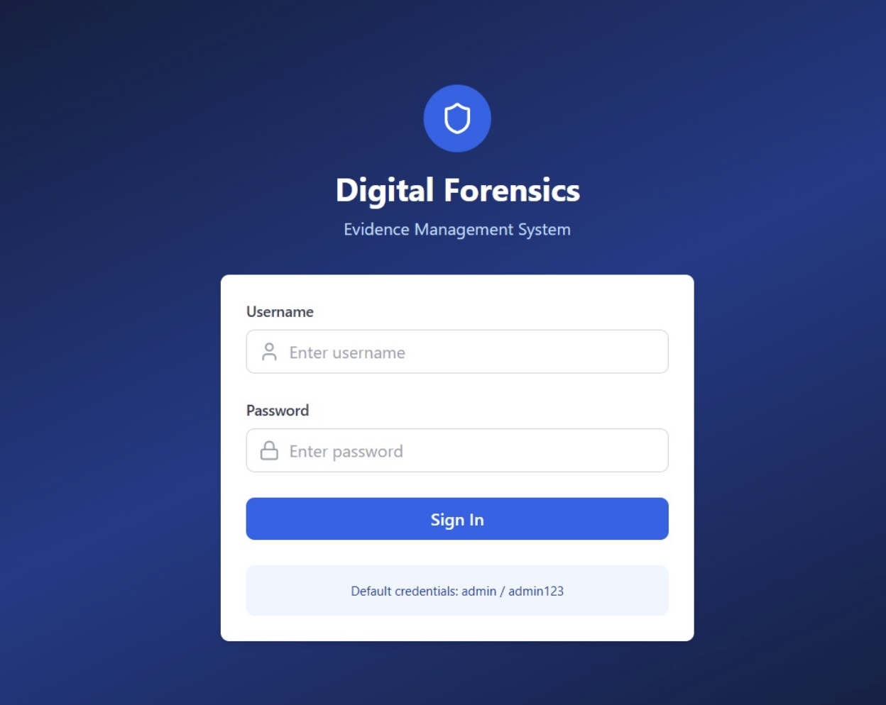
Results and Discussion
19-11-2025
Batch no : 10
‹#›
Notes:
Discuss about the results from the Project
‹#›

Slide 13
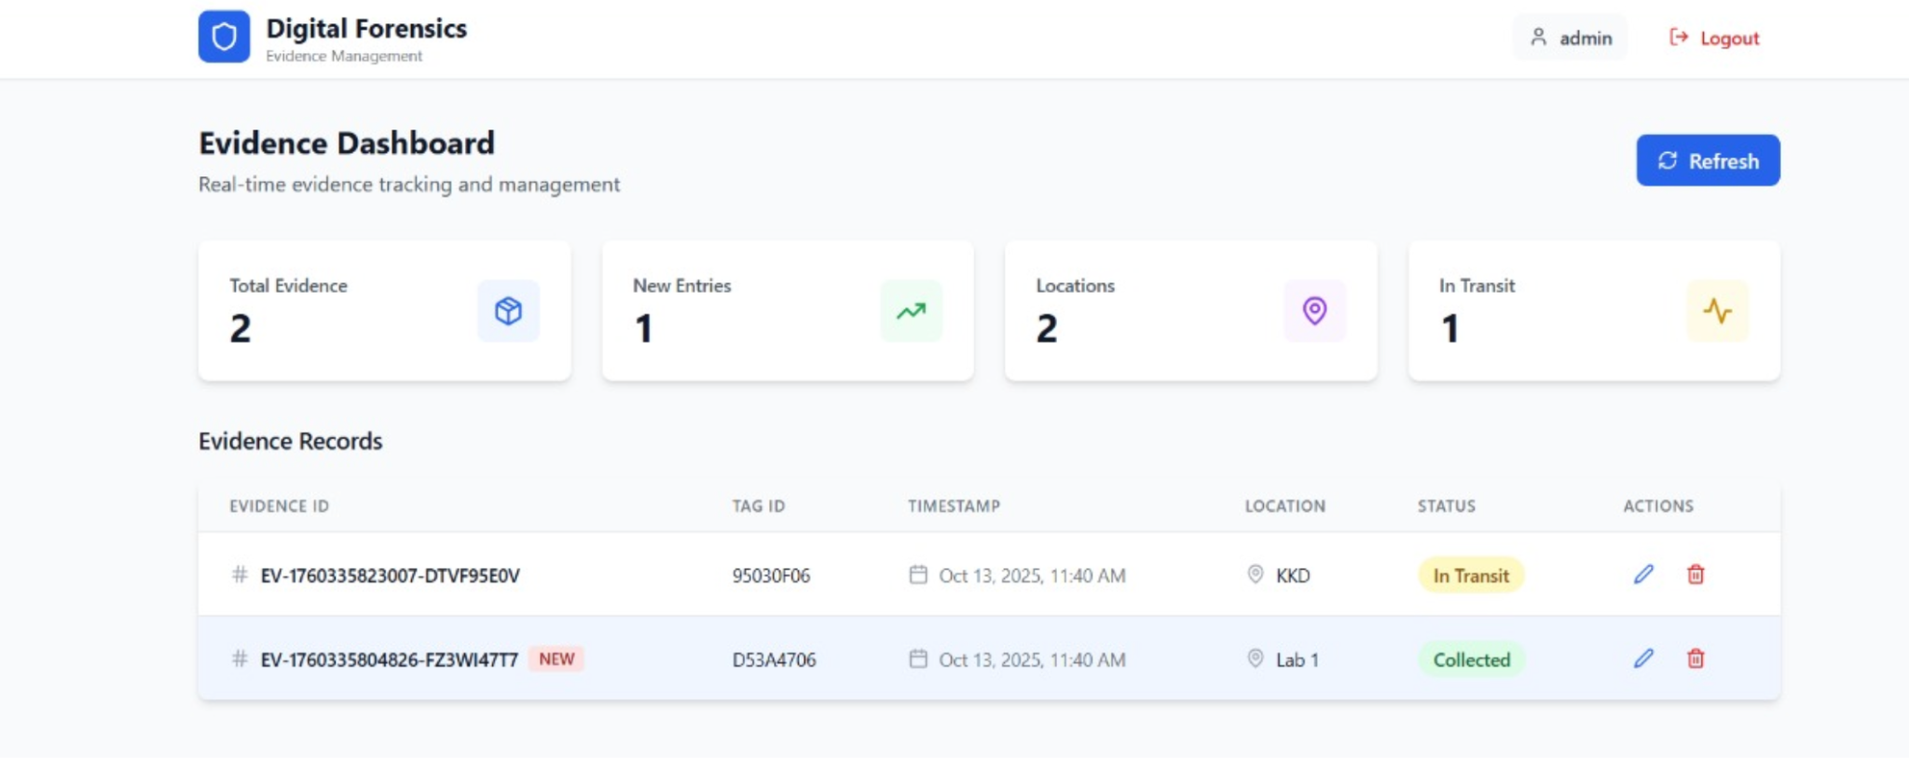
Results and Discussion
19-11-2025
Batch no : 10
‹#›
Notes:
Discuss about the results from the Project
‹#›

Slide 14
Conclusion
1.The Digital Forensics and Evidence Management System ensures secure, transparent, and efficient handling of forensic evidence from collection to courtroom presentation.
2.By combining RFID tracking and blockchain technology, the system eliminates tampering risks and maintains a reliable chain of custody.
3.Features like role-based access control and biometric authentication enhance user accountability and data protection at every stage.
4.Overall, the system strengthens trust, accuracy, and integrity in forensic investigations, setting a new standard for modern digital justice systems.
19-11-2025
Batch no : 10
‹#›
Notes:
Discuss about the results from the Project
‹#›

Slide 15
Future Scope
Mobile Access: Develop a mobile app for investigators to update and track evidence in real-time.
Basic AI Alerts: Implement simple AI or rule-based alerts for misplaced, delayed, or mishandled evidence.
Enhanced Security: Add multi-factor authentication and improved role-based access for stronger protection.
Integration with Court Systems: Link the system with judicial databases for smoother case management and evidence tracking.
19-11-2025
Batch no : 10
‹#›
Notes:
Discuss about the results from the Project
‹#›

Slide 16
References
[1] WILLIAMS, S. R., TAYLOR, M., IRLAND, J., & MEHTA, A. (2014). RFID TECHNOLOGY IN FORENSIC EVIDENCE MANAGEMENT: AN ASSESSMENT OF BARRIERS, BENEFITS, AND COSTS. NIST TECHNICAL REPORT.
[2] BONOMI, S., CASINI, M., & CICCOTELLI, C. (2018). B-COC: A BLOCKCHAIN-BASED CHAIN OF CUSTODY FOR EVIDENCES MANAGEMENT IN DIGITAL FORENSICS. ARXIV PREPRINT ARXIV:1810.02124.
[3] BROTSIS, S., KOLOKOTRONIS, N., LIMNIOTIS, K., SHIAELES, S., & KAVALLIEROS, D. (2019). BLOCKCHAIN SOLUTIONS FOR FORENSIC EVIDENCE PRESERVATION IN IOT ENVIRONMENTS. ARXIV PREPRINT ARXIV:1903.07807.
[4] AKBARFAM, A. J., HEIDARIPOUR, M., MALEKI, H., DORAI, G., & AGRAWAL, G. (2023). FORENSIBLOCK: A PROVENANCE-DRIVEN BLOCKCHAIN FRAMEWORK FOR DATA FORENSICS AND AUDITABILITY. ARXIV PREPRINT ARXIV:2305.05011.
[5] AKHTAR, M. S., & FENG, T. (2022). A BLOCKCHAIN-BASED SYSTEM FOR INTEGRITY ASSURANCE OF DIGITAL FORENSIC EVIDENCE IN IOT ENVIRONMENTS. EAI ENDORSED TRANSACTIONS ON SECURITY AND SAFETY, 8(29), E4.
19-11-2025
Batch no : 10
‹#›
Notes:
Provide the list of references as per journal format
Avoid putting links as Google.com, Wikipedia.com etc…. Provide the http link of the page or article refered
‹#›

Slide 17


19-11-2025
Batch no : 10
‹#›

