Slide 1
CURSOR
Cursor is a powerful AI-first code editor that enhances your development workflow .
AI-powered code completion that understands your codebase and provides context-aware suggestions.
Conversation interface for exploring, understanding, and modifying code with Ask, Edit, and Agent modes .
Intelligent tools for handling complex development tasks .

Slide 2
Settings :
Cursor is designed to be flexible and customizable. You can configure it in two ways:
Cursor Settings - Access via gear icon, Cmd/Ctrl + Shift + J, or Command Palette > Cursor Settings . Configure AI features and Cursor-specific preferences
Editor Settings - Access via Command Palette (Cmd/Ctrl + Shift + P) > "Preferences: Open Settings (UI)“ . Adjust editor behavior and appearance

Slide 3
FEATURES :
Tab –
Completion in Cursor is powered by advanced AI models that understand your code context. As you type, you’ll receive intelligent suggestions that:
Complete your current line of code
Suggest entire function implementations
Help with common patterns and boilerplate
Adapt to your coding style over time

Slide 4
Chat -
Cursor provides a unified AI interface with three modes that seamlessly work together:
Agent Mode (Default)
Make codebase-wide changes and refactoring
Implement new features from requirements
Debug complex issues across multiple files
Generate tests and documentation
Maintain consistency across your entire project
Ask Mode
Ask questions about specific code sections
Get explanations of complex functions
Find code patterns and examples
Discover and understand your codebase
Custom modes
Create your own modes that fits your workflow

Slide 5
Context -
Context is the foundation that powers all of Cursor’s AI features. Here’s how it works:
When you open a codebase, we automatically index your code to make it available as context
Use @-symbols to precisely control what context you provide:
@files and @folders for specific paths
@web for external documentation
@git for version control context
Configure rules for AI to customize behavior
Set up MCP for external context providers

Slide 6
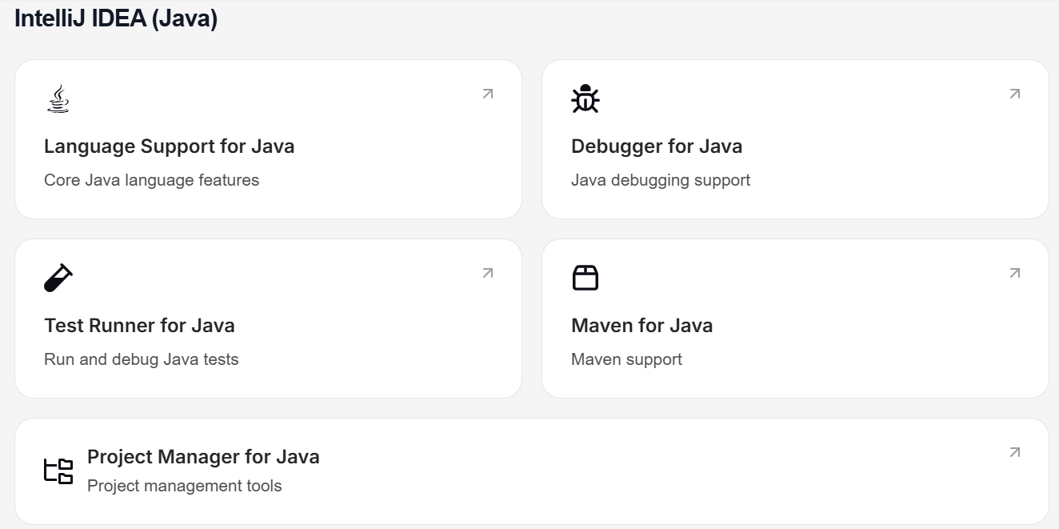
For Migration with Intellij IDE

Slide 7
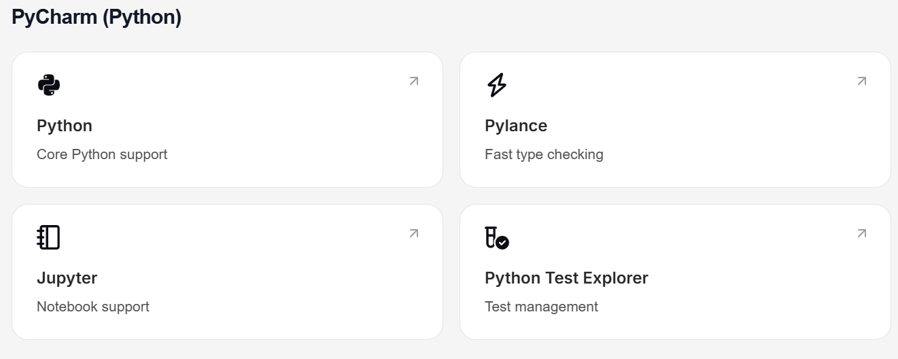
For Python :

Slide 8
Example Workflows -
Generate Java Boilerplate Use Tab completion to quickly generate constructors, getters/setters, equals/hashCode methods, and other repetitive Java patterns.
Debug Complex Java Exceptions When facing a cryptic Java stack trace, highlight it and use Ask to explain the root cause and suggest potential fixes.
Refactor Legacy Java Code Use Agent mode to modernize older Java code - convert anonymous classes to lambdas, upgrade to newer Java language features, or implement design patterns.
Frameworks Development Add your documentation to Cursor’s context with @docs, and generate framework-specific code throughout Cursor.

Slide 9
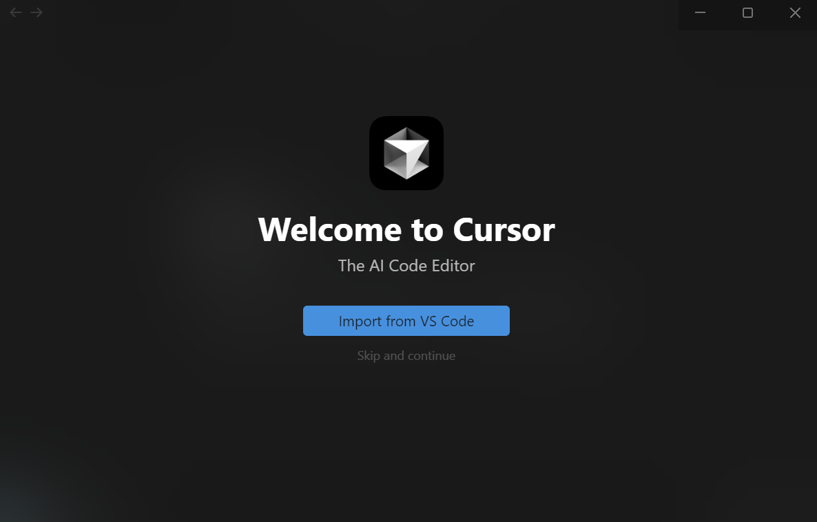

Slide 10
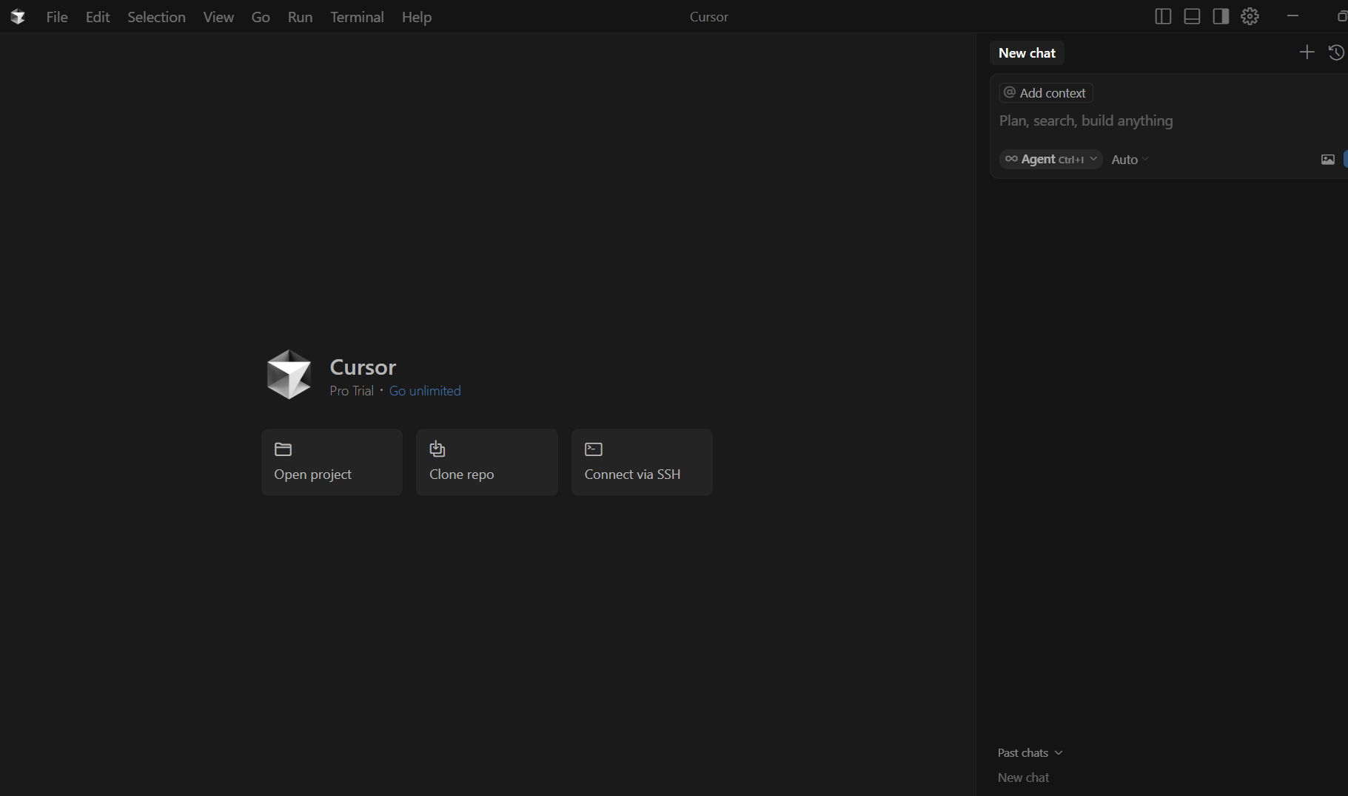

Slide 11
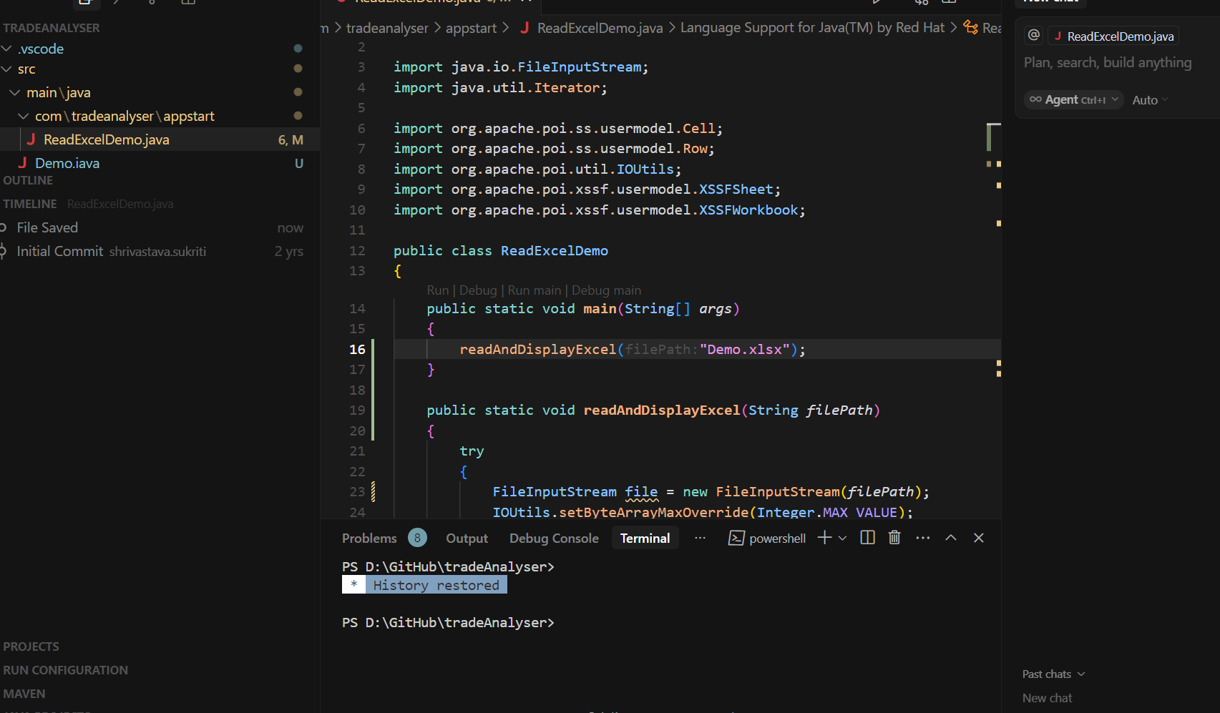

Slide 12
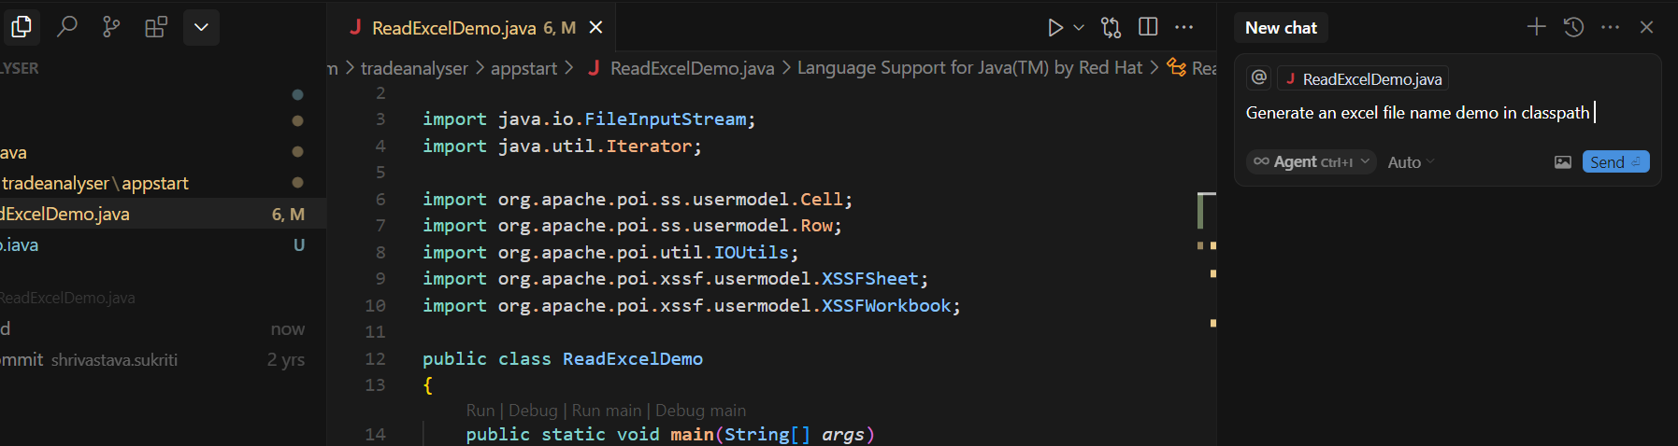
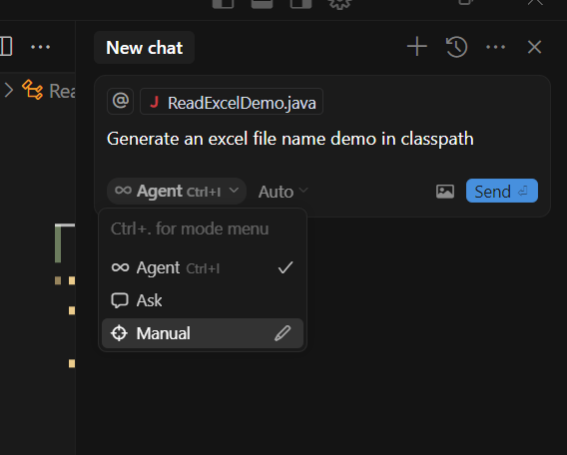

Slide 13
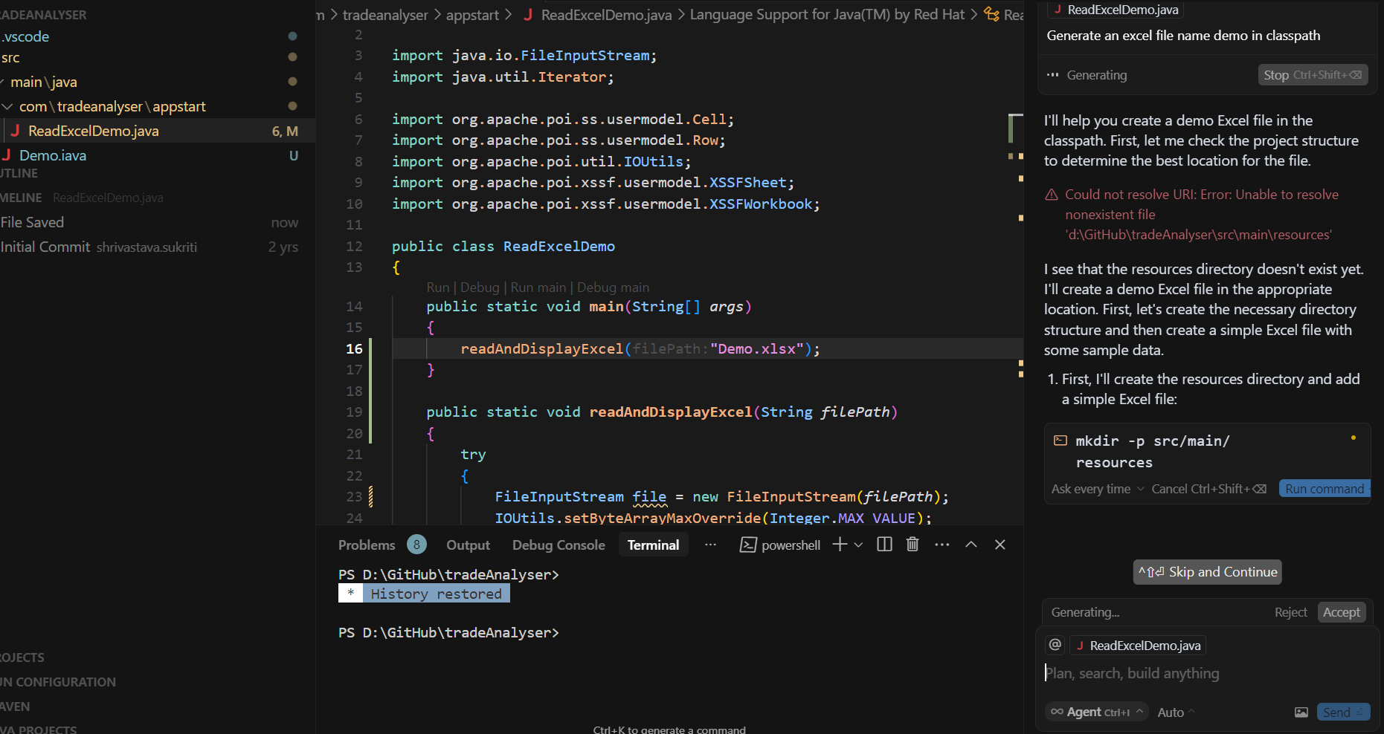

Slide 14
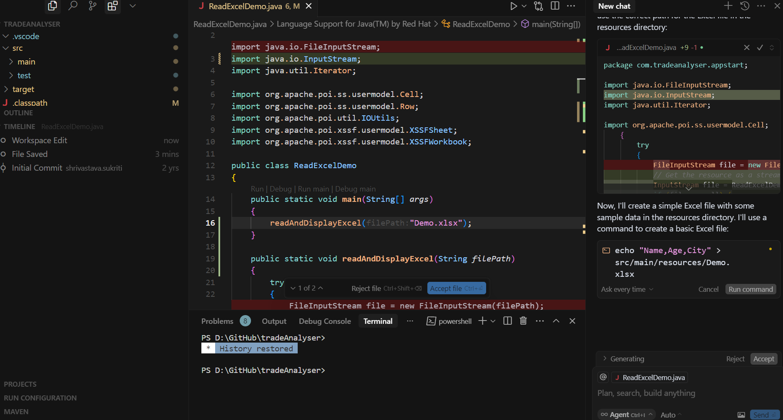

Slide 15
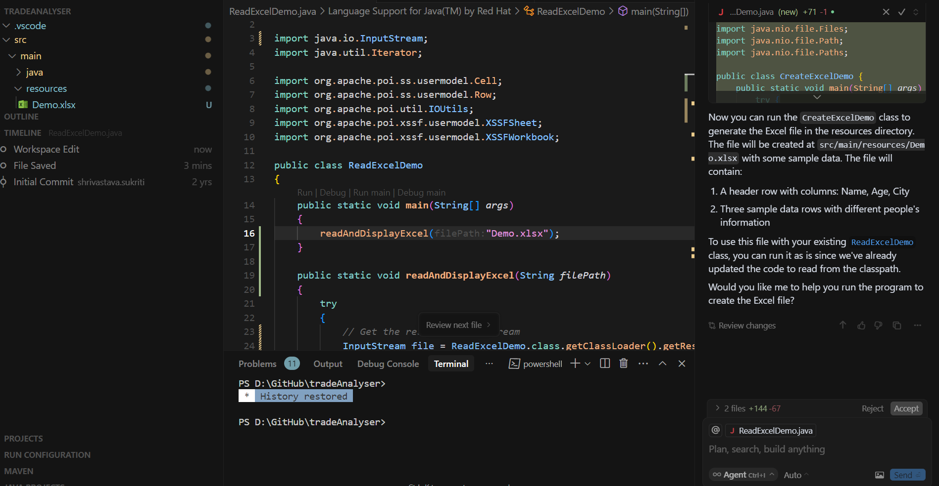

Slide 16
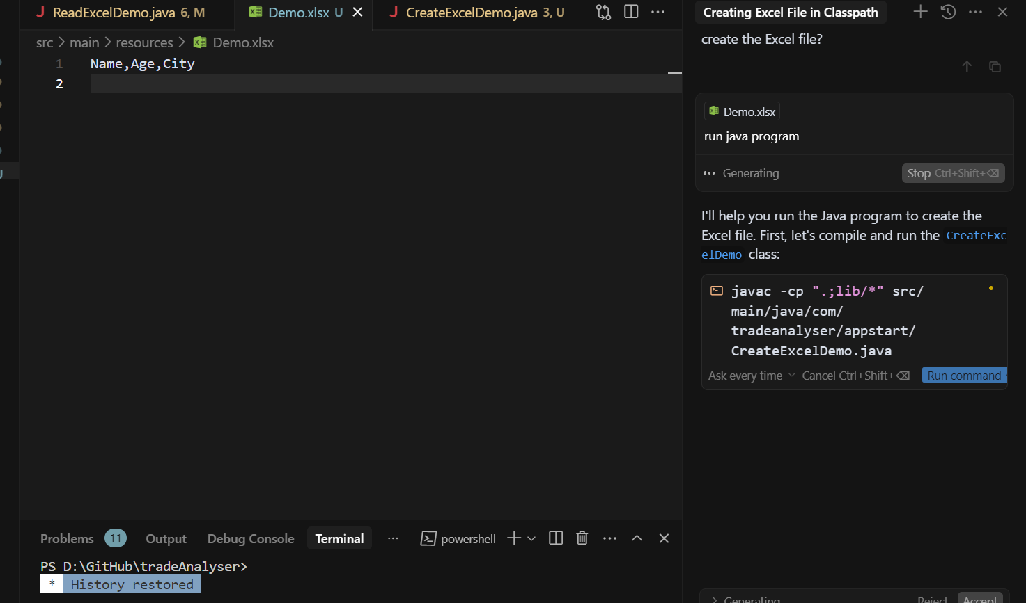
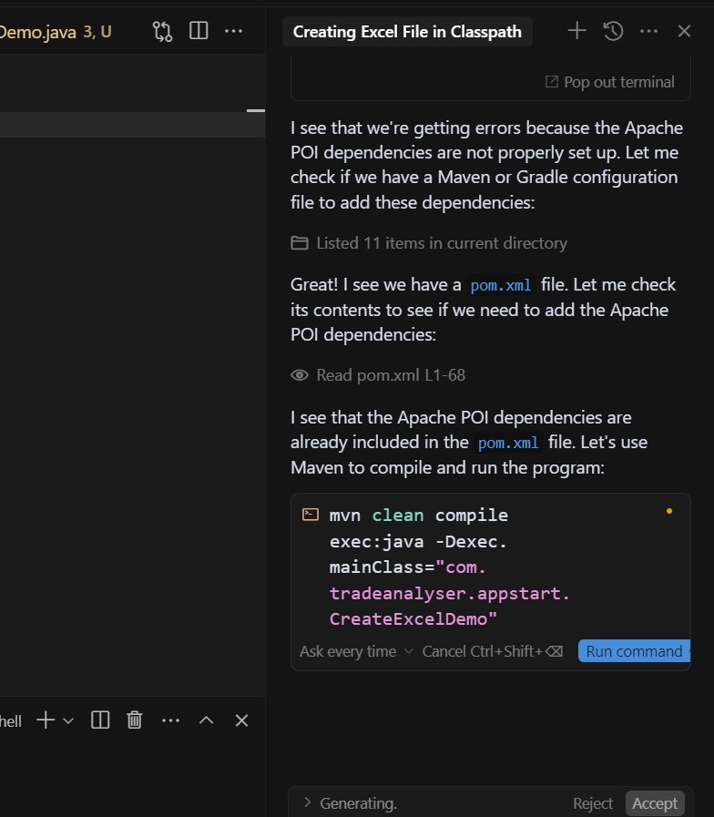

Slide 17
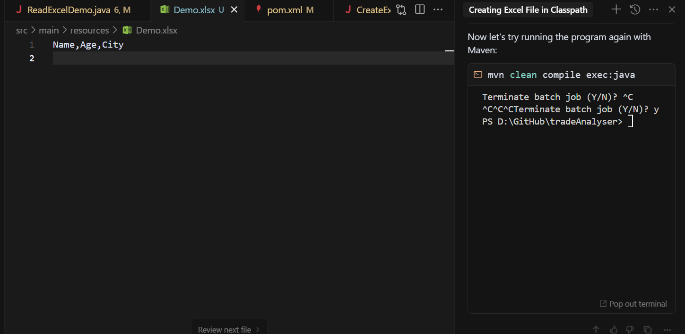

Slide 18
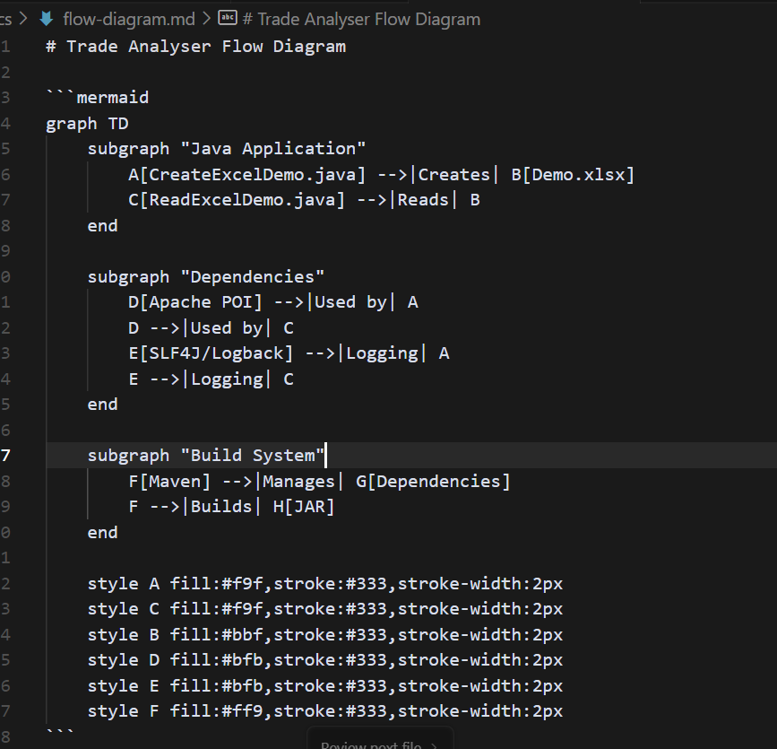

Slide 19
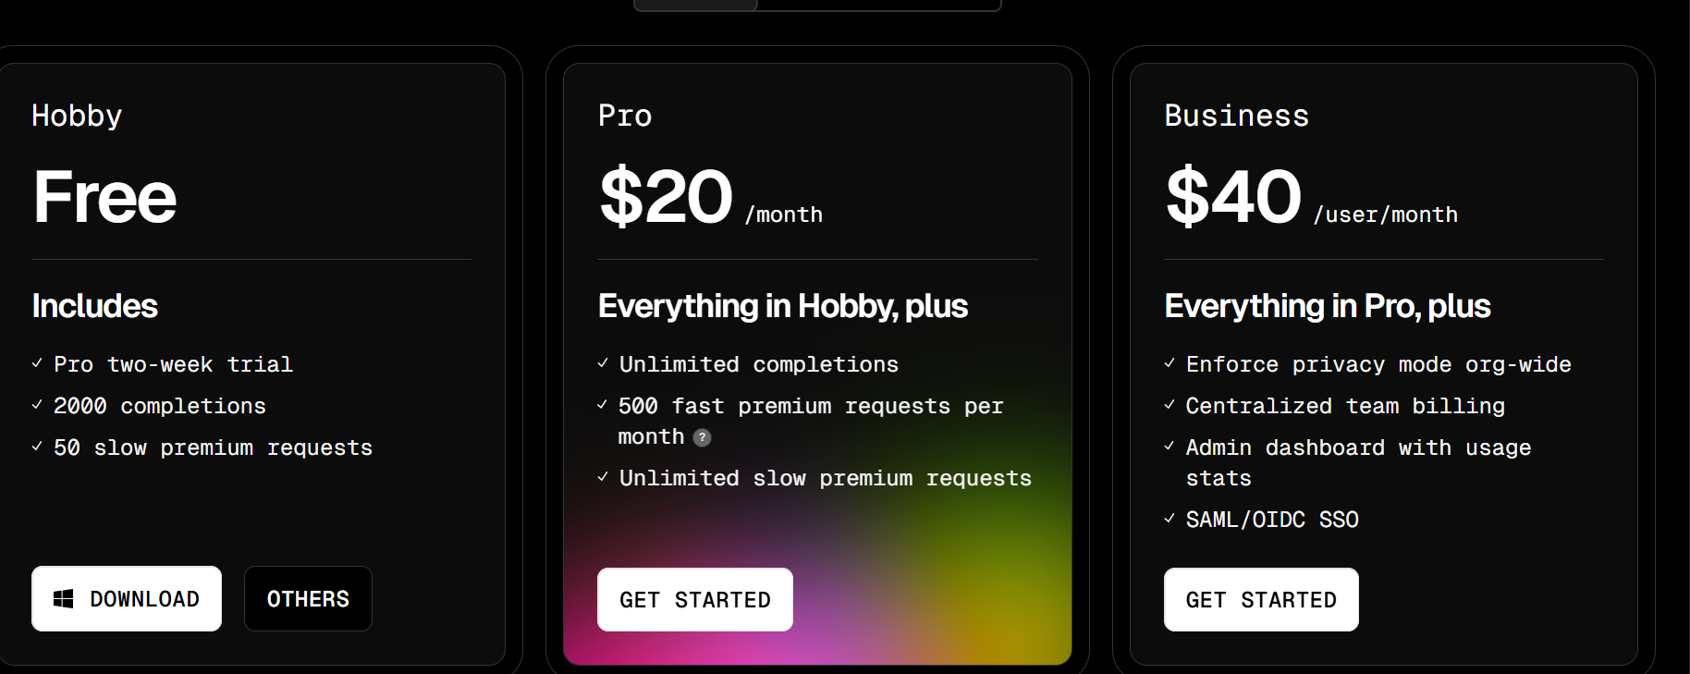
Plans & Pricing

Slide 20
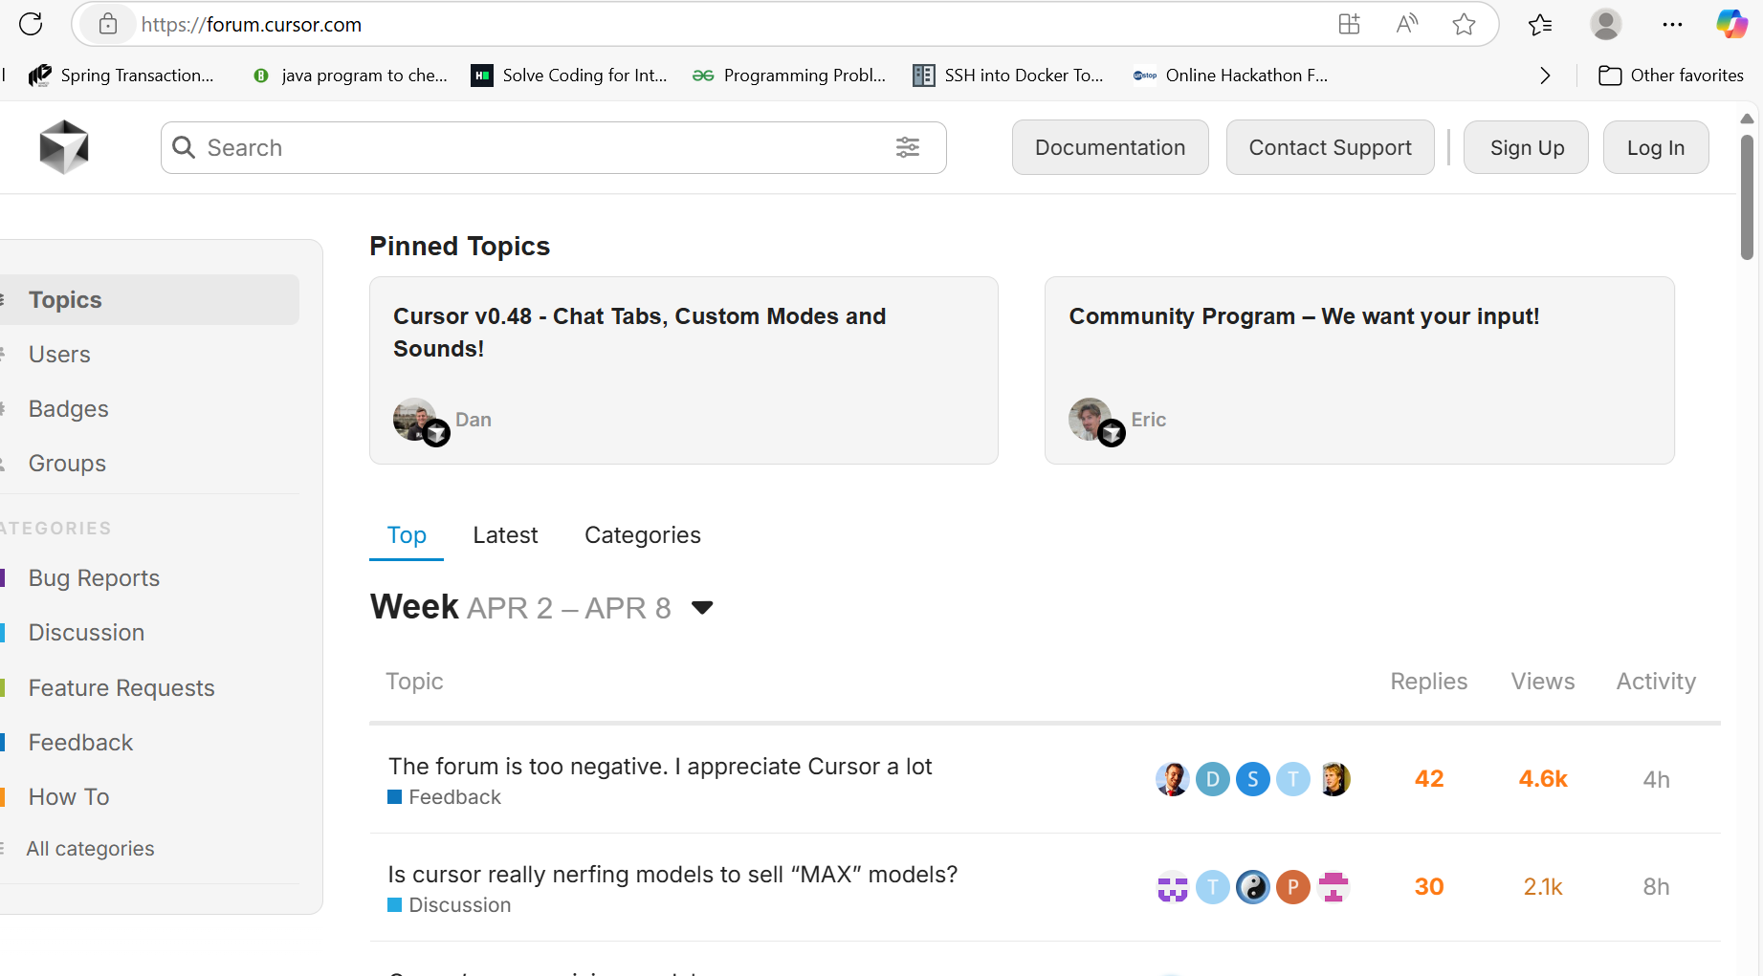

Slide 21
Privacy & Security
With Privacy Mode enabled, none of your code will ever be stored by us or any third-party. Otherwise, we may collect prompts, code snippets and telemetry data to improve Cursor.
Even if you use your API key, your requests will still go through our backend. That’s where we do our final prompt building.
If you choose to index your codebase, Cursor will upload your codebase in small chunks to our server to compute embeddings, but all plaintext code ceases to exist after the life of the request.
The embeddings and metadata about your codebase (hashes, obfuscated file names) are stored in our database, but none of your code is.

Slide 22
Cursor for Business:
It has built a suite of tools to help you manage your team, including SSO, team management, and more.
Create a team : Set up Business plan , Enter team details, Invite members, Enable SSO (optional)
Cursor is billed on a per-user basis, and does not have a fixed amount of seats. You can invite as many or as few users as you’d like to your team, and you will only be charged for the amount of users in your team.If you add or remove users from your team, the billing will be updated immediately, and you will either be charged or refunded accordingly. Refunds are done as account credit, so will be automatically applied to your next invoice.
Track team metrics including usage stats, per-user activity, and active user counts from the dashboard

