Slide 1
TRAYCER

Slide 2
INTRODUCTION
Traycer is an AI-powered coding assistant that transforms how you handle coding tasks. With its Tasks feature, Traycer helps you define objectives, generate actionable plans, and implement changes seamlessly. Whether you need to fix bugs, refactor code, or create new features, Traycer analyzes your input and automates the process while keeping you in control. Alongside tasks, Traycer offers real-time, context-aware Reviews, identifying issues, optimizing performance, and improving code quality—all without disrupting your workflow.

Slide 3
Tasks
The Tasks feature allows you to define high-level objectives, and Traycer works autonomously to analyze and modify your code to accomplish them. Whether it’s fixing bugs, creating new features, or optimizing existing code, you can rely on Traycer to handle complex coding tasks seamlessly.Example : User Query : Enter your task in the input box (e.g., “Refactor the login module”) and use @mention or the + icon to specify files or folders (e.g., @auth.js, @utils/). Once done, click the "Generate Plan" button to proceed.
Traycer generates a plan with steps for your task. You can edit the plan directly, add or remove files, or include reference files for context. Click the "Generate Changes" button when ready.
Code Changes : Traycer displays the code changes for each file in the plan in a structured view. You can click on any file to expand its details and review the changes. Each file includes options to Show Diff, allowing you to compare the proposed changes with the original code, and Apply, enabling you to integrate the changes into your codebase instantly. Selecting a file also opens a dedicated chat interface, where you can discuss, refine, or further customize the changes before applying them.
File Specific Chat : Traycer provides a dedicated chat interface for each file in the task, enabling focused collaboration and refinement. Once you select a file, you can view the proposed changes and engage with Traycer to discuss, clarify, or request additional modifications. Task History
Traycer maintains a log of your completed and ongoing tasks in the Task History panel. Each entry displays the task description and its current status, such as "Planning", "Plan Generated" etc. You can revisit any task to view its details or pick up where you left off, ensuring a seamless workflow and easy access to past and ongoing tasks.

Slide 4
Review
The Review feature allows you to analyze your code for potential issues, enhancements, and best practices. Traycer provides detailed suggestions to improve code quality, including bug fixes, performance optimizations, and adherence to coding standards. You can trigger reviews manually or let Traycer automatically analyze changes in real-time, ensuring your code is always at its best.
Automatic Analysis for Pro users only.
Manually Triggered Analysis - Available to all users with following activity Analyze File , Re-Analyze File, Analyze Changes in File, Analyze Changes in Workspace
Checking Analysis Status -To check the status of your analysis, hover over the Traycer icon. It will display the count of running analyses, such as “Traycer in-flight analysis: X”. If the count is 0, it means there are no analyses currently running.
Comments & Replies - Traycer adds comments to your code, suggesting improvements and highlighting potential issues such as bugs, performance, security, and clarity , Additionally, you can reply to comments to engage in a conversation with Traycer.
Traycer Comment - Code Snippet Display with Diff , Reply and Discuss, Quick Fix, Feedback Options, Actionable Insights.

Slide 5
Learnings
Learnings enable Traycer to capture user preferences and code-relevant insights from your interactions. When you reply to comments, Traycer analyzes your responses to identify preferences or learnings, saving them to improve future analyses and recommendations.
How It Works
Automatic Detection: Traycer scans your replies for indications of coding style preferences, tool configurations, or best practices you follow.
Personalized Experience: The saved learnings enable Traycer to tailor its feedback and suggestions to align with your specific needs and preferences.
Continuous Improvement: Ongoing interactions help Traycer better understand your coding habits and requirements.
Deleting Learnings: Click the Bin icon next to the learning you wish to delete.
Adding Learnings Manually: You can manually add new learnings by clicking the Plus icon. Specify preferences or insights directly without waiting for Traycer to capture them in your replies.
Privacy Control: Your privacy is important. Traycer provides a setting ,where you can opt out of the Learnings feature anytime. Opting out will delete all existing learnings. Note that the learning feature is on by default.

Slide 6
Communities
Discord: Join community here
X (Twitter): Follow on @TraycerAI
GitHub: File an issue on community repository.

Slide 7
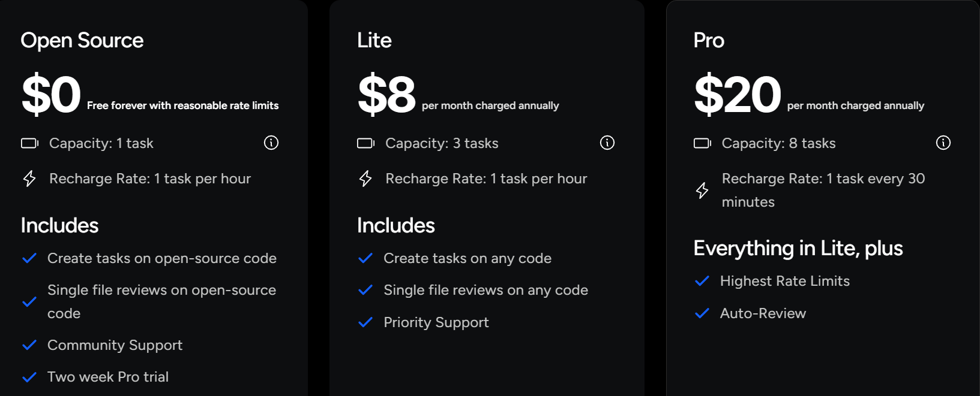
Pricing

Slide 8
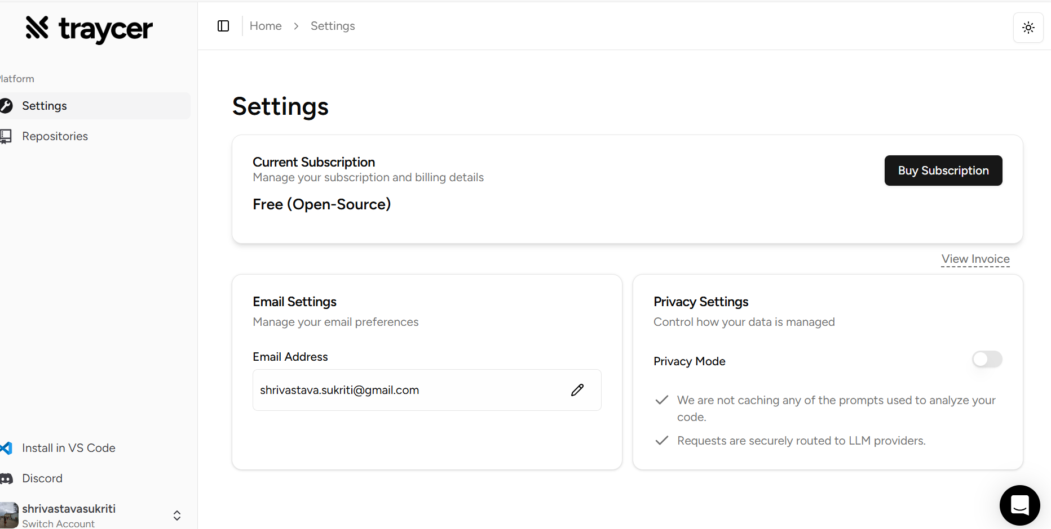
Privacy

Slide 9
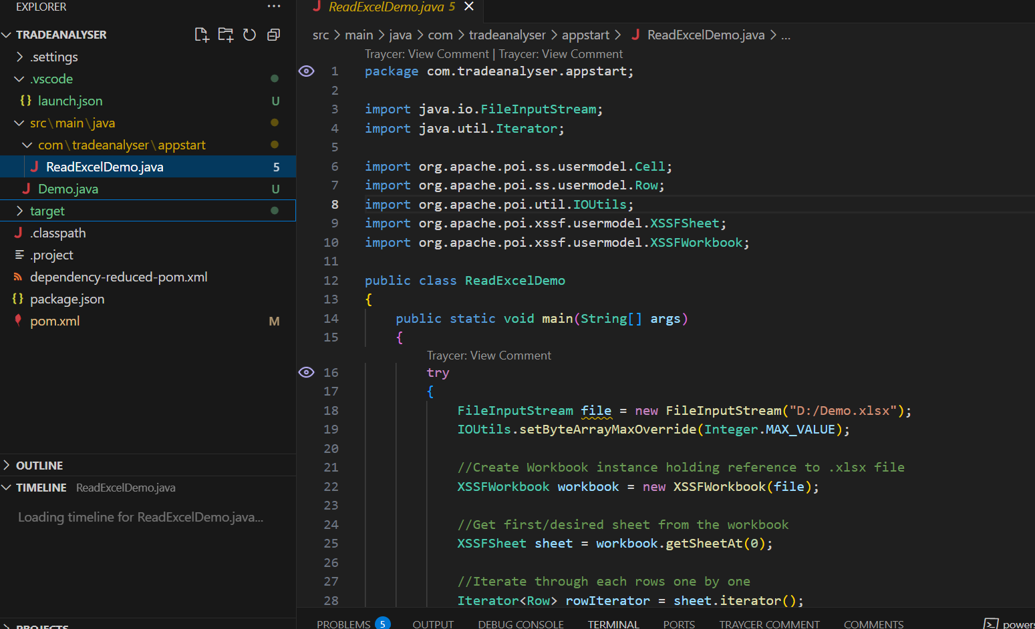
Screenshots :

Slide 10
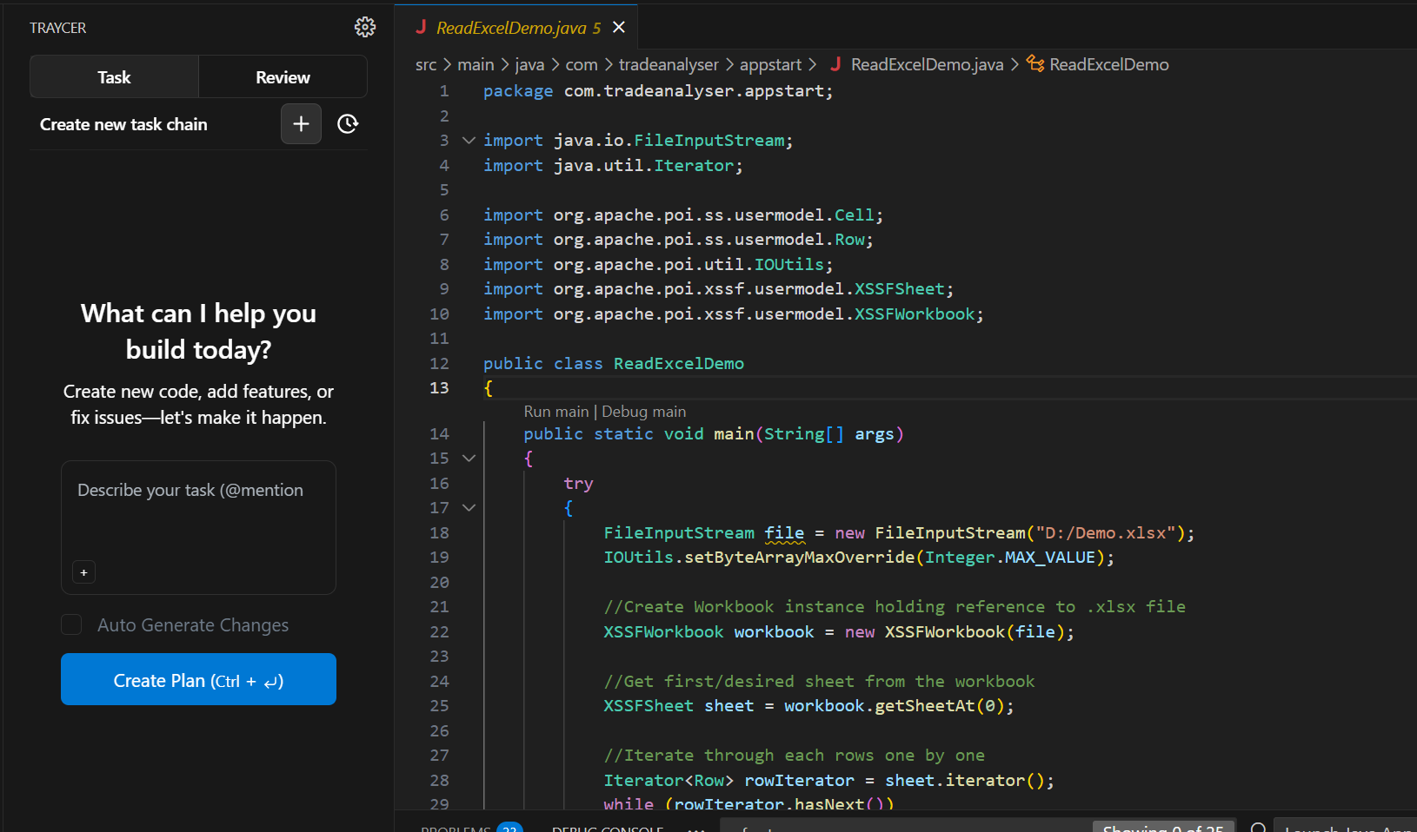

Slide 11
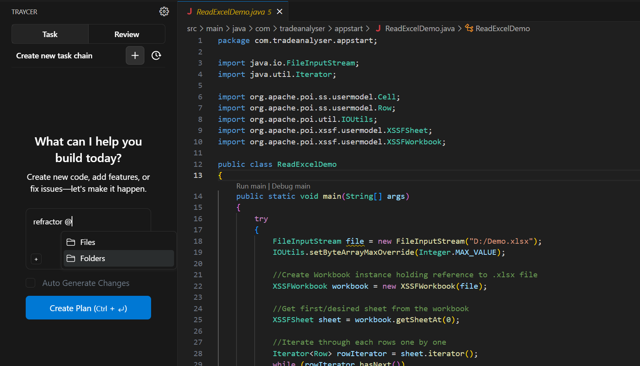

Slide 12
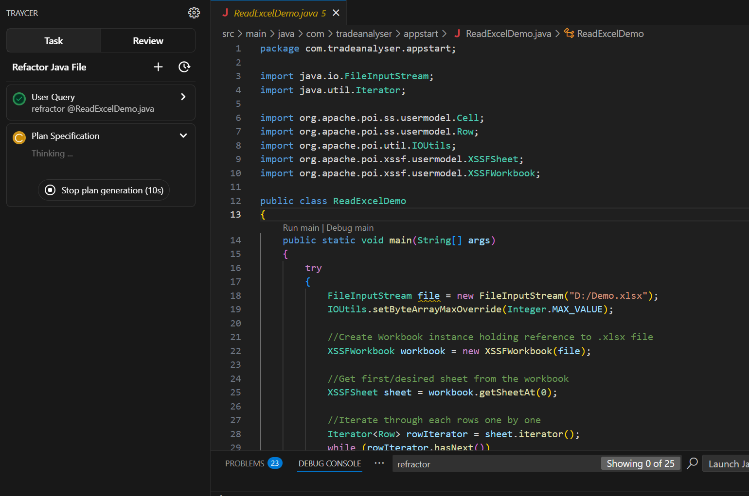

Slide 13
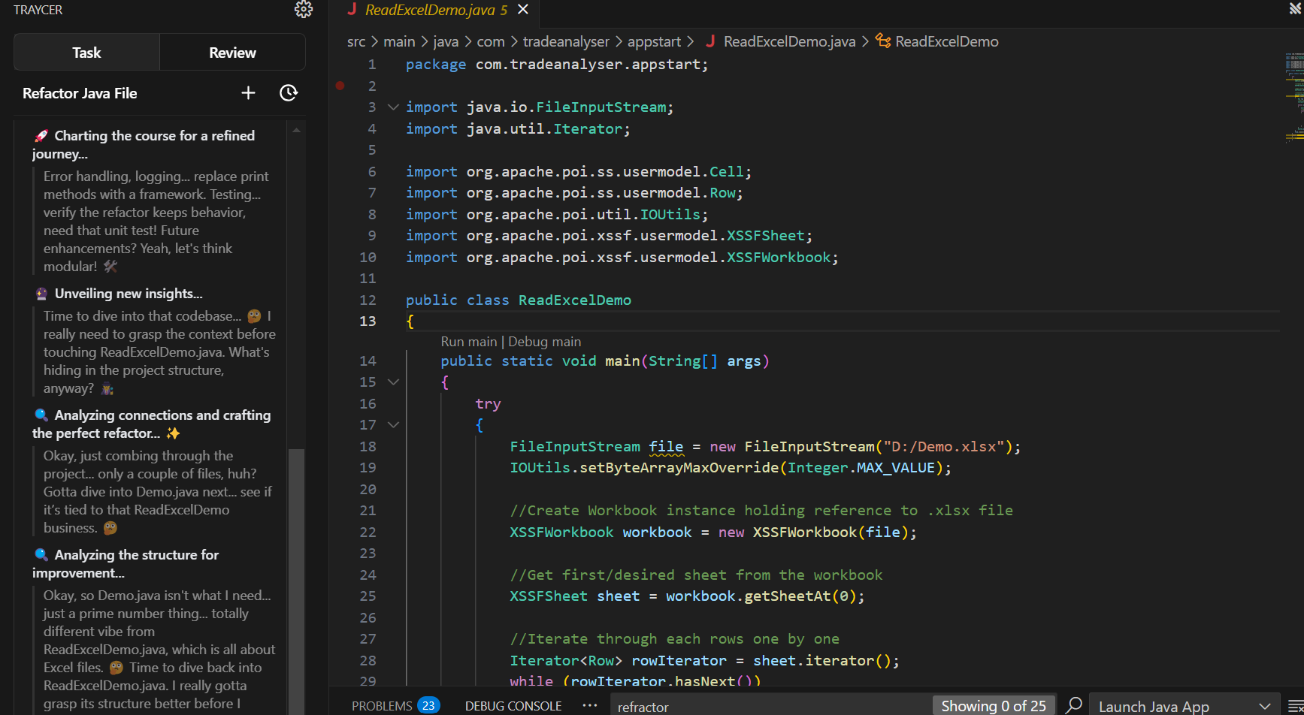

Slide 14
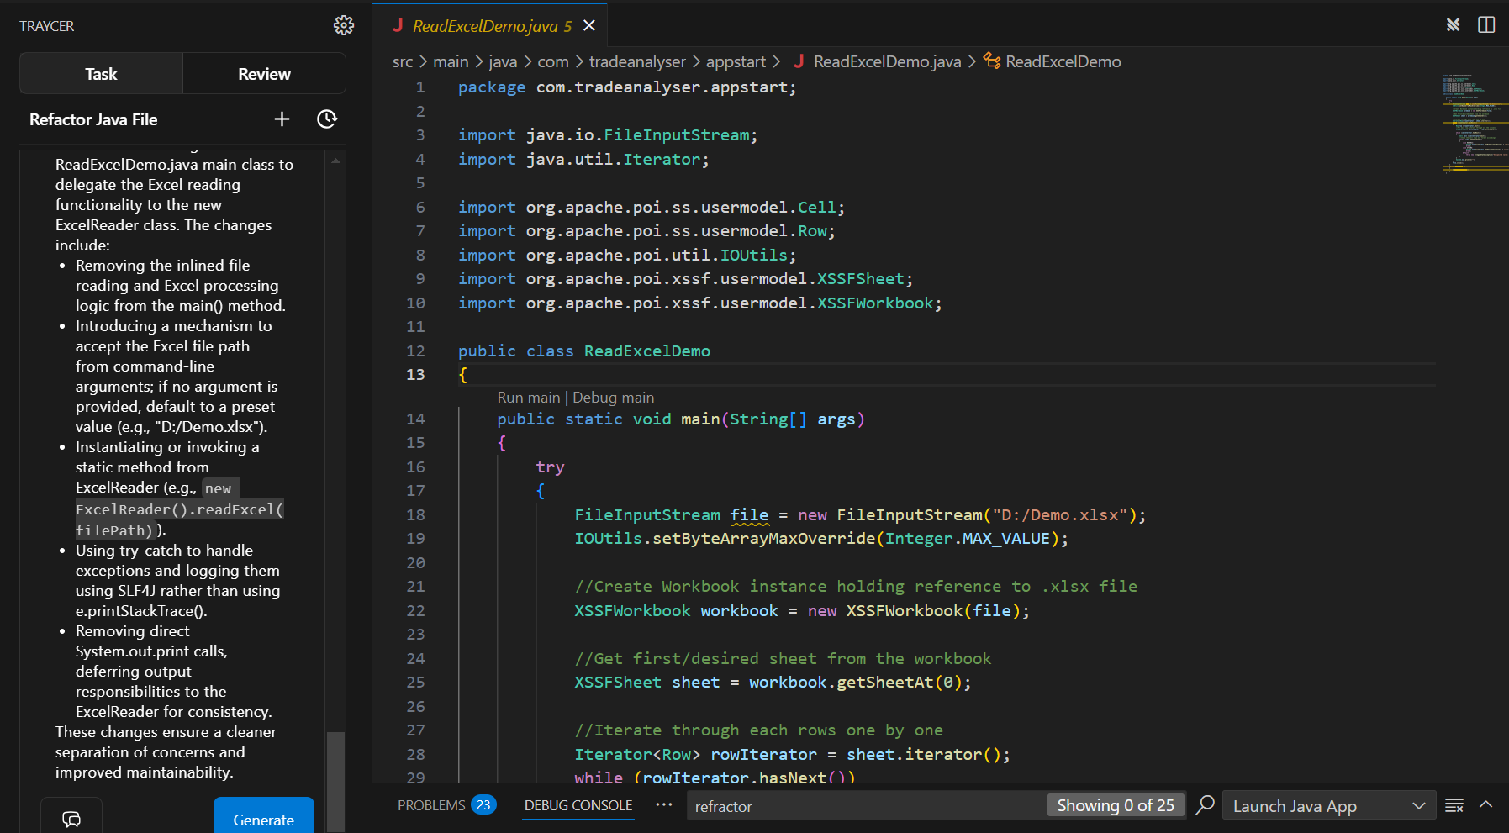

Slide 15
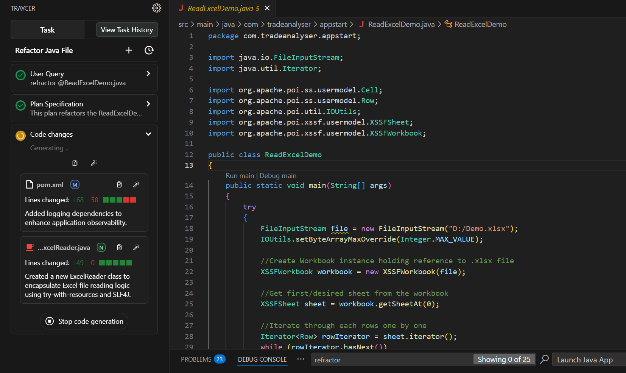
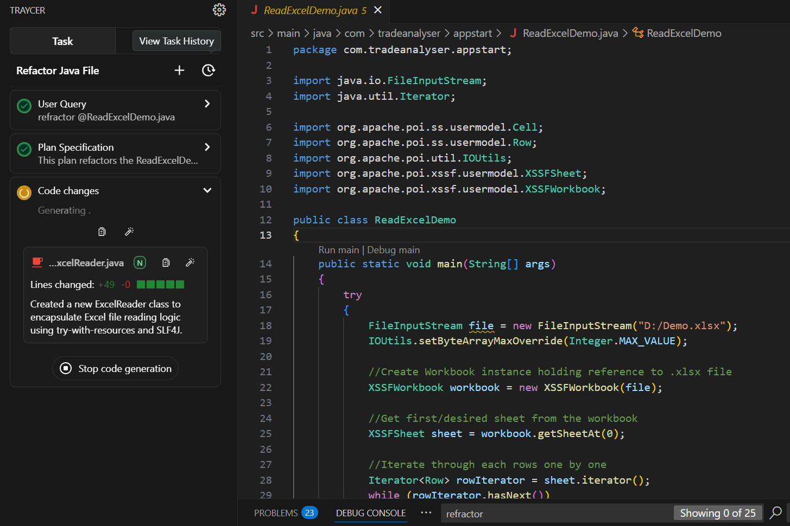
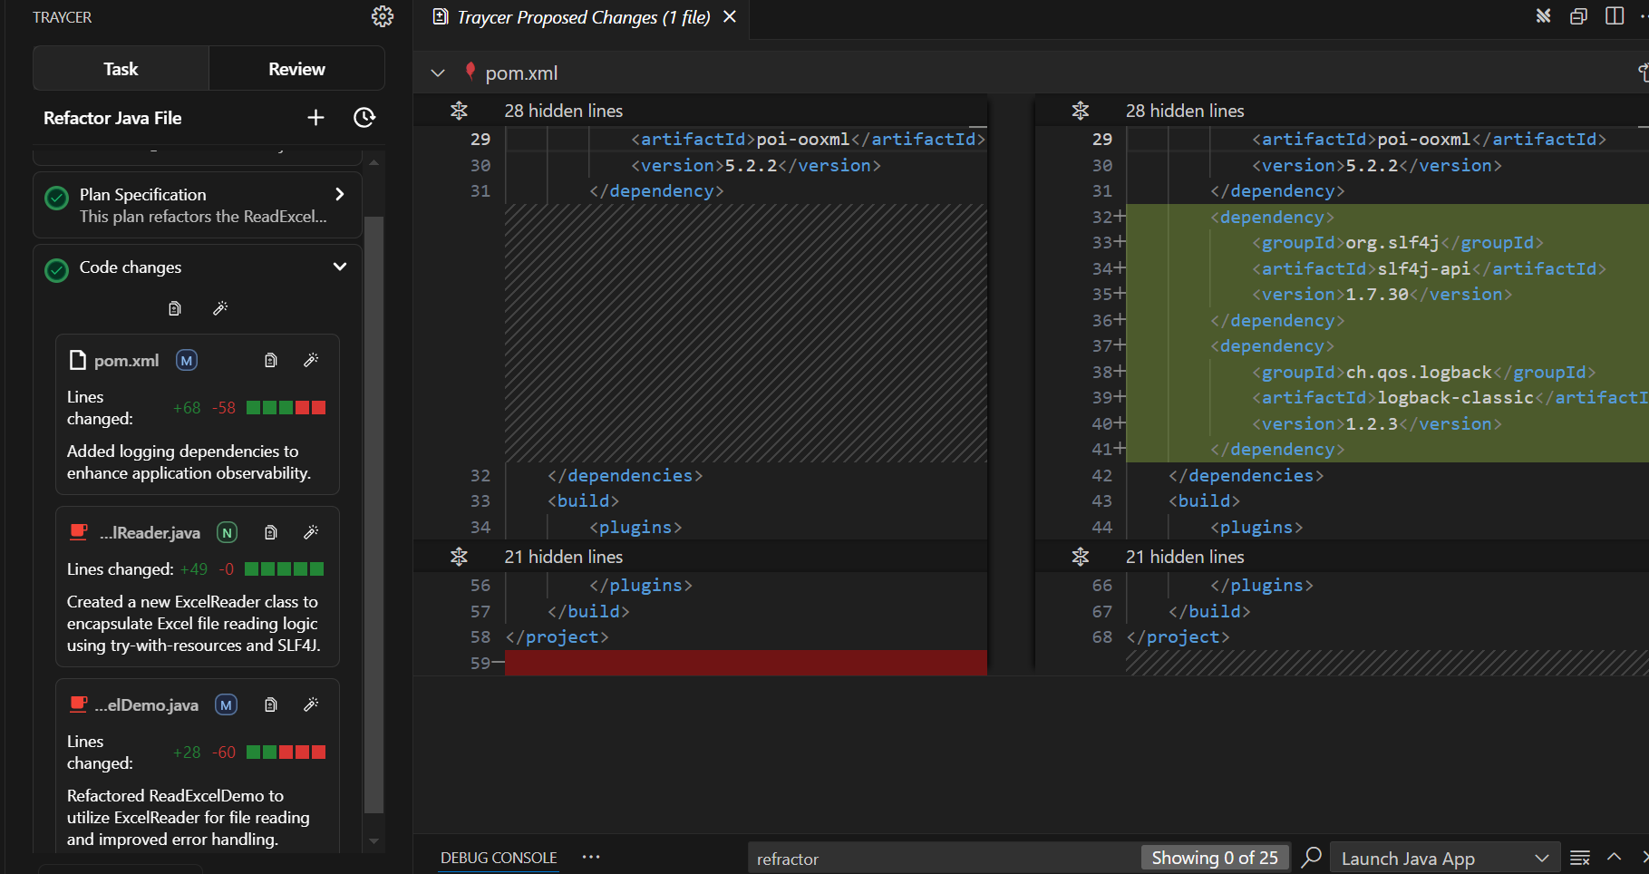

Slide 16
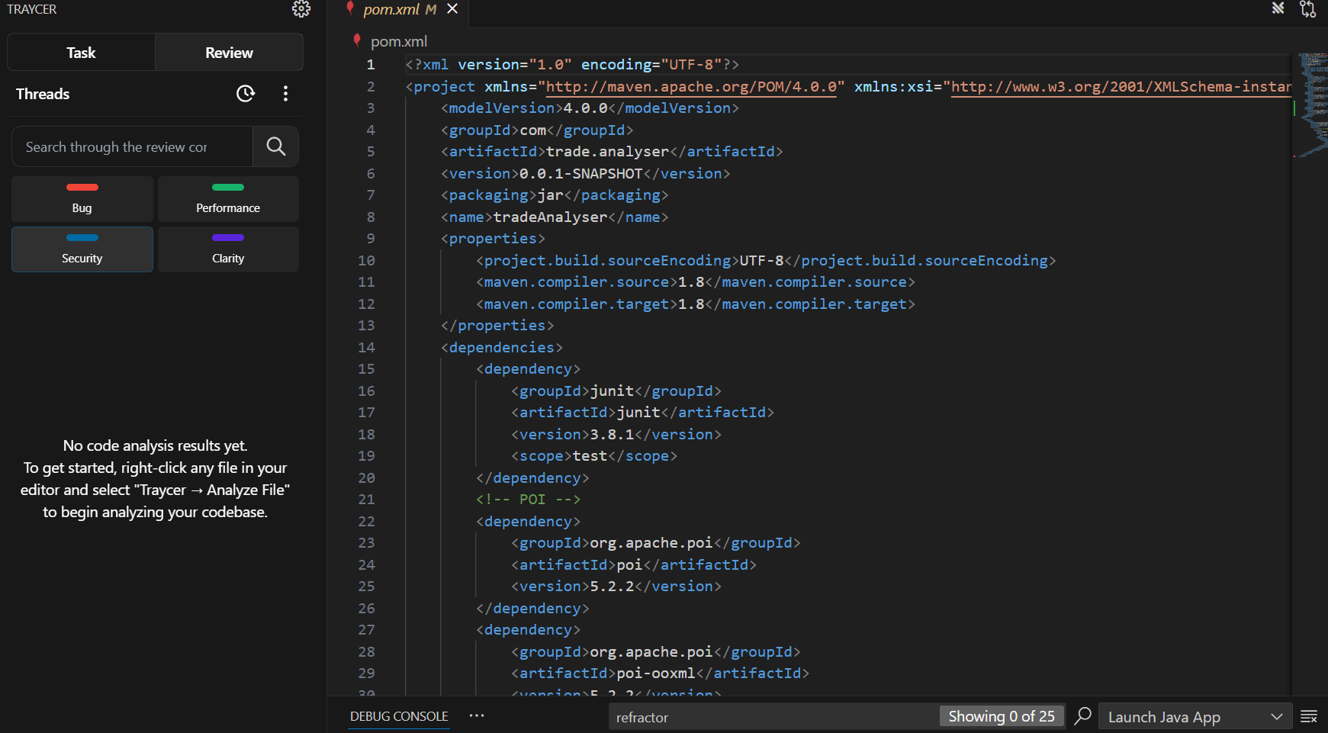

Slide 17
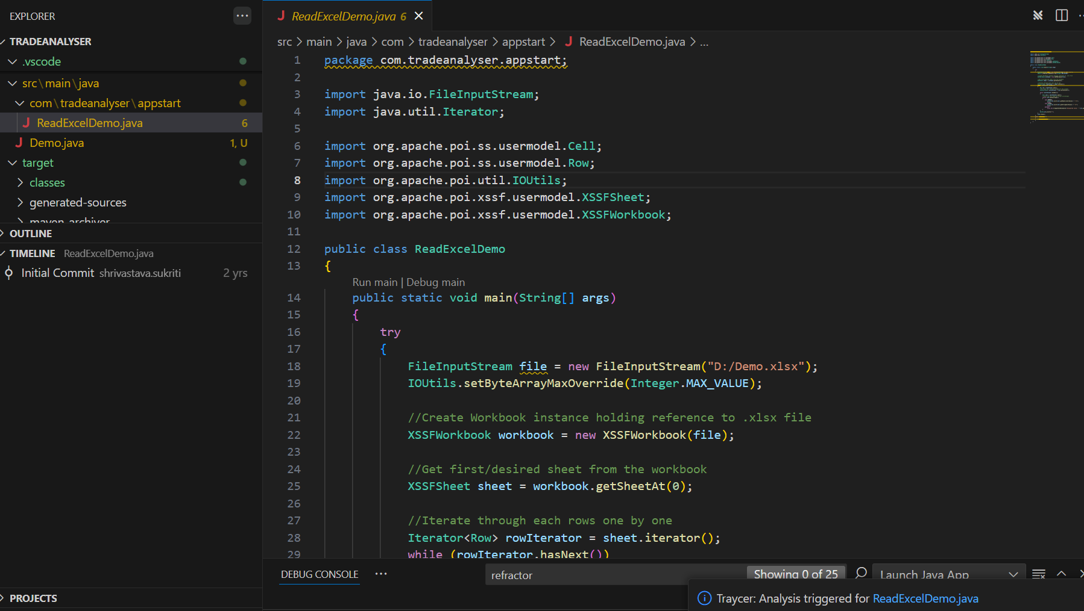

Slide 18
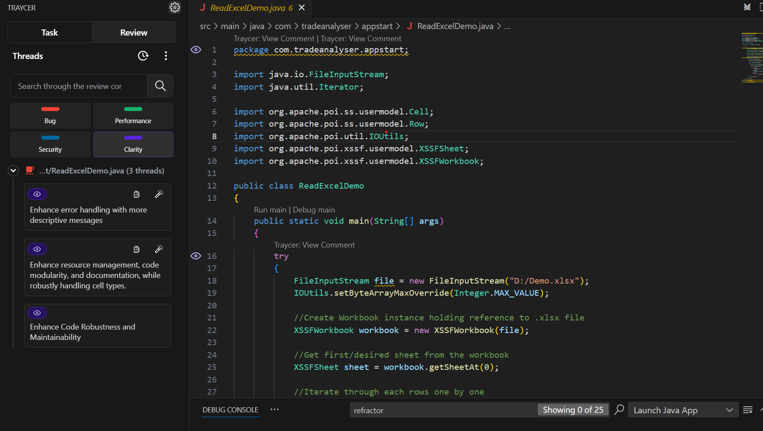

Slide 19
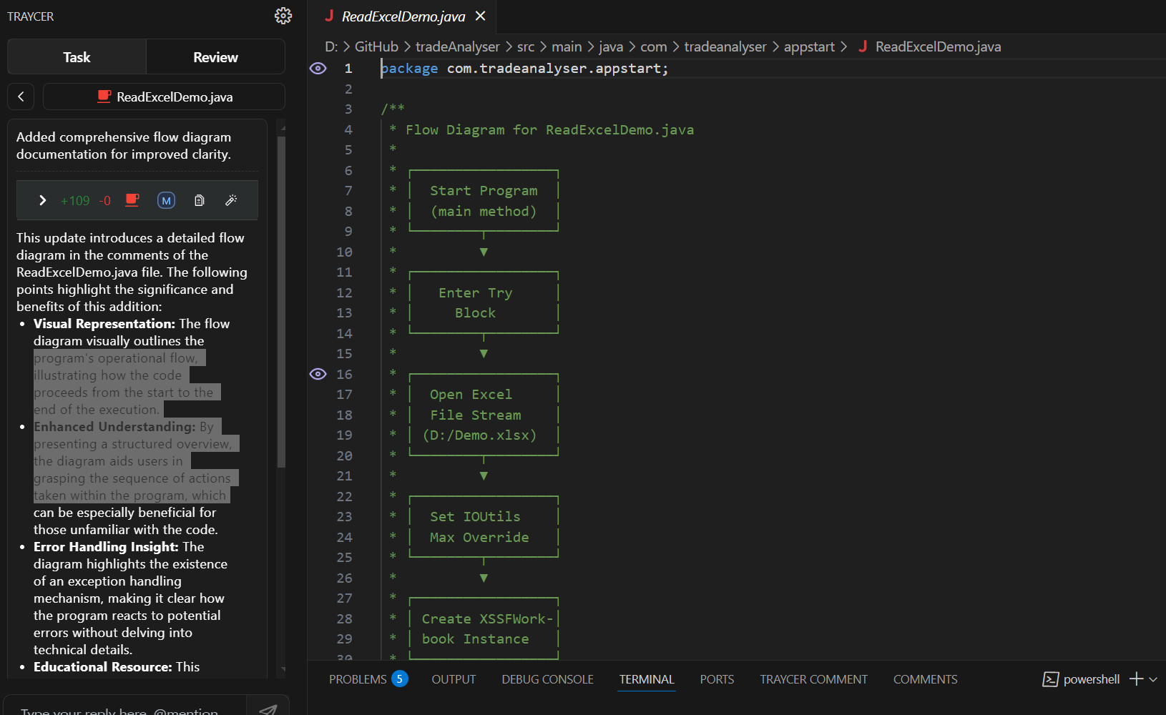

Slide 20
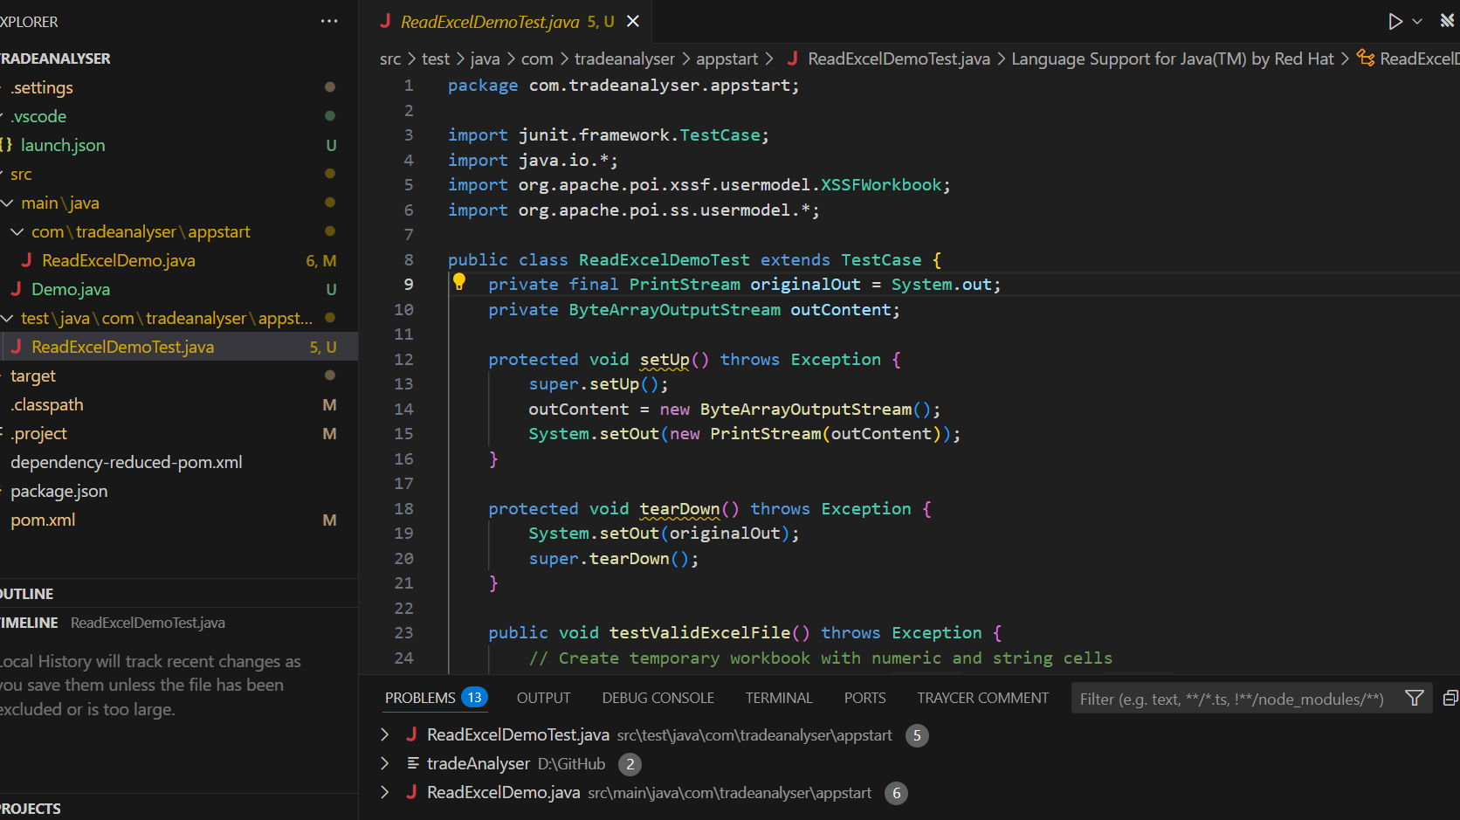

Slide 21
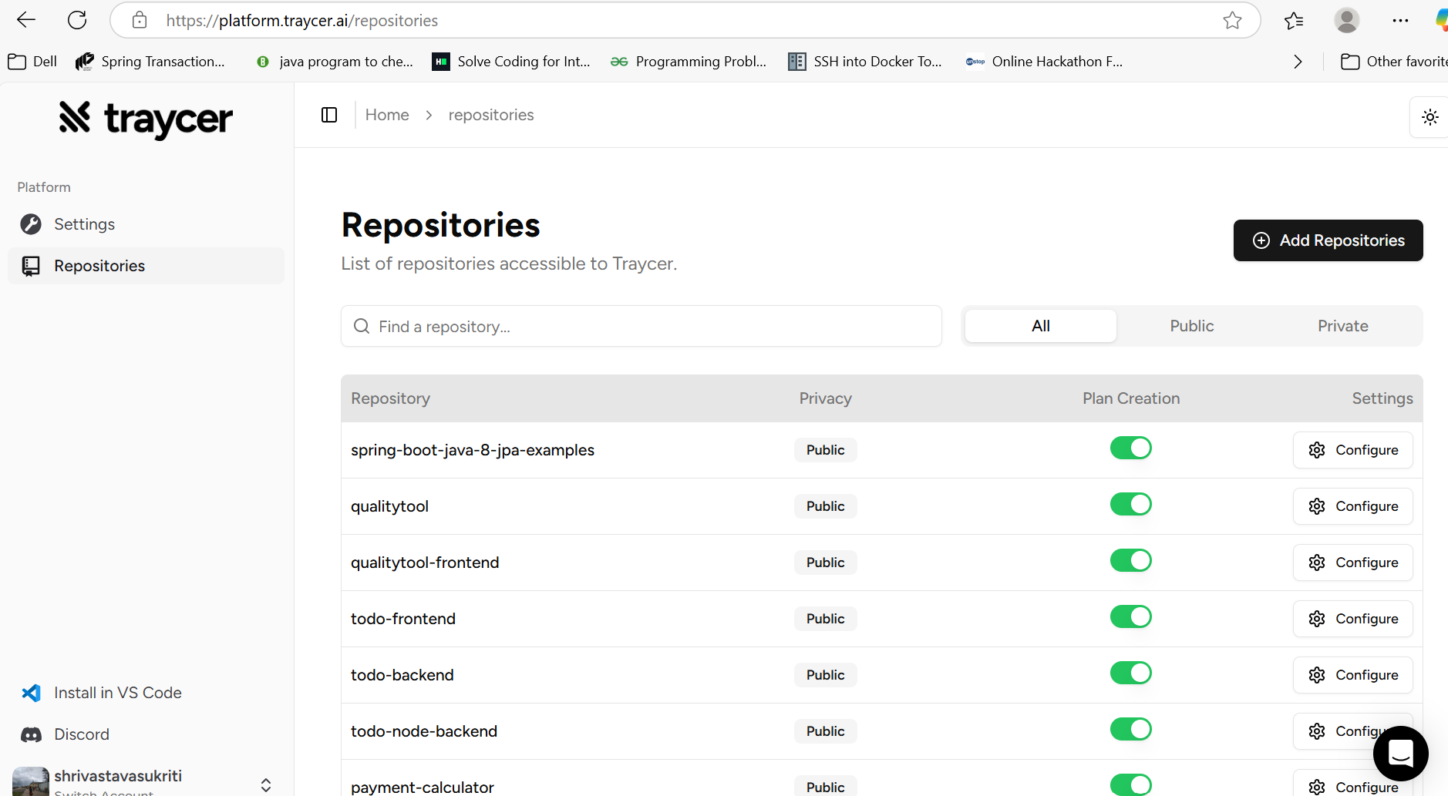
Manage all Github Repositories with platform.traycer.ai The ticket assist feature will automatically compute plans and post it as a comment directly on your GitHub Issue. For this feature to work we need read permission on your repository. Traycer gets installed as a GitHub App.

Slide 22
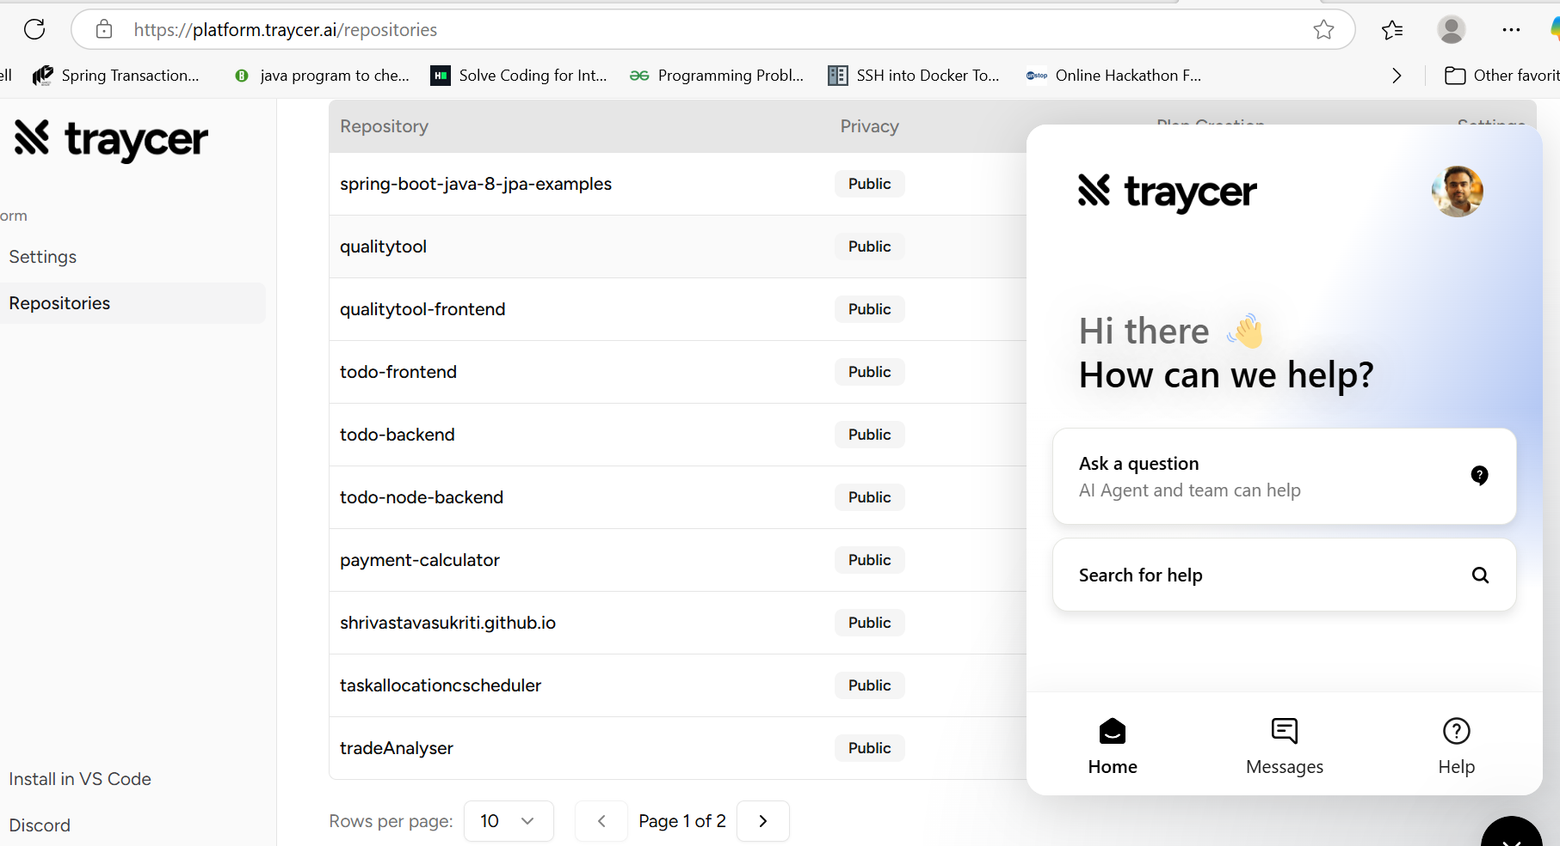
Chat support available on Traycer Platform

Slide 23
Privacy with Platform.traycer.ai
We don’t store the codebase longer than we need. We clone it in a temporary secure environment while computing the plan.

Slide 24
Open – Source capabilities
Traycer AI is not entirely open source, but we do offer an Open Source plan.This plan is free forever with reasonable rate limits and includes:
• Creating tasks on open-source code
• Single file reviews on open-source code
• Community support
• A two-week Pro trial
The Open Source plan has a capacity of 1 task with a recharge rate of 1 task per hour. For more extensive use or work on private code, we offer paid plans like Lite and Pro with additional features and higher rate limits.

