Slide 1
Day 2: Facial Recognition
Lauryn Fluellen• SMASH

Slide 2
Hall of Fame

Slide 3
Examples of when facial recognition is used?

Slide 4
Facial Recognition can be found:
Video surveillance
Stores
Gas stations
Red light cameras
Airports
iPads, Smartphones
Snapchat filters
Face ID
Facebook tagging
Facial recognition in video surveillance can be used to help find missing people, or criminals.
Facial recognition in technology like smartphones and ipads make opening devices easier and quicker than using a password

Slide 5
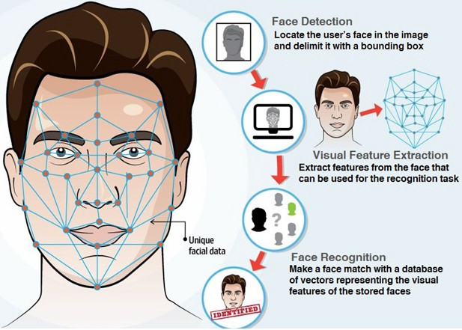
Steps to Facial Recognition
Face detection
Feature extraction
Facial recognition

Slide 6
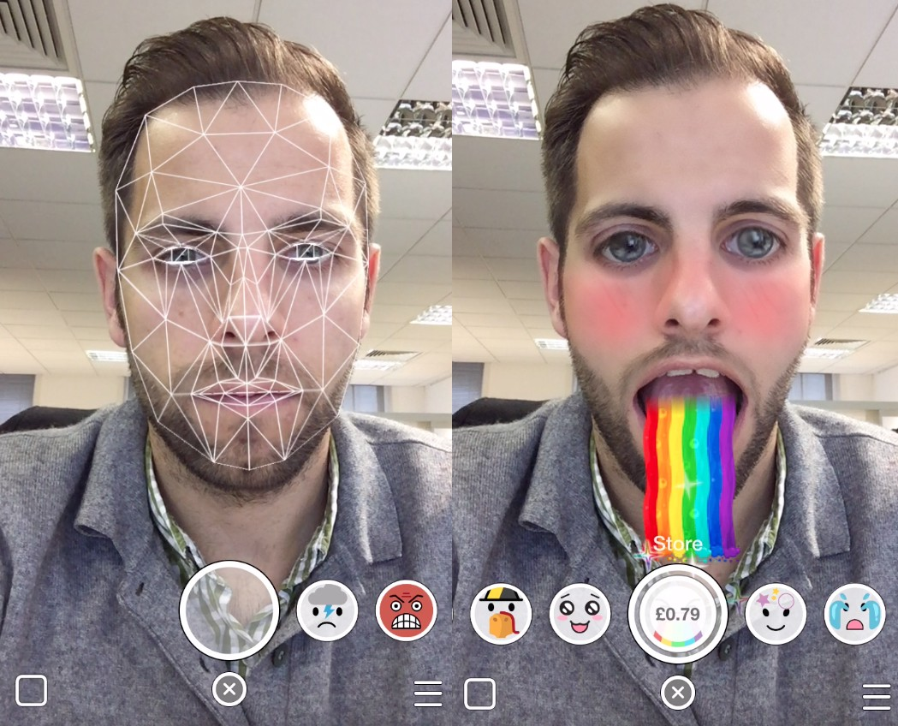
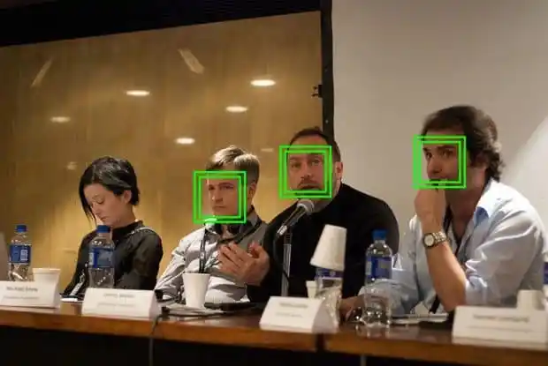
Face Detection
Find the face in our image or camera view

Slide 7
Steps to Facial Recognition
Face detection
Feature extraction
Facial recognition

Slide 8
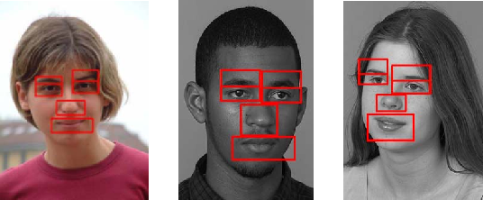
Feature Extraction
Create a list of features found in the face detected

Slide 9
Steps to Facial Recognition
Face detection
Feature extraction
Facial recognition

Slide 10

Facial Recognition
Make a face match by comparing features extracted with the given face

Slide 11
Feature based model

Slide 12


Eye color
Eye shape
Face shape
Eyebrow shape
Nose shape
Notes:
the distance between your eyes, the depth of your eye sockets, the distance from forehead to chin, the shape of your cheekbones, and the contour of the lips, ears, and chin

Slide 13
Partner Activity
Find a partner
Take your cartoon character and write down 4 facial features your character has that would be detected during the feature detection process
When you are done raise your hand, a teacher will come around to see your 4 features

Slide 14



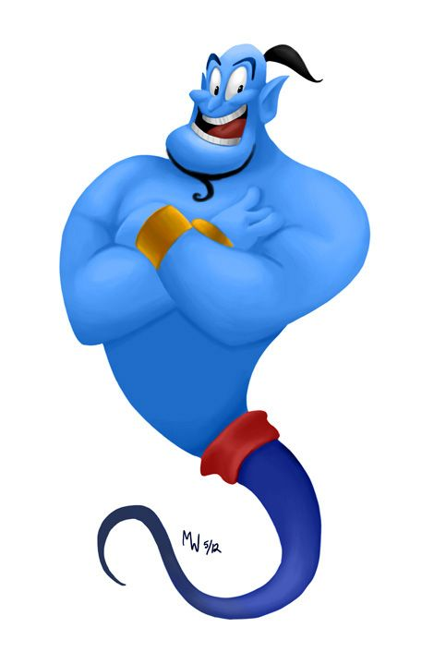
Coding activity
https://bit.ly/3cgyIV3
Face ID: Write a facial recognition program for your character’s phone in python to process user input and grant access if the detected features match.

Slide 15
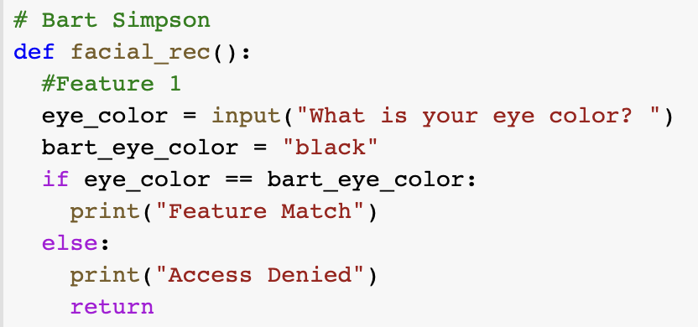
Starter code:
Think of your cartoon character and their features. Write a program hard coded for them that asks the user for user input and if the user input matches for all features of your cartoon print “Access granted”, otherwise print “Access denied”

Slide 16
Homework
Talk to someone and explore what tech they use most and the benefits and downsides of those technologies.

