Slide 1
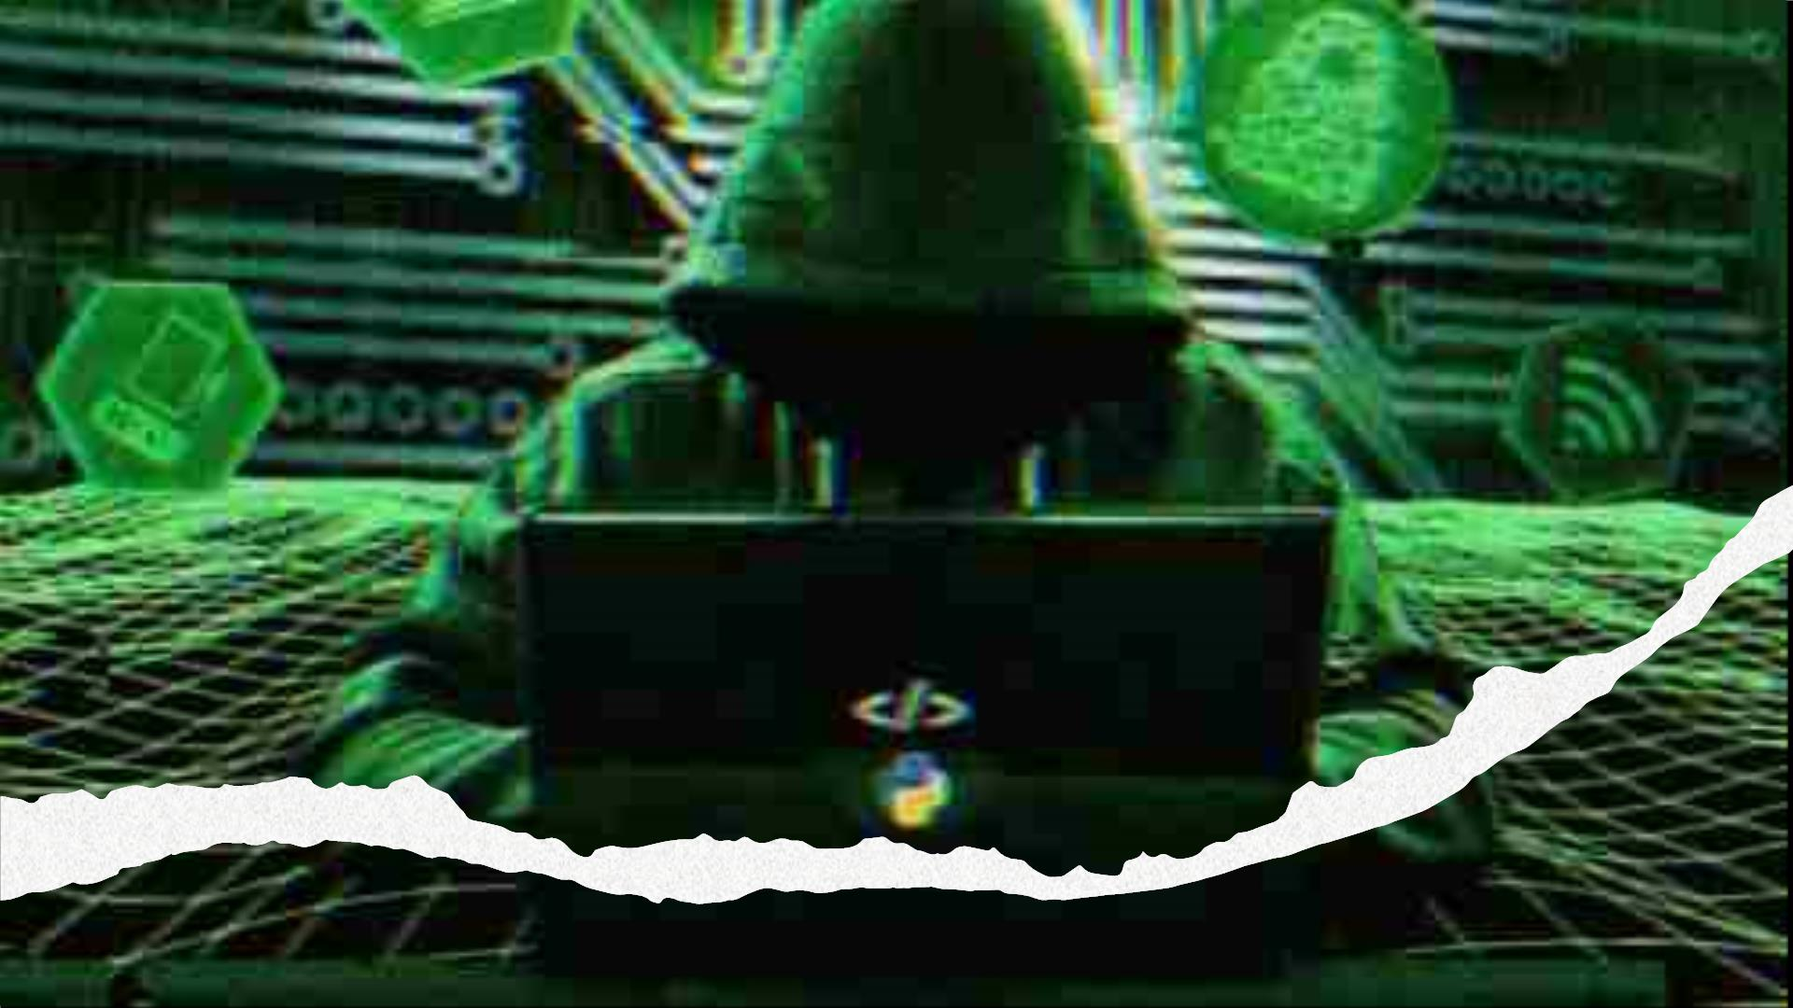
Have you been
Hacked?
SmashꢀDayꢀ4

Slide 2
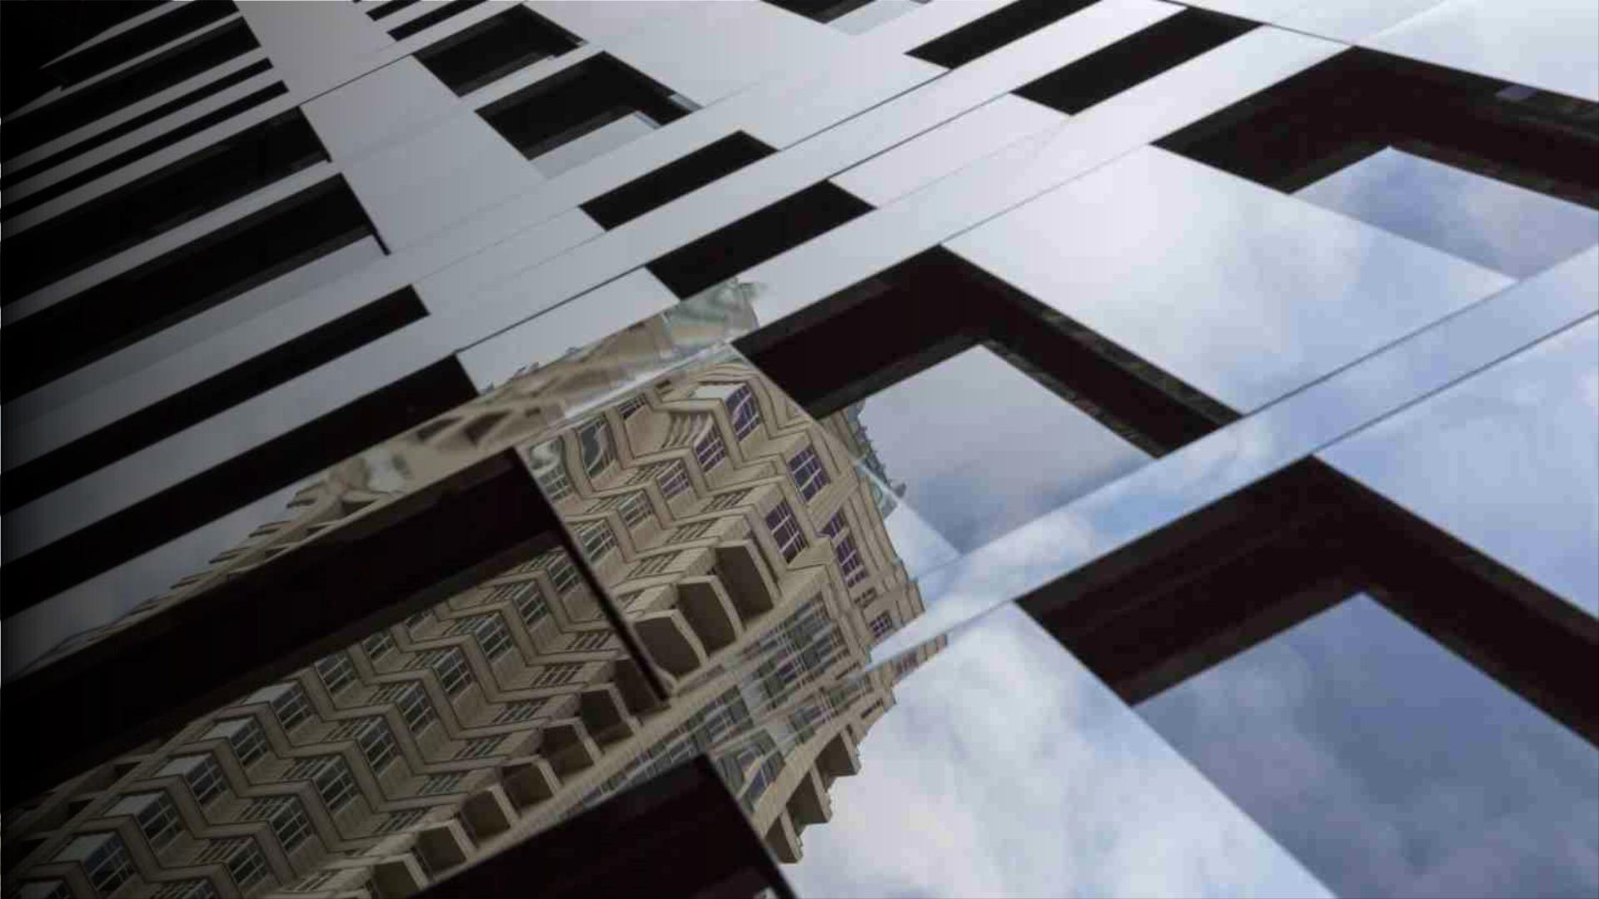
Reflections from the
past weekꢀ

Slide 3
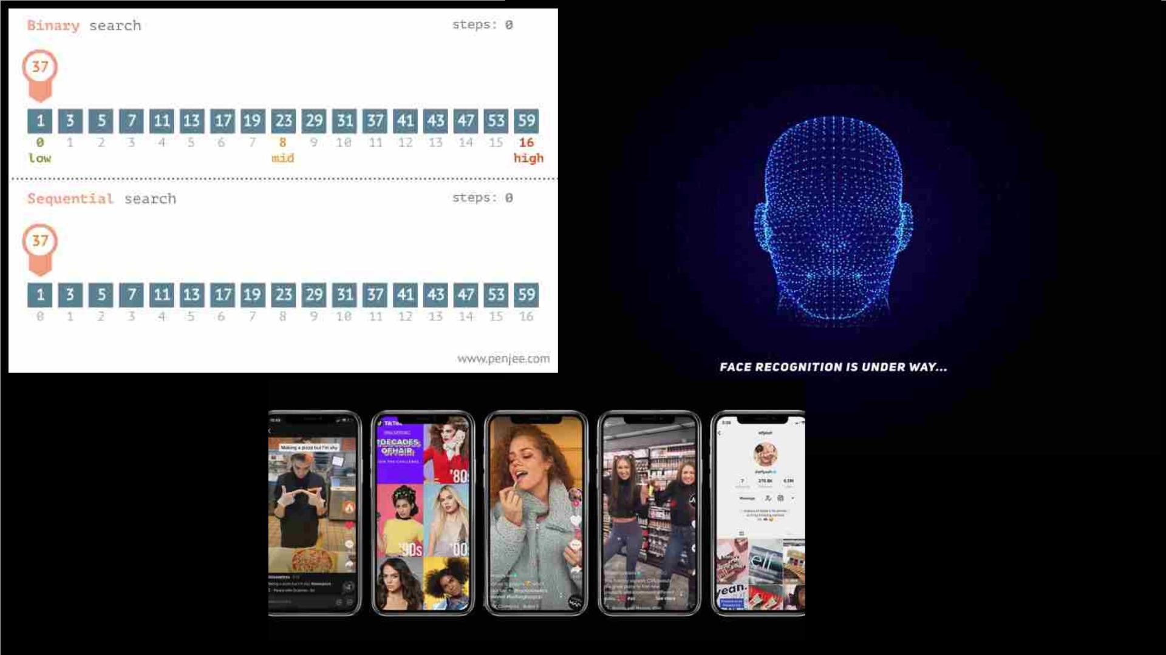

Slide 4

Technology,
A Blessing?

Slide 5
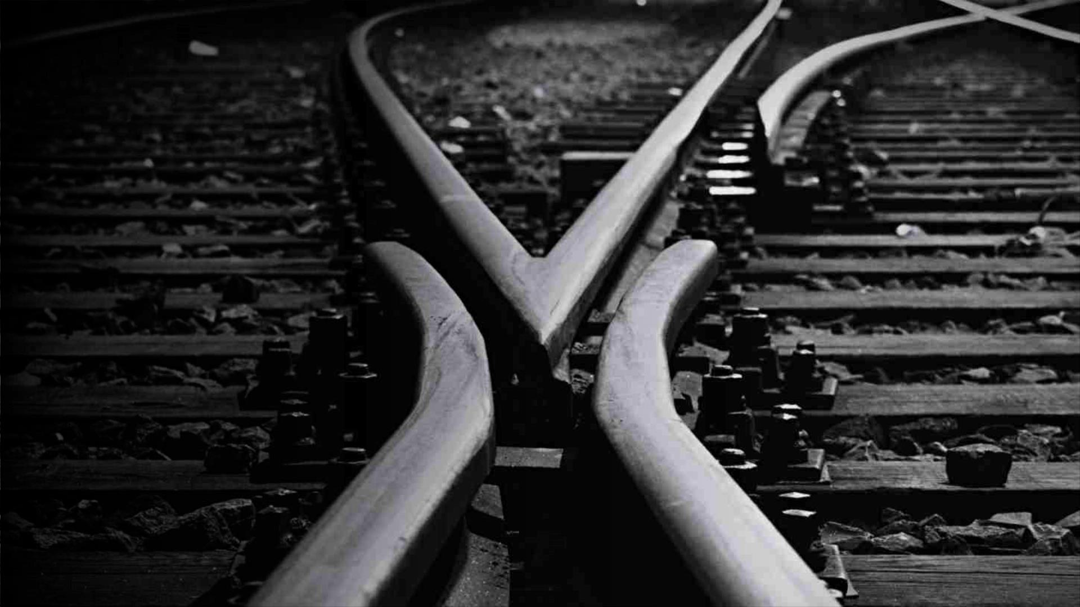
Technology, A Threat?
Think in terms of :ꢀꢀ
-- Web Search
-- Facial Recognition Software
-- Popularity Algorithm

Slide 6

Thoughts?

Slide 7

A few
questions to
ponder over...

Slide 8
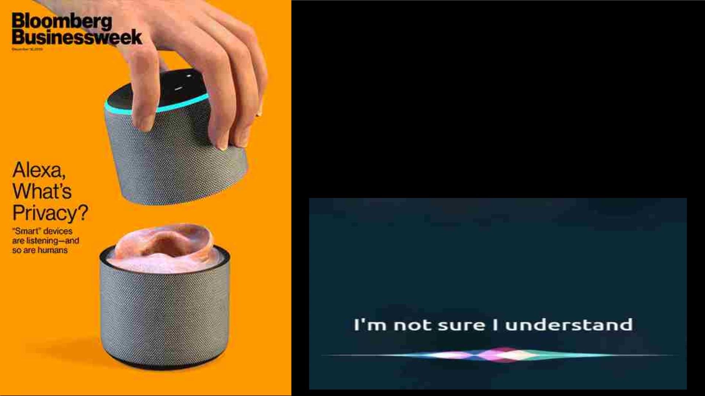
ꢀEthical Question 1: Is yourꢀSmartphoneꢀsecretly listening to
you?ꢀ
How much information collected byꢀyour Google search or
YouTubeꢀwatch history is being used toꢀdeanonymize you
without yourꢀconsent?
Is it being used to target certain issues and influence you?

Slide 9
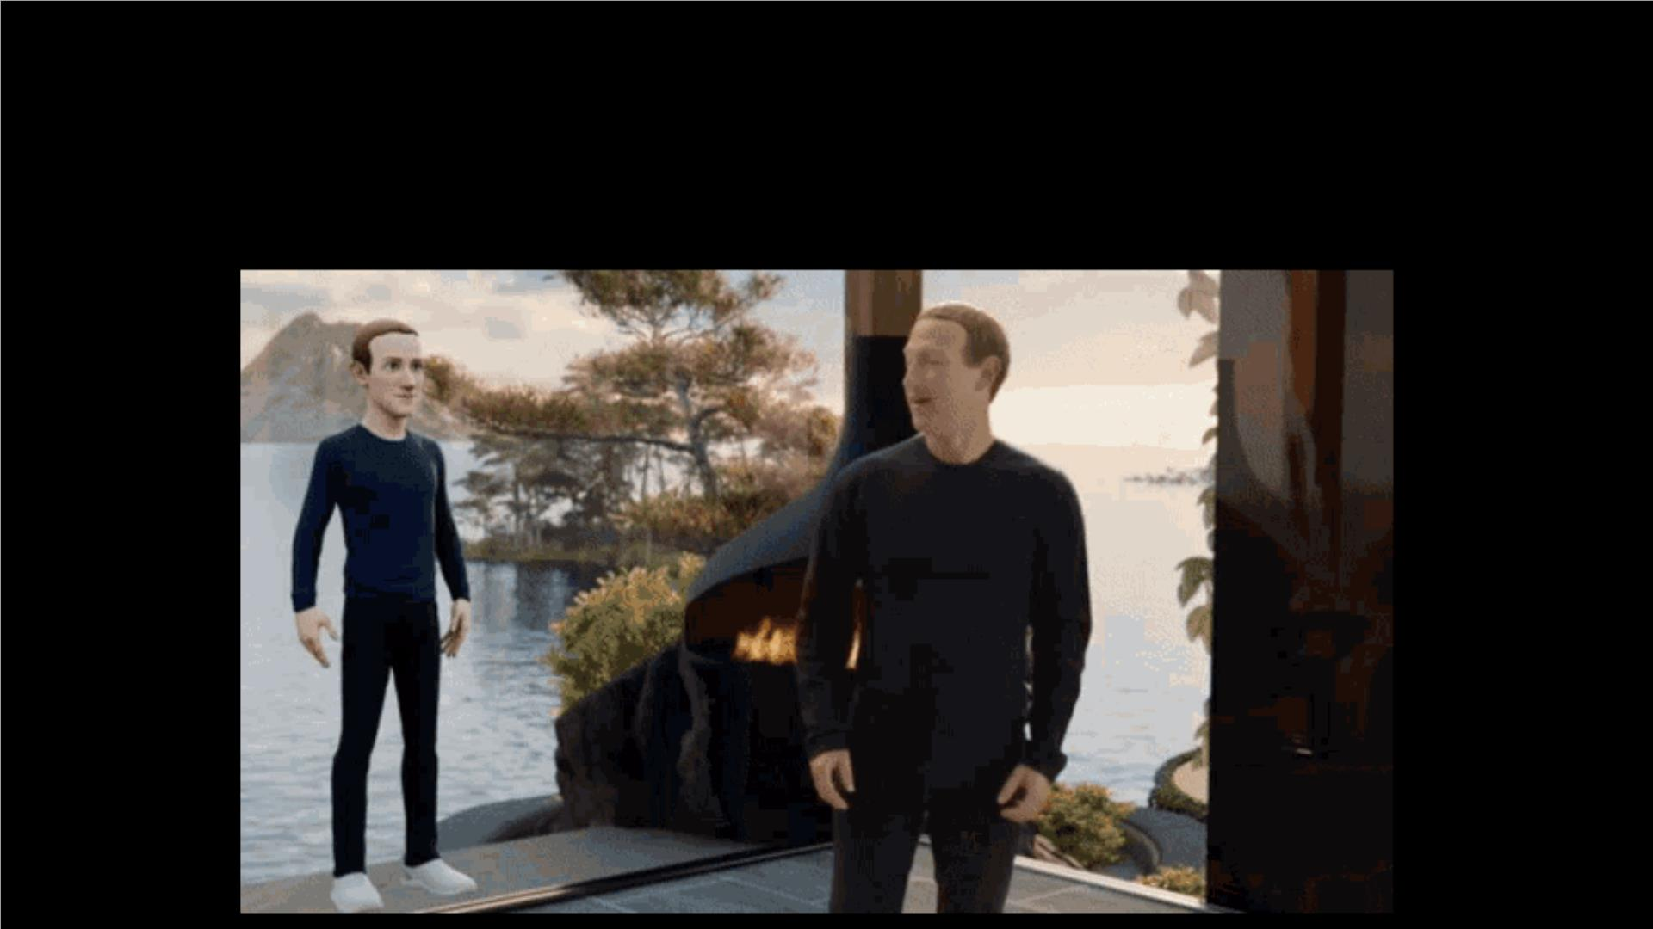
ꢀEthical Question 2:ꢀGiven the obvious bias that exists in
algorithmic designs for minorities, how safe is metaverse?

Slide 10
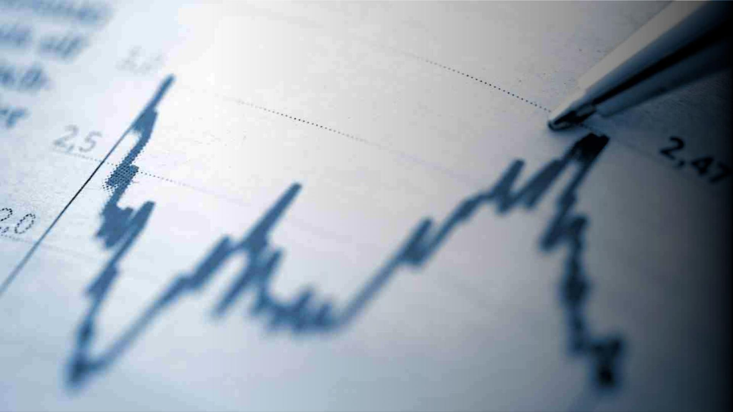
Why is it
important to
protect data?

Slide 11
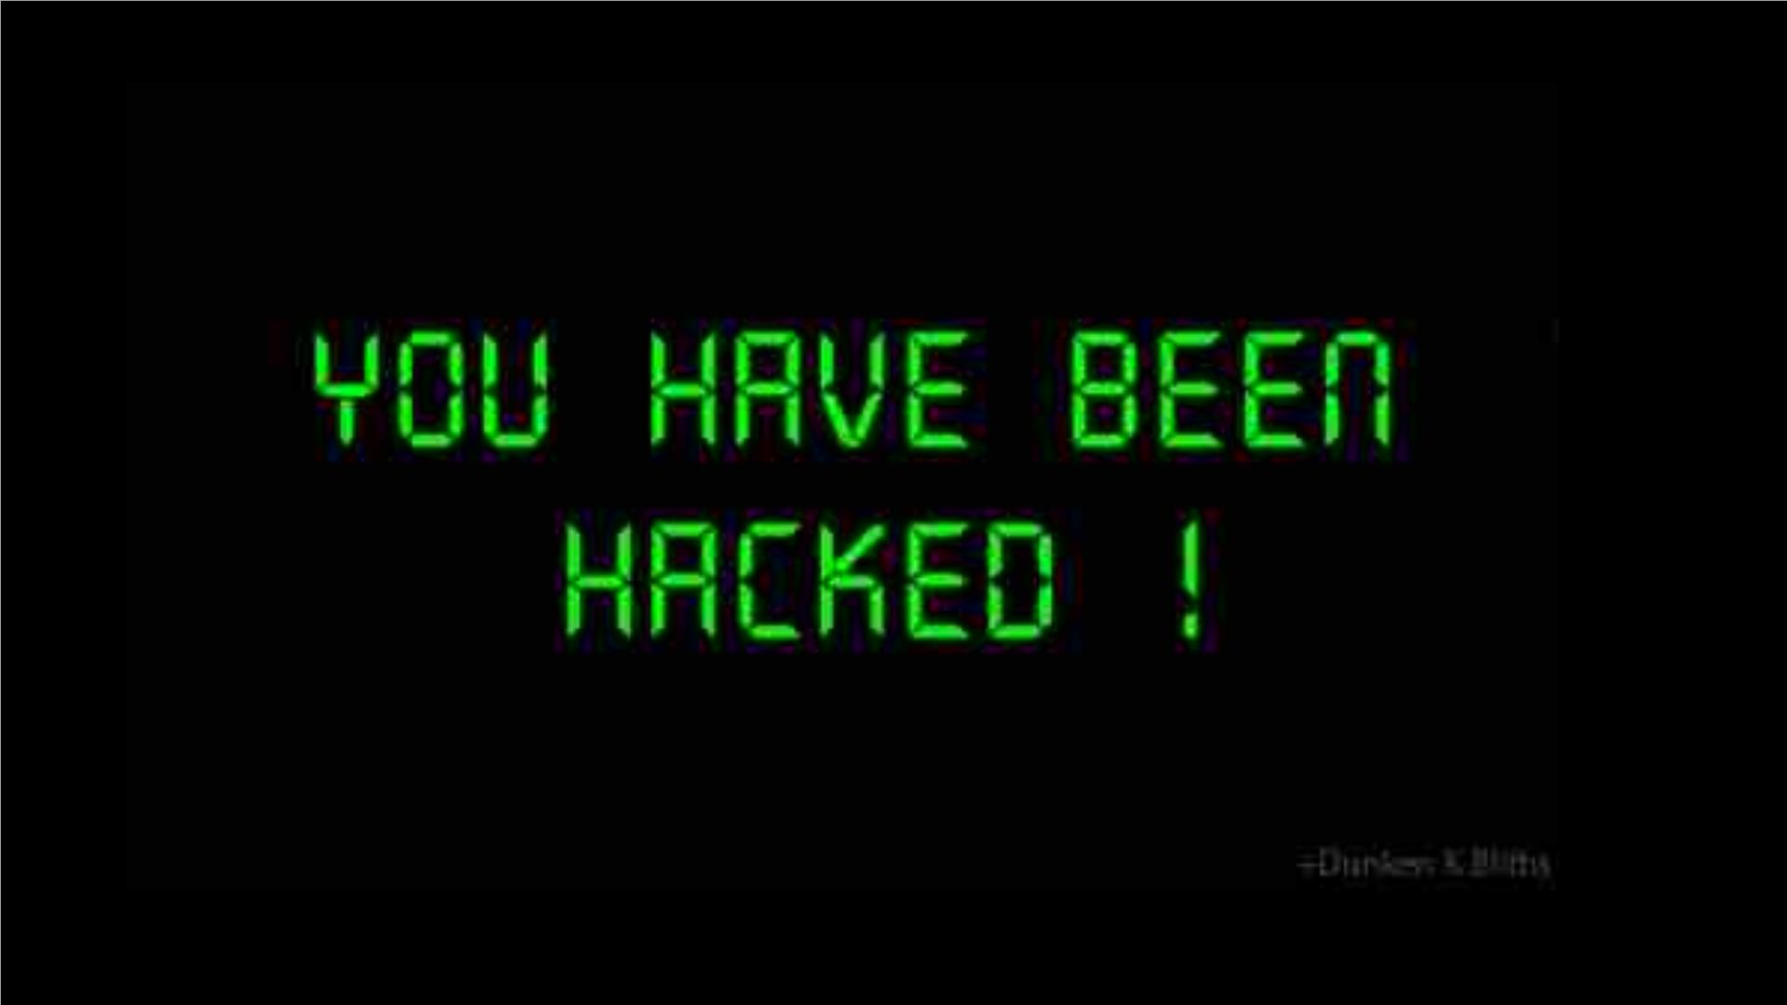

Slide 12

Malware andꢀRansomware Attacks
Malware is the general term for any program that is designed to damage, disrupt, or hack a device.ꢀ
Viruses and ransomware are malware.ꢀ
Ransomware are malicious programs that block access to your device until you pay a ransom fee to its creator. It
is often very difficult and expensive to remove

Slide 13
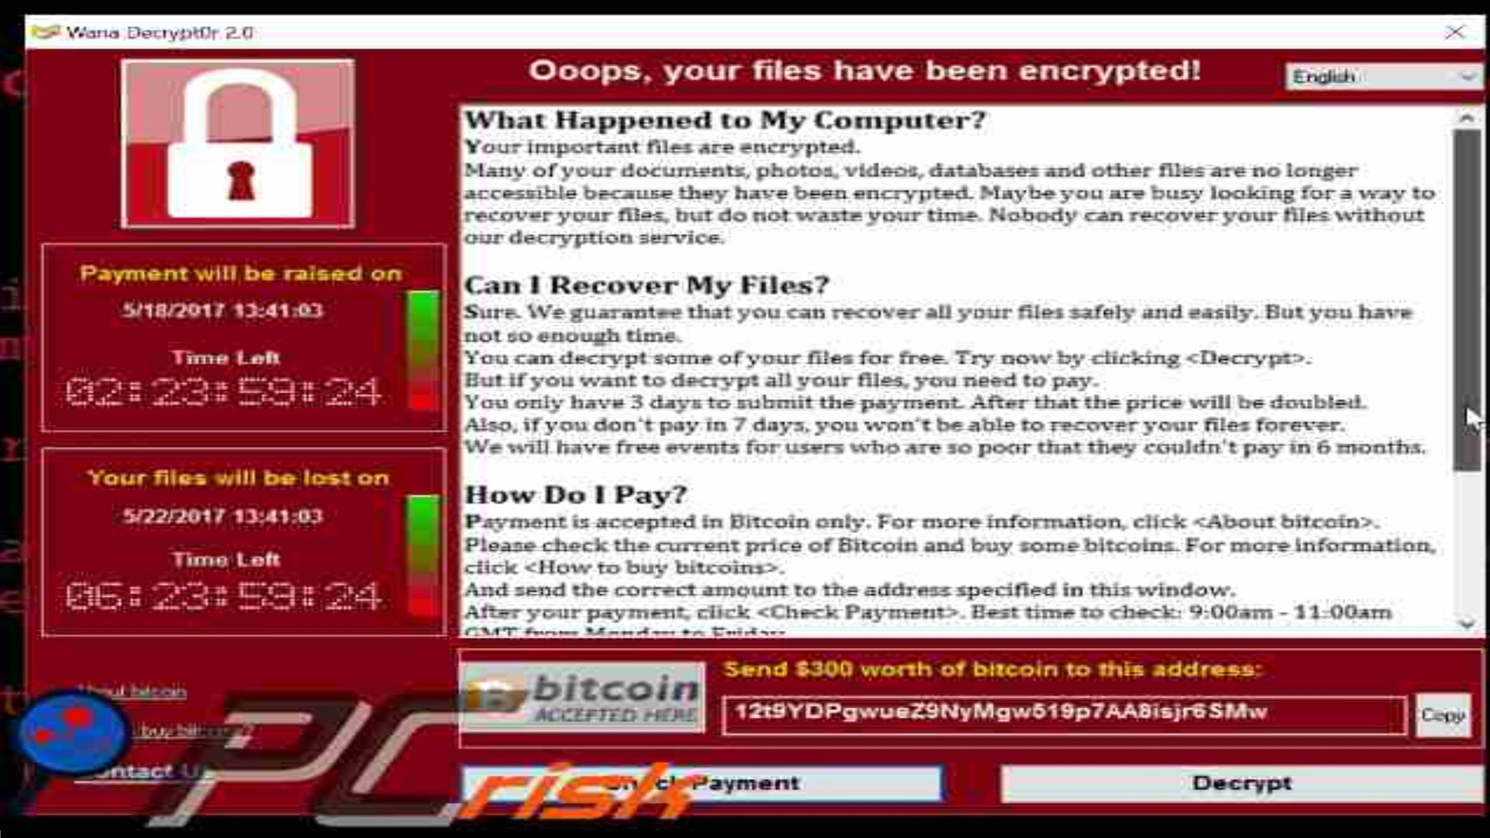

Slide 14
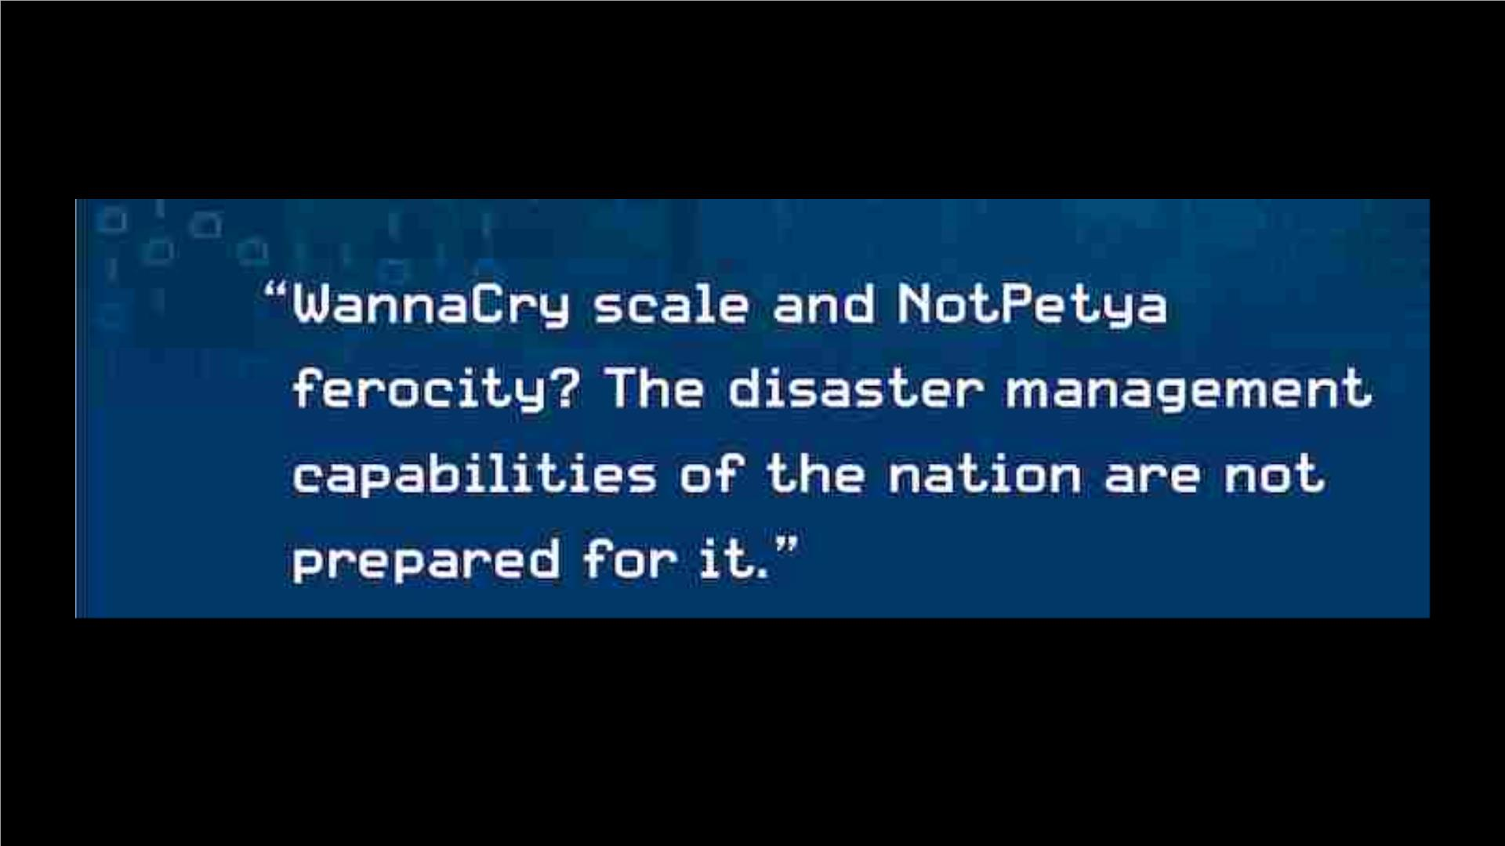
TheꢀWannaCry ransomware attackꢀwasꢀaꢀworldwideꢀcyberattackꢀinꢀMayꢀ2017ꢀbyꢀtheꢀ
WannaCryꢀransomwareꢀcryptoworm,ꢀwhichꢀtargetedꢀcomputersꢀrunningꢀtheꢀMicrosoftꢀ
Windowsꢀoperatingꢀsystemꢀbyꢀencryptingꢀdataꢀandꢀdemandingꢀransomꢀpaymentsꢀinꢀ
theꢀBitcoinꢀcryptocurrency
Russiaꢀwasꢀchargedꢀwithꢀconductingꢀtheꢀmostꢀdisruptiveꢀandꢀdestructiveꢀseriesꢀofꢀcomputerꢀattacksꢀ
everꢀattributedꢀtoꢀaꢀsingleꢀgroup,ꢀincludingꢀunleashingꢀtheꢀNotPetyaꢀmalwareꢀ-ꢀevenꢀthoughꢀitꢀwasꢀ
designedꢀtoꢀinfiltrateꢀcomputerꢀsystemsꢀviaꢀaꢀpopularꢀpieceꢀofꢀUkrainianꢀaccountingꢀsoftware,ꢀtheꢀ
virusꢀspreadꢀfarꢀbeyondꢀtheꢀbordersꢀofꢀUkraine,ꢀcausingꢀanꢀincredibleꢀamountꢀandꢀvarietyꢀofꢀdamageꢀ
uptoꢀ$10B.ꢀꢀ

Slide 15
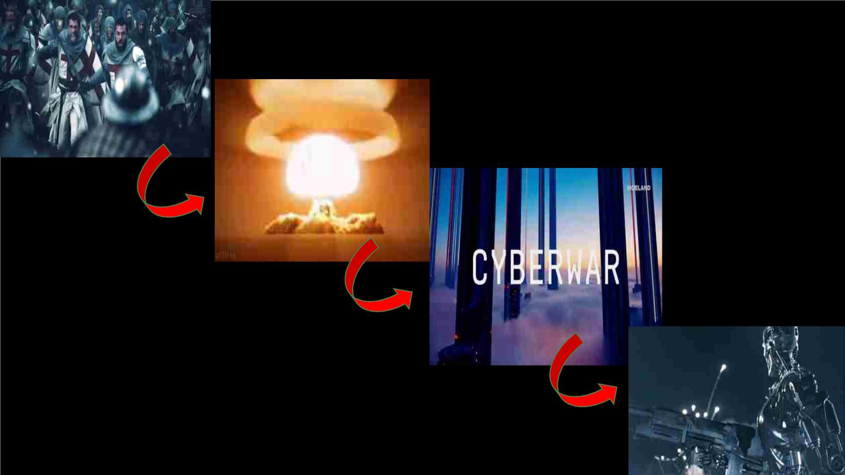
Evolution of Wars – A TimeLine?
??

Slide 16
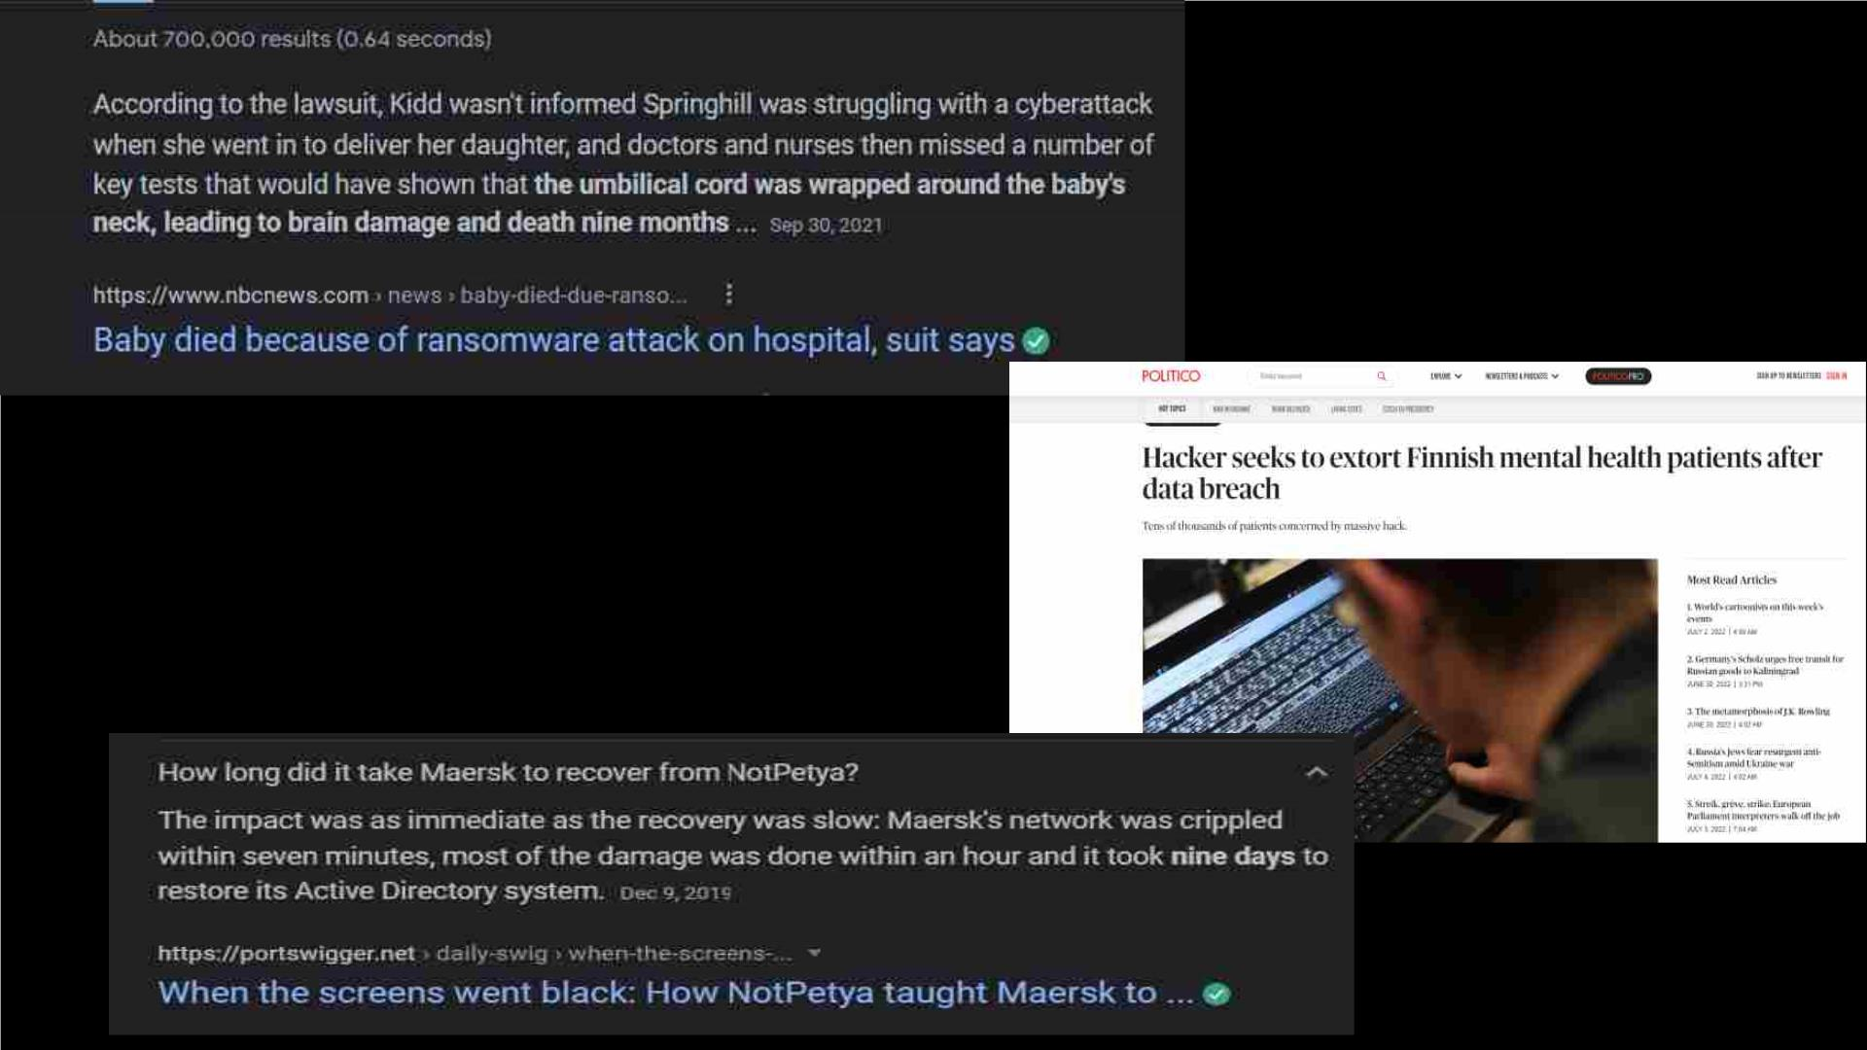
Ethical Question 3: Why brand these attacks as "war"?
How many of these cyberattacks are purely monetary or
political?ꢀ
Attackers know who has been hit –ꢀPeople are not collateral
damage -ꢀthreatening lives?

Slide 17
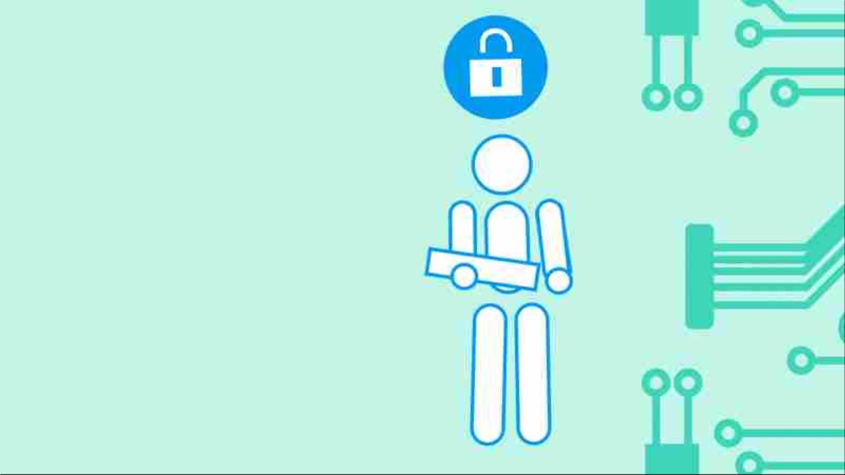
What is Cybersecurity?

Slide 18
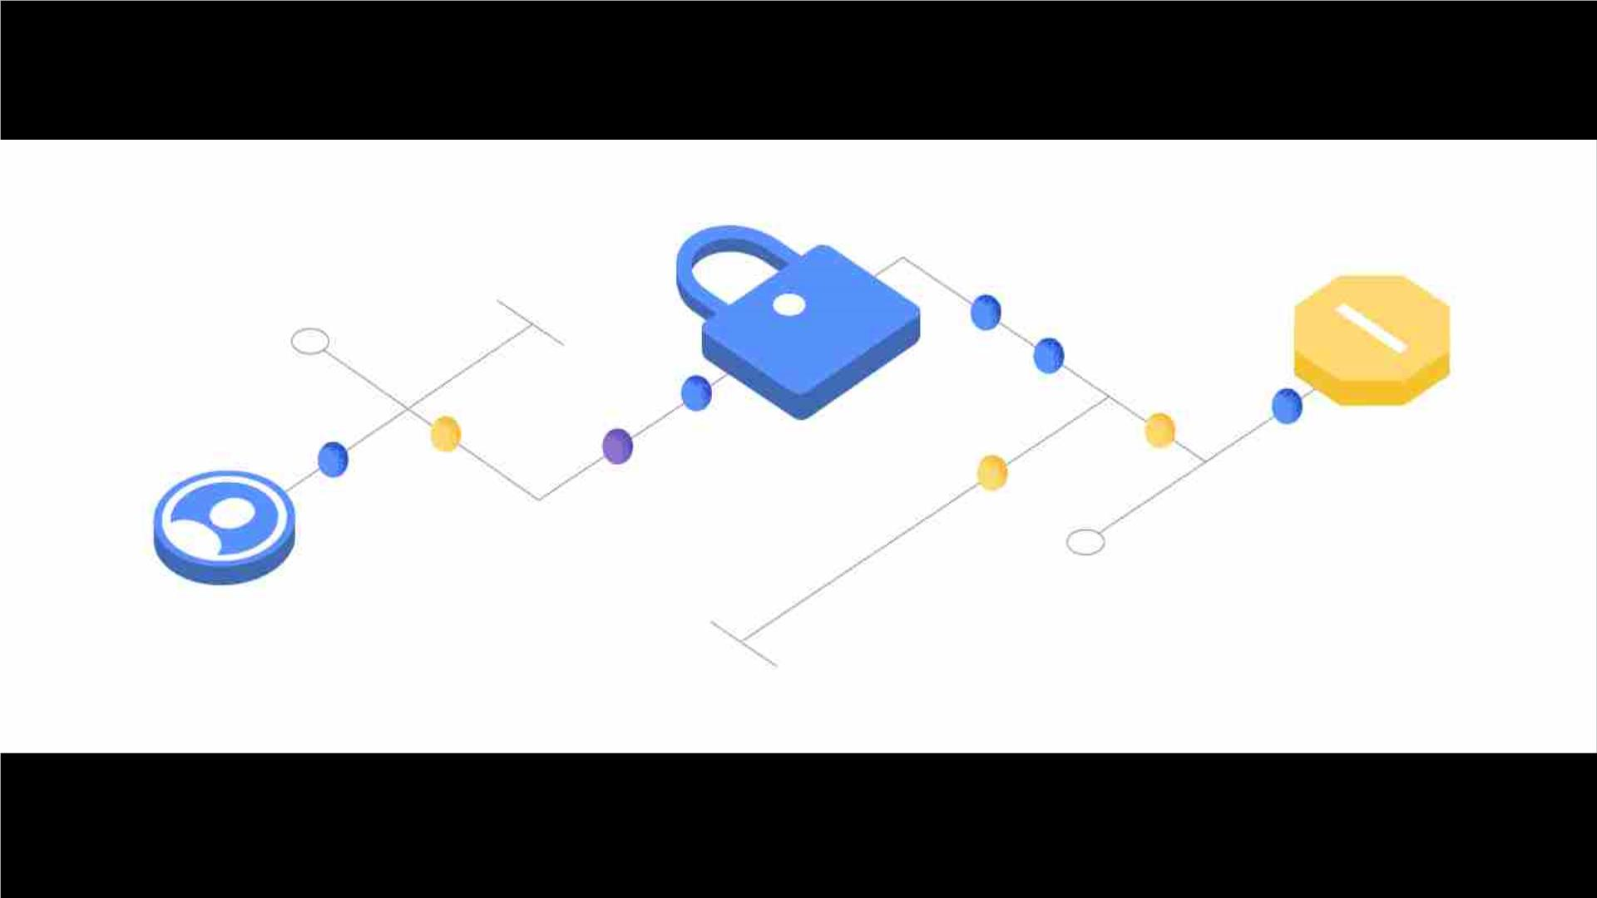
Cybersecurity isꢀthe practice of deploying people, policies, processes and technologies to protect
organizations, their critical systems and sensitive information fromꢀdigital attacks
Clickꢀtoꢀaddꢀtext
Access to user data is the biggest boon and bane of this century --- Passwords?ꢀ

Slide 19
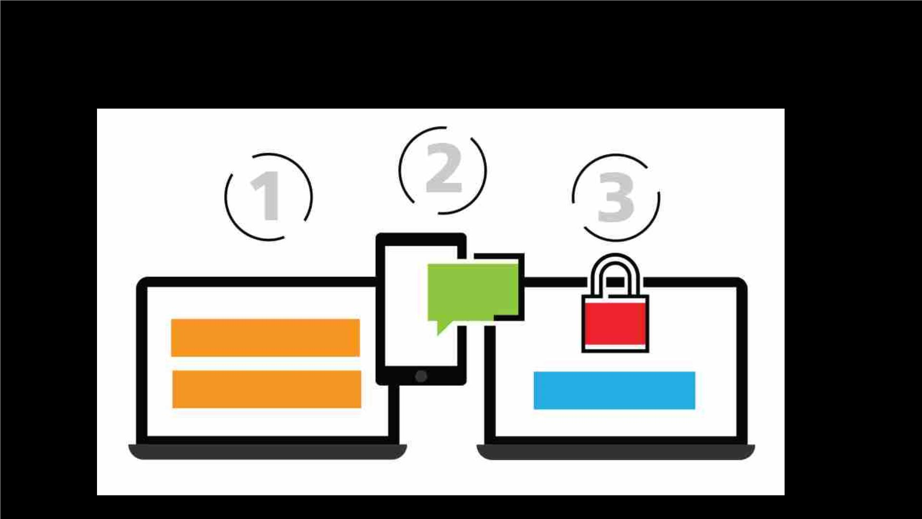
What is 2 Factor Authentication?

Slide 20
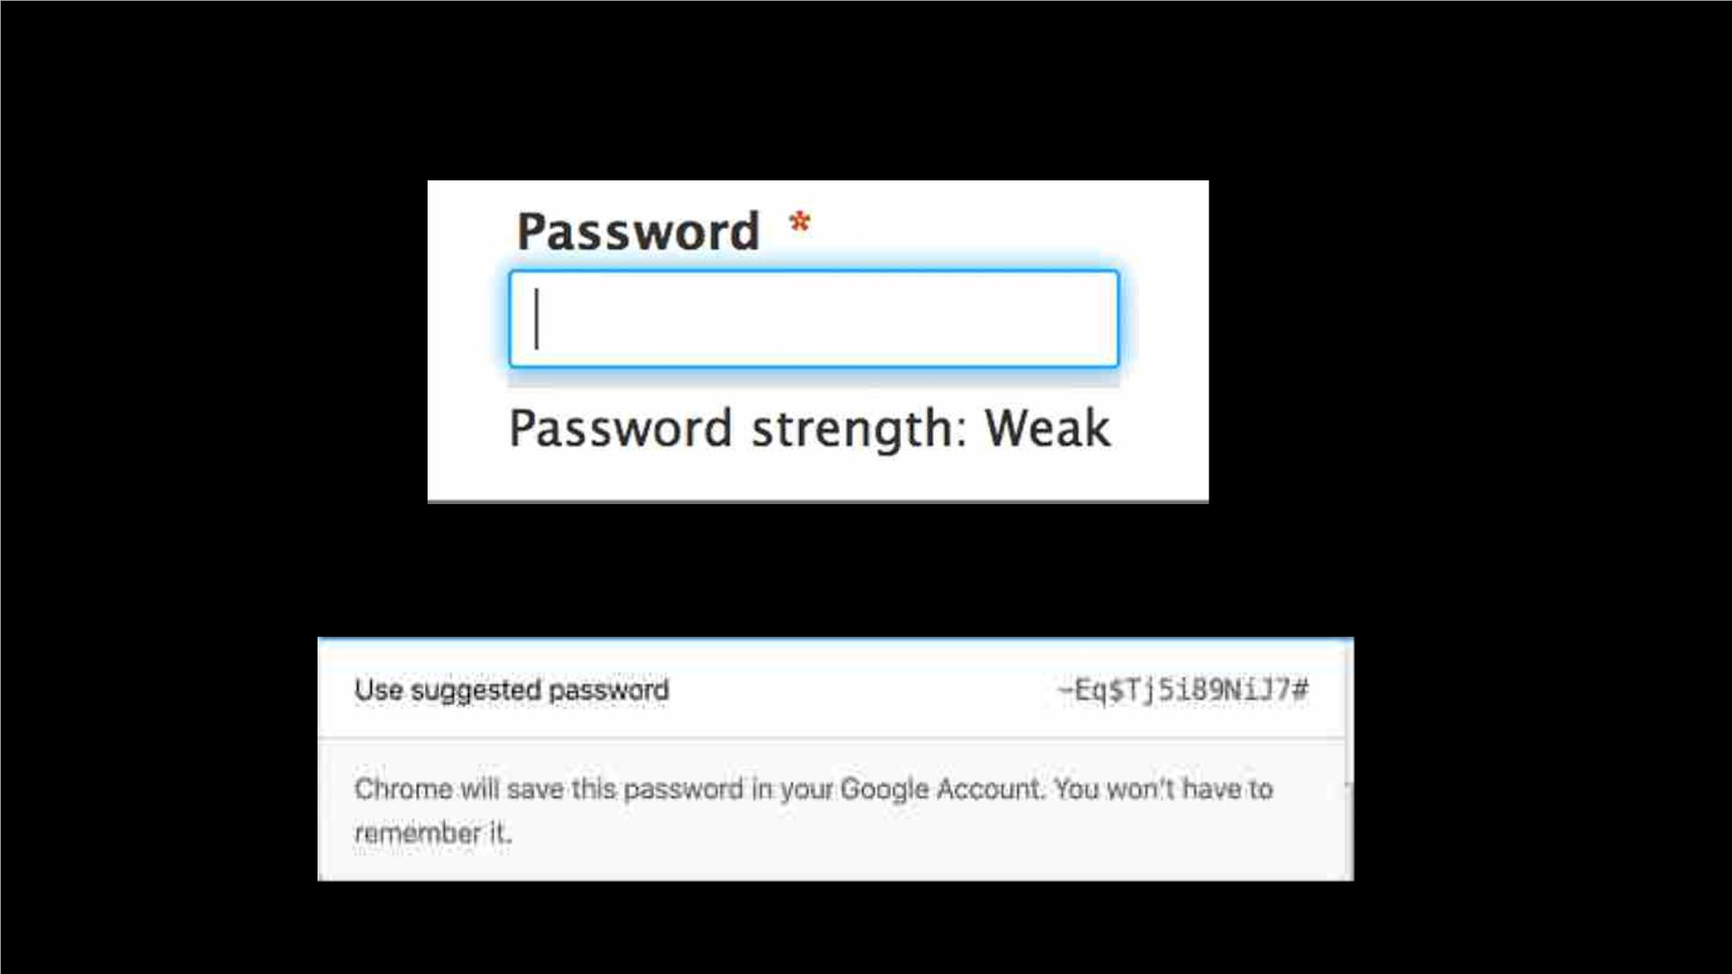
Why is Password Strength important?
MoreꢀImportantly,ꢀwhyꢀgoꢀgoogleꢀsuggestedꢀpasswordsꢀlookꢀlikeꢀ
this?

Slide 21
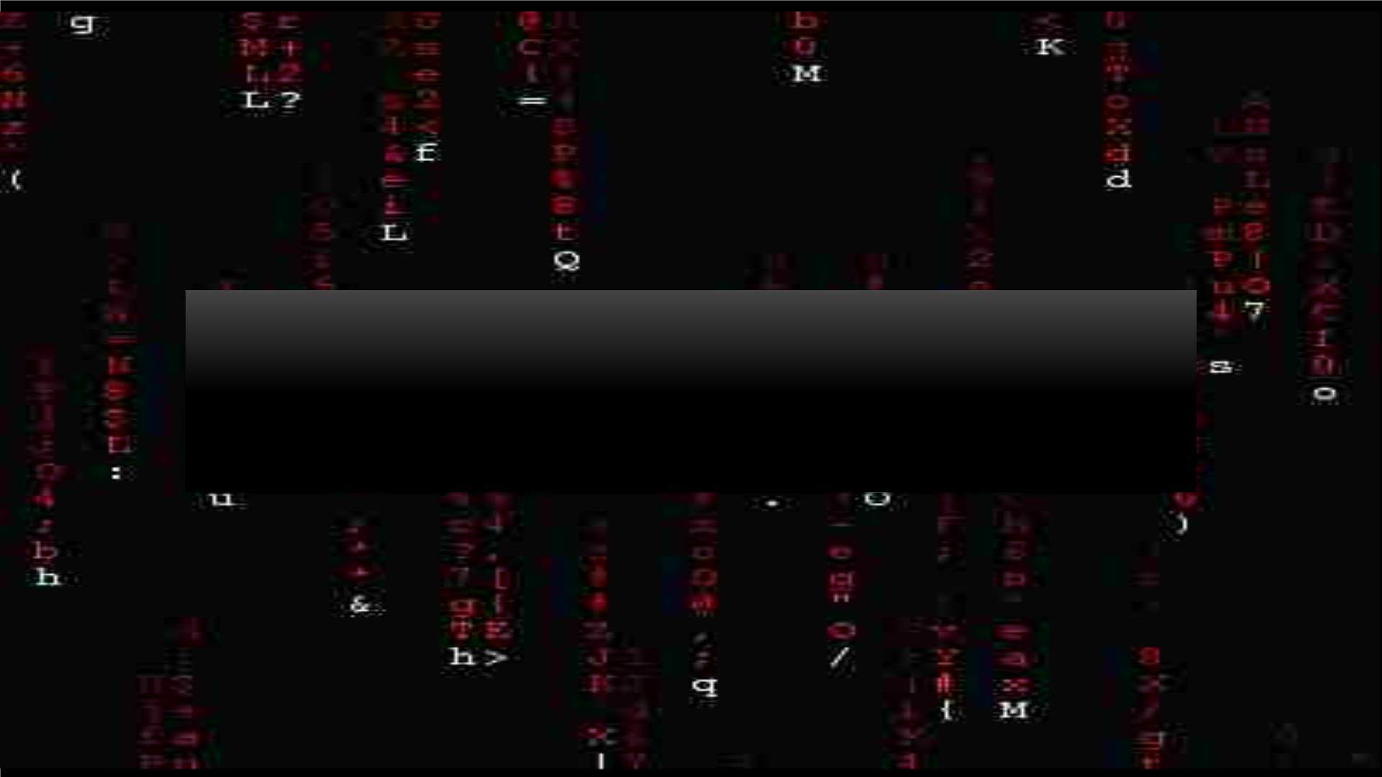
Let'sꢀsayꢀweꢀhaveꢀaꢀpasswordꢀofꢀlengthꢀ4ꢀwithꢀonlyꢀ
digitsꢀ0-9.ꢀ
Aꢀhackerꢀcanꢀgenerateꢀ10000ꢀpasswordsꢀinꢀ1ꢀ
minute.ꢀ

Slide 22
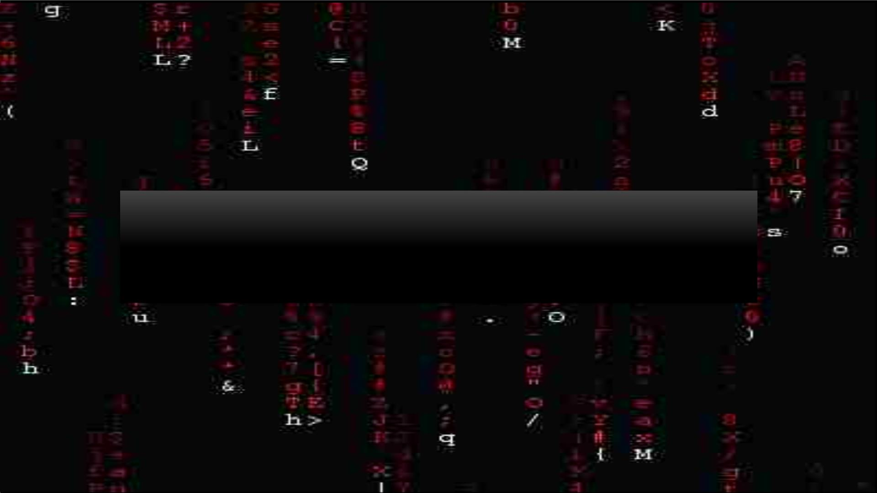
Forꢀaꢀlongerꢀpassword,ꢀsayꢀlengthꢀ10,ꢀthereꢀwouldꢀbeꢀ
10¹⁰ꢀpossibleꢀpasswords.
Itꢀwouldꢀtakeꢀhimꢀ10⁶ꢀminutesꢀ(nearlyꢀ1.9ꢀyears!)

Slide 23
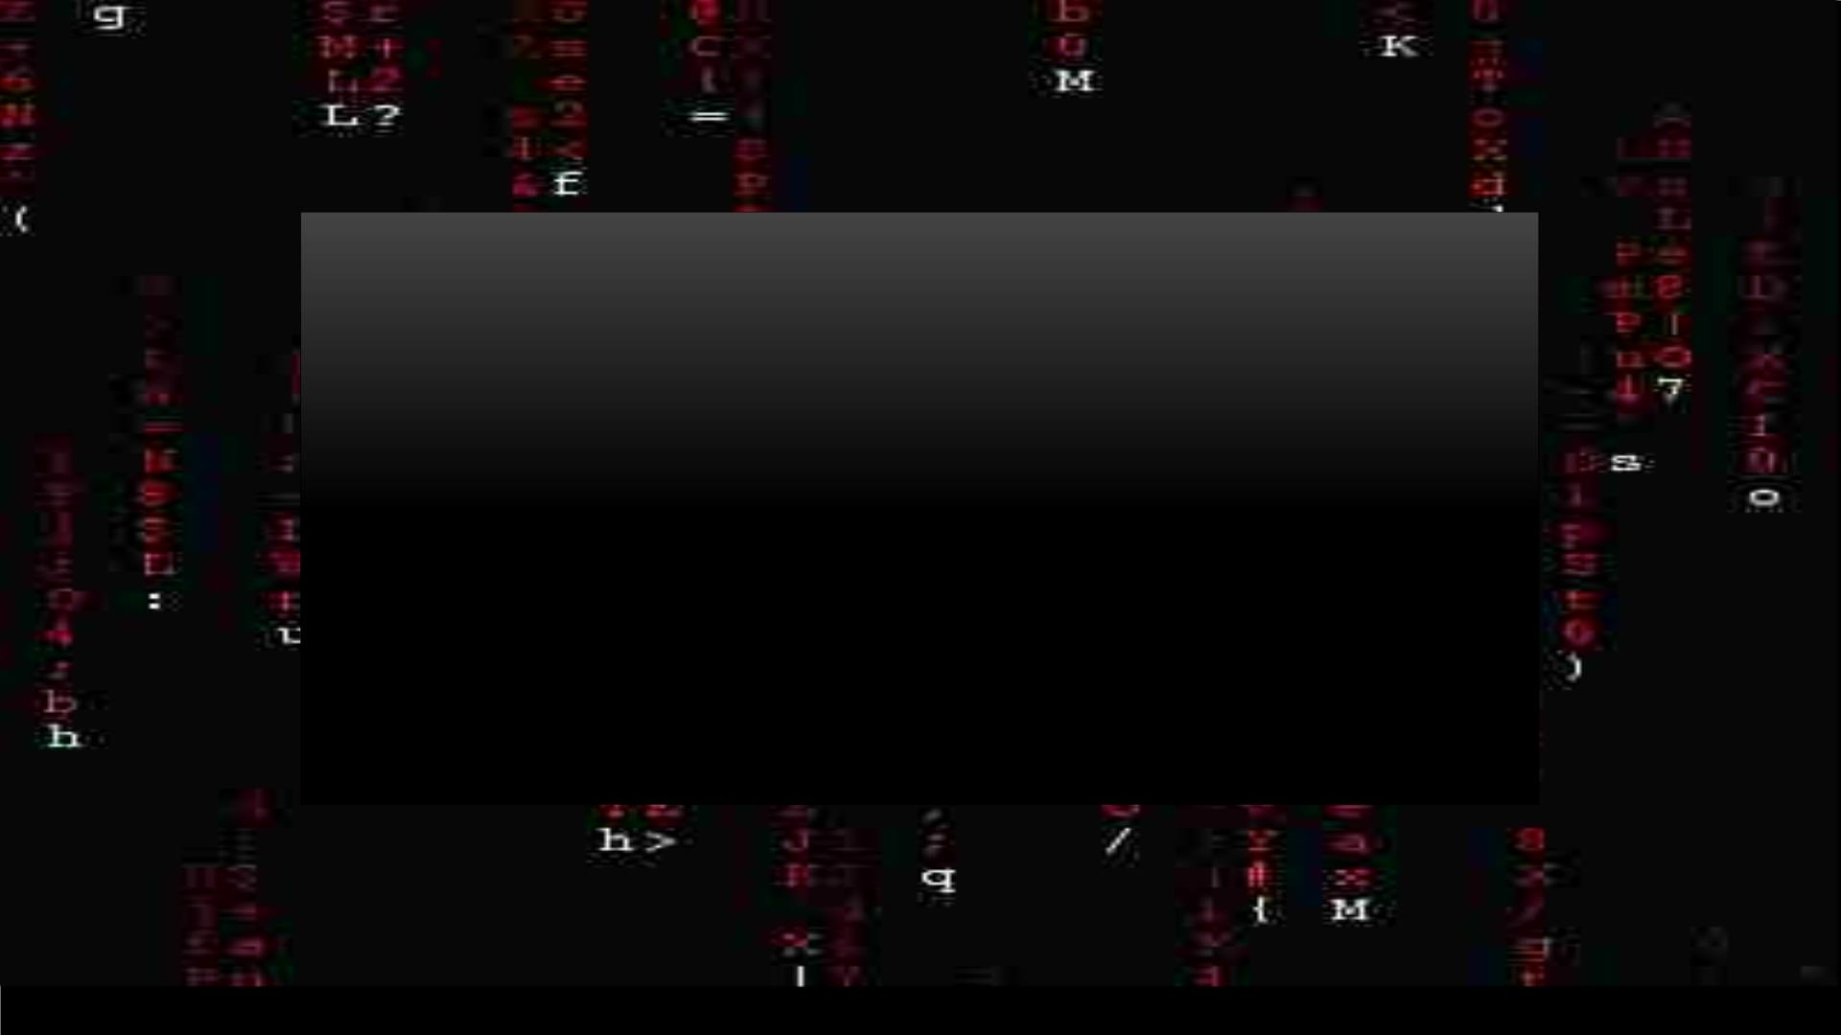
• If you had Uppercase,ꢀLowercaseꢀand digits, it would take him even
longer to hack into the system.ꢀ
• - 26 lowercase characters
• - 26 uppercase characters
• - 10 digits
• Total – 10 + 26 + 26 = 62 possible answers for one character of the
password.
For a password of say length 12ꢀ
-ꢀ 62¹²ꢀpossible passwords!

Slide 24
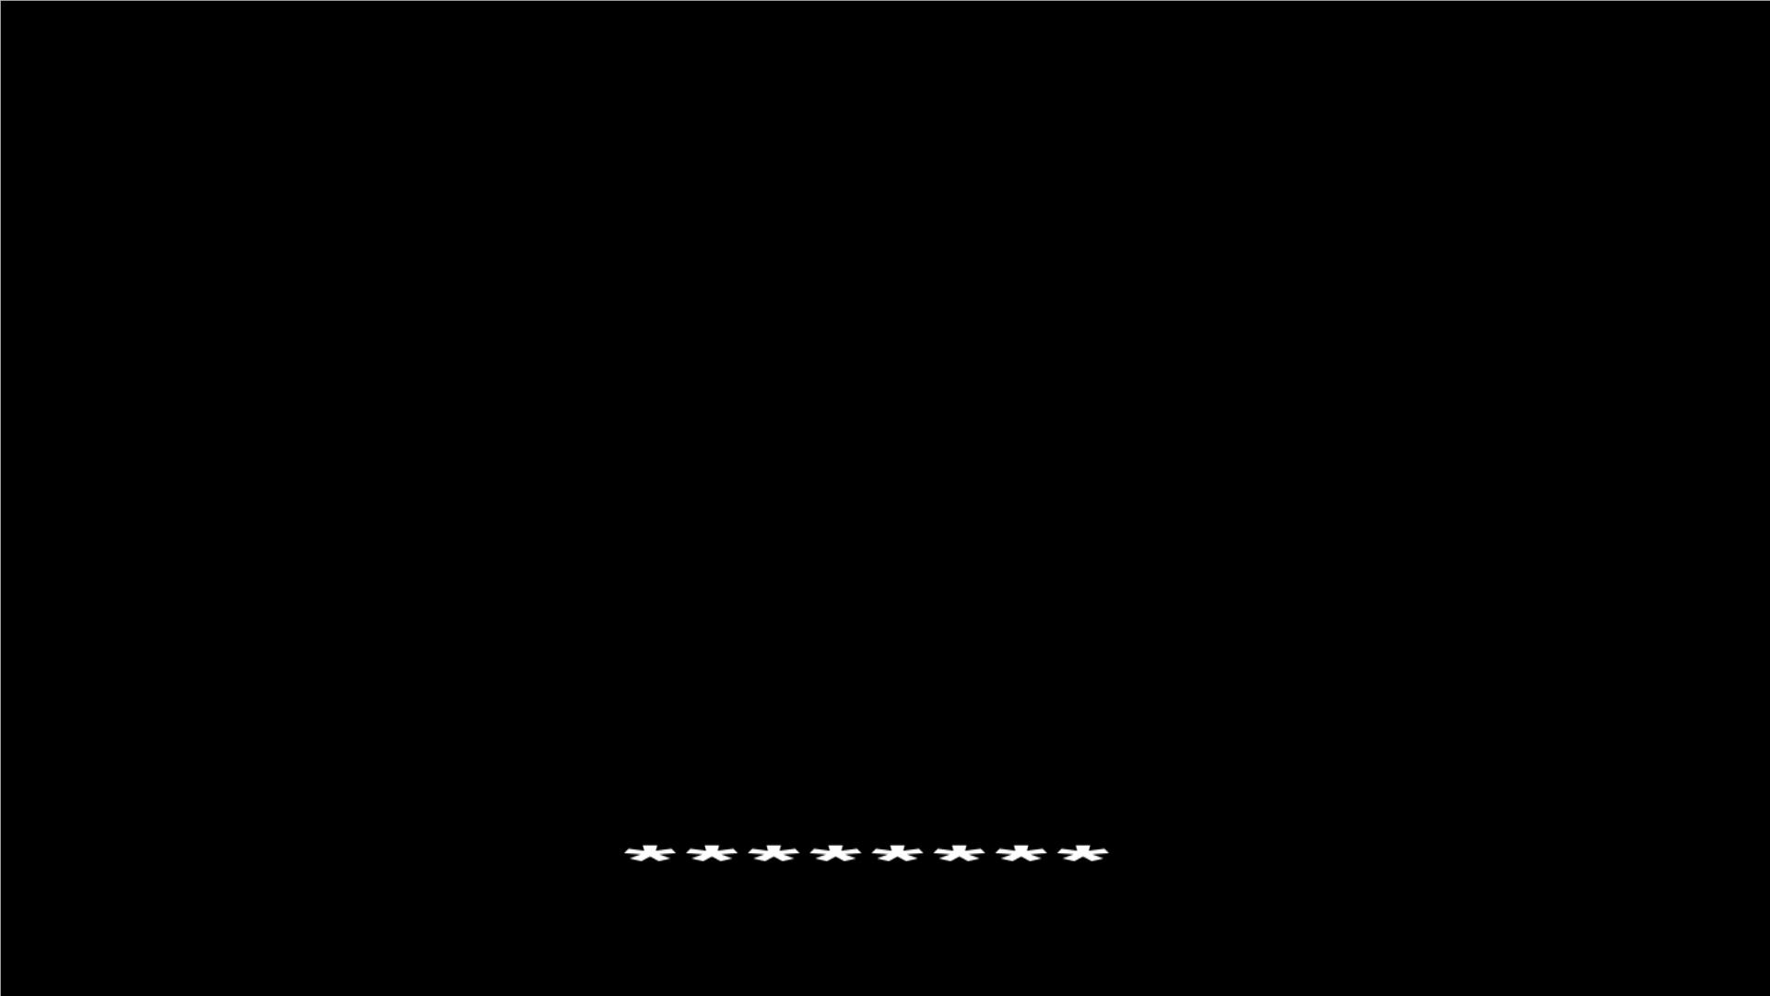
Time To CODE!!!
Task – Beware! The hackers are trying to get into your SNAPCHAT
account!!! We must prevent this!ꢀ
Write a program to check if the password generated is valid!ꢀ
Checking criteria for password :ꢀ
• Atleast 1 uppercase character
• Atleast 1 lowercase character
• Atleast 1 digit 0-9
• Atleast 1 special character
• Atleast length of size 8

Slide 25
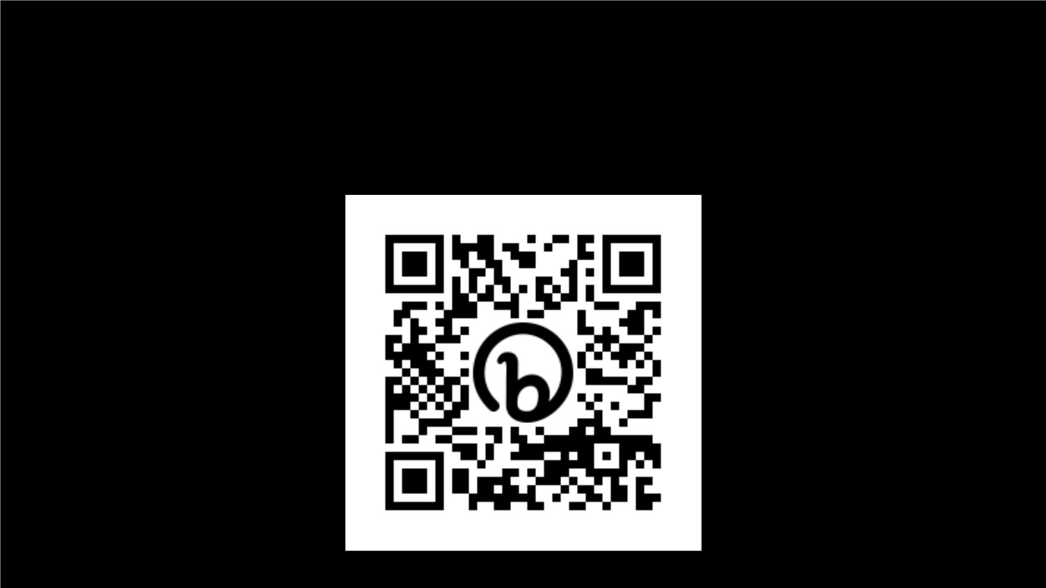
https://bit.ly/3AVrYGg

Slide 26

Hall of Fame

Slide 27
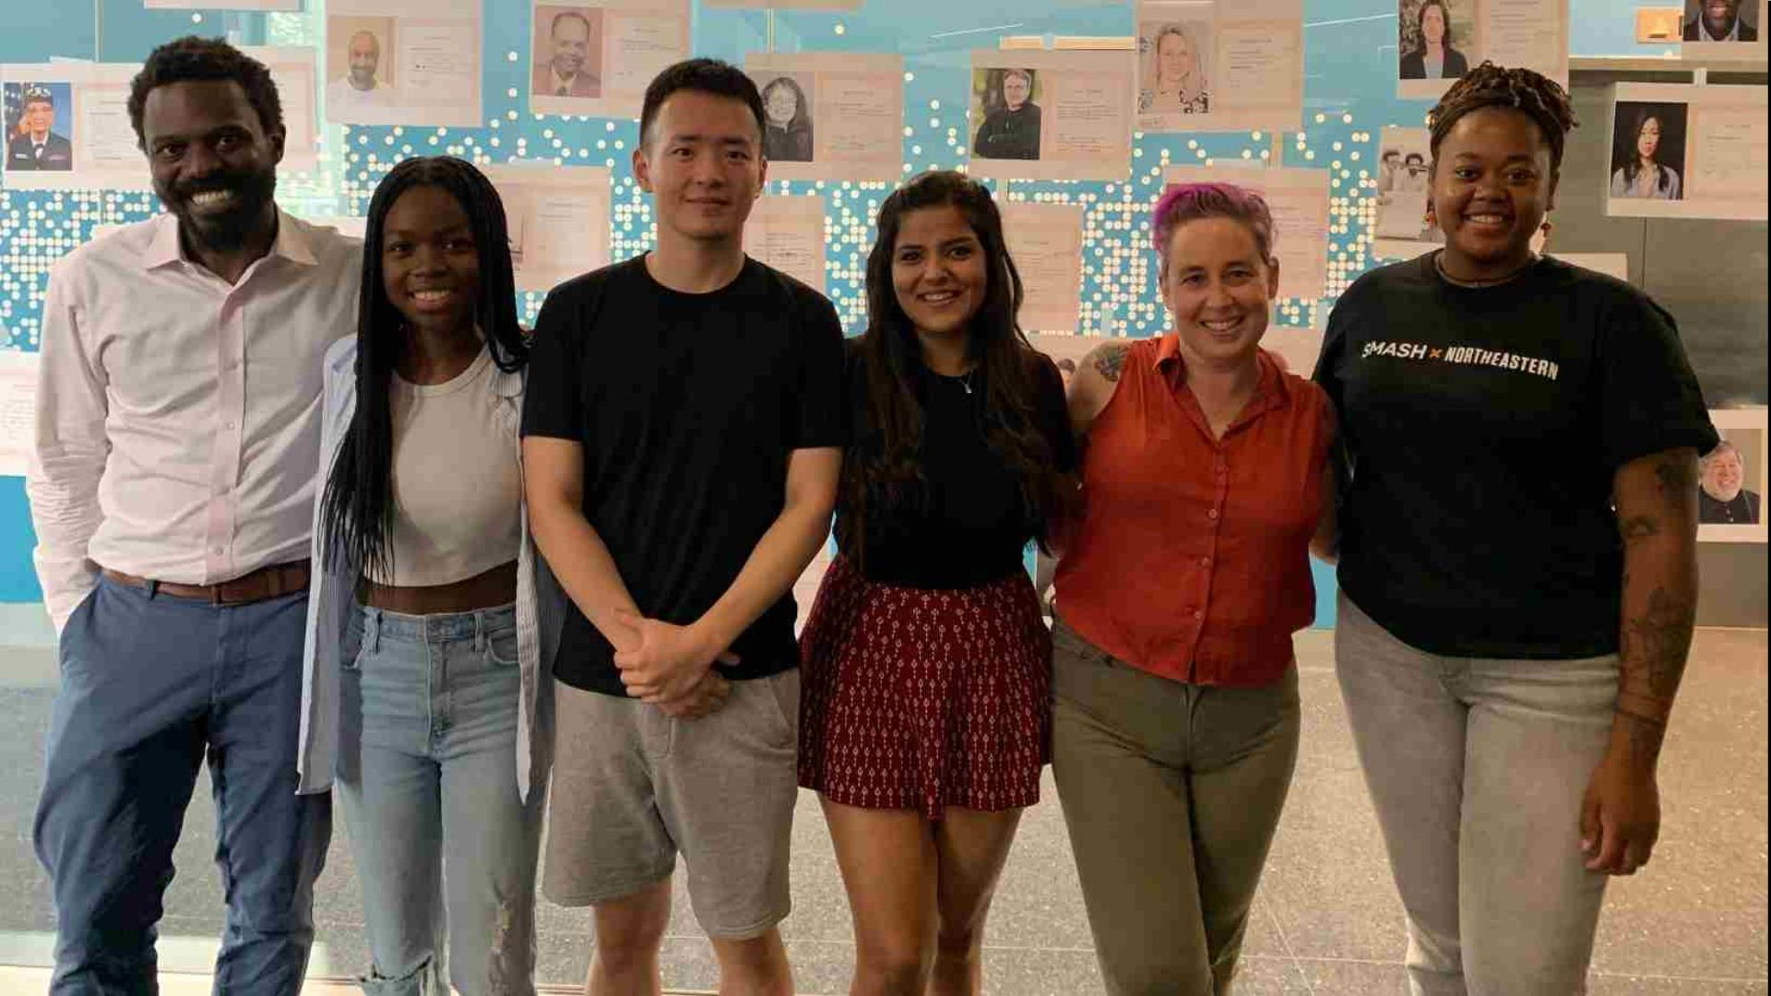
Goodbye, team!

