Slide 1

JPEG-Style Grayscale Image Compression Acceleration
8x8 DCT + Quantisation + Zigzag Scan + Zero RLE on the Kria KV260
Scope: Simplified JPEG-style block compression, not a full .jpg file encoder

Slide 2
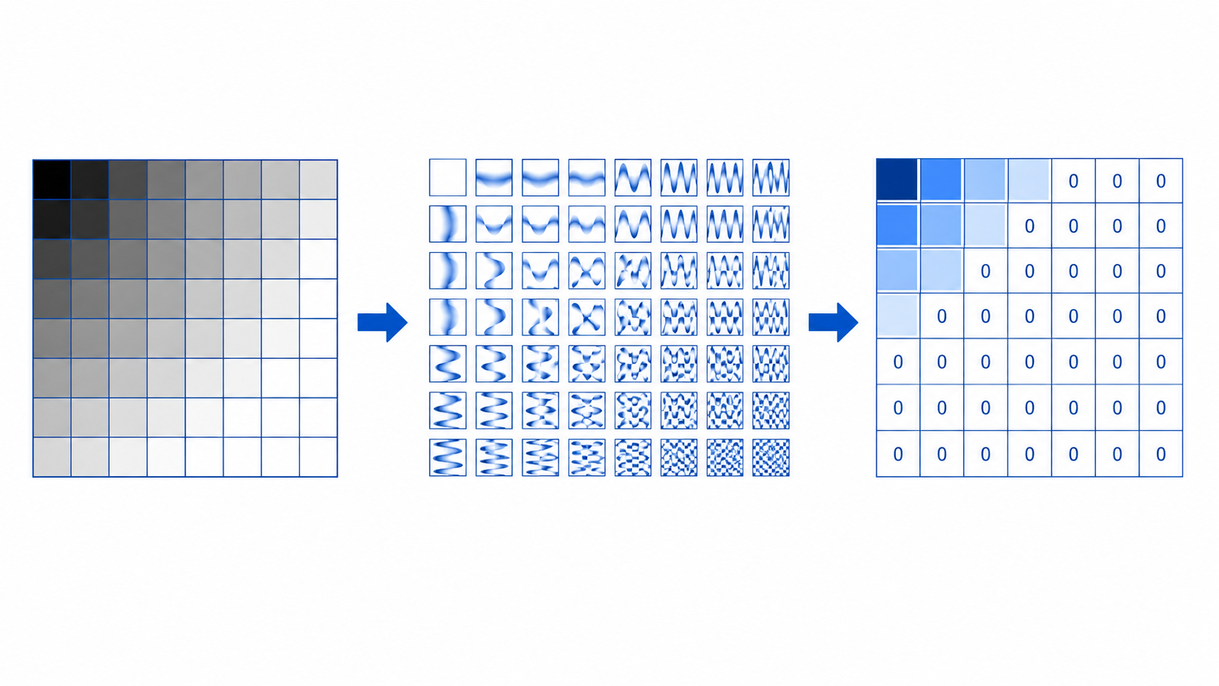
Problem outline
Why image compression is a suitable compute-acceleration task for COMP4601
The software bottleneck
The hardware opportunity
JPEG-style compression repeatedly applies an 8x8 transform to every block of the image. The direct DCT contains many multiply-add operations, making it slow on a sequential CPU baseline.
Each 8x8 block is independent, fixed-size, and processed with the same arithmetic pattern. This is well matched to FPGA pipelines, local buffers, loop unrolling, and array partitioning.
The project constraint
We avoid full JPEG file-format complexity. The project focuses on the core compression-side kernel: DCT, quantisation, zigzag ordering, and zero run-length encoding.
Key design decision:
Use: Grayscale PGM/raw images first.
Avoid: RGB, YCbCr, chroma subsampling, Huffman coding, and JPEG headers.
Expected output of the project
A working KV260 accelerator with CPU baseline, FPGA kernel timing, end-to-end timing, compression ratio, PSNR/MSE quality metrics, resource usage, and risk-aware discussion of transfer overhead.

Slide 3
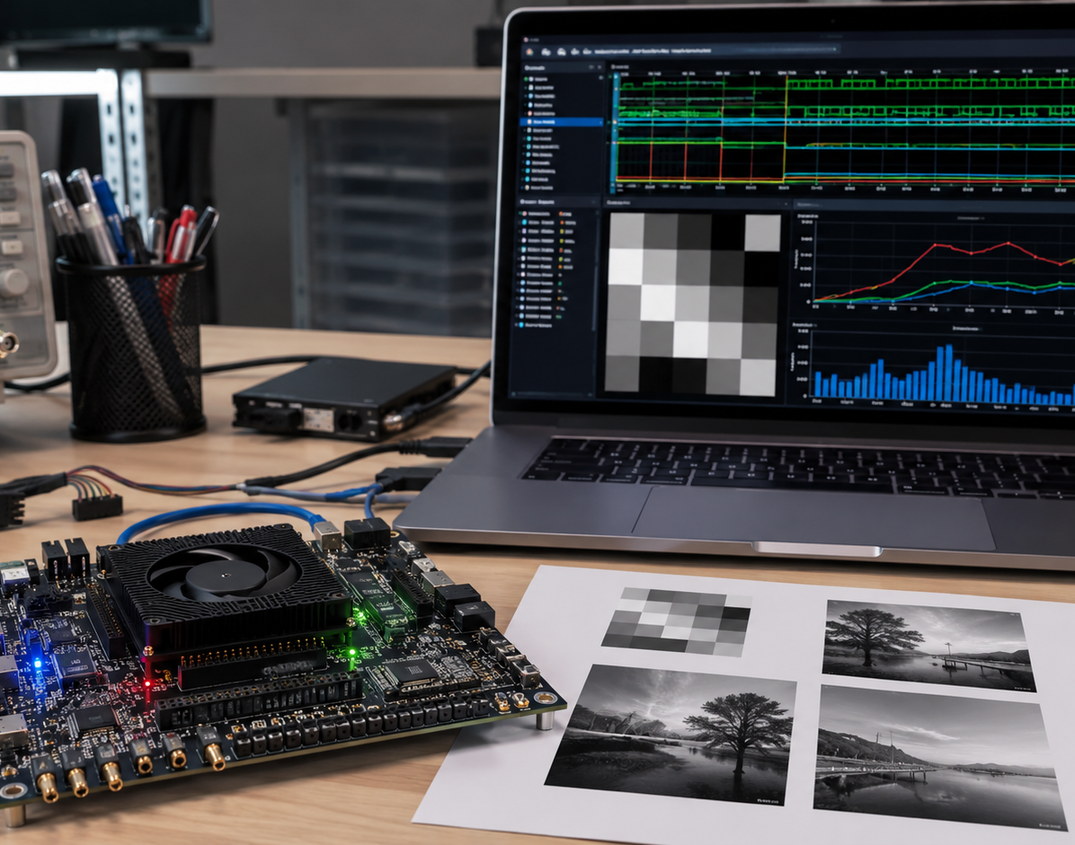
Project-specific aims
A realistic target is a complete compression-side accelerator plus software verification
Functional
CPU baseline and FPGA kernel produce compatible quantised/RLE output.
Performance
Measure kernel-only and end-to-end runtimes on the KV260.
Compression
Use RLE pair counts to calculate actual compressed size.
Quality
Use inverse path in software to calculate MSE and PSNR.
Engineering
Show HLS resources: LUT, FF, BRAM, DSP, latency and II.
Primary target: 10x-30x kernel speedup over a naive CPU baseline, with 3x-10x end-to-end if transfer overhead is controlled.

Slide 4
Algorithm to be accelerated
Compression-side pipeline with stage function and hardware opportunity
Load
PGM/raw
8x8
blocks
Level
shift
2D DCT
Quantise
Zigzag
Zero RLE
Compressed
blocks
FPGA accelerated compression kernel
Image blocking
Level shift + DCT
Quantise + reorder
RLE + verification
CPU loads fixed grayscale PGM/raw data; FPGA reads 8x8 tiles into local buffers. Acceleration opportunity: regular burst reads and block-level pipelining.
Subtract 128, then perform separable DCT: 1D DCT across rows followed by columns. Main acceleration point: pipelined MACs, loop unrolling, precomputed constants, array partitioning.
Divide each DCT coefficient by an 8x8 quantisation matrix; zigzag uses a fixed lookup order to place low frequencies first and high frequencies last. Acceleration: 64 independent coefficient operations.
RLE stores zero-run counts and non-zero AC values using fixed 63-pair slots per block. CPU decodes and reconstructs image to calculate PSNR/MSE.

Slide 5
Stage function and acceleration points
How each pipeline stage works, and whether it should run in FPGA
Stage
How it works
Where acceleration is possible
8x8 blocks
Split fixed grayscale image into independent 64-pixel tiles. Each block is processed the same way.
Parallel/block pipeline friendly; local buffers reduce repeated DDR access.
Level shift
Convert unsigned pixels to signed values: pixel - 128, centering the block around zero.
Simple per-pixel operation; pipeline with block loading at II close to 1.
DCT
Convert spatial pixels into 64 frequency coefficients; DC = average brightness, AC = detail.
Main hotspot: use separable row/column DCT, fixed point, unrolled MACs, partitioned arrays.
Quantisation
Divide coefficients by Q matrix; high-frequency values use larger Q and become zeros.
64 coefficient operations can be pipelined/partially unrolled; use constants/reciprocals.
Zigzag scan
Read coefficients in low-to-high frequency order so zeros collect near the end of the list.
Fixed lookup table; low compute cost but can stay inside FPGA to avoid extra CPU pass.
Zero RLE
Store DC plus pairs (zero_run, value) for non-zero AC coefficients; num_pairs marks valid output.
Variable output managed by fixed 63-pair slots; accelerate counting/writing while compression size uses num_pairs.
Priority order for hardware: DCT first, quantisation second, zigzag/RLE third. This keeps a working fallback if integration time is limited.

Slide 6
Acceleration model and expected performance
The best speedup comes from accelerating repeated arithmetic, not file-format handling
Slowest baseline
Naive C++ direct 2D DCT + quantisation + zigzag + RLE on CPU. Useful as the slowest valid reference.
Acceleration potential by stage
DCT
Very high
Core compute bottleneck; parallel MAC pipelines
Quantise
Medium
64 independent coefficient divisions/scales
Fair baseline
Optimised CPU separable DCT with precomputed constants. This prevents inflated speedup claims.
Zigzag
Low
Fixed index reorder; useful to keep on FPGA
RLE
Medium / risk
Zero counting is simple; variable output needs fixed slots
FPGA target
Fixed-point separable DCT, pipelined loops, unrolled 8-point MACs, partitioned local arrays, FPGA zigzag/RLE if stable.
Transfers
Risk
Measure kernel-only and end-to-end separately
Expected speedup range
20x-100x vs naive
5x-30x vs fair CPU
2x-15x end-to-end
Target: 3x-10x overall

Slide 7
Investigation so far and project plan
Four-week implementation path from CPU reference to KV260 measurements
Week 5
Week 6
Week 7
Week 8
Software reference
HLS kernel
KV260 integration
Optimisation + report
PGM/raw image loader
CPU DCT + quant + zigzag + RLE
Decompression + PSNR/MSE
C simulation and testbench
DCT + quant first, then zigzag/RLE
Inspect latency, II and resources
Build xclbin and host app
AXI buffer transfer
Run on board and verify output
Pipeline, unroll, partition, fixed point
Collect speedup, compression and energy
Prepare demo, slides and report
Investigation completed / decisions made
Planned evidence
Use grayscale images to avoid RGB and colour-space complexity.
Use simplified JPEG-style pipeline rather than full JPEG bitstream.
Profile each stage separately so we can show where acceleration helps most.
Use fixed maximum RLE output per block to avoid dynamic memory in HLS.
CPU vs FPGA runtime table for DCT, quantisation, zigzag/RLE and full kernel.
Compression ratio vs PSNR for multiple quantisation scales.
Resource usage, data-transfer overhead and stage-level acceleration discussion.

Slide 8
Risks, contingencies and team roles
Keep the scope tight: DCT + quantisation first, then zigzag, then RLE
RLE variable output
Use fixed 63-pair slots per block and store num_pairs; report actual compressed size separately from allocated buffer.
Proposed team roles
DCT numerical mismatch
Start with CPU float reference, then fixed-point HLS. Use tolerances and PSNR rather than exact coefficient equality.
Abhishek Poddar
z5581147
Software baseline, image I/O, inverse path, PSNR/MSE
Sakina Huzaifa
z5400462
HLS DCT + quantisation kernel and fixed-point design
Transfer overhead hides speedup
Measure kernel-only and end-to-end times; test larger images such as 512x512 or 1024x1024 if stable.
Krishna Mittal
z5625451
Zigzag/RLE format, compression ratio, test vectors
Schedule risk
Minimum fallback: FPGA accelerates DCT + quantisation; zigzag/RLE can run in software if integration time is tight.
Shriya Malik
z5619441
KV260 integration, host code, timing, resource/energy results
Final deliverable: a working FPGA-assisted compressor with measured speedup, quality loss, compression ratio, resources, and a clear explanation of limitations.

