Slide 1

JPEG-Style Grayscale Image Compression Acceleration
8x8 DCT + Quantisation + Zigzag Scan + Zero RLE on the Kria KV260
Scope: Simplified JPEG-style block compression, not a full .jpg file encoder

Slide 2
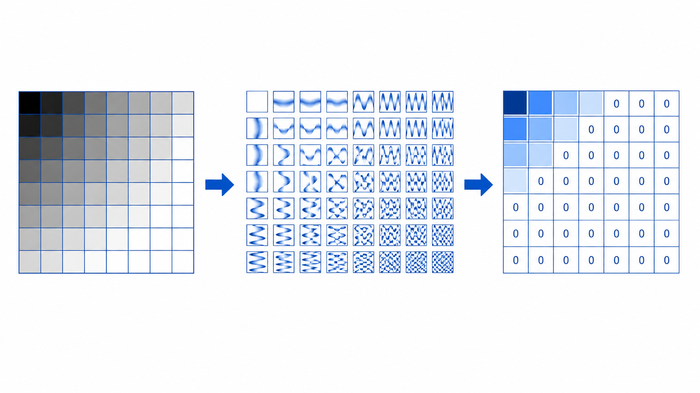
Problem outline
Why image compression is a suitable compute-acceleration task for COMP4601
The software bottleneck
The hardware opportunity
JPEG-style compression repeatedly applies an 8x8 transform to every block of the image. The direct DCT contains many multiply-add operations, making it slow on a sequential CPU baseline.
Each 8x8 block is independent, fixed-size, and processed with the same arithmetic pattern. This is well matched to FPGA pipelines, local buffers, loop unrolling, and array partitioning.
The project constraint
We avoid full JPEG file-format complexity. The project focuses on the core compression-side kernel: DCT, quantisation, zigzag ordering, and zero run-length encoding.
Key design decision:
Use: Grayscale PGM/raw images first.
Avoid: RGB, YCbCr, chroma subsampling, Huffman coding, and JPEG headers.
Expected output of the project
A working KV260 accelerator with CPU baseline, FPGA kernel timing, end-to-end timing, compression ratio, PSNR/MSE quality metrics, resource usage, and risk-aware discussion of transfer overhead.

Slide 3
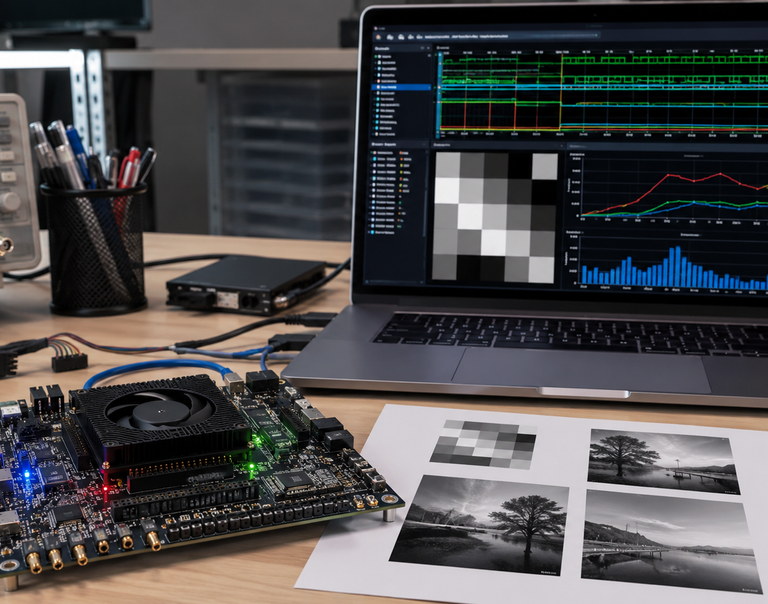
Project-specific aims
A realistic target is a complete compression-side accelerator plus software verification
Functional
CPU baseline and FPGA kernel produce compatible quantised/RLE output.
Performance
Measure kernel-only and end-to-end runtimes on the KV260.
Compression
Use RLE pair counts to calculate actual compressed size.
Quality
Use inverse path in software to calculate MSE and PSNR.
Engineering
Show HLS resources: LUT, FF, BRAM, DSP, latency and II.
Primary target: 10x-30x kernel speedup over a naive CPU baseline, with 3x-10x end-to-end if transfer overhead is controlled.

Slide 4
Algorithm to be accelerated
Compression side runs on FPGA; decompression remains in software for verification
Load
PGM/raw
8x8
blocks
Level
shift
2D DCT
Quantise
Zigzag
Zero RLE
Compressed
blocks
FPGA accelerated compression kernel
Input representation
Core transform
Compression mechanism
Verification path
Use fixed-size grayscale arrays, e.g. 256x256 or 512x512. Each pixel is 8-bit and all blocks are independent.
A separable DCT applies 1D DCT across rows, then columns. This replaces the direct 2D formula with a more efficient structure.
Quantisation creates zeros, zigzag groups them toward the end, and RLE stores zero runs plus non-zero coefficients.
Software decodes RLE, inverse-zigzags, inverse-quantises, applies IDCT, reconstructs pixels, and measures PSNR/MSE.

Slide 5
How the compression works
The pipeline turns spatial pixels into a sparse coefficient stream
Zigzag scan order
Low frequency first, high frequency last - this pushes long zero runs toward the end of the 64-value list.
0 1 5 6 14 15 27 28
2 4 7 13 16 26 29 42
3 8 12 17 25 30 41 43
9 11 18 24 31 40 44 53
10 19 23 32 39 45 52 54
20 22 33 38 46 51 55 60
21 34 37 47 50 56 59 61
35 36 48 49 57 58 62 63
DC = 52
(0, -4)
(0, 3)
(3, 5)
(2, -2)
EOB / num_pairs
1
DCT: pixels to frequencies
The 8x8 block is converted into 64 frequency coefficients. The top-left DC coefficient holds average brightness; later AC coefficients represent increasing detail.
2
Quantisation: controlled loss
Compressed block format: DC coefficient + number of RLE pairs + repeated (zero_run, value) pairs. Fixed max 63 pairs per block keeps HLS output simple.
Each coefficient is divided by an 8x8 quantisation matrix. High-frequency coefficients use larger values, so many become zero.

Slide 6
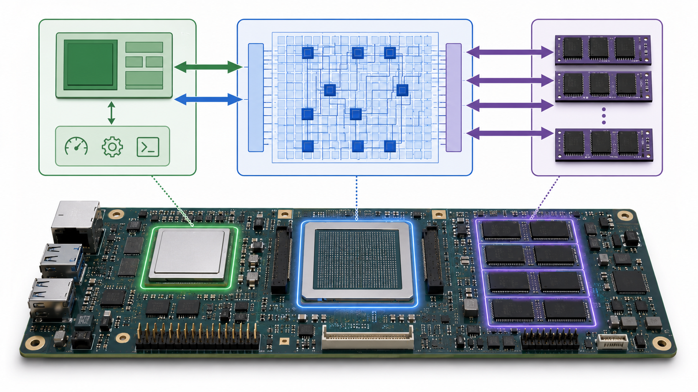
Acceleration model and expected performance
Measure both kernel-only speedup and end-to-end speedup including memory transfers
Expected acceleration range
vs naive CPU
20x-100x
vs optimised CPU
5x-30x
end-to-end
2x-15x
Software baseline
Most accelerated design
Naive C++ CPU direct 2D DCT + quantisation + zigzag + RLE. This is the slowest valid baseline. Also compare against a fair separable-DCT CPU version.
FPGA fixed-point separable DCT with precomputed constants, pipelining, loop unrolling, local array partitioning, and optional dataflow across stages.
A conservative project target is 10x-30x kernel speedup and 3x-10x overall speedup after transfer overhead.

Slide 7
Investigation so far and project plan
Four-week implementation path from CPU reference to KV260 measurements
Week 5
Week 6
Week 7
Week 8
Software reference
HLS kernel
KV260 integration
Optimisation + report
PGM/raw image loader
CPU DCT + quant + zigzag + RLE
Decompression + PSNR/MSE
C simulation and testbench
DCT + quant first, then zigzag/RLE
Inspect latency, II and resources
Build xclbin and host app
AXI buffer transfer
Run on board and verify output
Pipeline, unroll, partition, fixed point
Collect speedup, compression and energy
Prepare demo, slides and report
Investigation completed / decisions made
Planned evidence
Use grayscale images to avoid RGB and colour-space complexity.
Use simplified JPEG-style pipeline rather than full JPEG bitstream.
Use fixed maximum RLE output per block to avoid dynamic memory in HLS.
CPU vs FPGA runtime table for 256x256 and 512x512 images.
Compression ratio vs PSNR for multiple quantisation scales.
Resource usage and transfer-overhead discussion.

Slide 8
Risks, contingencies and team roles
Keep the scope tight: DCT + quantisation first, then zigzag, then RLE
RLE variable output
Use fixed 63-pair slots per block and store num_pairs; report actual compressed size separately from allocated buffer.
Proposed team roles
DCT numerical mismatch
Start with CPU float reference, then fixed-point HLS. Use tolerances and PSNR rather than exact coefficient equality.
Member 1
zid
Software baseline, image I/O, inverse path, PSNR/MSE
Member 2
zid
HLS DCT + quantisation kernel and fixed-point design
Transfer overhead hides speedup
Measure kernel-only and end-to-end times; test larger images such as 512x512 or 1024x1024 if stable.
Member 3
zid
Zigzag/RLE format, compression ratio, test vectors
Schedule risk
Minimum fallback: FPGA accelerates DCT + quantisation; zigzag/RLE can run in software if integration time is tight.
Member 4
Zid
KV260 integration, host code, timing, resource/energy results
Final deliverable: a working FPGA-assisted compressor with measured speedup, quality loss, compression ratio, resources, and a clear explanation of limitations.

