Slide 1
PLAGIARISM BASED ASSIGNMENT MANAGEMENT SYSTEM

Slide 2
WHAT IS PLAGIARISM
In the 1st century, the use of the Latin word plagiarius (literally kidnapper) to denote stealing someone else's work was pioneered by Roman poet Martial, who complained that another poet had "kidnapped his verses." "Plagiary", a derivative of "plagiarus" was introduced into English in 1601 by dramatist Ben Jonson to describe someone guilty of literary theft.
The derived form plagiarism was introduced into English around 1620.The Latin plagiārius, "kidnapper", and plagium, "kidnapping", has the root plaga ("snare", "net"), based on the Indo-European root *-plak, "to weave" (seen for instance in Greek plekein, Bulgarian "плета" pleta, Latin plectere, all meaning "to weave").

Slide 3
INTRODUCTION
The educational community across the world is facing the increasing problem of plagiarism.
This widespread problem has motivated the need of an efficient, robust and fast detection procedure.
This system automatically checks for plagiarism in the assignments.
This system also calculates the extent to which the plagiarism exists.

Slide 4
DESCRIPTION OF PROJECT
This comparator can be used to detect plagiarism and mark programs for assignments.
To achieve the aim, the project has defined a number of objectives as follows:
To design a program-comparing algorithm and develop a program comparator.
To implement the comparator as a plagiarism detection tool.
To implement the comparator as an automatic marking tool.
To evaluate the comparator. An online assignment management system including plagiarism detection and automatic marking is developed.

Slide 5
ACTIVITIES
To design a program-comparing algorithm and develop a program comparator.
To implement the comparator as a plagiarism detection tool.
To implement the comparator as an automatic marking tool.
To evaluate the comparator. An online assignment management system including plagiarism detection and automatic marking is developed.

Slide 6
REFERENCES
Google
Java Tutorials
Wikipedia
StackOverflow

Slide 7
TECHNOLOGIES USED
JAVA EE: Java Enterprise Edition is a programming platform— part of the Java Platform-for developing and running distributed multi-tier architecture Java applications, based largely on modular software components running on an application server.
Tools & Development Environment :
Apache Tomcat 6.0.18 Server: Apache Tomcat is a Servlet container developed by the Apache Software Foundation (ASF). Tomcat implements the Java Servlet and the JavaServer Pages (JSP) specifications from Sun Microsystems, and provides a "pure Java" HTTP web server environment for Java code to run.
ECLIPSE J2EE: Eclipse is a toolkit which is designed for the creation of complex projects, providing fully dynamic web application utilizing EJB’s. This consist of EJB tools , CMP ,data mapping tools & a universal test client that is designed to aid testing of EJB’s.
CMD: For command Line deployment.
Sublime Text Editor : Text editing purpose.
Wampserver:
Sefrvlets:

Slide 8
THE ARCHITECTURE
Two basic elements :
Analyzer
Comparator
Analyzer – lexical and syntactical analysis of the code Language specific Produce the syntax tree and stores it into the database Based on ANTRL. A 1-gram approach
Comparator – compare elements Can be used to compare code, trees, fingerprints . Here text snippets.

Slide 9
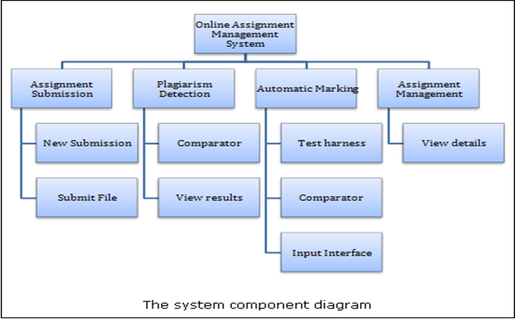
ARCHITECTURE DIAGRAM

Slide 10
SOFTWARE SYSTEM ATTRIBUTES
Since, there are a number of attributes of software that can serve as requirements; the following items provide a partial list. These are also known as non-functional requirements or quality attributes.
These are characteristics the system must possess, but that might pervade through the design.

Slide 11
1. Availability
The system should be available at all times, meaning the user can access it using a web browser, only restricted by the down time of the server on which the system runs. In case of a of a hardware failure or database corruption, a replacement page will be shown. Also in case of a hardware failure or database corruption, backups of the database should be retrieved from the server and saved by the administrator. Then the service will be restarted.

Slide 12
2. Reliability
The reliability of the overall program depends on the reliability of the separate components. The main pillar of reliability of the system is the backup of the database which is continuously maintained and updated to reflect the most recent changes. Also the system will be functioning inside a container (since the implementation is J2EE oriented). Thus the overall stability of the system depends on the stability of container and its underlying operating system

Slide 13
3. Security
Passwords will be saved encrypted in the database in order to ensure the user's privacy.
The user's IP will be logged.
Sensitive data will be encrypted before being sent over insecure connections like the internet.
Certain functions will be assigned to certain modules only.
Data integrity will be checked for critical variables.

Slide 14
4. Maintainance
A commercial database is used for maintaining the database and the application server takes care of the site. In case of a failure, a re-initialization of the program will be done. Also the software design is being done with modularity in mind so that maintainability can be done efficiently.

Slide 15
5. Portability
The application is J2EE based and should be compatible with all other systems which have a native Java implementation. The end-user part is fully portable and any system using any web browser should be able to use the features of the application, including any hardware platform that is available or will be available in the future.

Slide 16
ACTION SEQUENCES
To implement the comparator as a plagiarism detection tool.
To implement the comparator as an automatic marking tool.
To design a program-comparing algorithm and develop a program comparator.
To evaluate the comparator. An online assignment management system including plagiarism detection and automatic marking is developed

Slide 17
CONTEXT LEVEL DFD
STUDENT
PLAGIARISM DETCTOR
ASSIGNMENT DATABASE
UPLOAD
PLAGIARISM NOT
FOUND
PLAGIARISM
FOUND

Slide 18
LEVEL 0 DFD
PROGRAM
COMPARATOR
UPLOAD
EXTRACTION
STUDENT
ASSIGNMENT
DATABASE
COMPARISON
BEING
DONE
ANALYSER
AND
DISPLAY
PLAGIARISM FOUND
PLAGIARISM NOT
FOUND

Slide 19
USER INTERFACE DESIGN
Every user interface- whether it is designed for a WebApp, or a traditional software application- should exhibit the following characteristics:
Easy to use.
Easy to learn.
Easy to navigate.
Intuitive.
Consistent.
Efficient.
Error-free.

Slide 20
APPLICATION TESTING
Application (App) testing is a collection of related activities with a single goal: to uncover errors in app content, function, usability, navigability, performance, capacity, and security. To accomplish this, a testing strategy that encompasses both reviews and executable testing is applied throughout the software engineering process. If end users encounter errors that shake their faith in the App, they will go elsewhere for the content and function they need, and the App will fail. For this reason as many errors as possible must be eliminated before the App goes to client users.

Slide 21
Submitted By
Kajal Gupta
Pranjal Verma
Paras Chachondhia

