Slide 1
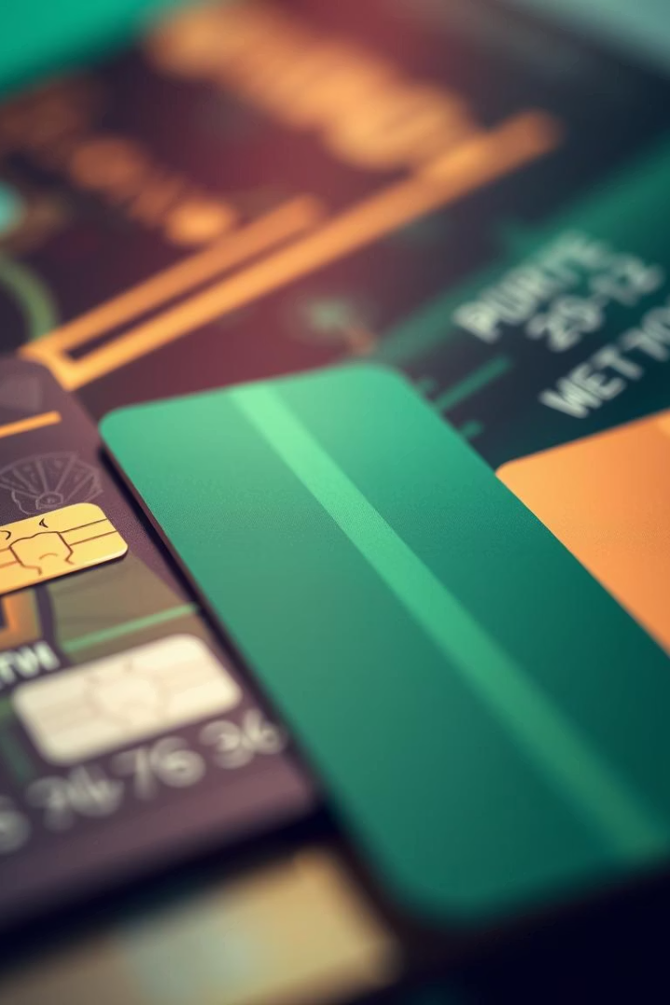

Credit Card Fraud Detection Using Image Processing
A hybrid computer vision approach to identify fake or tampered cards
Mentor- Dr. Anuradha Phadke
Shriya Samridhi - 1032221380

Slide 2
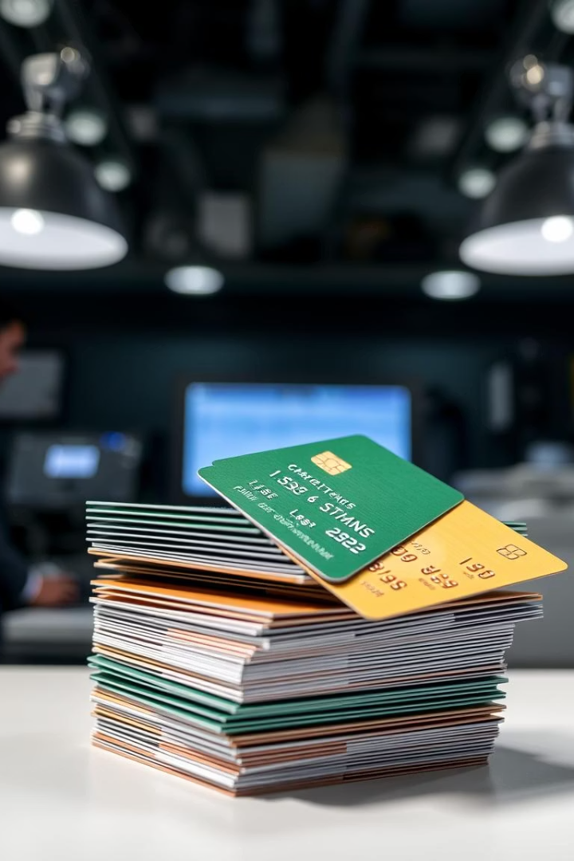
Problem Statement
Rising Fraud Cases
Detection Gaps
Increase in fake, cloned, and tampered cards
Traditional systems miss physical counterfeit cards
Need for Visual Verification
Rapid manual and automated check required

Slide 3

Project Objectives
User Guidance
Logo Detection
Early Fraud Identification
Manual verification of card features
OpenCV template matching for genuine logos
Assist in detecting counterfeit cards quickly

Slide 4
Technologies Used
Python 3.11
OpenCV
NumPy
GUI (Optional)
Core programming language
Image processing and template matching
Matrix handling and computations
Tkinter or PyQt for user interface

Slide 5
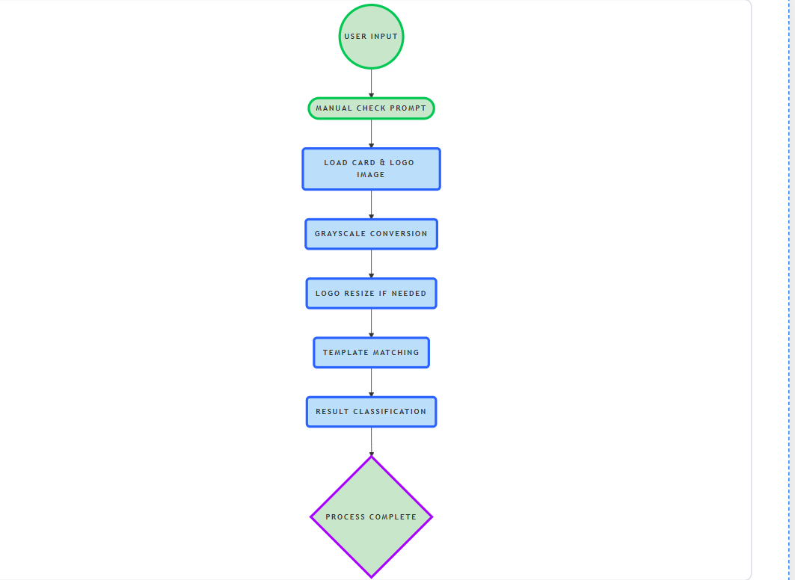
Workflow Diagram
User input and manual prompt
Load card and logo images
Convert images to grayscale
Resize logos if needed
Perform template matching
Classify results based on threshold

Slide 6
Key Code Explanation
Manual Check Prompt
Image Preprocessing
Template Matching
Thresholding
Load, convert to grayscale for analysis
cv2.matchTemplate() with TM_CCOEFF_NORMED method
Score ≥ 0.6 indicates legitimate logo
Warn users about texture, stiffness checks

Slide 7

Output Example
Max Value
Max Location
Status
0.76 indicates strong match
Coordinates (558, 23) on card image
Card logo is legitimate

Slide 8
Real-World Use & Challenges
Use Cases
Challenges
Integrated in ATMs and POS systems
Variable lighting and image quality
Mobile app pre-screening
Predefined logos only
Support for banks and law enforcement
Need for high-quality input images

Slide 9
FUTURE SCOPE
AI-Based Logo Detection Upgrade from template matching to deep learning (CNN) for improved accuracy.
Real-Time CCTV Surveillance Integrate with surveillance systems for instant fake card detection at ATMs or retail outlets.
Authentic Logo Database Develop and maintain a centralized logo database covering all major banks.
Touch & Texture Sensors Use embedded sensors to detect physical differences in material and finish.
Mobile App Integration Enable merchants and users to verify card authenticity through smartphone cameras.
Multi-Factor Authentication Combine visual checks with chip, QR, or barcode verification methods.
Fraud Pattern Learning Use machine learning to recognize new and evolving fraud techniques over time.

Slide 10
THANK YOU

