Slide 1
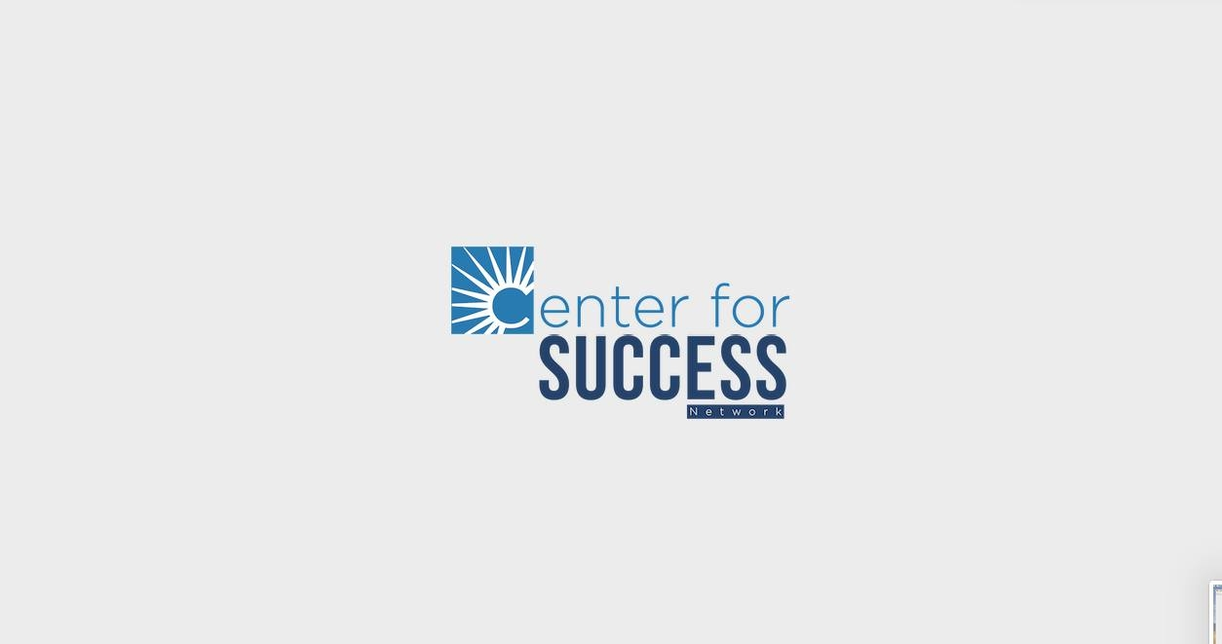
Social Media Marketing Analytics Report
A visual analysis

Slide 2
Email

Slide 3
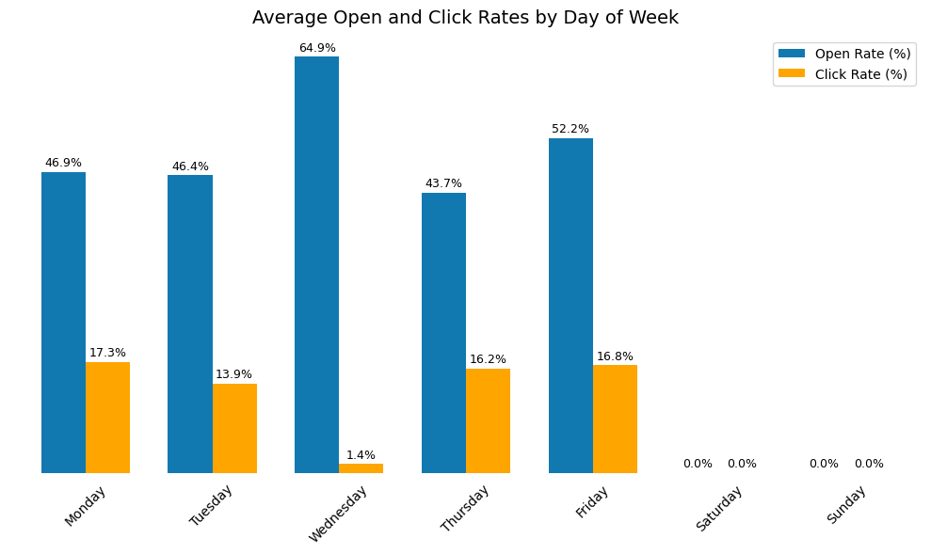
What days are best for sending emails?
Engagement peaks on Wednesdays and Thursdays — highest open and click rates
Audiences are more responsive midweek, likely due to routine email checking

Slide 4
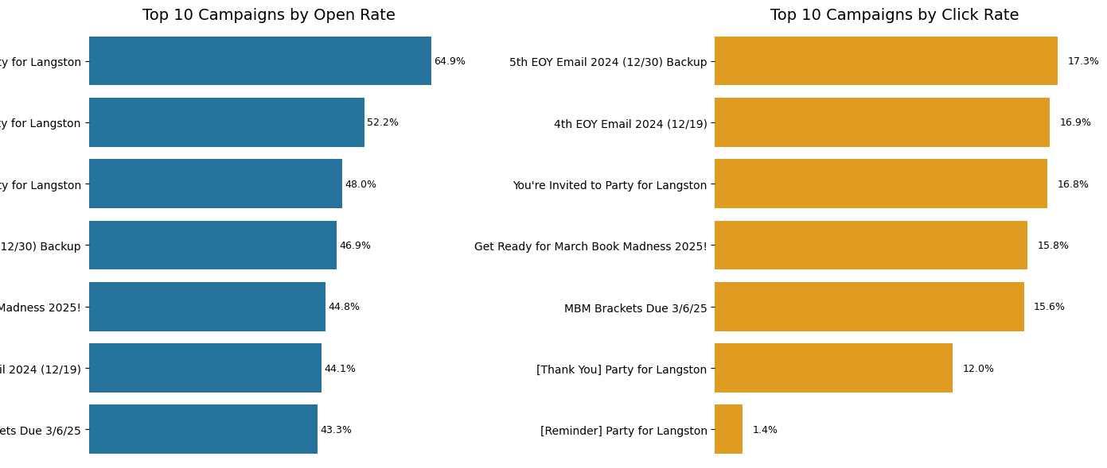
Which email campaigns were the most successful?

Slide 5
Which email campaigns were the most successful?
Campaigns with high open rates don't always guarantee high click rates.
For instance, "[Reminder] Party for Langston" had a strong open rate but low clicks, suggesting interest didn't translate into action.
By contrast, the "EOY 2024" emails show consistent performance across both metrics.

Slide 6
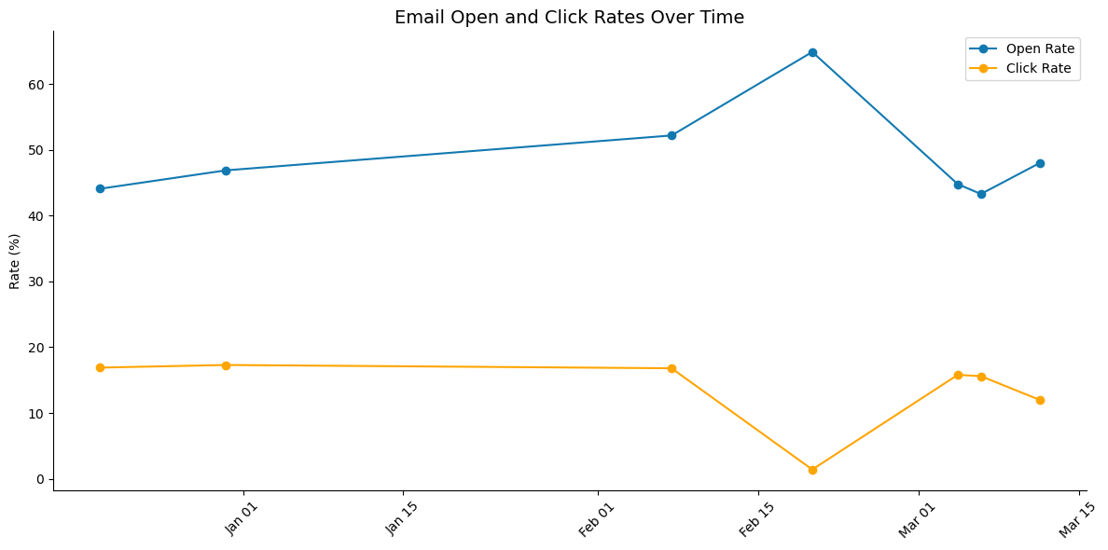
How have email and open click rates changed over time?
Click and open rates spike during campaign bursts in late December and early March
Seasonal or time-sensitive content (e.g., year-end wrap-ups, March Book Madness) drives higher engagement

Slide 7
Summary
Email engagement has trended upward in recent months, especially during EOY and event-based campaigns
01
Best campaigns had open rates of 40–50% and click rates above 15–17%
02
High performance awas linked to strong subject lines and time-sensitive, seasonal, or event-focused content
03
Emails sent on Wednesdays and Thursdays consistently performed best, highlighting the importance of timing
04

Slide 8
Recommendations
Send emails midweek (Wednesday or Thursday) for better open and click rates
1
Repeat styles from successful campaigns like EOY 2024 and March Book Madness
2
Use timely themes such as holidays, seasons, or special events to boost engagement
3
Write short, clear subject lines and A/B test to find what performs best
4
Regularly clean the email list by removing invalid or bounced addresses
5
Keep emails focused with one clear message and a single strong call-to-action button
6

Slide 9
Instagram

Slide 10
Instagram Overview
High Visibility, Low Engagement Reached 1,279 users, but only 82 engaged
Reels Are Watched, Not Tapped Reels: 46% of post reach, but only 19 interactions
Strong Profile Interest 281 profile actions, 266 were visits
Stories Need Improvement Low reach (215) and interactions (13)
Followers Drive Engagement Most reach = non-followers; most engagement = followers (69/82)

Slide 11
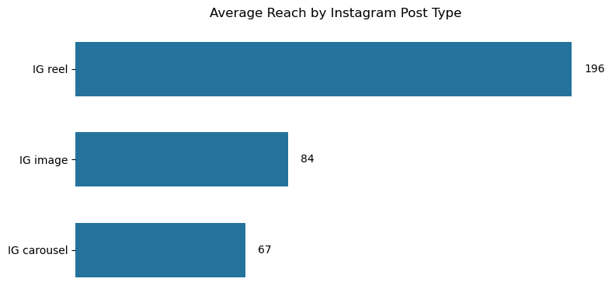
What kind of content drives the most engagement?
Image posts have the highest average reach
Carousels and videos show slightly lower engagement
Focus on image posts is working well

Slide 12
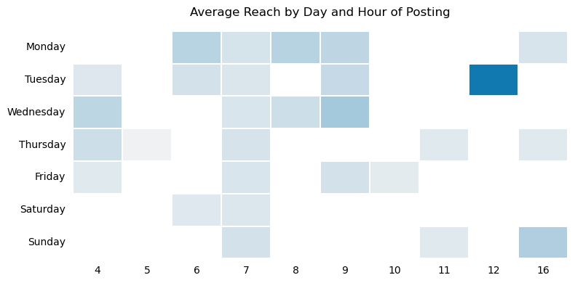
When’s the best time to post?
Tuesday at 12 PM is the top-performing time slot overall
Early mornings on Monday and Wednesday also show strong reach
These times are ideal for posting important updates or high-priority content

Slide 13
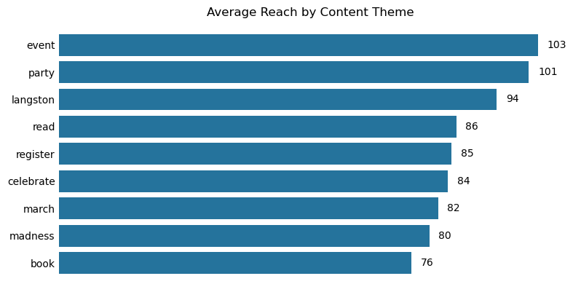
What content topics lead to high engagement?

Slide 14
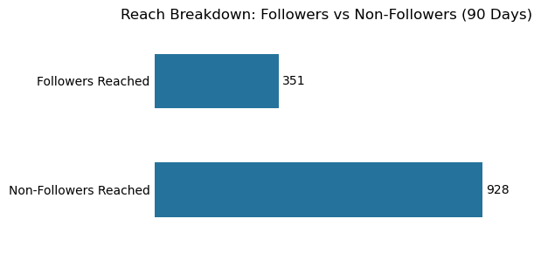
How far is our reach extending?
Over the last 90 days, reach from non-followers was more than 2.5x that of followers
Strong reach driven by hashtags, shares, and explore page visibility
Optimizing content for discovery can boost visibility and attract new followers

Slide 15
Summary
1,279 accounts reached — strong overall visibility
Reels performed best, averaging 196 reach per post
73% of reach came from non-followers — strong discoverability
Only 6% of reach led to engagement — interaction needs improvement
Best times to post: Tuesday at 12 PM, and early mornings on weekdays
Top-performing content themes: event, party, and celebration-related posts

Slide 16
Recommendations
Prioritize Reels — they have the highest reach; use trending audio, captions, and CTAs
Post during high-engagement times — focus on Tuesdays at 12 PM and weekday mornings
Add CTAs and interactive elements (polls, questions) to boost engagement, especially in Reels and Stories
Focus on event-based content — themes like parties and Langston campaigns perform well
Optimize profile — ensure bio and pinned posts convert visits into follows and deeper engagement
Refresh Story strategy — use stickers, countdowns, and behind-the-scenes content to lift performance

Slide 17
Facebook

Slide 18
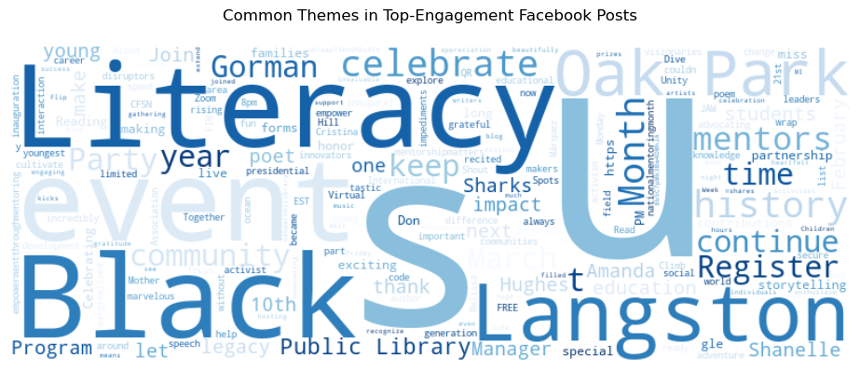
Which Facebook posts had the highest engagement?
High-engagement posts often include words like “celebrate,” “community,” “thankful,” and “event”
Themes of gratitude, recognition, and shared moments resonate well with the audience

Slide 19
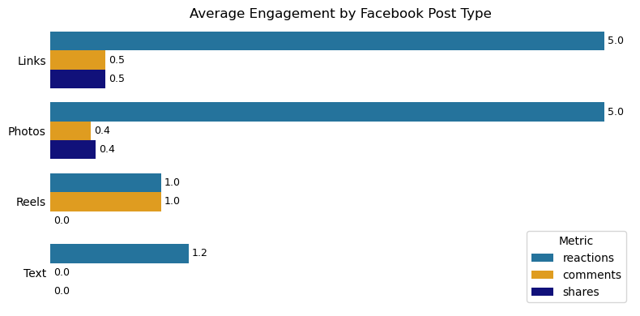
What type of posts are most effective?
Photos drive the highest engagement — reactions, comments, and shares
Visual storytelling with images is the most effective way to connect with your Facebook audience

Slide 20
Summary
Photos generate the highest engagement across reactions, comments, and shares
Gratitude, celebration, and community-focused themes perform best
Engagement peaks align with events or milestones — these posts resonate most
Clicks are moderate, mostly from general interactions; link and photo clicks follow
Most posts see low link click activity — stronger CTAs are needed to drive action

Slide 21
Recommendations
Use more photo-based posts — they consistently drive the highest engagement
1
Highlight people, gratitude, and achievements — these stories resonate with your audience
2
Add clear, visual CTAs — use buttons, short links, and direct language to drive clicks
3
Post around key events and milestones — these posts see the biggest engagement spikes
4
Optimize for interaction — use polls, questions, and captions that invite responses
5
Repurpose top-performing posts — reuse effective formats and consider boosting them with ads
6

Slide 22
LinkedIn

Slide 23
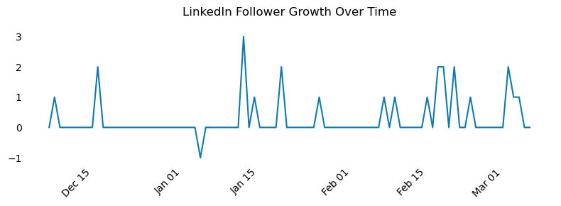
How is the growth of the page?
Follower count is increasing, but growth is slow
Growth appears organic with limited acceleration

Slide 24
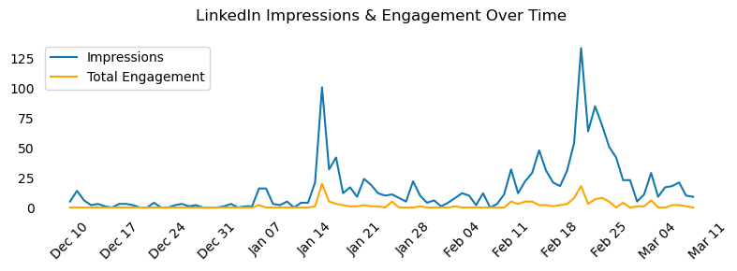
What kind of posts drive engagement?
Gap between visibility and interaction
Spikes in impressions correlate to seasonal events like March Madness New Year’s.

Slide 25
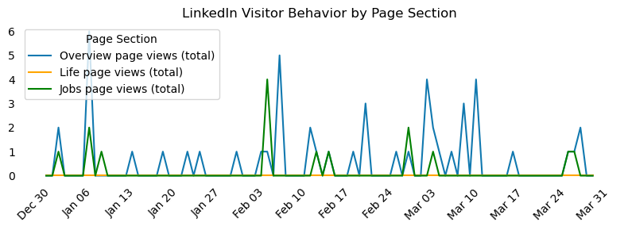
What pages are viewed most?
Views mainly on the overview page, followed by Jobs page.
Minimal views on the life page.

Slide 26
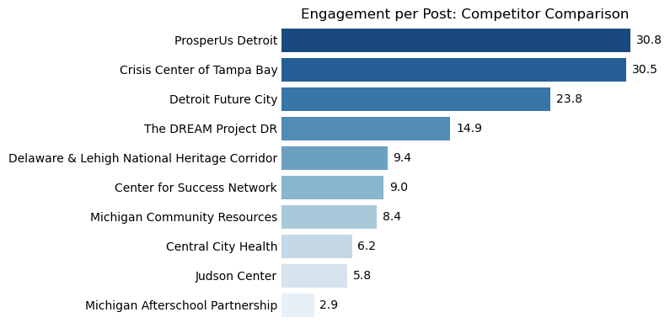
Are there strategies from competitors we could adopt?
Competitors with high engagement post more frequently
They use emotionally engaging and mission-driven content
Center for Success can close the gap by:
Sharing impactful stories
Tagging partners and collaborators
Posting more often with a consistent visual identity

Slide 27
Summary
Engagement is low and flat despite 90 recent posts
01
Reach (1,453) and engagement (140) are low relative to posting volume
02
Visitors mostly view the Overview tab; Life and Jobs sections are underused
03

Slide 28
Recommendations
Post Stories, Not Just Stats Share impact stories, milestones, and visuals for personal connection
Repurpose Top Content Adapt high-performing Facebook/Instagram posts for LinkedIn (e.g., carousels, quotes)
Show the Team & Partners Feature staff, interns, and collaborators to increase relatability and engagement
Promote the Life Section Update with images, bios, or testimonials; cross-promote via email and captions
Increase Posting Frequency Post 1–2 times per week with a focus on quality and content variety

Slide 29
Cross-platform Insights

Slide 30
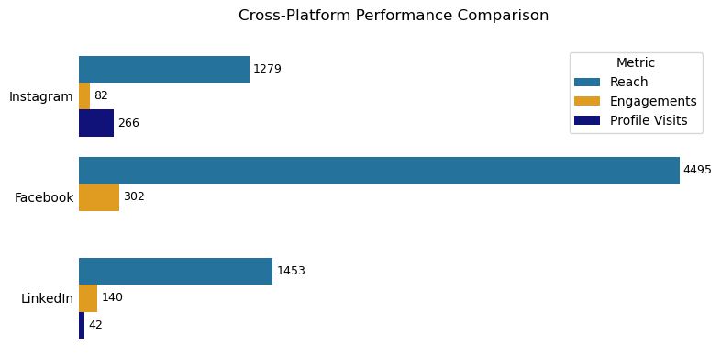
What platforms are driving overall most value?
Facebook leads in overall reach and engagement
Instagram drives more profile visits with fewer posts
LinkedIn shows moderate results, with clear potential for growth

Slide 31
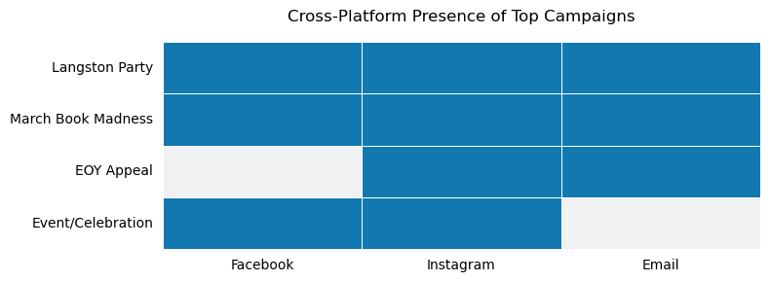
What campaigns worked best across all platforms?
Top campaigns (e.g., Langston Party, March Book Madness) succeeded across Facebook, Instagram, and Email
Cross-channel promotion significantly boosts engagement
Single-platform campaigns (e.g., EOY appeal) performed well but had limited reach
Amplifying key themes across all major platforms increases impact and visibility

Slide 32
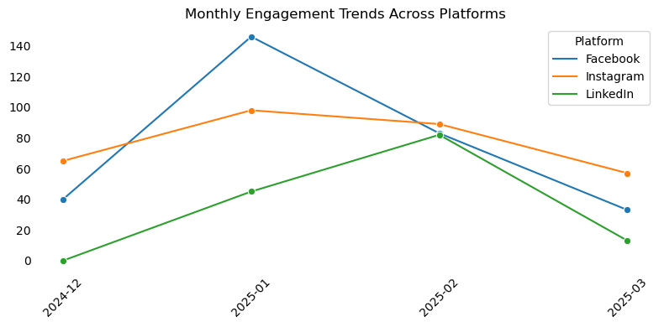
Are there months or events with more engagement?
Engagement peaks in January and March, especially on Facebook
These align with EOY fundraising and Book Madness campaigns
Plan major campaigns around these months for greater impact
Mirror themes across platforms to maximize reach and engagement

Slide 33
Summary
Facebook: Highest reach (4,495) and engagement (302)
01
Instagram: Strongest profile conversion (266 visits) with fewer posts
02
LinkedIn: Moderate results — lowest return per post
03

Slide 34
Recommendations
Leverage Instagram for High-Intent Engagement
Post Reels tied to campaigns with clear CTAs
Focus on storytelling and action-driven content
Maximize Facebook for Awareness
Prioritize photo-based gratitude and event posts
Optimize for reach, shares, and reactions
Strengthen LinkedIn with People-Centered Content
Share team spotlights, event recaps, and partner stories
Increase posting frequency to match industry benchmarks
Run Cross-Platform Seasonal Campaigns
Align messaging across Email, IG, and FB in Jan, March, and Fall
Use consistent hashtags and themes for unified voice
Repurpose High-Performing Content
Turn top FB posts into LinkedIn carousels
Adapt Email content into IG infographics

Slide 35
Thank you.

