Slide 1
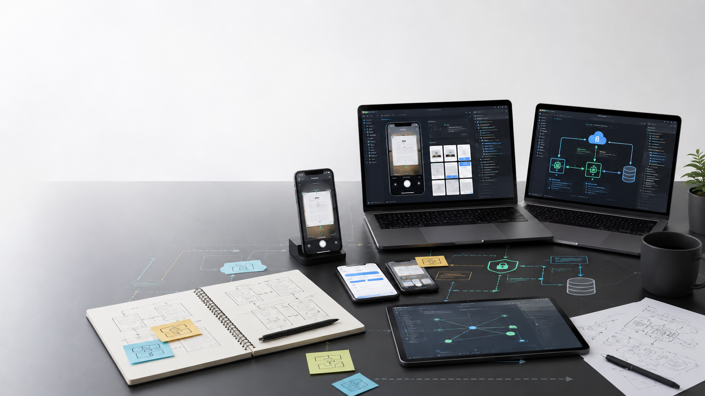
New Graduate Engineering Pitch
Memora
Build the mobile memory layer for useful links, screenshots, and notes
Prepared for Coding Monkey Labs
September 2026
Notes:
Product source: MEMORA_README.md, cml-memoryhive-apps.
Product source: MEMORYHIVE_REQUIREMENTS.md, cml-memoryhive/docs.
Deck standardizes on the user-facing product name Memora. The PRD source uses Memoryhive.
Generated cover visual created for this pitch package. No external market claims used on this slide.

Slide 2
Why Memora Exists
People save useful knowledge faster than they can organize it.
2 sec
500 ms
Offline
Target time to capture a useful item
Target save action for instant local capture
Core capture and search should work without network access
The user pain is simple: links, screenshots, and notes get saved across apps, then disappear when the user actually needs them.
Screenshots hold valuable text, but normal bookmark tools cannot search them.
Bookmarks preserve the URL, but lose the reason the user saved it.
Notes apps work only when users stop and organize manually.
Memora
02
Notes:
Product source: MEMORA_README.md, cml-memoryhive-apps.
Product source: MEMORYHIVE_REQUIREMENTS.md, cml-memoryhive/docs.
Deck standardizes on the user-facing product name Memora. The PRD source uses Memoryhive.
Targets come from MEMORYHIVE_REQUIREMENTS.md success criteria and non-functional requirements.

Slide 3
PRODUCT DEFINITION
Capture, Understanding, Recall
The product rule: every feature must improve one of these three jobs.
Capture
Understand
Recall
Screenshots, URLs, text, and photos saved from mobile flows
OCR, readable link extraction, summaries, and tags run in the background
Full-text search across items, source filters, time filters, and resurfaced context
Core principles
Mobile-first
Offline-first
Local ownership
Background AI
Minimal effort
Memora
03
Notes:
Product source: MEMORA_README.md, cml-memoryhive-apps.
Product source: MEMORYHIVE_REQUIREMENTS.md, cml-memoryhive/docs.
Deck standardizes on the user-facing product name Memora. The PRD source uses Memoryhive.
Product framing from MEMORYHIVE_REQUIREMENTS.md sections 1, 6, and 15.

Slide 4
MVP Experience
The first release should make capture feel instant and recall feel obvious.
1
Save from share menu
2
Store locally
3
Process in background
4
Search later
A screenshot, link, or text snippet reaches Memora without extra metadata.
Raw content and the first search index land on the device first.
OCR, title extraction, summary, and tags run after the save action.
Users find items by words inside screenshots, links, source, or time.
The MVP avoids folders, collaboration feeds, task management, and chat with notes. That restraint gives interns a clearer product surface and a better engineering target.
Memora
04
Notes:
Product source: MEMORA_README.md, cml-memoryhive-apps.
Product source: MEMORYHIVE_REQUIREMENTS.md, cml-memoryhive/docs.
Deck standardizes on the user-facing product name Memora. The PRD source uses Memoryhive.
MVP scope and explicit non-goals are from MEMORYHIVE_REQUIREMENTS.md sections 9 and 14.

Slide 5
What New Grads Will Build
A real product surface with meaningful ownership across mobile, backend, search, sync, and AI.
Mobile capture
React Native and Expo flows for camera, image picker, share sheet, deep links, and offline-first UX.
Local data layer
MMKV storage, encrypted session state, search index persistence, and device-first performance tuning.
Backend services
FastAPI APIs for auth, metadata, items, sync push/pull, stats, and cloud persistence.
Search and AI
OCR, readable link extraction, summary generation, auto tags, and background processing orchestration.
Memora
05
Notes:
Product source: MEMORA_README.md, cml-memoryhive-apps.
Product source: MEMORYHIVE_REQUIREMENTS.md, cml-memoryhive/docs.
Deck standardizes on the user-facing product name Memora. The PRD source uses Memoryhive.
Workstreams map to MEMORA_README.md architecture and roadmap sections.

Slide 6
REFERENCE ARCHITECTURE
Mobile-First Technical System
The architecture teaches practical product engineering: latency, offline behavior, sync, data ownership, and asynchronous processing.
Mobile app
Local store
API layer
Data services
Expo Router, React Native, Zustand
MMKV, SecureStore, local search index
Auth, items, search, sync, stats
Postgres or MongoDB, MinIO object storage
Background processing
OCR, summary, keywords, auto tags
Memora
06
Notes:
Product source: MEMORA_README.md, cml-memoryhive-apps.
Product source: MEMORYHIVE_REQUIREMENTS.md, cml-memoryhive/docs.
Deck standardizes on the user-facing product name Memora. The PRD source uses Memoryhive.
Architecture combines MEMORA_README.md current stack with MEMORYHIVE_REQUIREMENTS.md target storage and AI pipeline options.

Slide 7
Learning Outcomes
The project is narrow enough for focus and deep enough for serious engineering growth.
Mobile UX
Offline systems
Capture flows, navigation, permissions, and app store constraints
Local persistence, sync queues, retries, and conflict handling
API design
Search quality
Auth, pagination, filters, CRUD, and observable service behavior
Text extraction, indexing, ranking, and empty-state design
AI product judgment
Privacy engineering
When OCR and summaries help, and when they should stay optional
Data export, deletion, clear storage choices, and trust-building UX
Memora
07
Notes:
Product source: MEMORA_README.md, cml-memoryhive-apps.
Product source: MEMORYHIVE_REQUIREMENTS.md, cml-memoryhive/docs.
Deck standardizes on the user-facing product name Memora. The PRD source uses Memoryhive.
Learning outcomes are derived from the requested audience and source architecture.

Slide 8
Intern Project Tracks
Each track ends with a demoable product increment and a written engineering decision record.
Capture track
Share sheet, camera/gallery intake, text note capture
A capture flow that works in under two seconds
Recall track
OCR ingestion, local index, filters, result grouping
Search that finds screenshot text and saved links
Sync track
Push/pull, retry queue, merge rules, network states
Offline capture that syncs without user intervention
AI track
Readable link extraction, summaries, keywords, auto tags
Background enrichment that never blocks saving
Track scope can be assigned to individuals or two-person pods depending on intern count.
Memora
08
Notes:
Product source: MEMORA_README.md, cml-memoryhive-apps.
Product source: MEMORYHIVE_REQUIREMENTS.md, cml-memoryhive/docs.
Deck standardizes on the user-facing product name Memora. The PRD source uses Memoryhive.
Project tracks translate the PRD into intern-sized delivery units.

Slide 9
Eight Week Build Plan
The plan balances onboarding, implementation, validation, and a final product demo.
Week 1
Weeks 2-3
Weeks 4-5
Weeks 6-7
Week 8
Product and stack onboarding
Track implementation starts
Search, sync, and quality pass
Beta hardening and analytics
Demo, handoff, next backlog
Expected cadence: weekly demos, short design reviews, small pull requests, and a product metric attached to every feature.
Memora
09
Notes:
Product source: MEMORA_README.md, cml-memoryhive-apps.
Product source: MEMORYHIVE_REQUIREMENTS.md, cml-memoryhive/docs.
Deck standardizes on the user-facing product name Memora. The PRD source uses Memoryhive.
Build plan is an operating proposal, not a source requirement.

Slide 10
Engineering Operating Model
New grads learn how product, design, and engineering decisions connect.
User problem
Thin spec
Build
Learn
Start with a real saved item and the recall moment the user wants
Define the smallest behavior change worth building
Ship a focused increment with tests and observability
Review usage, latency, bugs, and the next product question
This model keeps the internship practical. Every project should improve capture speed, search success, or user trust.
Memora
10
Notes:
Product source: MEMORA_README.md, cml-memoryhive-apps.
Product source: MEMORYHIVE_REQUIREMENTS.md, cml-memoryhive/docs.
Deck standardizes on the user-facing product name Memora. The PRD source uses Memoryhive.
Operating model created for the recruiting pitch.

Slide 11
Why This Internship Matters
New grads can own visible product behavior instead of isolated tasks.
The strongest learning happens when engineers see how a small decision affects a real user flow.
A capture bug directly affects whether users trust the app.
A slow search result directly affects whether users come back.
A poor privacy choice directly affects whether users store personal knowledge.
A clear demo lets interns show product judgment, not only implementation effort.
Memora
11
Notes:
Product source: MEMORA_README.md, cml-memoryhive-apps.
Product source: MEMORYHIVE_REQUIREMENTS.md, cml-memoryhive/docs.
Deck standardizes on the user-facing product name Memora. The PRD source uses Memoryhive.
Phone sketch is a native editable product concept diagram, not a screenshot.

Slide 12
The Opportunity
Build the memory layer for mobile knowledge workers.
Memora is narrow by design: capture useful information once, understand it in the background, and recall it when it matters.
Mobile engineering
Backend systems
Search and AI
Product craft
Memora
12
Notes:
Product source: MEMORA_README.md, cml-memoryhive-apps.
Product source: MEMORYHIVE_REQUIREMENTS.md, cml-memoryhive/docs.
Deck standardizes on the user-facing product name Memora. The PRD source uses Memoryhive.
Closing slide for intern recruiting conversation.

