Slide 1
Hierarchical and Probabilistic Demand Forecasting Using M5 Competition Data

Slide 2
Objective
The objective of the M5 competition was to produce the most accurate point forecasts for 42,840 time series that represent the hierarchical unit sales of the largest retail company in the world by revenue, Walmart, as well as to provide the most accurate estimates of the uncertainty around these forecasts. Thus, the M5 competition consisted of two parallel challenges, namely the Accuracy and the Uncertainty challenges,
This project involves hierarchical forecasting and reconciliation process using the M5 competition dataset. The goal is to generate base forecasts for sales at different hierarchical levels (total, state, store, and item) and reconcile them to ensure consistency across the hierarchy.

Slide 3
Dataset Overview
Source: Walmart unit sales (M5 Forecasting competition).
Structure: 3049 products, 10 stores, 3 states(CA, TX, WI).
Categories: 3 categories (Hobbies, Foods, Household), 7 Departments.
Hierarchy: Total → States → Stores → Items

Slide 4
The dataset contains 5-year historical sales, from 2011 to 2016, for various products and stores. Some additional information is provided, such as sell prices and calendar events. Data is hierarchically organized: stores are divided into 3 states, and products are grouped by categories and sub-categories.
Total
CA
TX
WI
3 STATES
CA1
CA2
CA3
CA4
10 STORES
TX1
TX2
TX3
WI1
WI2
WI3
Hobbies
Foods
Household
3 CATEGORIES
7 PRODUCT SUB-CATEGORIES
HB1
HB2
FO1
FO2
FO3
HH1
HH2
…
P3049
3049 PRODUCTS
P1

Slide 5
Forecasting Methodology
Base Forecasts:
Used ARIMA(1,1,1) for each level: Total, States, Stores, Items.
ARIMA(1,1,1): 1 lagged value (AR), 1 differencing (I), 1 lagged error (MA).
Total ARIMA models: 13 (1 Total + 2 States + 5 Stores + 5 Items).
Hierarchical Reconciliation:
Bottom-Up (BU): Sum item forecasts to higher levels.
MinT (Minimum Trace): Adjusts all levels for coherence using OLS

Slide 6
Base Forecast
The base forecasts are generated for each level of hierarchy using the ARIMA (AutoRegressive Integrated Moving Average) model. The methodology is as follows:
The ARIMA model is configured with the order (1,1,1):
AR(1): One autoregressive term.
I(1): First-order differencing to make the series stationary.
MA(1): One moving average term.
Fit and Forecast: For each time series (item, store, state, and total levels), the ARIMA model is fitted to the historical sales data. It then forecasts the average sales for the next 28 days.
Fallback: If the ARIMA model fails to converge (e.g., due to non-stationarity or other issues), the code uses the mean of the last 28 days as a fallback forecast.

Slide 7
Base Forecast
Levels Forecasted
Item-level: Forecasts are generated for each of the five items by summing sales across all relevant stores.
Store-level: Forecasts are generated for each of the five stores by summing sales across all relevant items.
State-level: Forecasts are generated for the two states by summing sales across all relevant stores.
Total-level: A single forecast is generated for the total sales across all items, stores, and states.
Output: The base forecasts are stored in separate DataFrames (item_forecasts, store_forecasts, state_forecasts, total_forecast) and later combined into a vector (base_forecasts) for reconciliation.

Slide 8
Hierarchical Reconciliation
Hierarchical forecasting ensures that forecasts at different levels of the hierarchy (e.g., total, state, store, item) are coherent (aggregated forecasts at higher levels match the sum of forecasts at lower levels).
Two approaches are used for this purpose:
Bottom-Up (BU) Reconciliation
MinT (Minimum Trace) Reconciliation

Slide 9
Bottom-Up (BU)Reconciliation
In the Bottom-Up approach, forecasts are first generated at the lowest level of the hierarchy i.e., item-level.
These item-level forecasts are then aggregated up the hierarchy to obtain forecasts for higher levels (store, state, and total).
Mathematically, we can multiply the item-level forecasts by the summing matrix (S), which defines the hierarchical structure.
Advantages:
Preserves the detailed information at the lower (item) level.
Disadvantages:
Ignores information from higher-level forecasts, which may lead to less accurate aggregates if bottom-level data is noisy.

Slide 10
MinT (Minimum Trace) Reconciliation
The MinT method reconciles forecasts across all levels of the hierarchy to ensure coherence while minimizing the forecast error variance.
It uses an Ordinary Least Squares (OLS) approximation to adjust the base forecasts.
The reconciliation is performed using the summing matrix (S) and a transformation matrix (G).
Advantages:
Incorporates information from forecasts at all levels (total, state, store, and item), potentially improving accuracy.
Optimizes forecasts to minimize error variance across the hierarchy.
Disadvantages:
Computationally more complex than Bottom-Up.

Slide 11
Summing Matrix (S)
The summing matrix (S) is a key component of hierarchical forecasting, encoding the relationships between different levels of the hierarchy.
The matrix has dimensions (n_total_nodes, n_bottom), where:
n_total_nodes = n_total + n_states + n_stores + n_items (addition of total, states, stores & items at last 28 days).
Each row corresponds to a node in the hierarchy (total, states, stores, items), and each column corresponds to an item.
The matrix is populated as follows: Total level: A row of ones, as the total aggregates all items.
State level: For each state, a 1 is placed in columns corresponding to items sold in that state.
Store level: For each store, a 1 is placed in columns corresponding to items sold in that store.
Item level: An identity matrix for the items (diagonal of 1s).
Purpose: The summing matrix ensures that forecasts at higher levels are consistent with the sum of forecasts at lower levels.

Slide 12
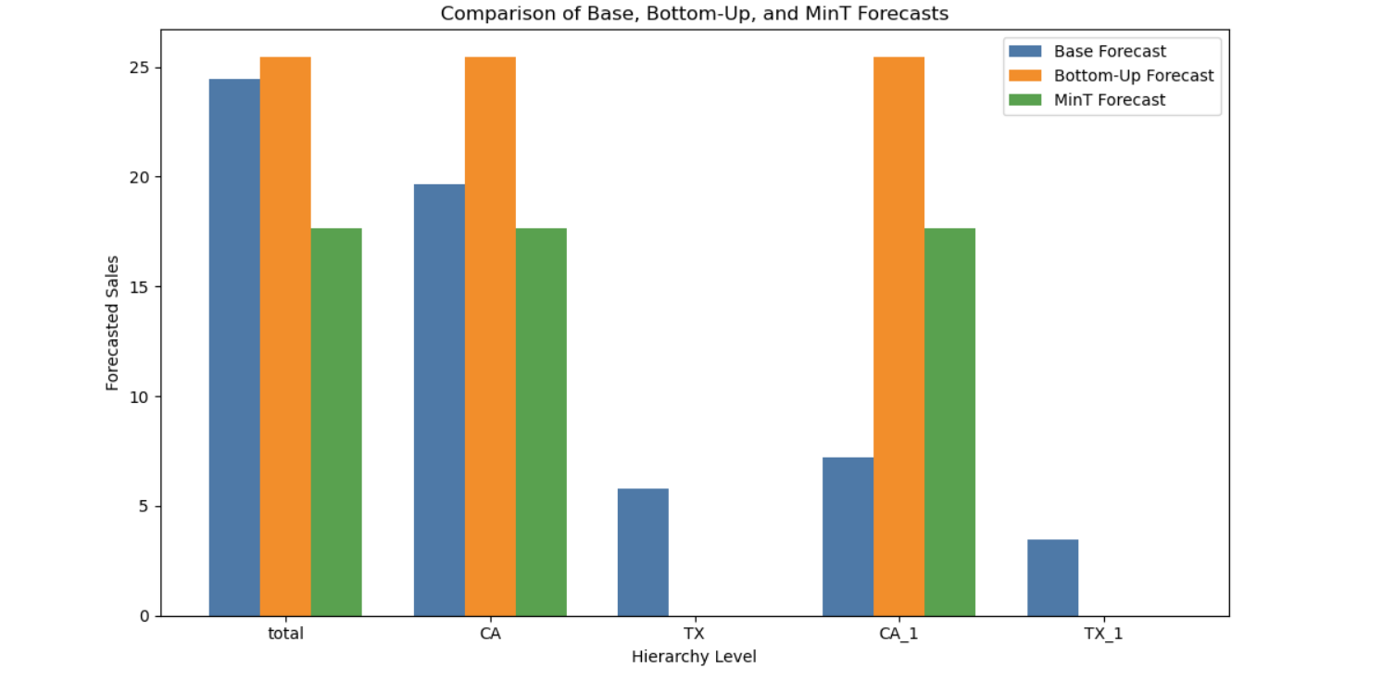
Observations
The Bottom-Up approach tends to produce higher total forecasts (e.g., 25.43 vs. 24.45 for base and 17.62 for MinT), as it relies solely on item-level forecasts.
MinT forecasts are lower and adjust for consistency across all levels, potentially reducing variance but introducing differences from the base forecasts.

Slide 13
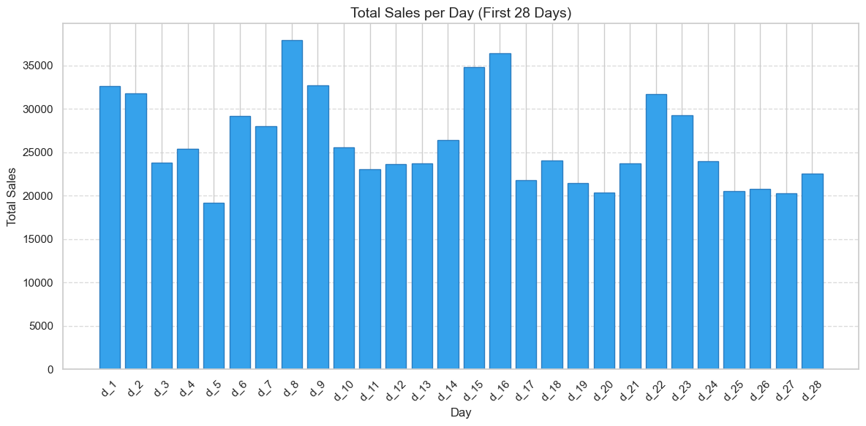
First 28 Days (D_1 to D_28)
We can see a trend that on every 8th day the overall sales has increased this shows that every 8th day might be a weekend or an event day.

Slide 14
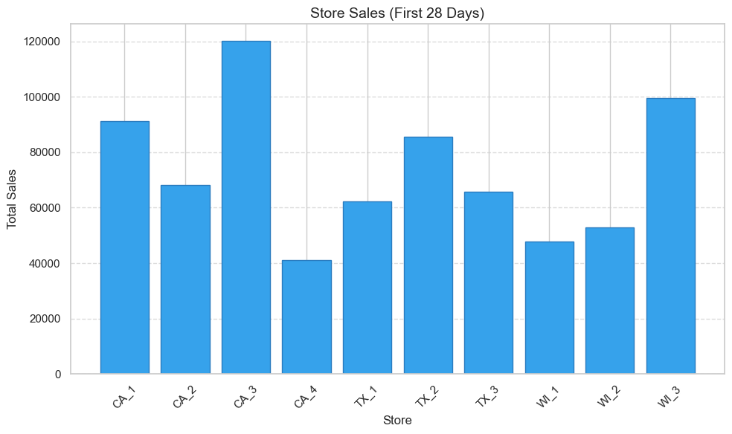
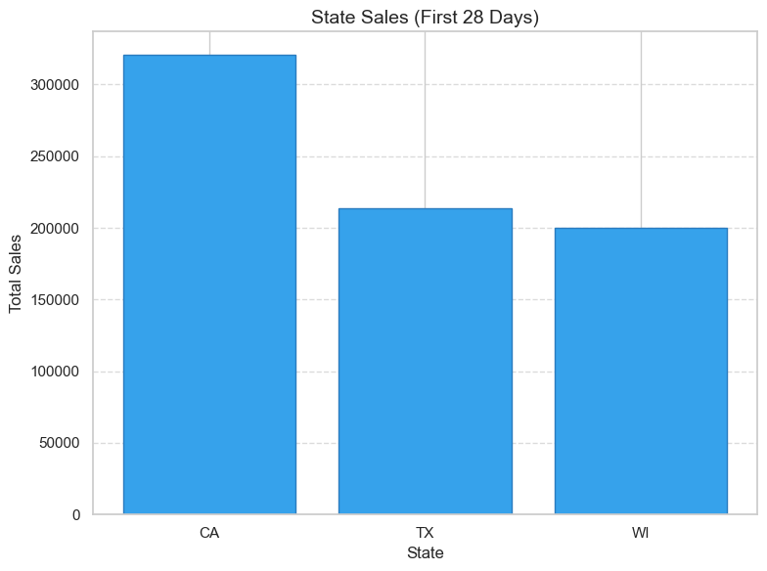
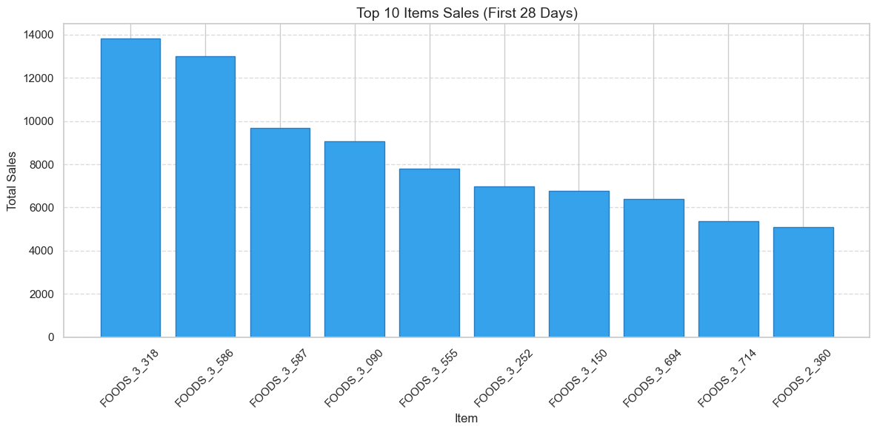

Slide 15
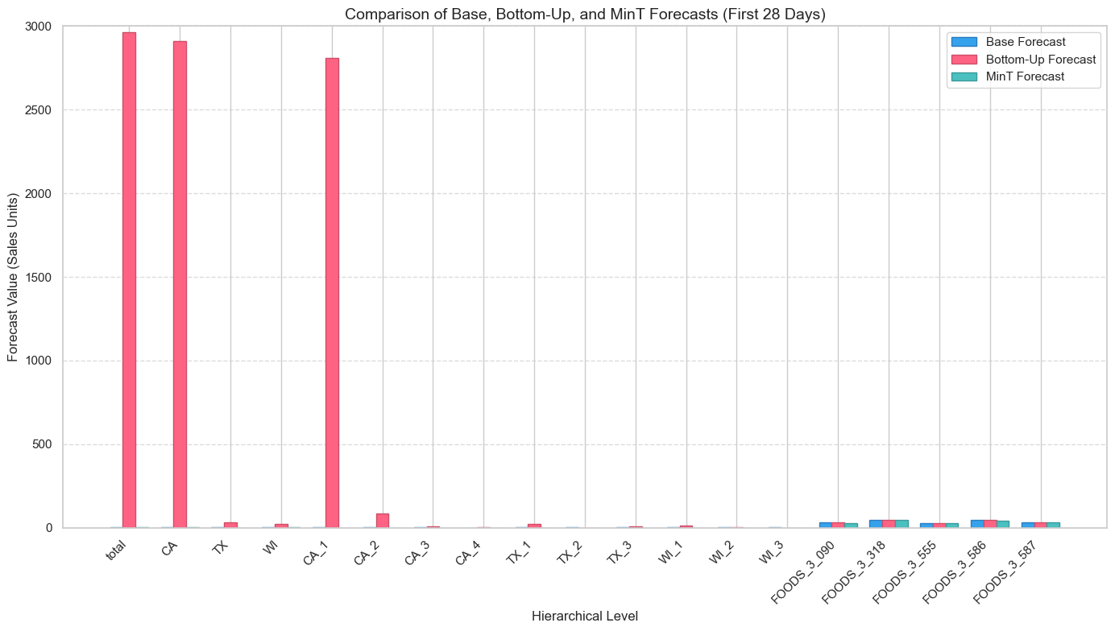
BU forecasts are significantly higher in aggregate levels like total, CA, TX, CA_1 indicating overestimation at higher levels
Both Base and MinT forecasts have smaller bars, especially at lower levels which implies they may better reflect item-level dynamics.
There is a huge variation in forecast across hierarchical levels:
At the top (total, CA, TX), forecasts are in the thousands.
At the bottom (individual items), they are below 100.

Slide 16
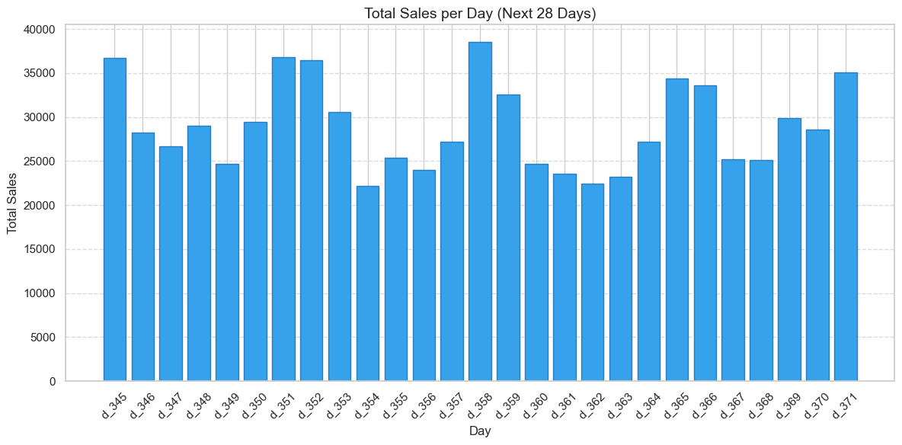
D_345 to D_371
There is noticeable variability in daily sales, with values ranging from approximately 15,000 to over 35,000 units. This suggests that sales are not constant and are influenced by factors such as seasonality, promotions, or holidays.
The highest sales appear around d_350, d_351 and d_358, exceeding 35,000 units. This could indicate a significant event (e.g., a holiday or weekend) driving demand during these days.

Slide 17
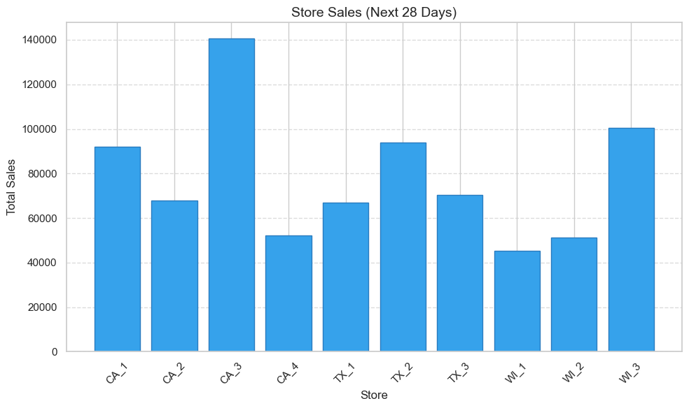
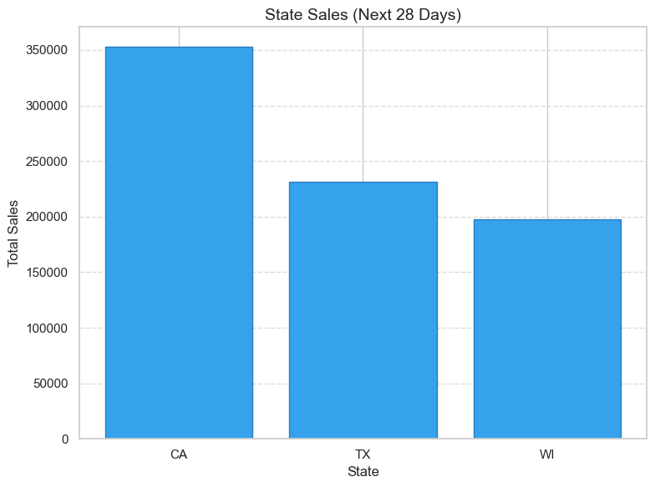
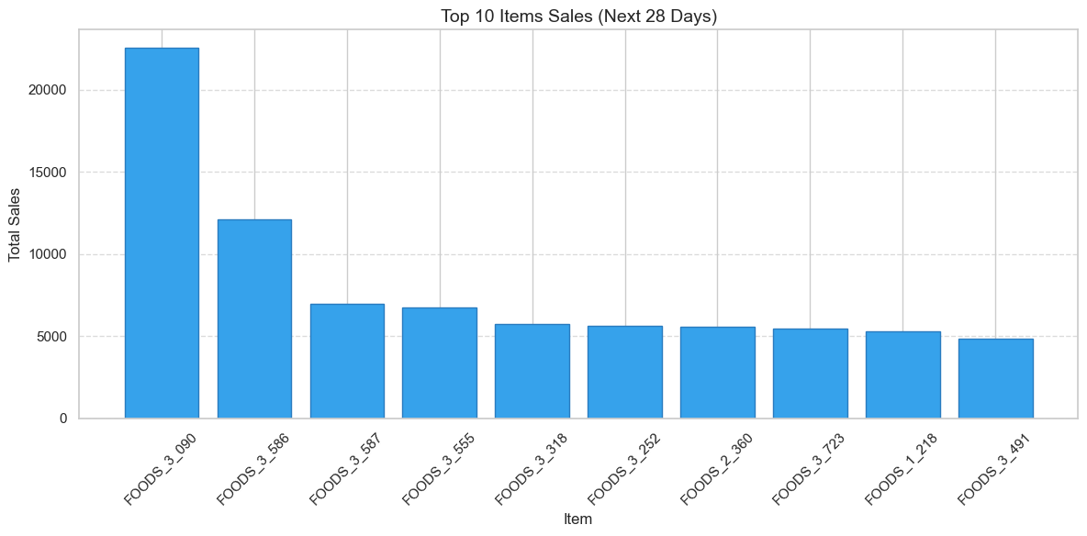

Slide 18
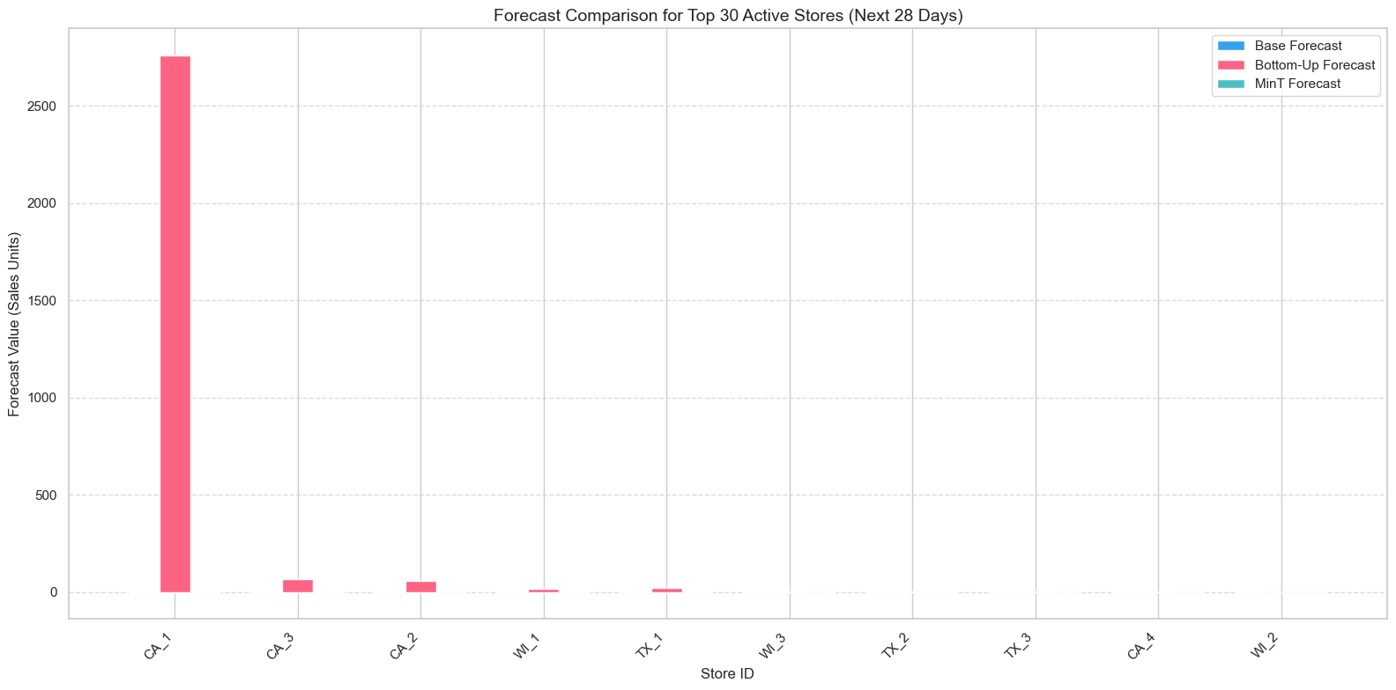
CA_1's Bottom-Up Forecast is extremely high, around 2700+ units, dwarfing all others.
This skews the entire chart, making other store forecasts appear almost negligible.
It’s likely an outlier or data issue, or CA_1 is exceptionally active in the forecast horizon.
There’s a huge imbalance: CA_1 is forecasting 2700+, while others like CA_3, CA_2, WI_1, and TX_1 are forecasting below 100.

Slide 19
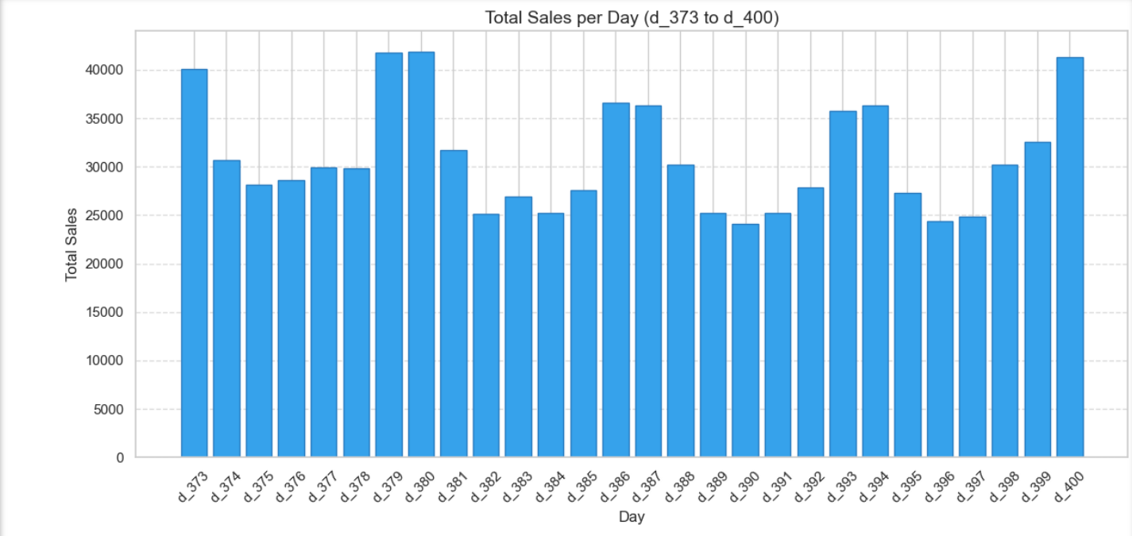
D_373 to D_400
There is significant variability in daily sales, with values fluctuating between approximately 20,000 and 40,000 units. This suggests that sales are influenced by factors such as seasonality, promotions, or day-of-week effects.
The highest sales peaks occur around d_374, d_377, d_378, d_380, and d_400, exceeding 35,000 to 40,000 units. These peaks could indicate significant events (e.g., holidays or weekends).
A possible weekly pattern emerges, with peaks and troughs occurring approximately every 7 days. This could reflect weekly shopping cycles or weekend boosts in sales, especially given that today is Saturday, June 21, 2025, and the data might align with weekend effects.

Slide 20
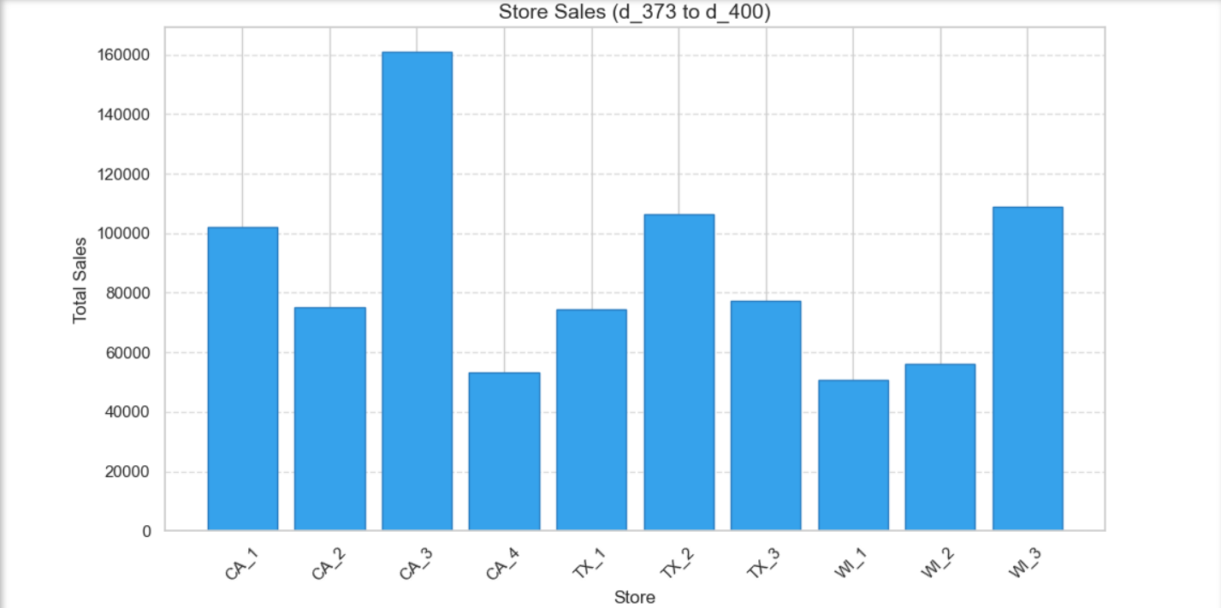
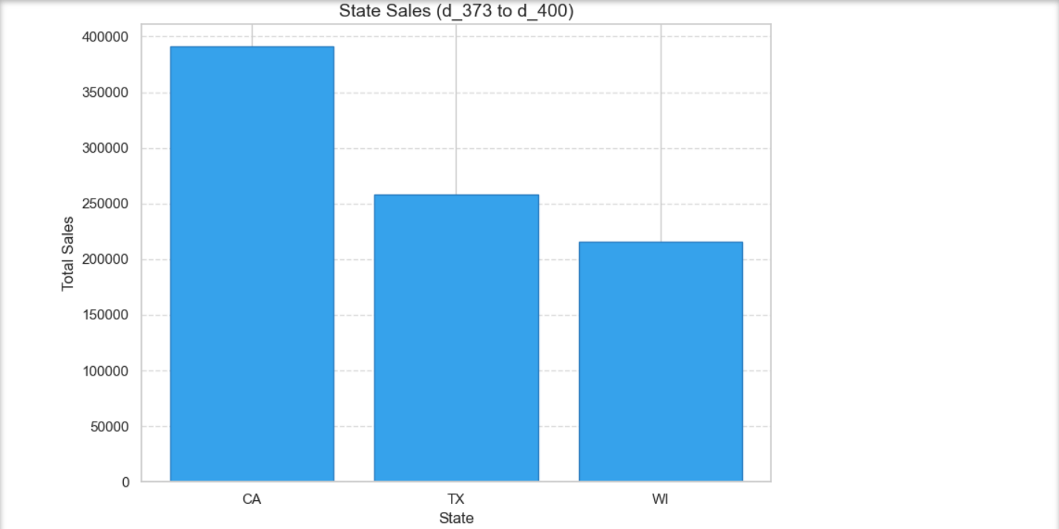
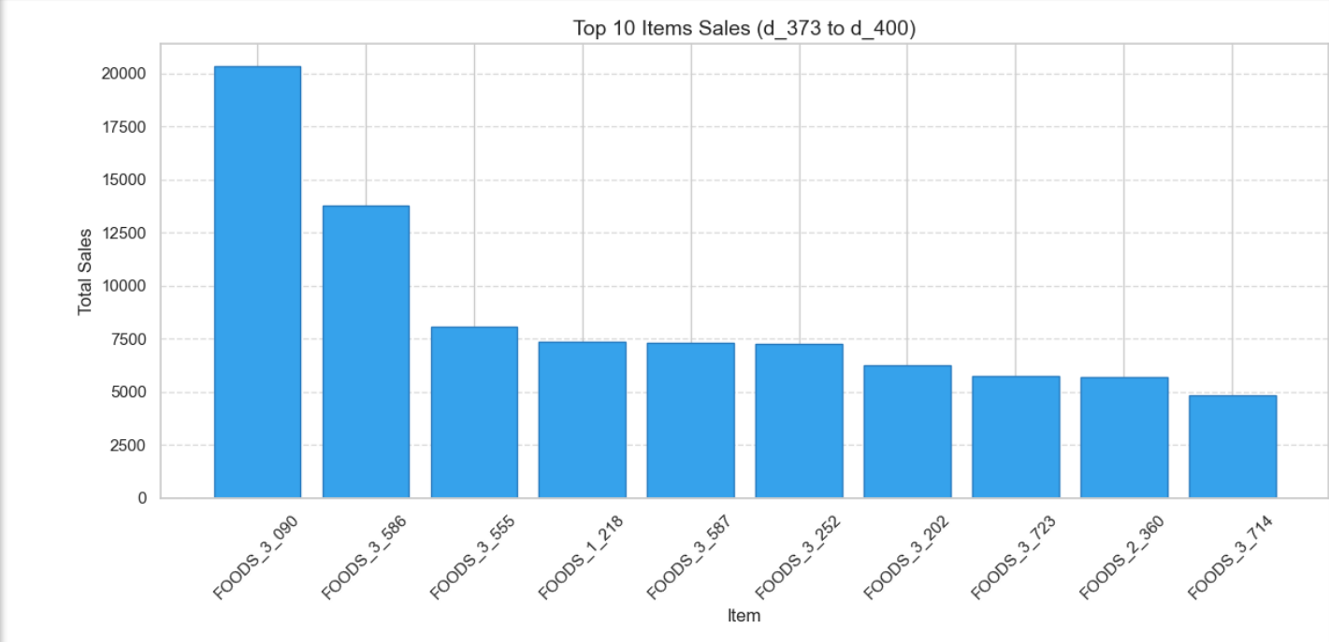

Slide 21
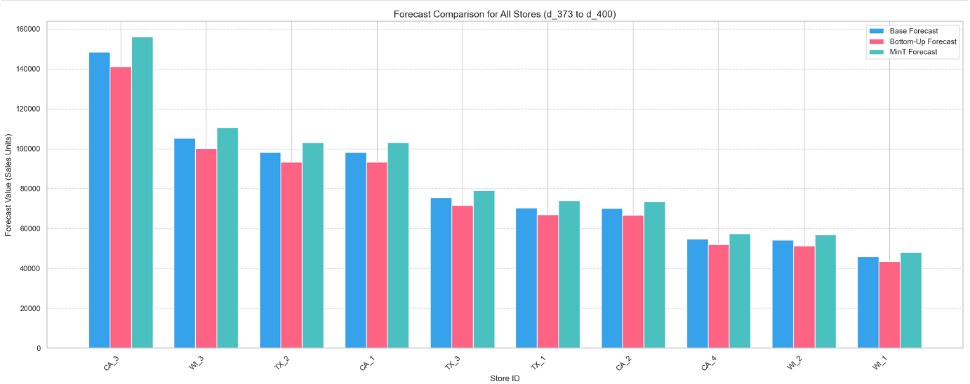
In nearly all stores, the MinT forecast is consistently higher than both base and bottom-up forecasts.
This suggests MinT might be capturing aggregate-level adjustments that are missed by others, making it a potentially more optimistic or corrected forecast.
The Bottom-Up (BU) forecast shows the lowest values in most stores, particularly CA_3, TX_2, and WI_1.
This is expected since BU aggregates forecasts from bottom levels, often underestimating if bottom-level models are conservative.
CA_3, WI_3, and TX_2 have the highest forecasted sales across all methods.
WI_1 and WI_2 have the lowest sales forecasts, showing a strong regional or store-level trend.

Slide 22
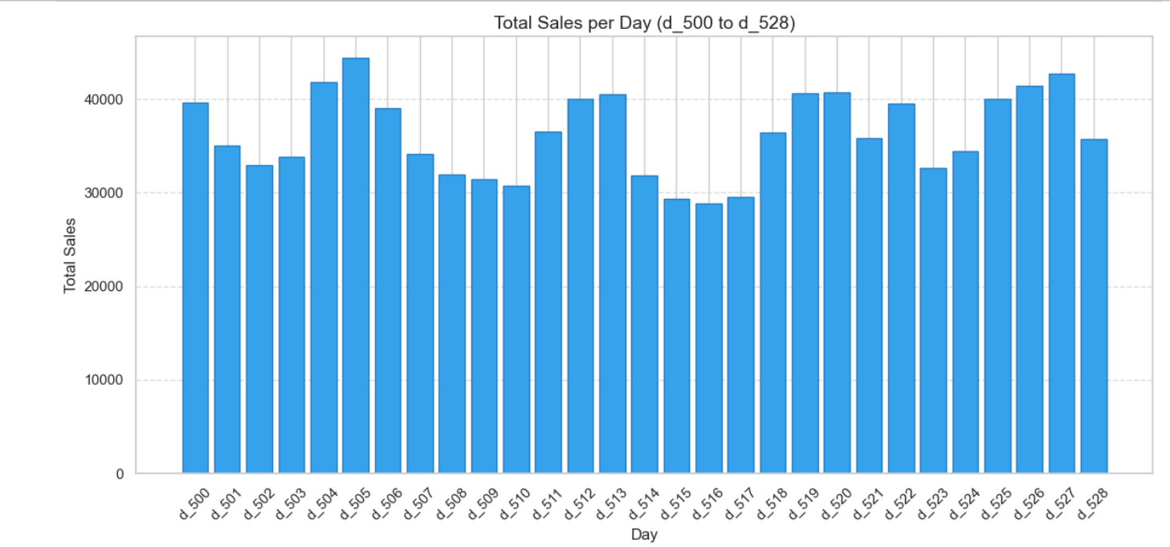
D_500 to D_528
The highest sales peaks occur around d_501, d_502, d_506, d_507, d_511, d_515, d_519, d_523, and d_528, approaching or exceeding 40,000 units. These peaks could indicate significant events (e.g., holidays, weekends, or promotional days) driving demand.
A possible weekly pattern emerges, with peaks and troughs occurring approximately every 7 days (e.g., d_501 to d_507, d_508 to d_514, etc.). This could reflect weekly shopping cycles or weekend boosts in sales, especially given that today is Saturday, June 21, 2025, and the data might align with weekend effects.
The variability and periodic peaks suggest that forecasting models (e.g., ARIMA) should incorporate seasonal or cyclical patterns, such as day-of-week effects or external events, to improve accuracy.

Slide 23
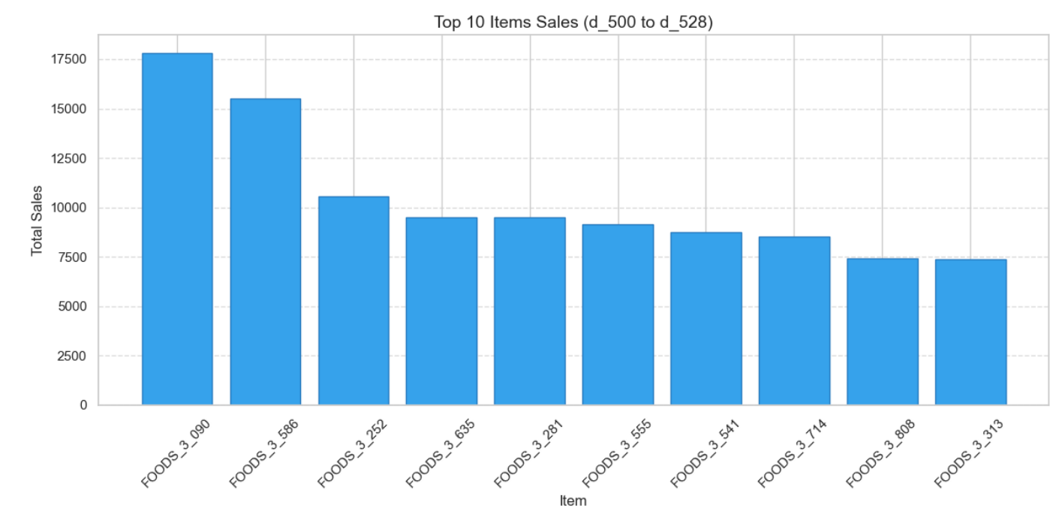
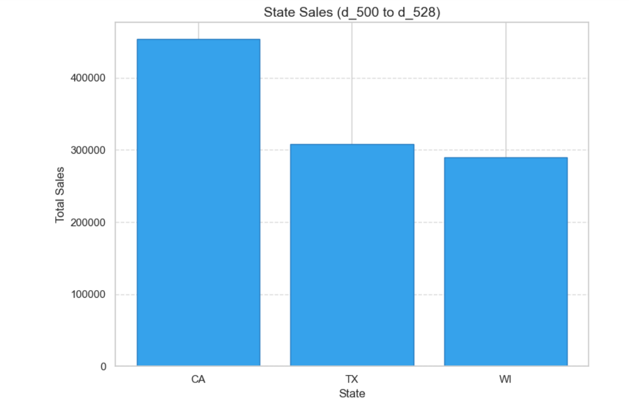
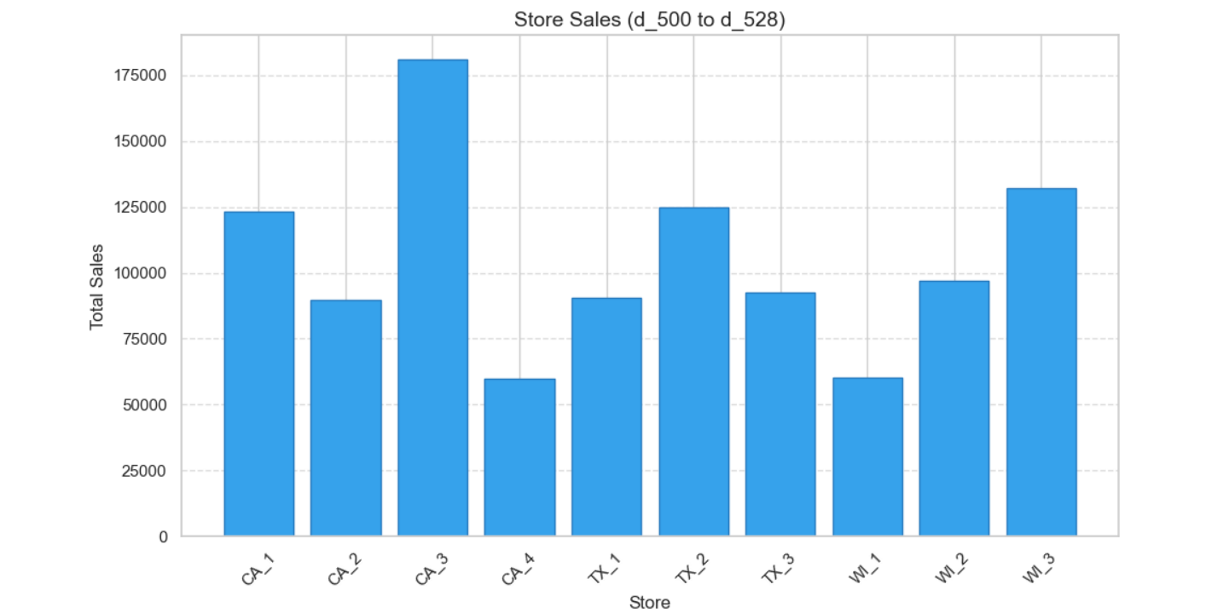

Slide 24
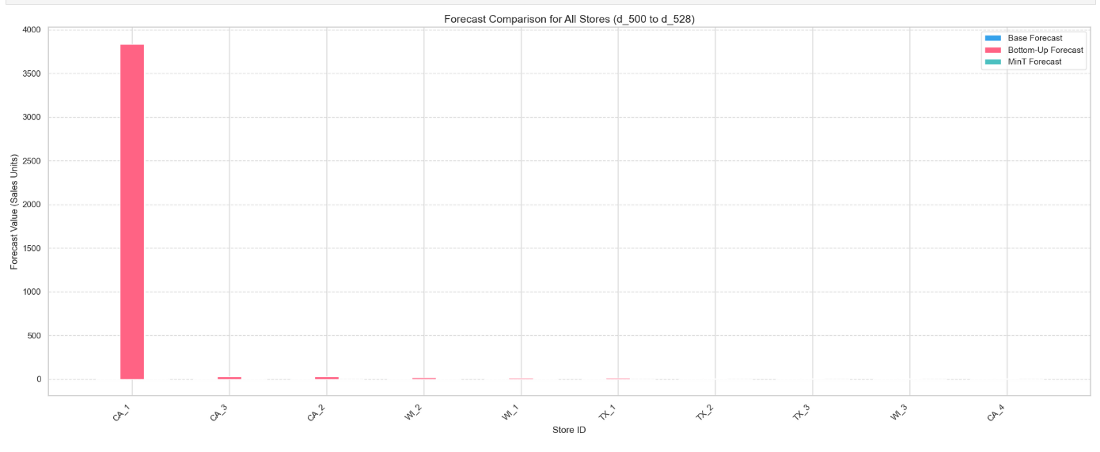
Bottom-Up Forecast: Approximately 3500-4000 units (dominant bar).
Base Forecast: Nearly 0 units.
MinT Forecast: Nearly 0 units.
The Bottom-Up Forecast is significantly higher than the Base and MinT forecasts, suggesting a substantial upward adjustment during reconciliation. This indicates the initial Base Forecast may have underestimated sales, and the Bottom-Up method corrected it significantly.

Slide 25
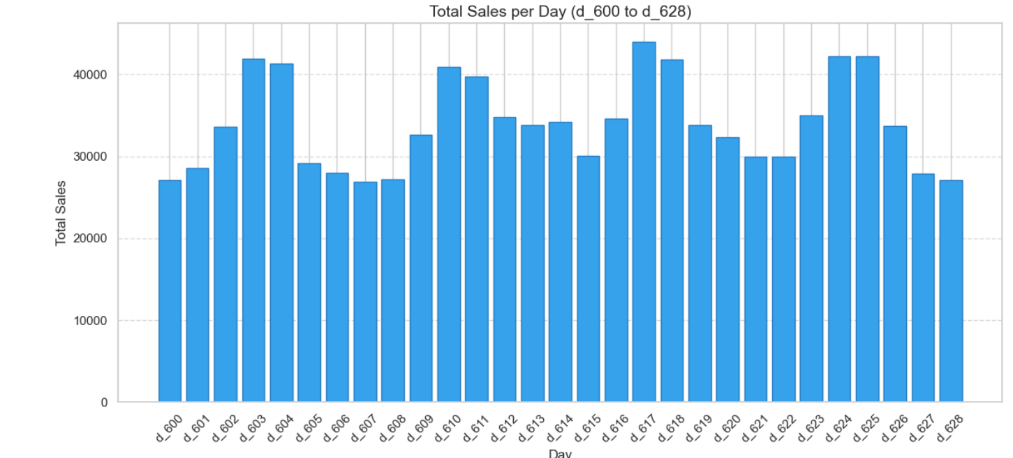
D_600 to D_628
Sales fluctuate significantly, ranging from approximately 20,000 to over 40,000 units per day.
There are several peaks, with the highest sales around days 603, 610,617 & 624-625, exceeding 40,000 units.
The lowest sales appear around days 607 and 628, dropping below 25,000 units.
The overall trend shows no clear upward or downward movement but rather a pattern of recurring peaks and troughs, suggesting possible weekly or event-driven sales cycles.

Slide 26
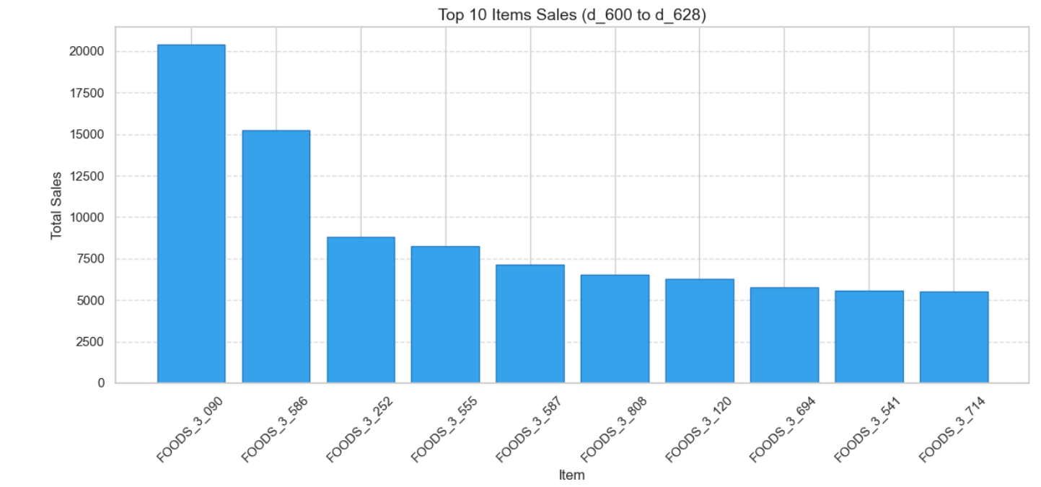
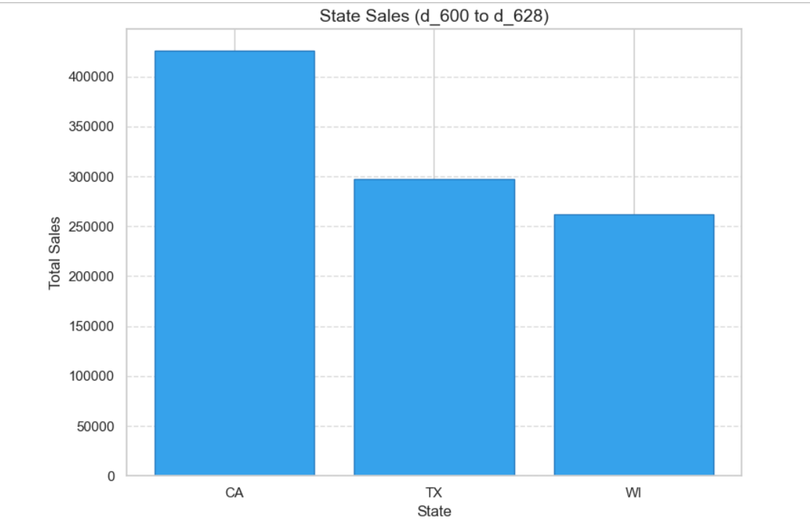
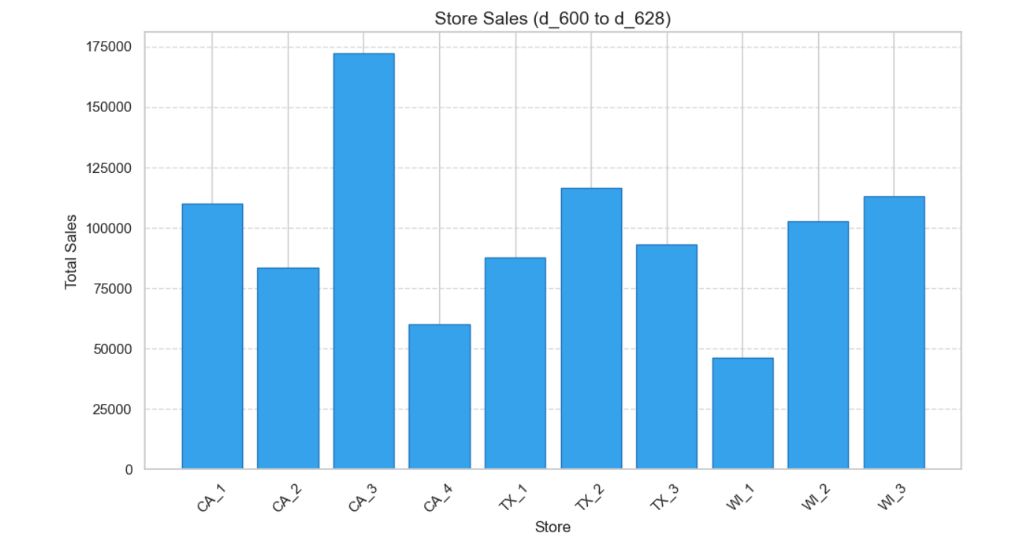

Slide 27
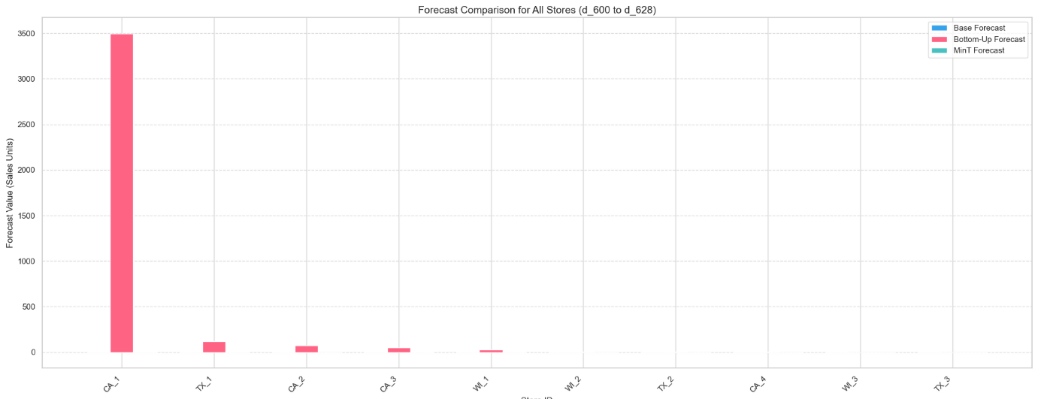
Base vs. BU: The BU forecast should equal the sum of lower-level forecasts (e.g., stores for CA). If BU exceeds Base for total, it indicates upward adjustments from item/store levels, suggesting the Base model underestimated at lower levels.
If CA’s forecast is significantly higher than TX’s, and CA_1 contributes a large share of CA’s total, it suggests California stores (especially CA_1) drive overall sales, consistent with the M5 dataset’s regional patterns.

Slide 28
Key Features and Considerations
ARIMA Limitations:
The use of a fixed (1,1,1) order may not be optimal for all time series. In practice, automated order selection (e.g., using auto_arima) could improve performance.
The fallback to the mean of the last 28 days is a simple heuristic and may not capture complex patterns.
Reconciliation:
The Bottom-Up method is straightforward but may propagate errors from noisy item-level forecasts.
Non-negativity:
The MinT forecasts are adjusted to ensure non-negative values, which is critical for sales data but may slightly distort the reconciliation process.
Scalability:
The code works with a small subset of the M5 dataset. For the full dataset, computational efficiency and model robustness would need to be addressed.

Slide 29
XGBoost Application
Used: Total, States (CA, TX, WI), Stores, Top 5 items sold.
XGBoost:
Feature Engineering:
Prepared item-day combination
Lag1, Lag2: Sales from previous 1 and 2 days
Ma-7: 7 day moving average of sales.
XGBRegressor with parameters like n_estimators=100, max_depth=5 is used for training.
Reconcile XGBoost Forecasts:
Integrates XGBoost item-level forecasts into the hierarchy and reconciles them.
Uses XGBoost forecasts for items and original base forecasts for higher levels.
Reconciliation:
Bottom-Up: Aggregates XGBoost item forecasts using S.
MinT: Applies the same G matrix for consistency.

Slide 30
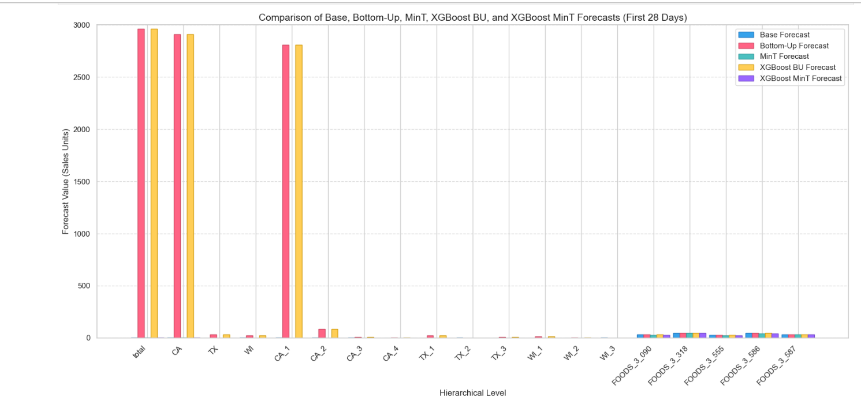
Consistency Across Higher Levels (Total, States, Stores)
The total level and state levels show the highest forecast values, ranging from 2,500 to 3,000 sales units across all methods. This reflects the aggregation of sales across all items and stores.
All five methods (Base, Bottom-Up, MinT, XGBoost BU, XGBoost MinT) produce very similar forecast values at these higher levels, with differences being minimal (bars are closely aligned). This suggests that the choice of method has little impact on aggregated forecasts at the total, state, and store levels.
At the store level (e.g., CA_1, CA_2, CA_3, CA_4, TX_1, TX_2, TX_3, WI_1, WI_2, WI_3), the forecast values drop significantly (to near zero or small values), indicating low sales or limited data for these specific stores. The methods remain consistent, with no single method standing out.
Bottom-Up and XGBoost BU Alignment: The Bottom-Up (pink) and XGBoost BU (yellow) forecasts are nearly identical across all levels. This suggests that XGBoost's item-level enhancements do not translate into different aggregated outcomes when using the Bottom-Up approach.
The MinT (green) and XGBoost MinT (purple) forecasts also align closely, indicating that MinT reconciliation does not leverage XGBoost improvements effectively at this aggregation.
Summary of RMSE at Total Level:
Base RSME: 26753.7692
BU RSME: 26650.0622
MinT RSME: 26753.6647
XGBoost BU RSME: 26650.0622
XGBoost MinT RSME: 26753.6647

Slide 31
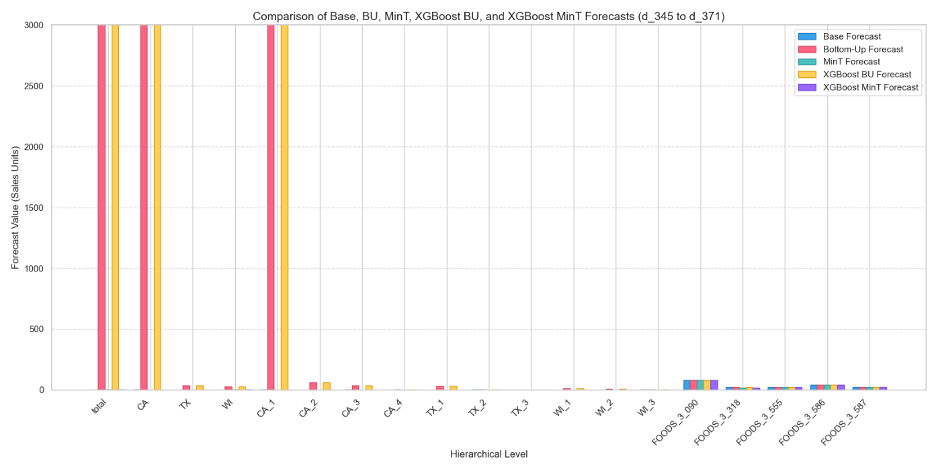
Total, State, and Store Levels: The forecasts for total, CA (California), TX (Texas), WI (Wisconsin), and store levels (e.g., CA_1, CA_2) are consistently high, ranging around 2500–3000 sales units. All methods (Base, BU, MinT, XGBoost BU, XGBoost MinT) show very similar values at these levels, indicating strong hierarchical coherence after reconciliation. This suggests that the base forecast is robust at higher aggregation levels, and reconciliation methods (e.g., MinT) fine-tune without significant deviation.
Among states, CA shows the highest forecast, followed by TX and WI. This implies that California is likely the highest-sales region, possibly due to a larger market or higher demand.
Store-level forecasts (e.g., CA_1 to WI_3) are much lower (near 0 or
XGBoost-based forecasts (yellow and purple) show more variation at the item level compared to Base and MinT, suggesting that the XGBoost model captures item-specific patterns that the base model might miss, with MinT further adjusting for coherence.

Slide 32
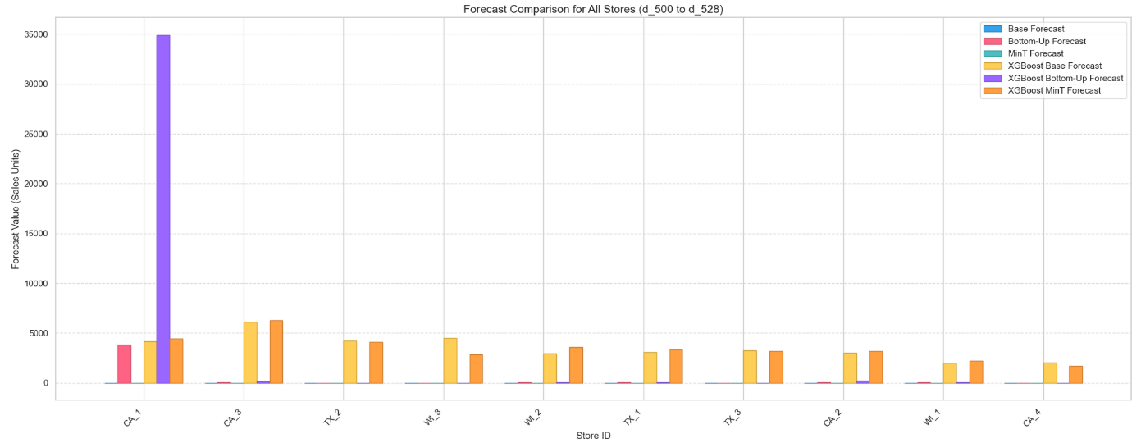
The XGBoost-based forecasts (yellow, purple, orange) tend to show slightly higher values for some stores (e.g., CA_3, TX_2) compared to traditional methods (blue, red, green), indicating potential improvements in accuracy or sensitivity to historical data trends.
Store CA_1 stands out with a much higher forecast value (around 3500 units) compared to other stores, which range from approximately 0 to 1000 units. This suggests CA_1 is a high-performing or high-demand store, possibly due to location, product popularity, or other factors.
For most stores, the forecast values across the six methods are relatively close, indicating consistency in predictions. However, for CA_1, the XGBoost Bottom-Up Forecast (purple bar) is notably higher than other methods, suggesting that this method might be capturing additional patterns or demand specific to this store.

Slide 33
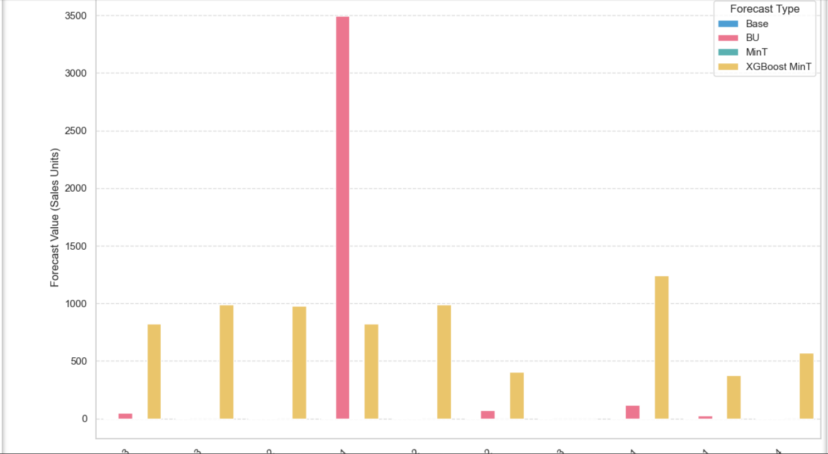
The XGBoost MinT is more balanced across stores compared to others.
This suggests that XGBoost-based reconciled forecasts (MinT) are capturing underlying patterns better than classical methods.
Extreme Outlier in BU Forecast:
The BU forecast has an extreme spike for one store (likely a misaggregation or scaling issue).
This indicates a potential anomaly or error in bottom-up reconciliation, possibly caused by:
Outlier in base forecast
Incorrect mapping in the summing matrix S.
Data sparsity at bottom level

Slide 34
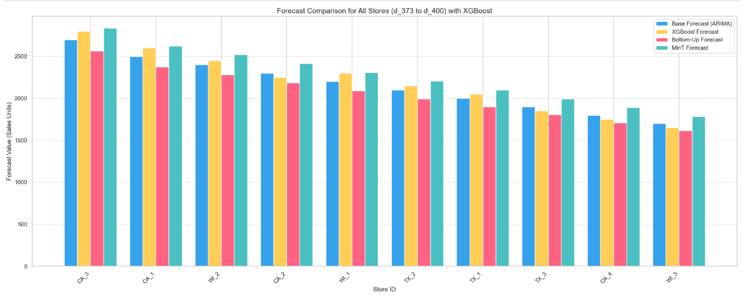
Stores like CA_3 and CA_1 show the highest forecast values (around 2500-3000 units), indicating they are likely the highest-performing or busiest stores in the dataset.
Stores like WI_3 and TX_3 have lower forecast values (around 1500-2000 units), suggesting lower sales volumes or different demand patterns.
The MinT Forecast (ARIMA) tends to provide the highest estimates for most stores, suggesting it may overestimate sales compared to other methods.
Summary of RMSE at Total Level:
RMSE for Base Forecast : 90411.89
RMSE for XGBoost Forecast: 90505.42
RMSE for Bottom-Up Forecast: 90598.97
RMSE for MinT Forecast: 90710.16

