Slide 1
CodeCraft Innovators
Track B: Analytics using Python
Shriya verma
Pratik Bhosarekar
Jatin Thakur
Nihal Chopada
Ritesh Shinde
Samar singh thakur

Slide 2
Problem Statement
Loans account for a large portion of bank profits. Despite the fact that many people are looking for loans, finding a legitimate applicant who will return the loan is difficult. Banks must determine if the borrower will be able to repay the loan. It is crucial to know whether or not the borrower is going to be in safe hands. Therefore, machine learning models are created to predict whether or not the customer would repay the loan.
Methodology
The given dataset is first analyzed. The data is visualized and insights are drawn. The data is then pre-processed where missing values are handled and label encoding is performed. After the data cleaning, machine learning algorithms are applied to predict the loan approval.

Slide 3
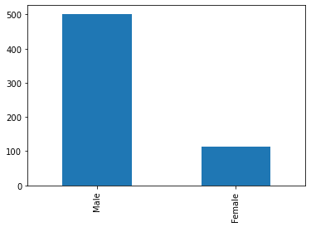
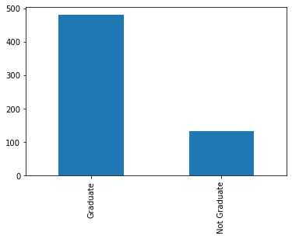
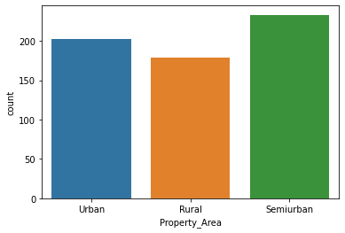
Data Visualization and Analysis
Gender Distribution
Graduation and Approval
Residential Area Analysis
There are 489 males and 112 females in the dataset.
Out of the total, 480 individuals are graduates.
The dataset includes people from different residential areas:
○ 179 people from rural areas.
○ 233 people from semi-urban areas.
○ 202 people from urban areas.

Slide 4
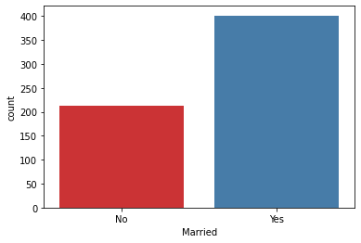
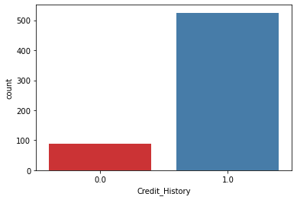
Data Visualization and Analysis
Marital Status Impact
Credit History Influence
There are 398 married individuals and 213 unmarried individuals.
89 individuals have a credit rating of 0, while 475 have a rating of 1.

Slide 5
Approval rate as per categories
Gender | Approval Rate
Male | 69%
Female | 66.9%
Education | Approval Rate
Graduate | 70.8%
Not Graduate | 61.1%
Residential Area | Approval Rate
Rural | 61.4%
Semiurban | 76.8%
Urban | 65.8%

Slide 6
Approval rate as per categories
Marital Status | Approval Rate
Married | 71.8%
Unmarried | 62.9%
Credit History | Approval Rate
0.0 | 7.8%
1.0 | 79%

Slide 7
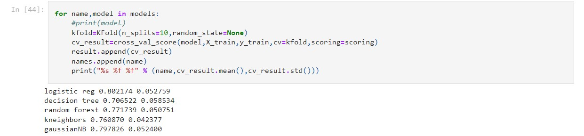
Implementation of the model
The 5 different algorithms- Logistic Regression, Decision Tree, Random Forest, K-Nearest Neighbor and Gaussian Naive Bayes are applied to find out the best performer. Logistic Regression had the highest accuracy of around 80%.

Slide 8
Conclusion
The program once given a large data set can accurately predict and correlate the various factors affecting the credit worthiness of a customer by looking and analyzing different aspects about the customer's profile and records.

