Slide 1


Slide 2

{{TITLE_LINE1}}{{TITLE_LINE2}}
{{SUBTITLE}}

Slide 3
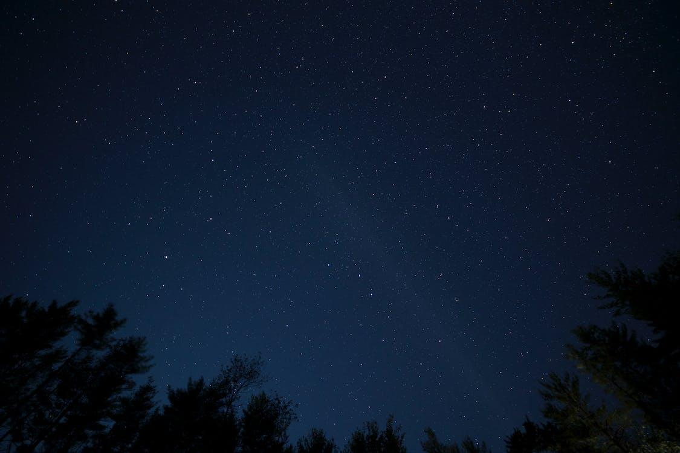
{{SECTION}}

Slide 4
{{SONG_TITLE}}

Slide 5
{{LINE}}
{{SONG_TITLE}}

Slide 6

설교말씀
{{PASSAGE_KO}}

Slide 7
{{VERSE_NO}} {{VERSE_KO}}
{{VERSE_EN}}
{{PASSAGE_KO}}
{{PASSAGE_EN}}

Slide 8
설교
{{SERMON_TITLE}}

Slide 10

{{LABEL}}

Slide 11

{{LABEL}}

Slide 12

{{LABEL}}

Slide 13
{{ANN_TITLE}}
{{ANN_LINE}}
{{FOOTER_TITLE}}
{{FOOTER_THEME}}

